Slide 1
Comparing DNA sequencing from fibroblast and iPS cells
Alexej Abyzov & Mark Gerstein,
July 13, 2011
iPSC meeting

Slide 2
Data set
Family | Person | F | i | # of reads | Lanes/Files
03 | Father | Y | Y | 209,054,528 180,198,406 | 110513_PINKERTON_0120_B81T51ABXX_L1,F 110513_PINKERTON_0120_B81T51ABXX_L2,i
 | Mather | Y | Y | 147,184,808 145,242,344 | 110315_BRISCOE_0348_B81NWJABXX_L8,F 110513_PINKERTON_0120_B81T51ABXX_L3,i
 | Son affected | Y | N | 172,498,516 | 110609_PINKERTON_0122_BD0C4DABXX_L1,F
 | Son unaffected | Y | Y | 134,263,984 201,504,160 | 110315_BRISCOE_0348_B81NWJABXX_L7,F 110513_PINKERTON_0120_B81T51ABXX_L4,i
S1123 | Father | Y | N | 110,219,684 | 100826_BRISCOE_0317_B804N8ABXX_L2,F
 | Mather | Y | N | 85,674,543 | 100826_BRISCOE_0317_B804N8ABXX_L3,F
 | Son affected | Y | N | 88,614,763 | 100826_BRISCOE_0317_B804N8ABXX_L4,F
 | PGP1, GM20431 | N | Y | 116,578,994 129,516,795 | 100902_MONK_0155_B200V8ABXX_L2,i 100923_PINKERTON_0096_A8024FABXX_L2,i
 | Neonatal (NHDF) | Y | N | 55,170,857 | 100816_BRISCOE_0314_A202ANABXX_L8,F
Increased output

Slide 3
Read depth analysis with CNVnator

Slide 4
Call statistics (CNVnator)
Person | Cell type | # of calls | Overlapping DGV or G1K | Overlapping DGV or G1K (50% reciprocal)
Father | F | 193 | 182 (94%) | 154 (80%)
 | i | 188 | 182 (97%) | 147 (78%)
Mother | F | 165 | 162 (98%) | 127 (77%)
 | i | 190 | 178 (94%) | 134 (71%)
Son | F | 159 | 151 (95%) | 114 (72%)
 | i | 169 | 165 (98%) | 127 (75%)
Using 1 kb bins for analysis

Slide 5
Comparing iPS and fibroblast sequencing (CNVnator, RD)
Region | Person | F CN | i CN | Comments
chr1:162043001-162108000 | Mother | 2.24 | 2.88 | By chance
chr2:126649001-126653000 | Mother | 0.00 | 2.00 | AT rich regions, overlap DGV
chr10:42410001-42485000 | Mother | 2.04 | 1.26 | Close to a gap centromere
chr12:37961001-38423000 | Mother | 1.90 | 1.36 | AT rich and repeat rich regions, overlap DGV
chr18:70516001-70543000 | Mother | 1.98 | 1.37 | Confident, del
chrX:124404001-124414000 | Mother | 0.21 | 1.56 | AT rich regions
chrX:141153001-141191000 | Mother | 1.95 | 1.43 | Confident, del
chr4:93228001-93258000 | Father | 2.10 | 2.89 | By chance
chr8:124671001-124704000 | Father | 2.21 | 3.07 | Confident, dup
chr22:38753001-38789000 | Father | 2.26 | 2.83 | SD, overlap DGV
chrX:124406001-124412000 | Father | 0.00 | 0.79 | AT rich regions
chr3:143236001-143867000 | Son | 2.06 | 2.83 | 1 PE support, Confident, dup
chr4:79028001-79080000 | Son | 2.10 | 2.68 | By chance
chr10:70514001-71136000 | Son | 1.85 | 3.05 | 3 PE support, Confident, dup
chr10:74033001-74650000 | Son | 1.89 | 3.17 | Confident, dup
chr8:15540001-15615000 | Son | 2.02 | 1.02 | 1 PE support, Confident, del
chrX:124406001-124414000 | Son | 0.00 | 0.82 | AT rich regions
chrY:6115001-6134000 | Son | 2.94 | 2.15 | Misgenotyping?
None of confident
has 50% reciprocal
overlap with
G1K or DGV,
no PE evidence in
fibroblast sequencing
For deletion:
gen1 < 1.5 &&
gen2 > 1.5 &&
|gen1 – gen2| > 0.5
For duplication:
gen1 > 2.5 &&
gen2 < 2.5 &&
|gen1 – gen2| > 0.5

Slide 6
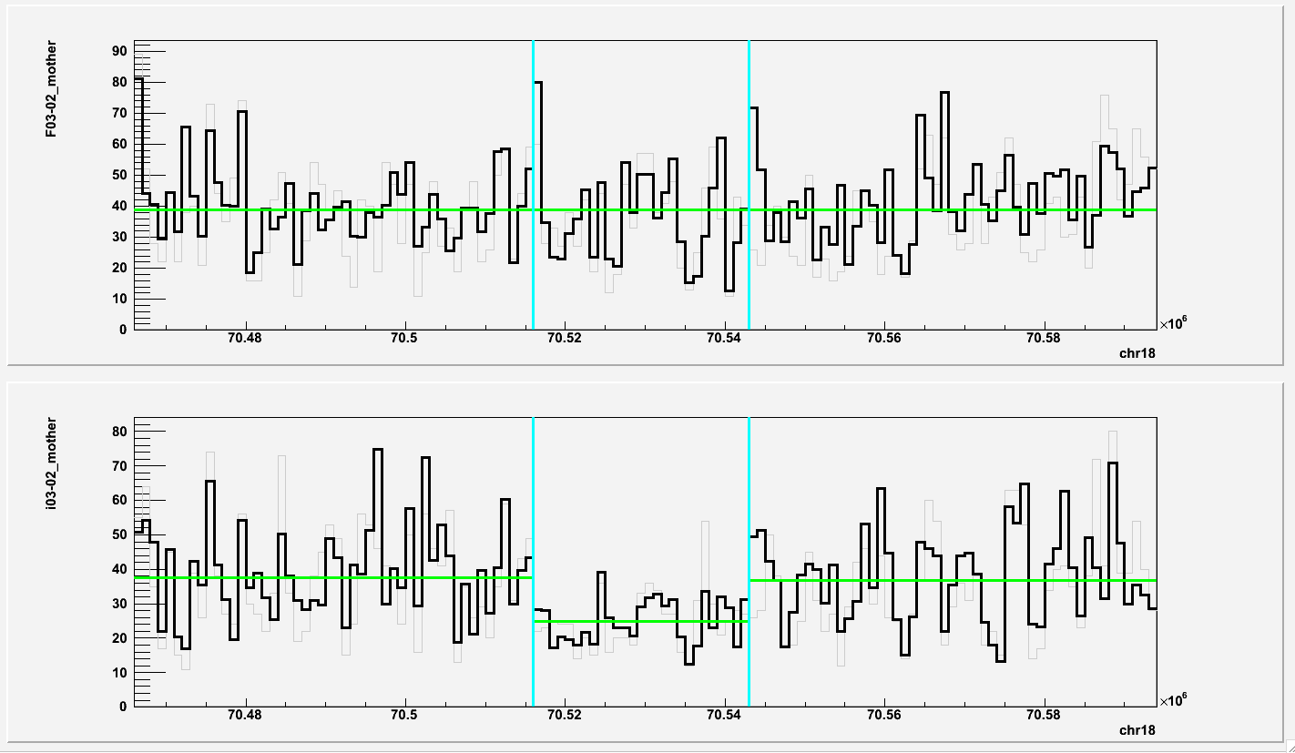
chr18:70516001-70543000 (deletion in mother)
iPS Fibroblast

Slide 7
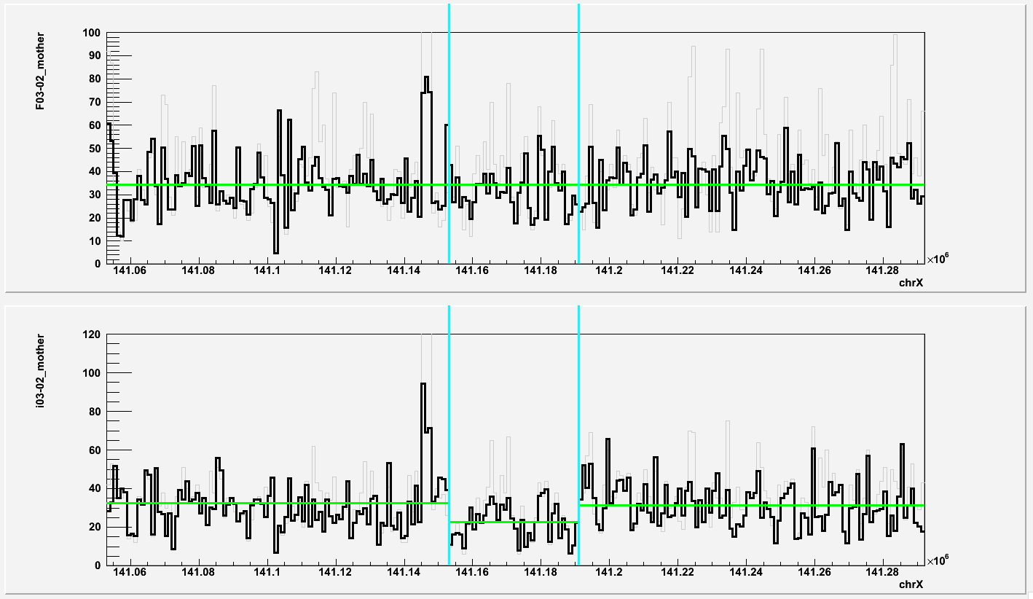
chrX:141153001-141191000 (deletion in mother)
iPS Fibroblast

Slide 8
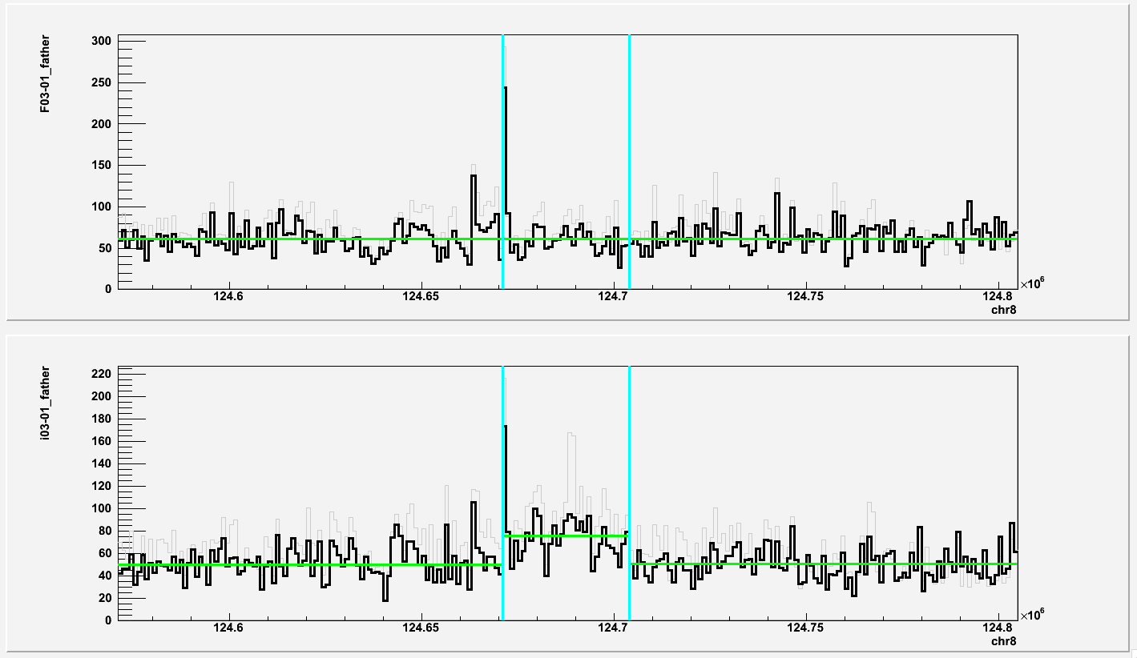
chr8:124671001-124704000 (duplication in father)
iPS Fibroblast

Slide 9
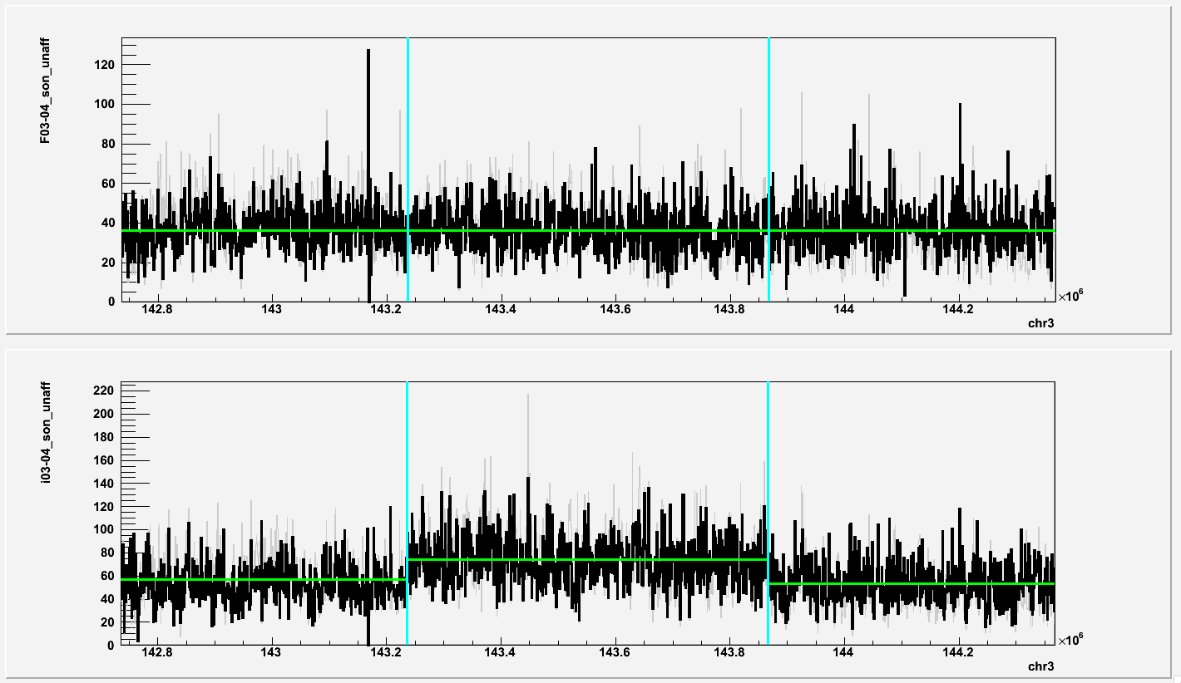
chr3:143236001-143867000 (duplication in son)
iPS Fibroblast

Slide 10
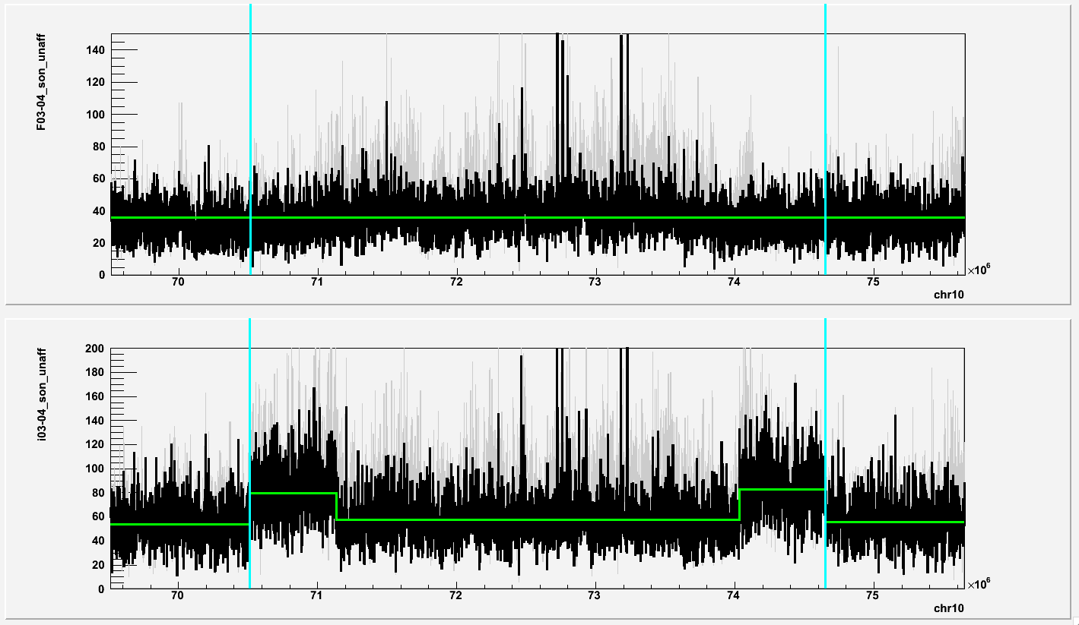
chr10:70514001-71136000 chr10:74033001-74650000 (duplications in son)
iPS Fibroblast

Slide 11
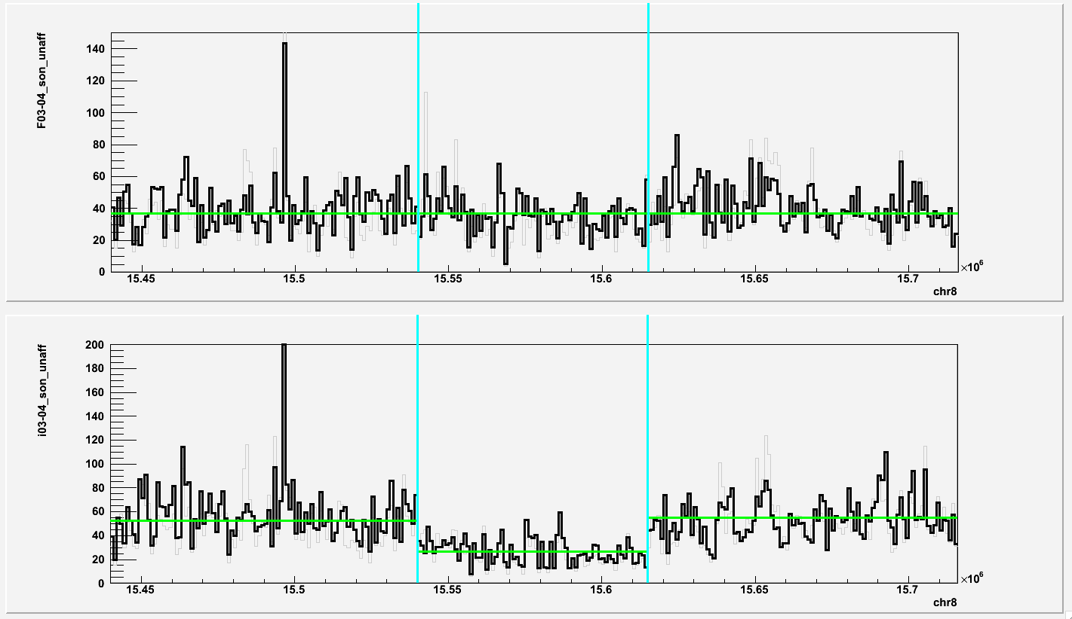
chr8:15540001-15615000 (deletion in son)
iPS Fibroblast

Slide 12
Control
Case | # of candidates
Fibroblast to iPS (father) | 4
Fibroblast to iPS (mother) | 7
Fibroblast to iPS (son) | 7
Father to mother (fibroblast) | 69
Father to mother (iPS) | 61

Slide 13
Paired-end analysis with BreakDancer

Slide 14
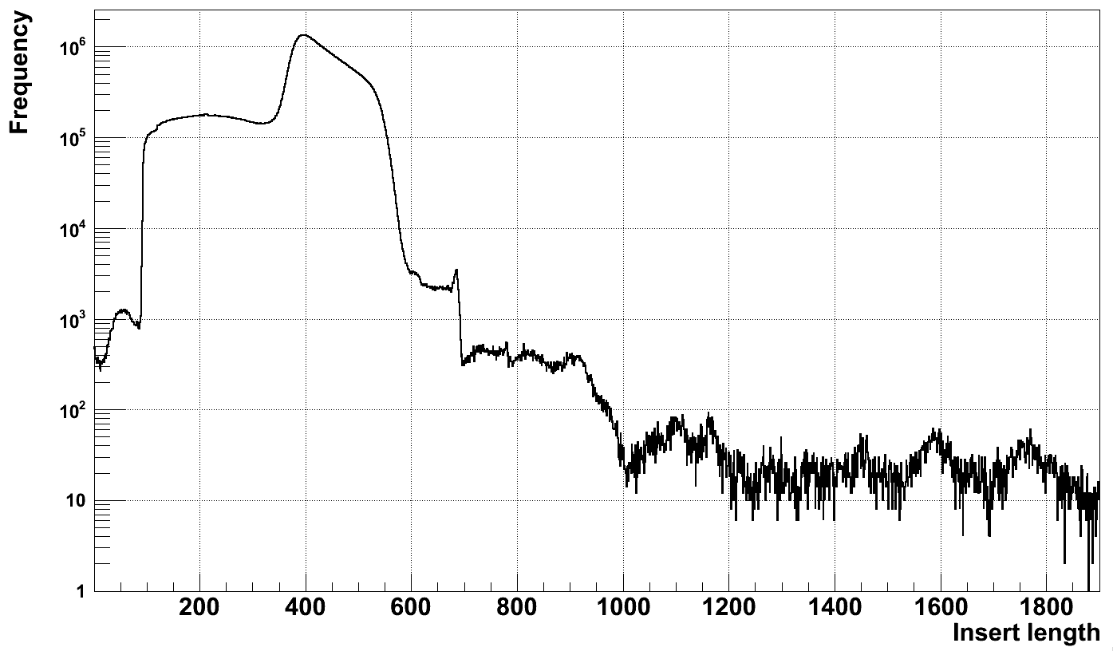
Insert length is still problematic
Father in 03 family,
fibroblast

Slide 15
Call statistics (BreakDancer)
Person | Cell type | # of del/inv | Overlapping DGV or G1K | Overlapping DGV or G1K (50% reciprocal)
Father | F | 688/113 | 678 (99%) | 604 (88%)
 | i | 487/98 | 480 (99%) | 436 (90%)
Mother | F | 291/66 | 289 (99%) | 254 (87%)
 | i | 476/112 | 467 (98%) | 421 (88%)
Son | F | 288/80 | 281 (98%) | 252 (88%)
 | i | 424/133 | 421 (99%) | 384 (91%)

Slide 16
Comparing iPS and fibroblast sequencing (BreakDancer, PE)
Region | Person | F CN | i CN | Comments
chr3:77563756-77566595 | Father | 2.07 | 1.02 | Confident
chr8:128751254-128752641 | Father | 1.47 | 3.22 | Inconsistent with BD
chr4:29461012-29462116 | Mother | 1.72 | 1.10 | Week evidance
chr2:27752461-27753524 | Son | 1.18 | 1.83 | Inconsistent with BD
chr7:57957582-57959473 | Son | 1.42 | 1.92 | Inconsistent with BD
chr7:61514374-61524879 | Son | 2.14 | 1.36 | Inconsistent with BD
chr8:128751270-128752694 | Son | 1.26 | 5.64 | Inconsistent with BD
Deletions with 50% reciprocal
overlap to G1K or DGV are excluded
For deletion:
gen1 < 1.5 &&
gen2 > 1.5 &&
|gen1 – gen2| > 0.5

Slide 17
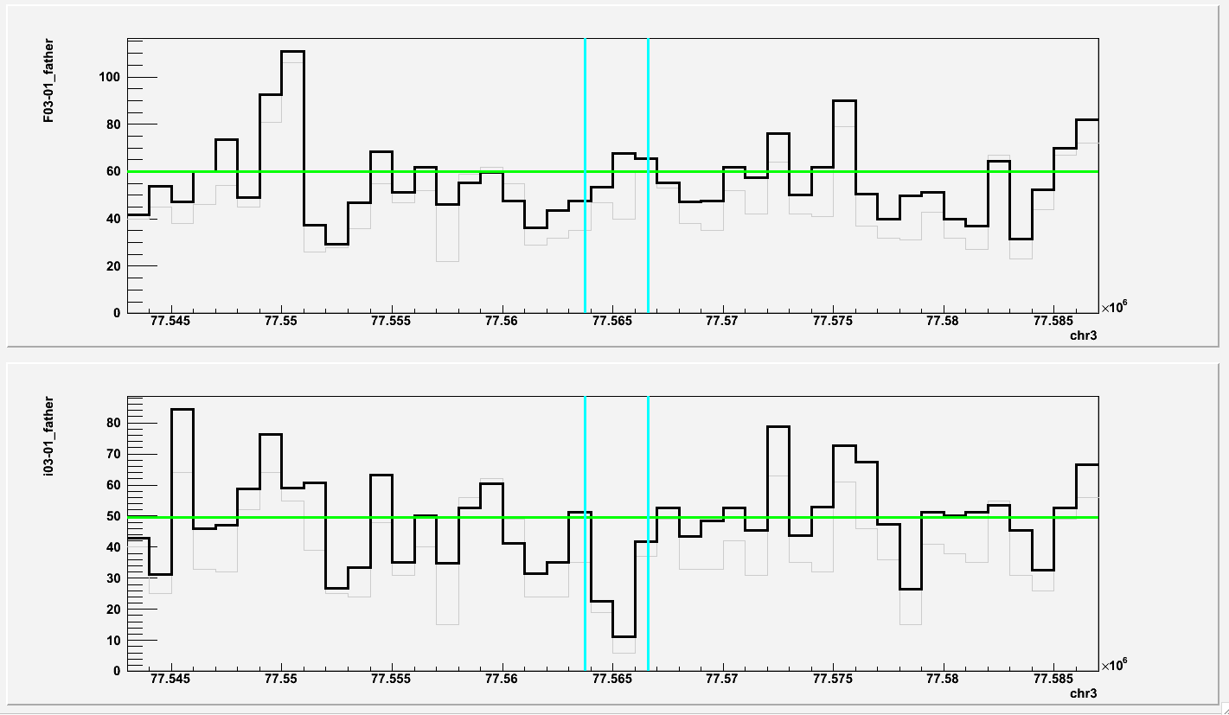
chr3:77563756-77566595 (deletion in father)
iPS Fibroblast

Slide 18
Next
Prediction of de novo SV/CNV
Including Pindel in the analysis

