Slide 1
Calling CNVs for phase1
Alexej Abyzov,
July 14, 2011

Slide 2
AT/GC fragment bias
No big success so far
Tried to different approaches
Reduced number of false calls by 20-30%, still for some populations have up to 80% of false calls
Run time increased few folds
Why difficult to correct?
Related to GC reach and GC poor regions
Exact reason and detail causing the bias are not known
Inhomogeneous across samples and populations

Slide 3
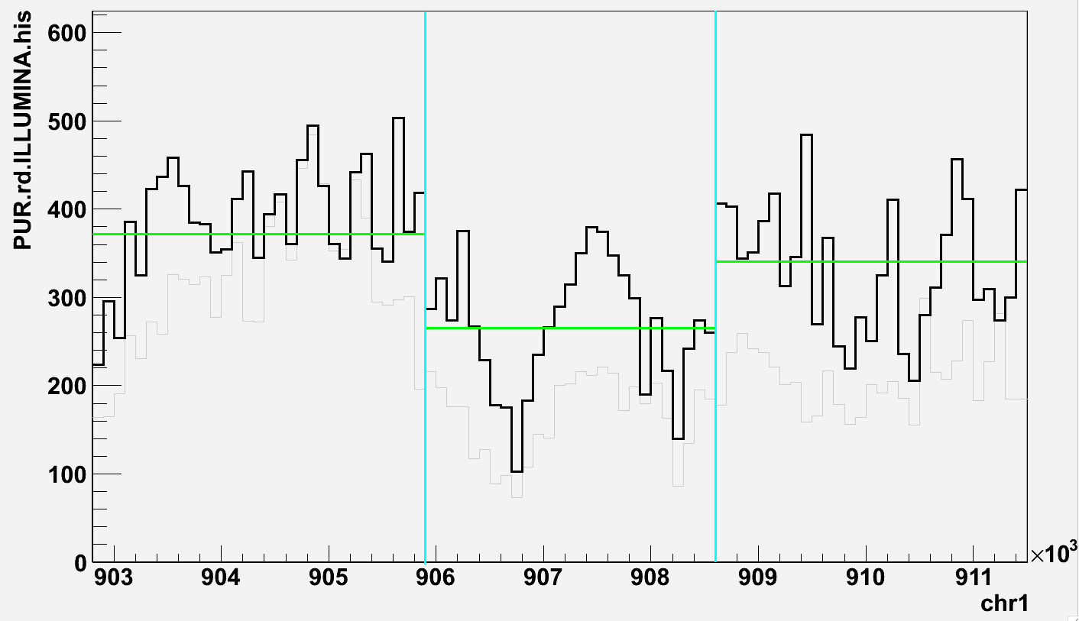
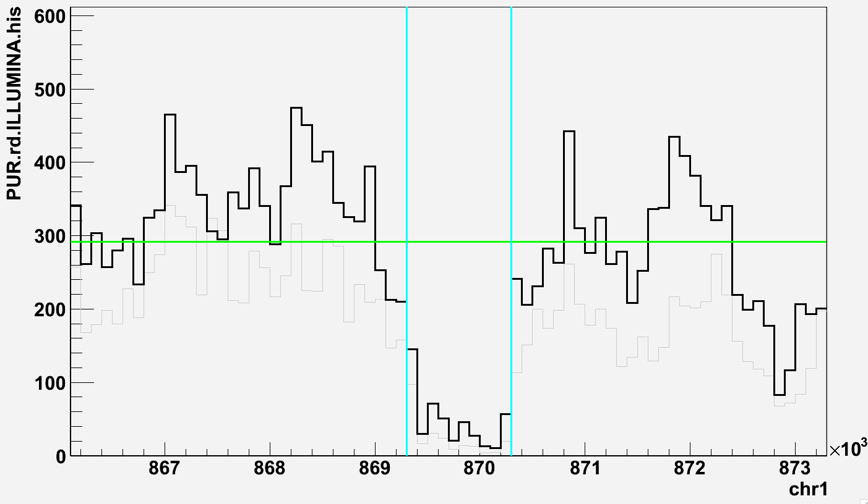
Alternative approaches
Significance by middle
Acquire PE support
1kb
1kb
Insert span is consistent with RD deletion size
At least one read is mapped with Q > 20
Span is abnormal (> 3 sd )for the average in the
corresponding library
Calibrate N_{pe} cut off for each population on the
set of known CNVs

Slide 4
Merging different calls
bin = 100 bp
usual calling
bin = 100 bp
relaxed calling
bin = 50 bp
usual calling
bin = 50 bp
relaxed calling
Take all duplications
PE support for deletion
PE support for deletion
PE support for deletion
PE support for deletion
Merge by 50% reciprocal overlap
Final calls

Slide 5
Result statistics
Population | Total deletions | Known deletions | Total duplications | Known duplications
ASW | 3026 | 2143 (71%) | 758 | 245 (32%)
LWK | 3365 | 2275 (68%) | 2983 | 453 (15%)
YRI | 3657 | 2360 (65%) | 953 | 333 (35%)
CEU | 2988 | 1899 (64%) | 1263 | 402 (32%)
FIN | 3306 | 2085 (63%) | 1407 | 386 (27%)
GBR | 3333 | 2081 (62%) | 1022 | 329 (32%)
IBS | 768 | 614 (80%) | 256 | 115 (45%)
TSI | 2080 | 1282 (62%) | 1818 | 457 (25%)
CHB | 3709 | 2321 (63%) | 1404 | 399 (28%)
JPT | 3176 | 2033 (64%) | 1036 | 336 (32%)
CHS | 4041 | 2470 (61%) | 1002 | 310 (31%)
CLM | 3264 | 2327 (71%) | 808 | 228 (28%)
PUR | 4158 | 2501 (60%) | 543 | 179 (33%)
MXL | 3862 | 2556 (66%) | 526 | 183 (35%)
VCF files
are ready
to go

Slide 6
Potential advantages RD+PE compare PE+RD
Testing smaller fraction of genome
CNVnator call length is proxy to SV length
Could relax requirement for an insert size to be abnormal
Could relax requirement for read mapping quality
Optimizing PE support could be a good project for rotation/undergrad student

