Slide 1
Null model for Ψgene discovery
Alexej Abyzov,
July 7, 2011

Slide 2
Making null
Gene model
Shift
Null model
Normal
splice-junction
library
Null
splice-junction
library
Bowtie mapping
Bowtie mapping
Not mapped reads
Not mapped reads
Gene structure is preserved by coordinates are shifted
BIG thanks to Lukas H.

Slide 3
Calling criteria
For each mapped read <= 6% of mismatches
Reads span for at least 5 + (read_len – 35)/20 bp on each side of junction
Calling novel Ψgene for a gene with read mapping to at least two non-overlapping junctions with at least one having two mapped reads

Slide 4
Seq. | Population | Individuals | # of genes with Ψgene
 |  |  | Normal | Null #1 (+ 10kb) | Null #2 (- 10kb)
Low cov. | ASW | 50 | 171 | 148 | 146
 | LWK | 83 | 820 | 579 | 624
 | YRI | 83 | 586 | 3134 | 3191
 | CEU | 91 | 827 | 3783 | 3790
 | FIN (new line) | 79 | 666 | 615 | 664
 | GBR (new line) | 77 | 1015 | 1294 | 1342
 | IBS | 6 | 11 | 1 | 1
 | TSI | 100 | 738 | 3951 | 3945
 | CHB | 83 | 302 | 3899 | 3913
 | JPT | 81 | 1038 | 2511 | 2492
 | CHS (blood) | 92 | 1014 | 1257 | 1278
 | CLM (new line) | 53 | 358 | 247 | 215
 | PUR (blood) | 59 | 54 | 22 | 23
 | MXL | 57 | 48 | 38 | 39

Slide 5
Calling criteria
For each mapped read <= 3% of mismatches
Reads span on each side of junction
Fixed cut off: 3-15 bps
Proportional cut off: 10-30%
Calling if
at least two non-overlapping junctions with at least one having two mapped reads (Scenario 1)
at least three non-overlapping junctions with at least one having two mapped reads (Scenario 2)
at least two non-overlapping junctions with each one having two mapped reads (Scenario 3)
Aim to discover maximum Ψgenes with < 5% of FP

Slide 6
Population | # | # generated reads (x10⁶) | # unmapped reads (x10⁶) | # inf. reads | Median read length | Cut offs (across junction, scenario) | # of genes with Ψgene (normal/null)
ASW | 50 | 11,840 | 203 | 6,761 | 76 | >= 9, SC1 | 68/2
LWK | 83 | 15,547 | 255 | 35,801 | 75 | >= 9, SC1 | 463/17
YRI | 83 | 25,343 | 490 | 12,696 | 43 | >= 10, SC2 | 42/2
CEU | 91 | 26,967 | 574 | 21,130 | 41 | >= 11, SC2 | 75/3
FIN (new) | 79 | 13,063 | 238 | 32,739 | 63 | >= 10, SC1 | 367/13
GBR (new) | 77 | 15,102 | 426 | 57,342 | 68 | >= 11, SC1 | 490/20
IBS | 6 | 877 | 5 | 336 | 100 | >= 3, SC1 | 11/0
TSI | 100 | 27,094 | 661 | 19,033 | 41 | >= 15, SC2 | 27/1
CHB | 83 | 20,384 | 483 | 7,495 | 45 | >=13, SC2 | 28/1
JPT | 81 | 25,380 | 669 | 29,906 | 73 | >= 12, SC1 | 294/12
CHS (blood) | 92 | 16,433 | 305 | 54,298 | 69 | >= 10, SC1 | 482/17
CLM (new) | 53 | 10,382 | 102 | 15,982 | 67 | >= 10, SC1 | 152/5
PUR (blood) | 59 | 12,460 | 194 | 4,604 | 91 | >= 11, SC1 | 29/0
MXL | 57 | 12,764 | 174 | 4,444 | 76 | >= 9, SC1 | 29/1
Bad sequencing quality:
For all reads => less SpJ reads & more other reads are unmapped
For unmapped => less SpJ reads & more other reads are mapped to SpJ
Longer reads => more confident mapping to SpJ
Total: 926

Slide 7
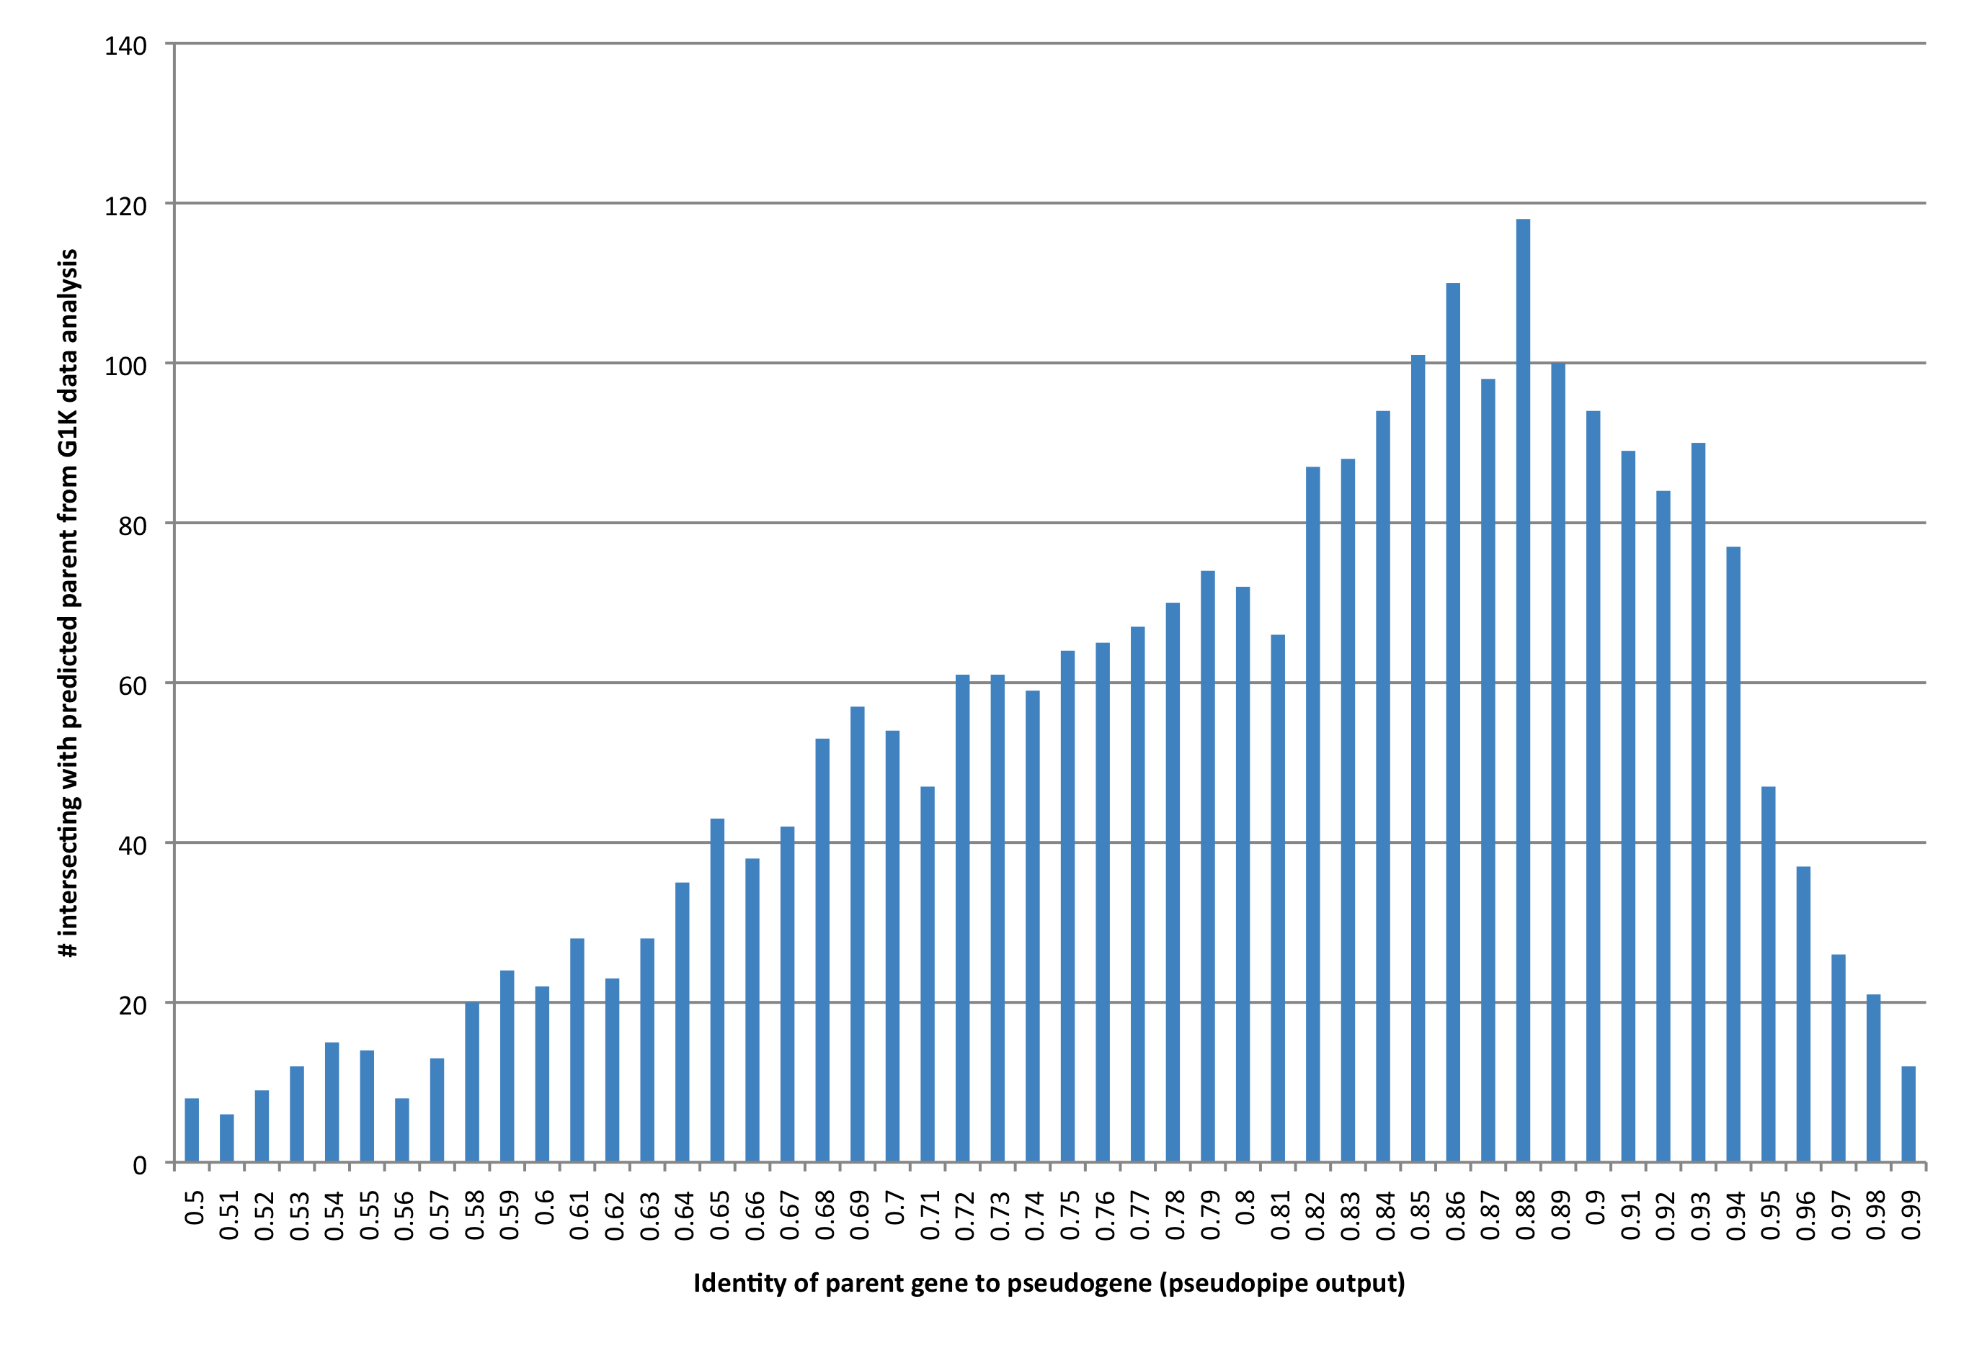
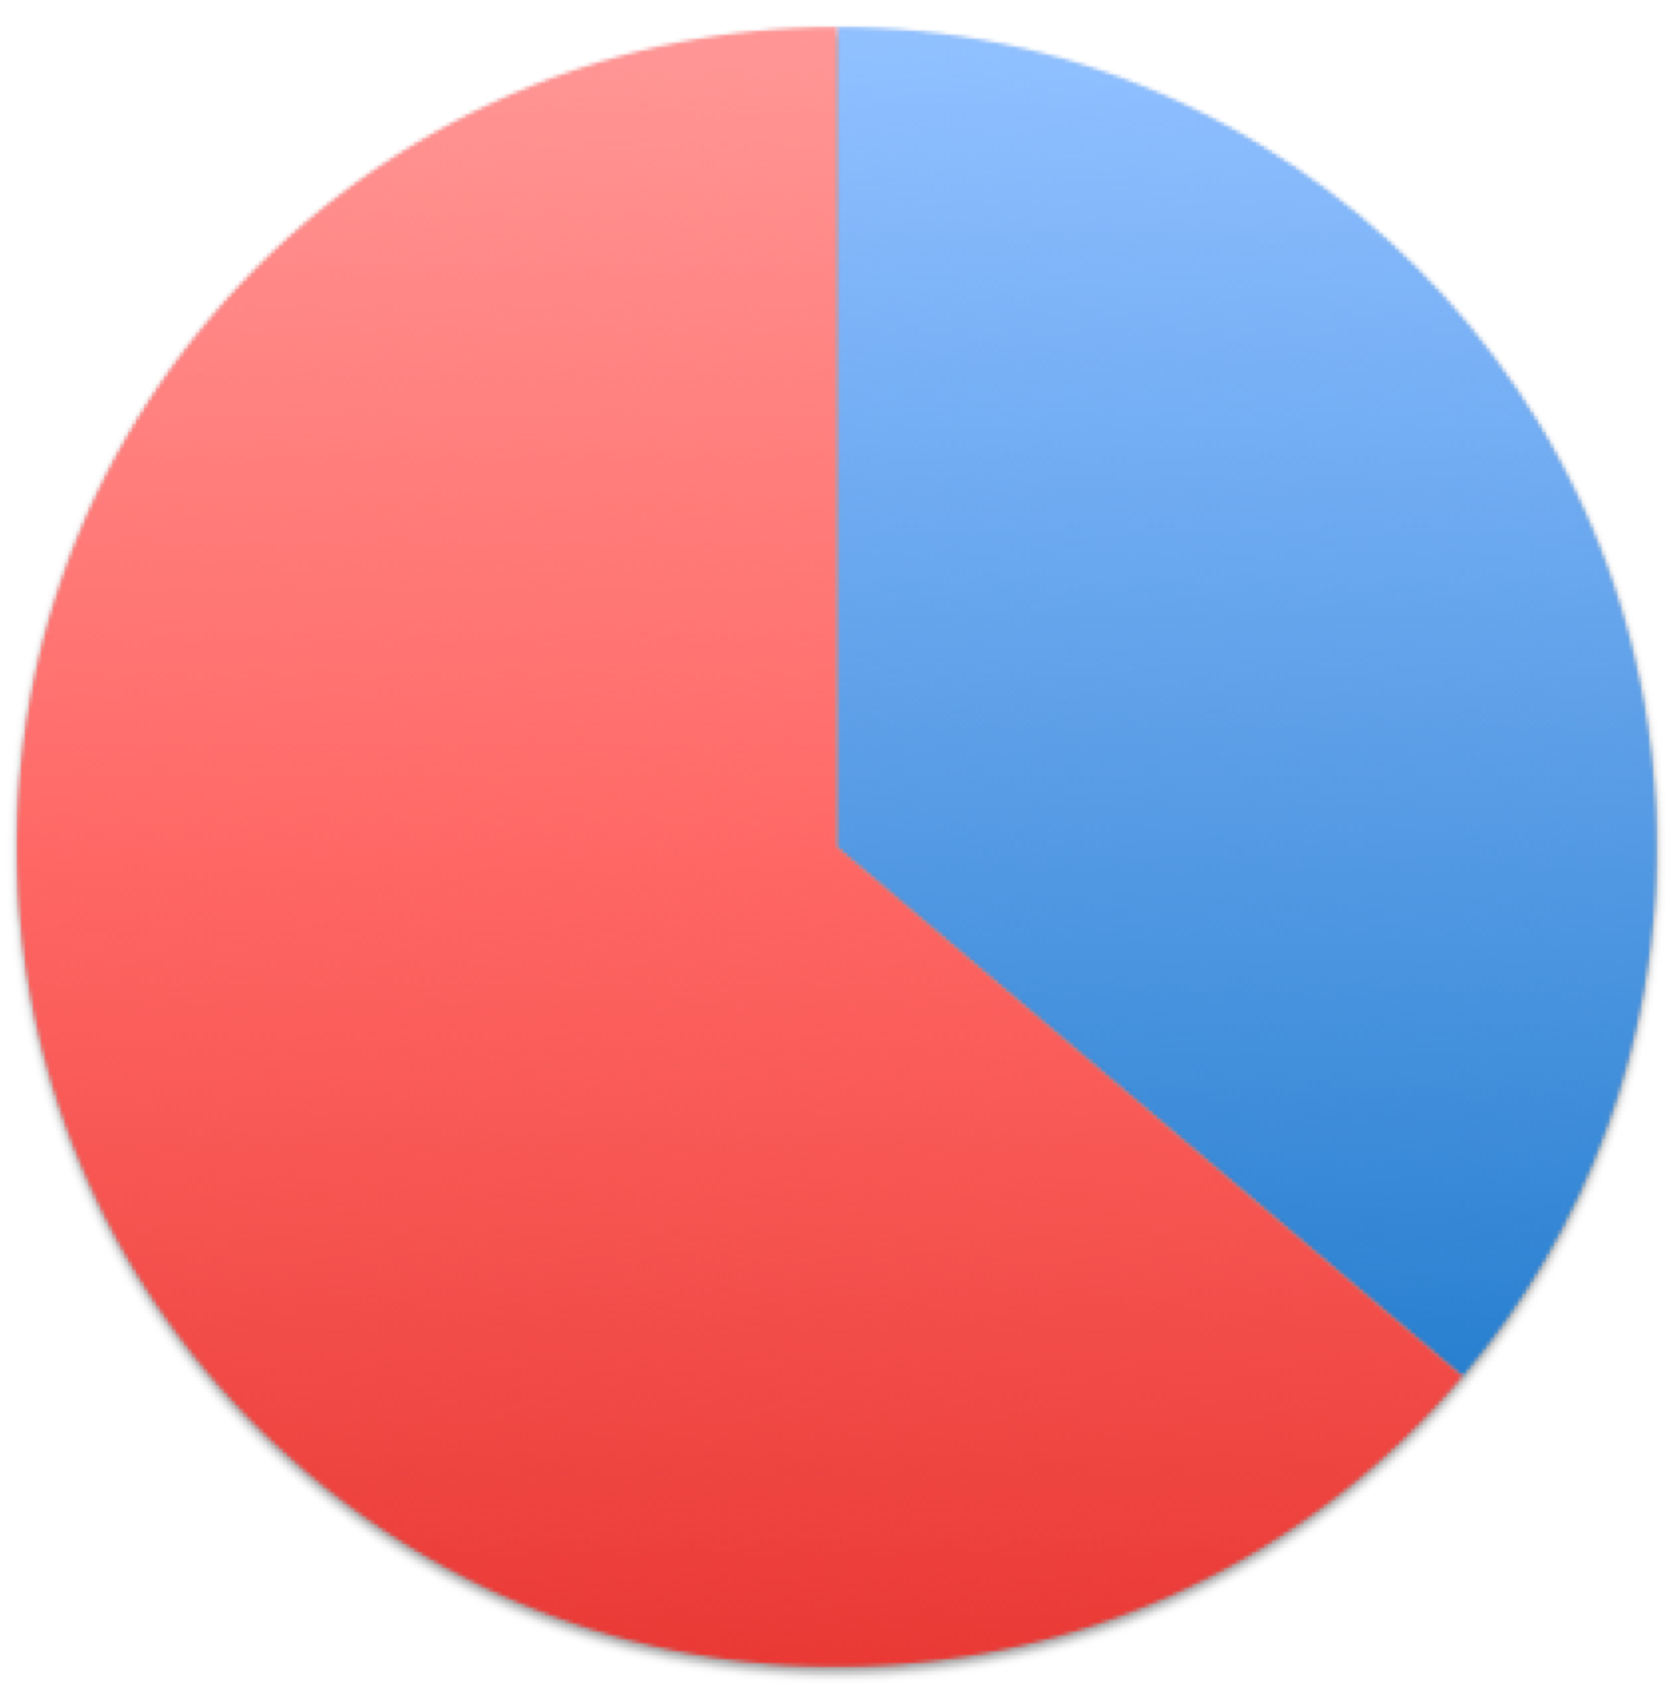
Intersection with known parents (Ψpipe 61 output)
New
In Ψpipe
135 (15%)

Slide 8
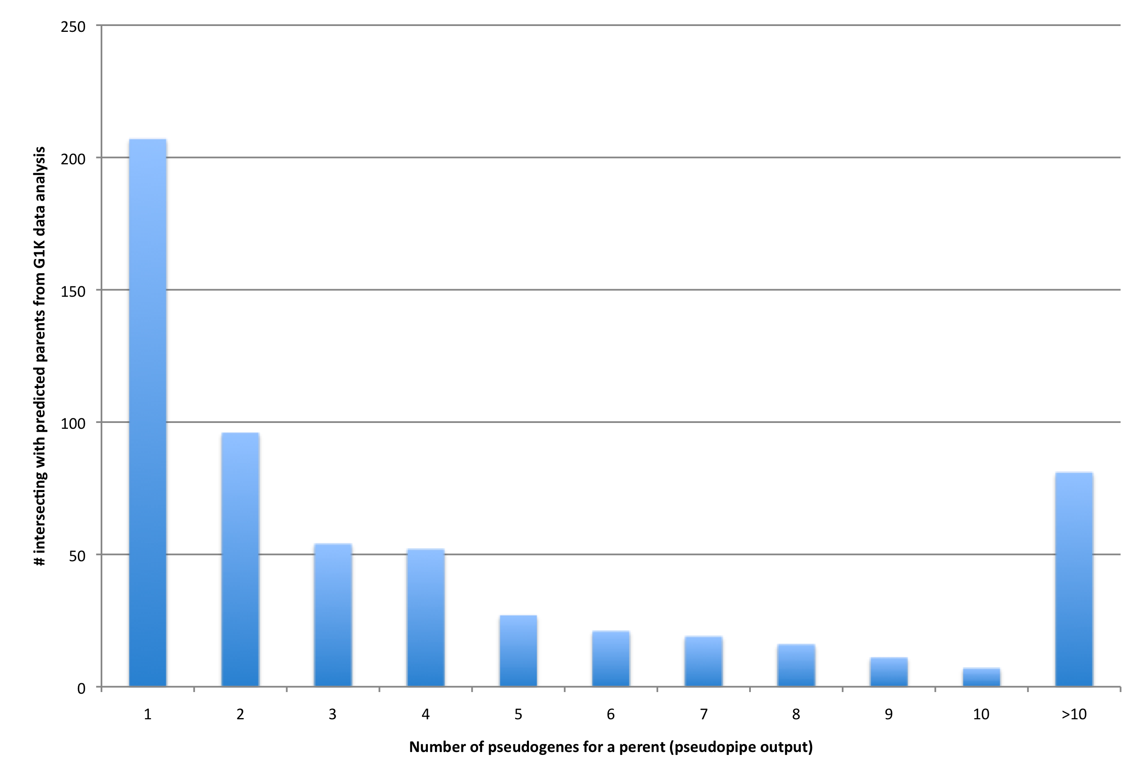
Known parents by # of Ψgenes (Ψpipe 61 output)

Slide 9
Conclusions
Short reads are not good for Ψgene discovery
Different number of calls per population is explained by different sensitivity due to heterogeneous sequencing: library preparation, evolving sequencing technology, read length, span length, base pair quality, etc.
Next:
Remapping with Q_{threshold}=30
Genotyping Ψgenes with RD
Use ratio G=RD_{exon}/RD_{intron}
Compare G for Ψgene candidates with background (derived from gene with little evidence of Ψgene)

