Slide 1
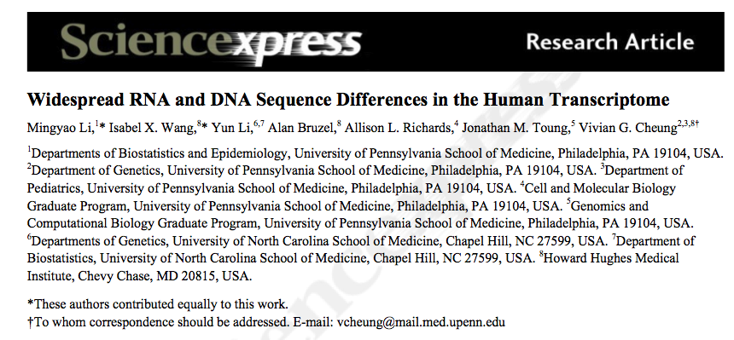
Journal club by Alexej Abyzov
June 29, 2011

Slide 2
Overview
DNA, 27 CEPH, skin and brain
RNA
Biology
HapMap, G1K, sequencing
Sequencing
Comparison
My comments are in red

Slide 3
Analysis
Monomorphic site (nor variation in dbSNP, HapMap, or G1K)
Additionally require >= 4 reads in G1K with all reference allele
Validation of 15 sites by Sanger sequencing (S2)
Homozygous SNPs (by both G1K and HapMap)

Slide 4
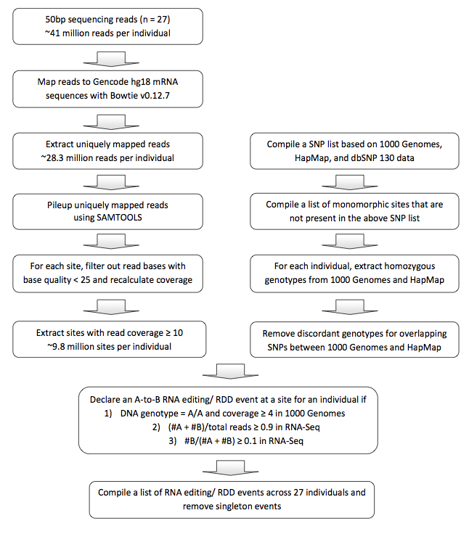
Potential flow: wrong or incomplete annotation
28,755 RDD events
in at least two samples
8,163 RDD events
in at least 50% of informative
sample
10,210 exonic sites
4,741 genes
(36% of sequence covered)

Slide 5
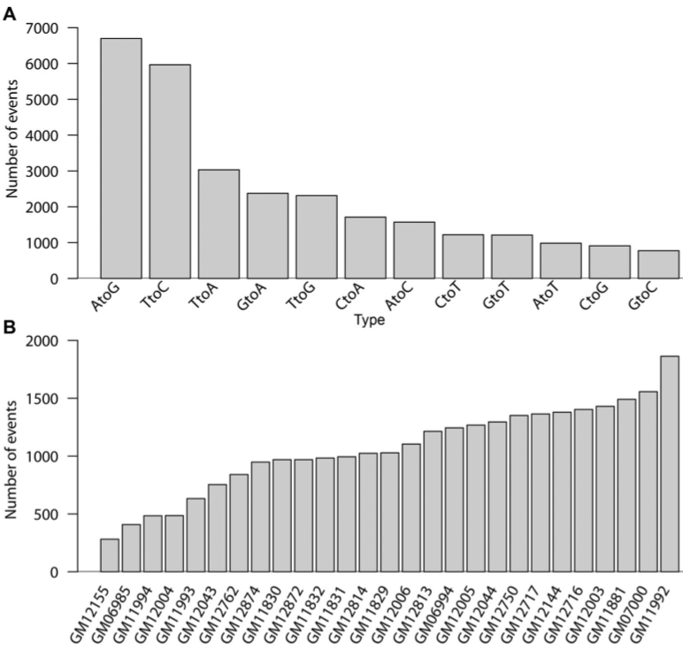
Statistics on RDDs
Possible deamination,
known mechanism

Slide 6
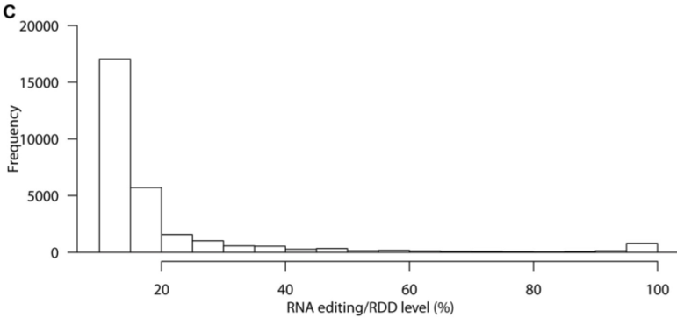
Frequency
Potential artifact of sequencing, etc.

Slide 7
Validation
120 sites
Looking for EST evidence
Confirmed 81
Sanger sequencing of 12 sites in 10-20 samples
Confirmed 11
Mass spectrometry
327 peptides cover RDD sites
28 confirm RNA difference
How about paralogs and pseudogenes?

Slide 8
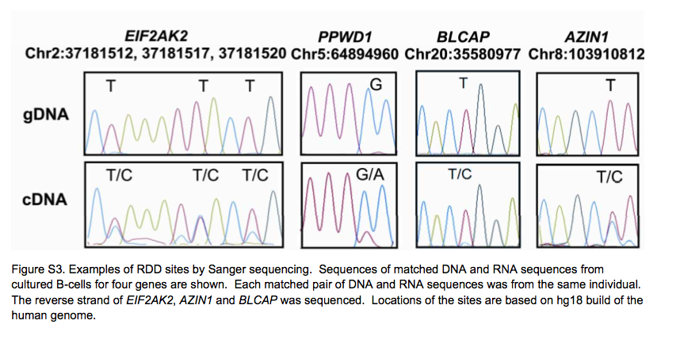
Proof by Sager sequencing
“RNA editing/ RDD sites were validated by visual inspection of
sequencing traces independently by at least two individuals.”

Slide 9
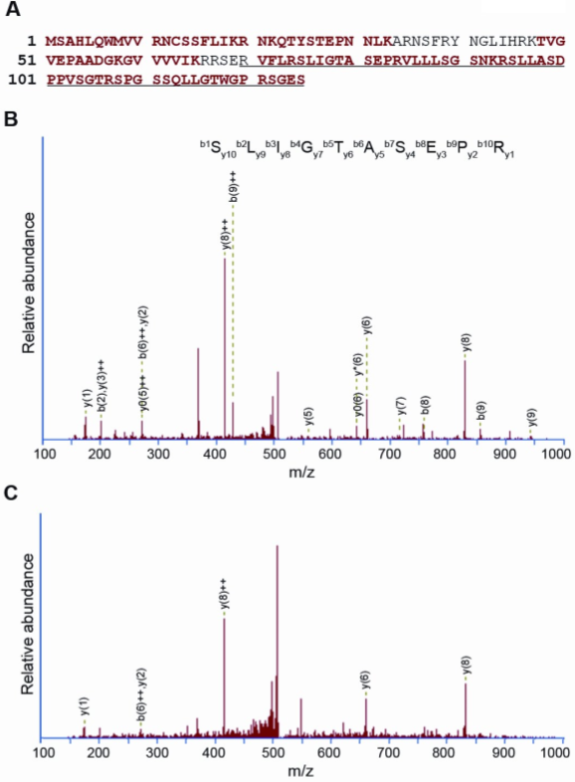
55 aa extension

Slide 10
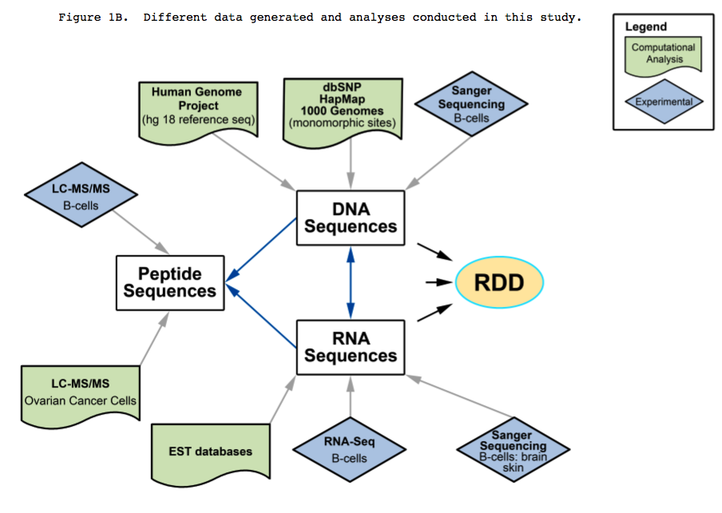
Summary

Slide 11
Discussion
On average 1,065 exonic events per person
Variation in number of sites per person can’t be explained by coverage neither by expression of ADAR (know RNA editing protein)
RDD sites are enriched (P<10⁻¹⁰) in genes that play a role in helicase activity, protein and nucleotide bindingsites
Not even distribution in gene (more at 3’-end)
44% (4,453 sites) in coding exons
4% (386 sites) are in the 5’ UTRs
39% (3,977 sites) are in the 3’ UTR (pseudogenes?)
4% are with 2 nucleotides of exon boundaries
AA changes
71% are nsSNPs
2.1% (~21 per person) gain/loss of stop codon (isn’t it too much?)
26% (2,613) are within 25 bps (paralogs, pseudogenes?)

Slide 12
Problems
Experimental artifacts (e.g, sequencing bias)
Addressed to some extent, but … see next slide
Repeats in genome (not addressed)
Rely on annotation, which may be incomplete
Do not consider known/unknown repeats (e.g., paralogs, pseudogenes)

Slide 13
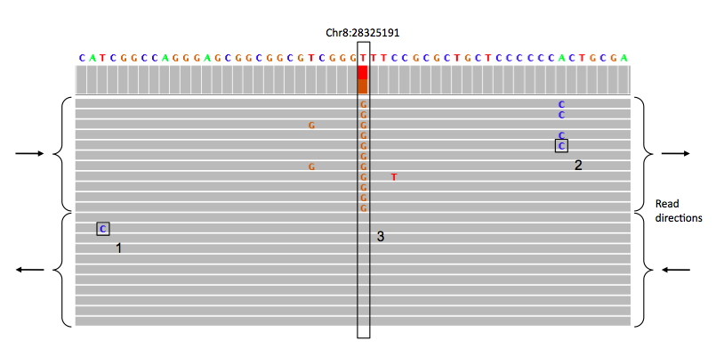
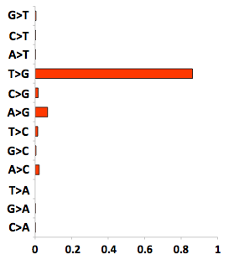
Sequencing bias
Meacham et al., 2011

Slide 14
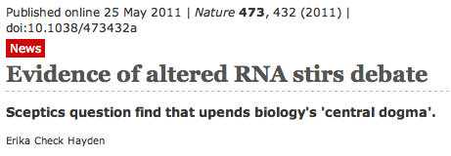
Repeats
"If the authors are accidentally attributing RNA from two different
regions of the genome to the same DNA region, they could falsely
infer RNA editing," Pickrell said. "I think many of their results could
be the result of errors in identifying the correct genomic origin of
their sequencing reads."

Slide 15
Thank you!

