Slide 1
Searching for de novo variants in CEU family (1463)
Alexej Abyzov
June 22, 2011

Slide 2
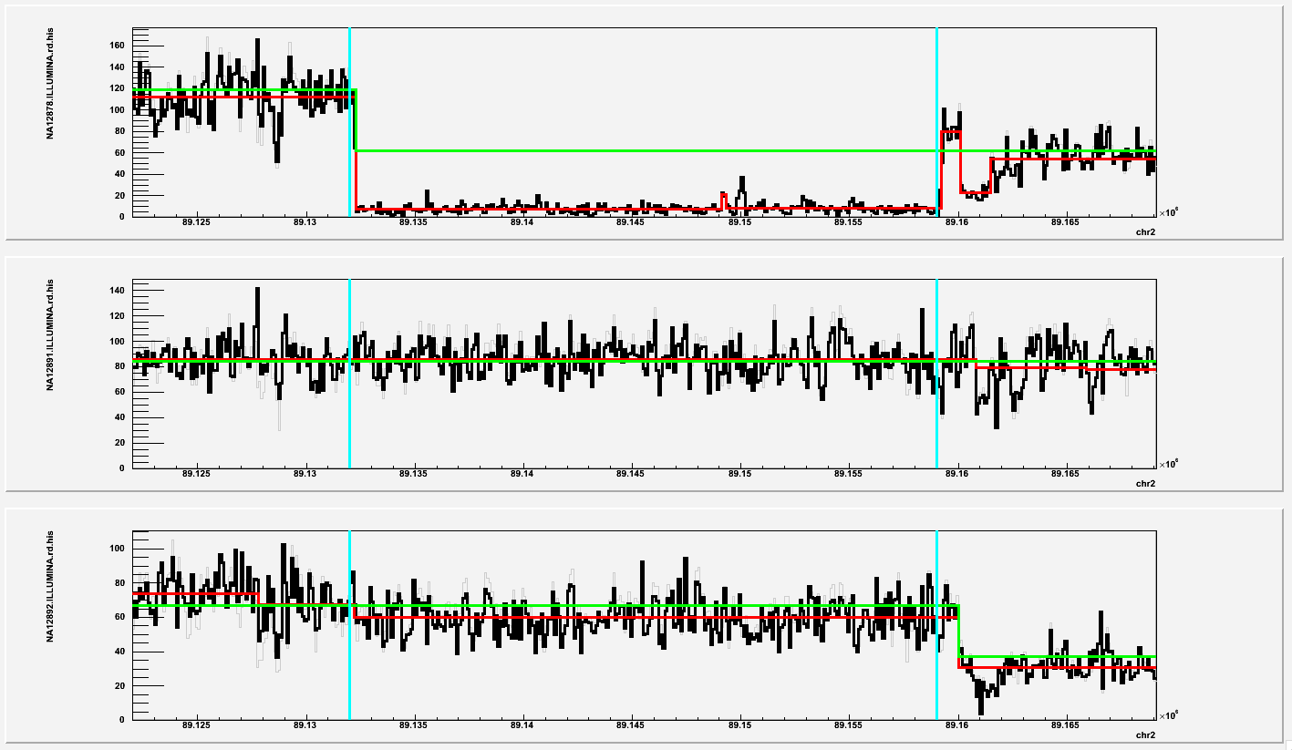
chr2:89132000-89159000
Was not in my initial screening as it is close to a gap in reference

Slide 3
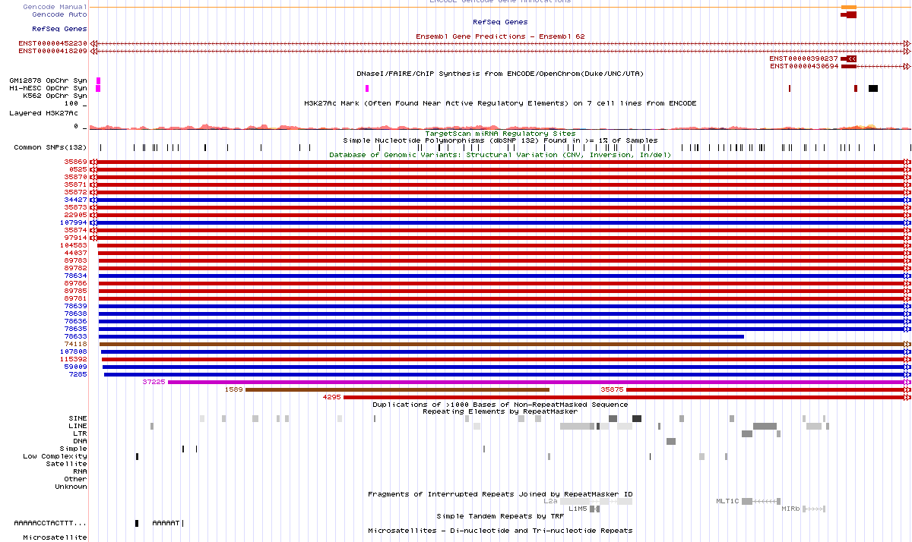
chr2:89132000-89159000
Variants

Slide 4
SNPs
Step | # of candidate SNPs | In G1K pilot CEU release (7,723,753 SNPs) | In G1K interim release (41,599,459 SNPs)
Intersection with parents | 61,205 | 27,239 (44.5%) | 48,212 (78,8%)
Intersection with spouse | 46,725 | 18,424 (39.4%) | 34,506 (73.8%)
Intersection with kids (>=3 && <=8) | 22,953 | 12,537 (54.6%) | 20,924 (91.2%)

Slide 5
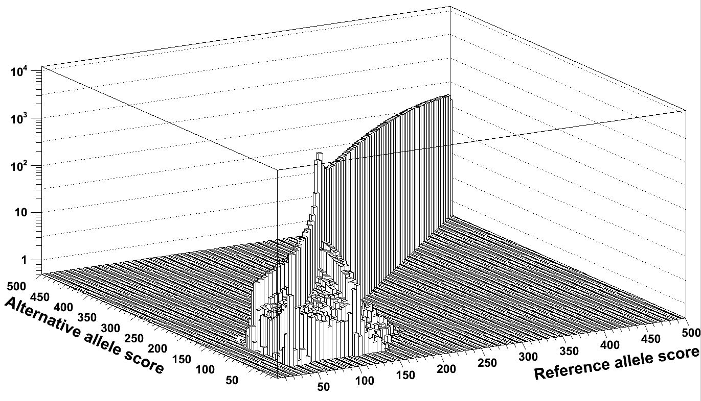
Using CG score

Slide 6
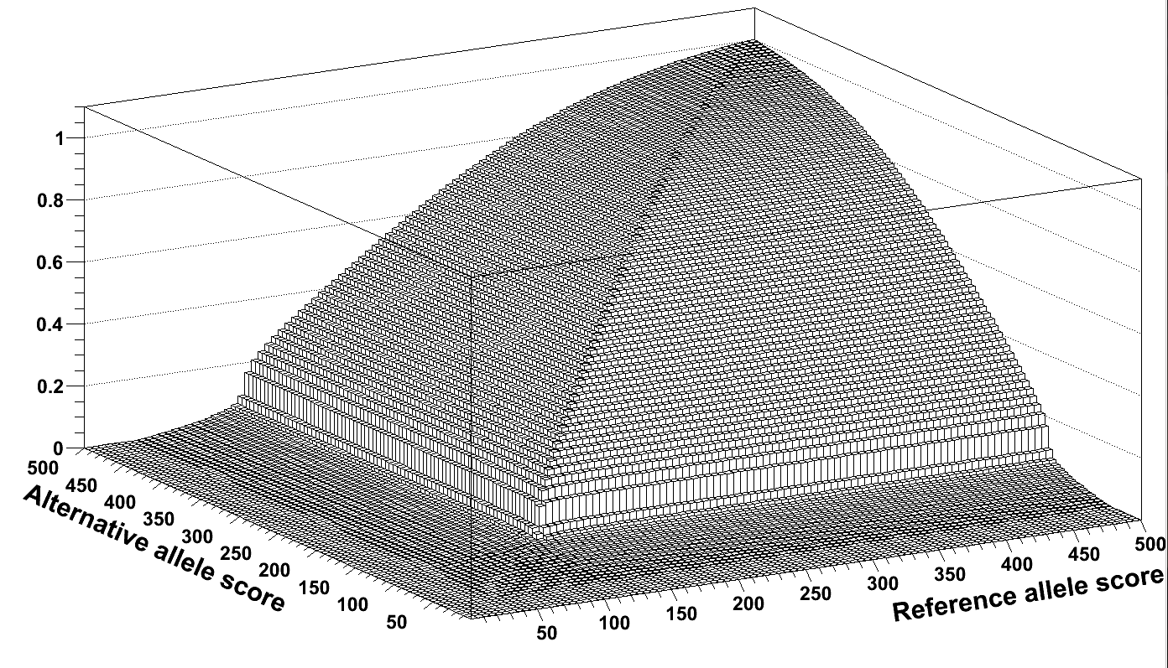
Using CG score (cumulative)
Empirical p-val = frac_SNPs(s < ref_score, s < alt_score)

Slide 7
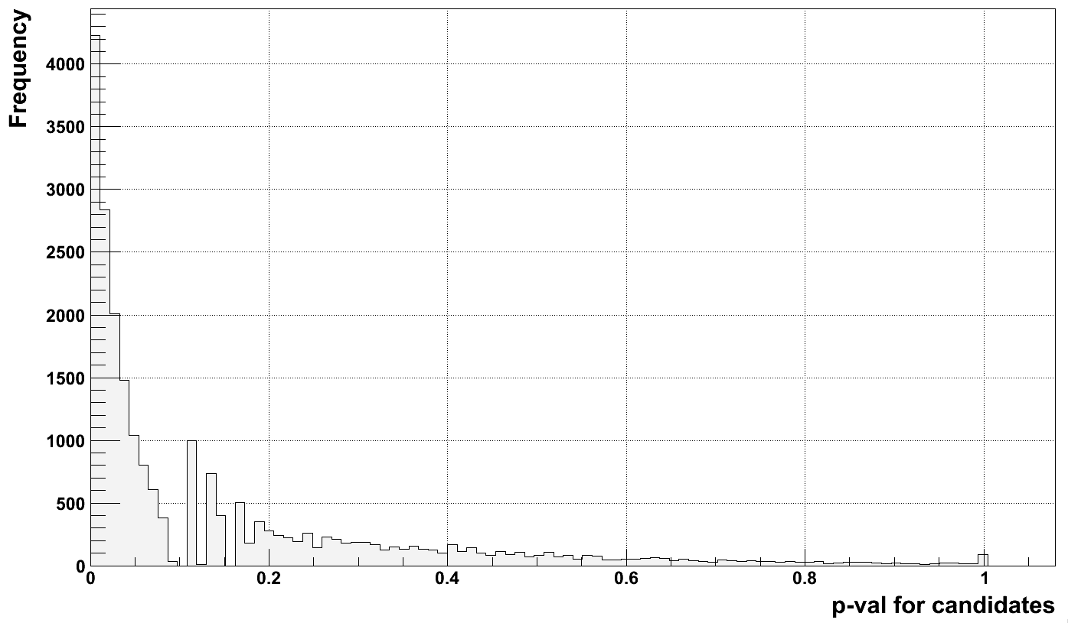
Using p-val

Slide 8
Step | # of candidate SNPs | In G1K pilot CEU release | In G1K interim release | De novo from G1K* | De novo candidate from G1K
Intersection with parents | 61,205 | 27,239 (44.5%) | 48,212 (78,8%) | 46 | 1151
Intersection with spouse | 46,725 | 18,424 (39.4%) | 34,506 (73.8%) | 46 | 1111
Intersection with kids (>=3 && <=8) | 22,953 | 12,537 (54.6%) | 20,924 (91.2%) | 42 | 62
Not in G1K pilot CEU release | 10,416 | 0 | 8,701 | 42 | 56
p-val > 0.1 | 3,796 | 0 | 3,208 | 39 | 52
p-val > 0.175 | 2,814 | 0 | 2,579 | 39 | 51
p-val > 0.9 | 117 | 0 | 82 | 9 | 10
Not in G1K interim release | 2,029 | 314 | 0 | 41 | 48
p-val > 0.1 | 676 | 88 | 0 | 38 | 45
p-val > 0.175 | 496 | 61 | 0 | 38 | 45
p-val > 0.9 | 37 | 2 | 0 | 9 | 9
*48 out of 49 could be lifted over to hg19

