Slide 1
Correcting sequencing bias
Alexej Abyzov
June 8, 2011

Slide 2
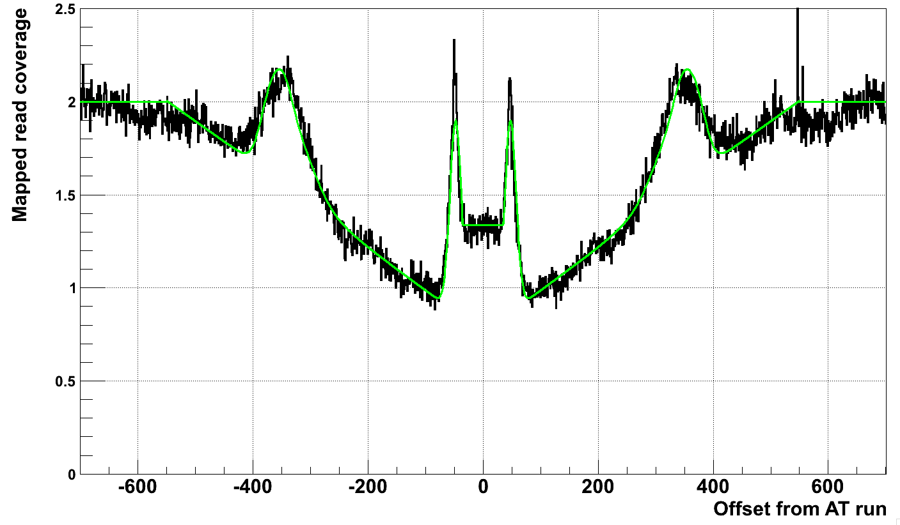
Sequencing bias around at runs

Slide 3
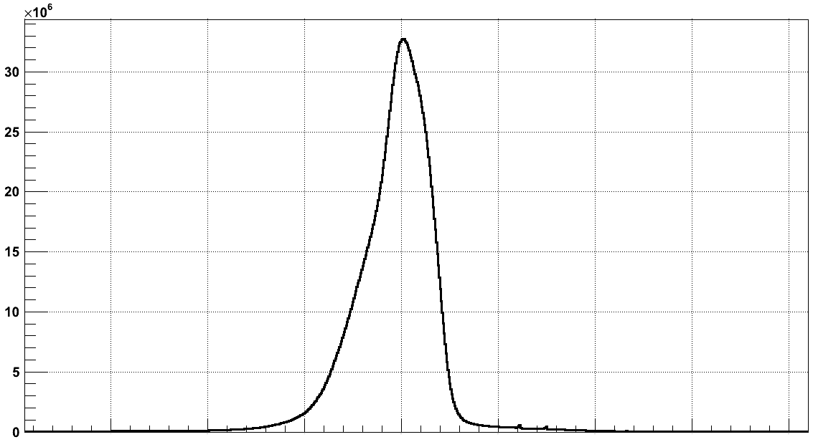
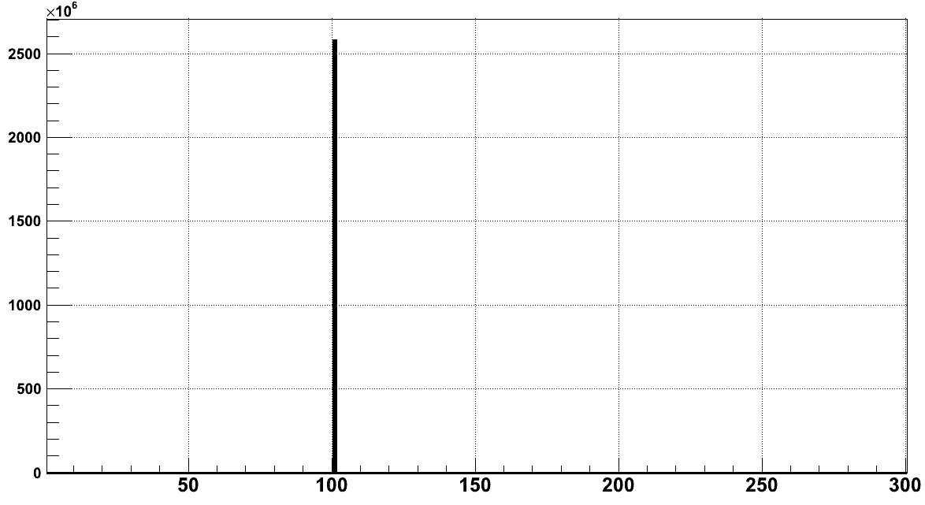
Model
Two levels
Linear increase
Insert length
Smeared
insert length

Slide 4
At the end
Implemented model for ATrun correction
Reduced # of calls by 20-30%
Realized that

Slide 5
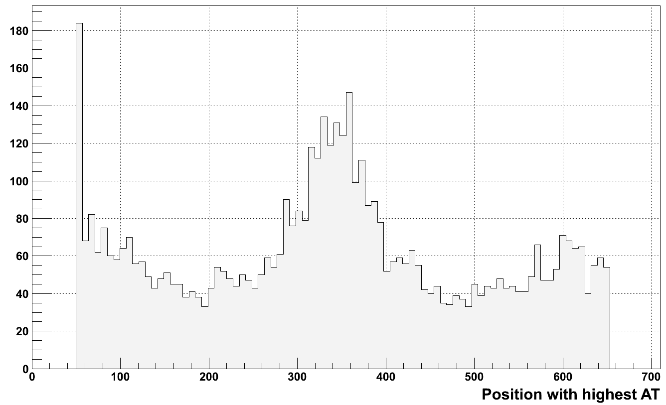
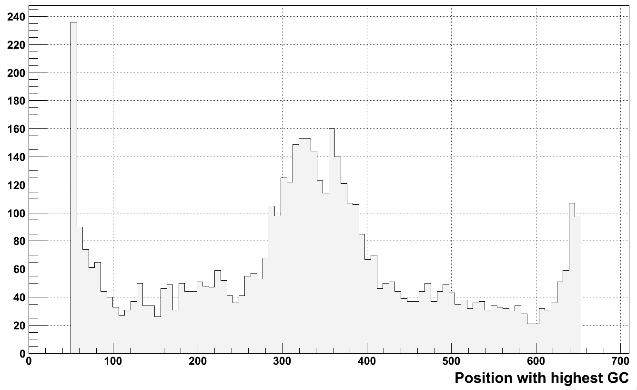

Slide 6
Current solution for 1KG calls
Submit all calls given from CNVnator (no AT run correction)
Select more confident calls
Have PE support
Long (>= 1500-2000 bp)
rd + q0*rd < 0.9 (deletions) and rd – q0*rd > 1.1 (duplications)

Slide 7
Next
Correction for GC-rich/poor bias using fragment length

