Slide 1
A Network Perspective of ICGC Cancer SNVs
Lucas Lochovsky
bNets subgroup
June 1, 2011
Notes:
Good evening. Tonight I’m going to present recent work on investigating genes disrupted by SNVs on protein interaction and transcription factor networks.

Slide 2
Starting Data
International Cancer Genome Consortium (icgc.org) SNV data on 9 human cancer types
Breast Cancer
Colorectal Cancer
Glioblastoma
Liver Cancer
Lung Adenocarcinoma
Malignant Melanoma
Ovarian Serous Cystadenocarcinoma
Pancreatic Cancer
Small Cell Lung Carcinoma
Notes:
This analysis was done with single nucleotide variant data recently obtained from the International Cancer Genome Consortium, spanning these 9 human cancers.

Slide 3
Networks Used
Extracted genes affected by each cancer
Used Biomart to map Ensembl gene IDs to official gene IDs
Mapped genes to a protein interaction network and a transcription factor-target gene network (short form: TF network)
Protein interaction data source: Human Protein Reference Database (HPRD) Release 9 (hprd.org)
TF network data source: ENCODE TFBS elucidated by ChIP-seq by Stanford/Yale/UC-Davis/Harvard
Focused on K562 TFs, since this cell line had the largest amount of data available
Notes:
What I did was take the names of all the genes affected by SNVs. Since the original data provided the genes’ Ensembl IDs, I used Biomart to map these to the official gene IDs used in the networks I used. Protein interaction data was derived from the latest release of the human protein reference database, and transcription factor-target gene data was derived from ChIP-seq TFBS data produced by groups at Stanford, Yale, UC-Davis, and Harvard. For this initial phase, I focused on TF data for the K562 cell line, since its data covers the largest number of TFs.

Slide 4
Analyses
Protein interaction network: Identified top 10 hubs in each cancer type
TF network
Identified top 5 genes with the highest number of TF regulators in each cancer type
Identified top 10 transcription factors with the highest number of target genes
Similar themes overlooked in favor of pointing out unique characteristics of each cancer type
TP53
Cell growth/differentiation
Cell cycle control
Transcription regulation
Histone remodelling
Notes:
In the protein interaction network, I identified the top 10 hubs in each cancer type. Ordinarily, I also would’ve done a bottleneck analysis, but this was deferred since earlier analyses indicated that bottleneck genes also tend to be hub genes, so I decided to put more time into analyzing the TF network. In the TF network, for each cancer type, I identified the top 5 genes with the highest number of TF regulators, and the top 10 transcription factors with the highest number of target genes. Now there’s a number of recurrent themes in my findings, so in the results I’m going to present, I’m going to focus on the unique characteristics of each cancer type.

Slide 5
Protein Interaction Hubs
Breast Cancer: Includes NFKB and its inhibitor, fibronectin (cell adhesion and migration), and muscle cell differentiation and regeneration.
Colorectal Cancer: Focus on SMAD TF family, fibronectin, lipid endocytosis
Glioblastoma: Receptors for estrogen and androgen, EGFR, a couple of SMADs
Liver Cancer: Primary focus is on MAPK pathway signalling
Lung Adenocarcinoma: Embryonic development, a couple of SMADs, cell adhesion
Notes:
So here are the highlights for the top protein interaction hubs for each cancer. Some of the hubs that frequently appeared involved the SMAD transcription factor family, the MAPK pathway, and epidermal growth factor. One interesting trend I noticed was that colorectal cancer, malignant melanoma, and pancreatic cancer had almost exactly the same top 10 hubs, implying some functionality similarity in these cancers’ disruption mechanisms.

Slide 6
Protein Interaction Hubs (cont’d)
Malignant Melanoma: Similar themes to Glioblastoma
Ovarian Serous Cystadenocarcinoma: Epidermal growth factor, MAPK pathway, serine/threonine kinases
Pancreatic Cancer: Similar themes to Malignant Melanoma
Small Cell Lung Carcinoma: Estrogen and EGF receptors, phosphorylation
Notes:
(And this is just the hubs for the remaining 4 cancer types)

Slide 7
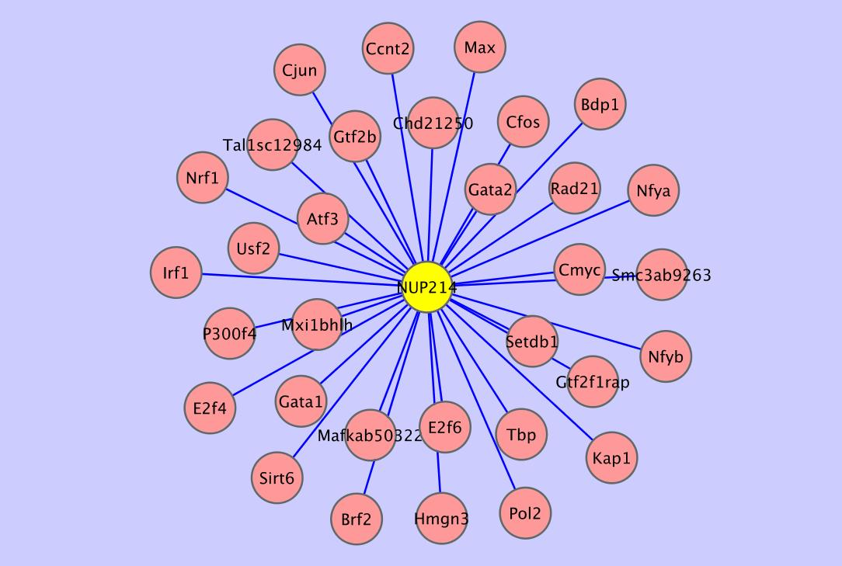
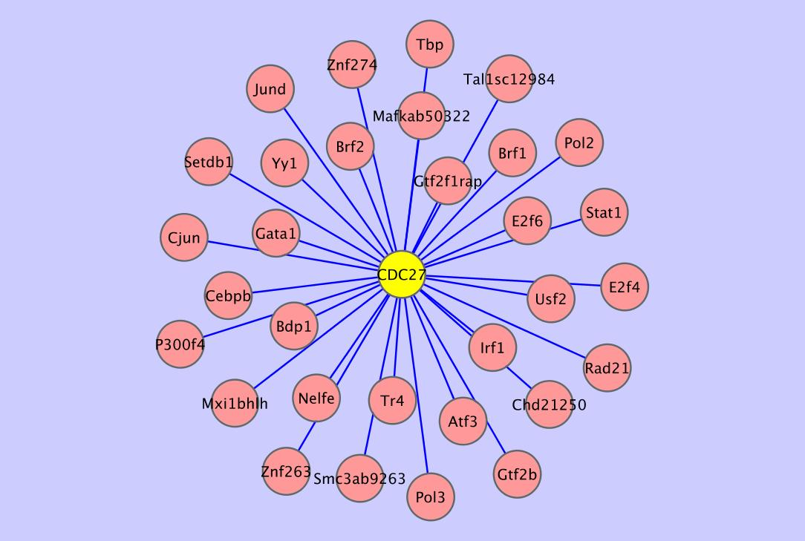
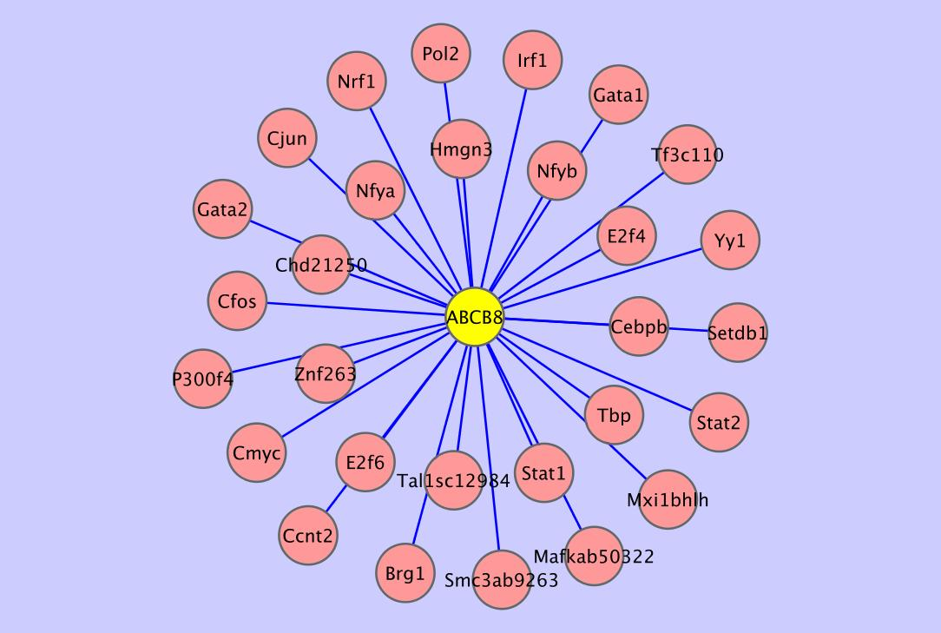
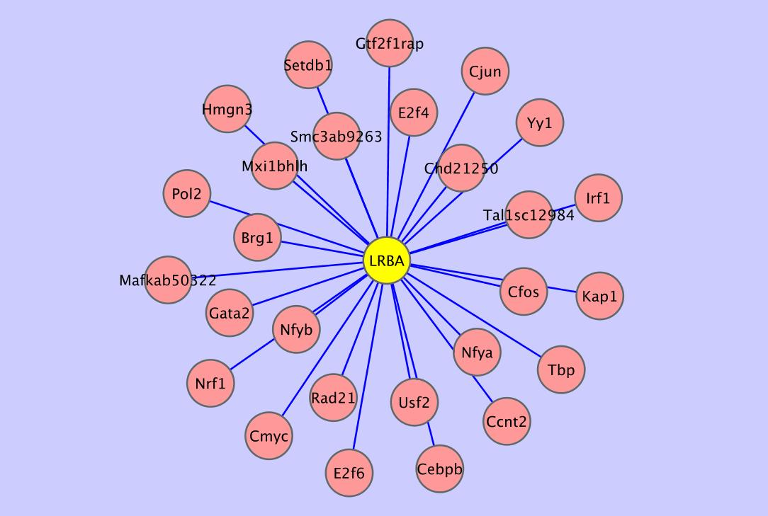
Breast Cancer: Most Regulated Genes
Notes:
Now we come to the disrupted genes with the highest number of TF regulators. Each factor is presented with its regulators surrounding it. In breast cancer, the top 5 were JUP, NUP214, CDC27, ABCB8, and LRBA.

Slide 8
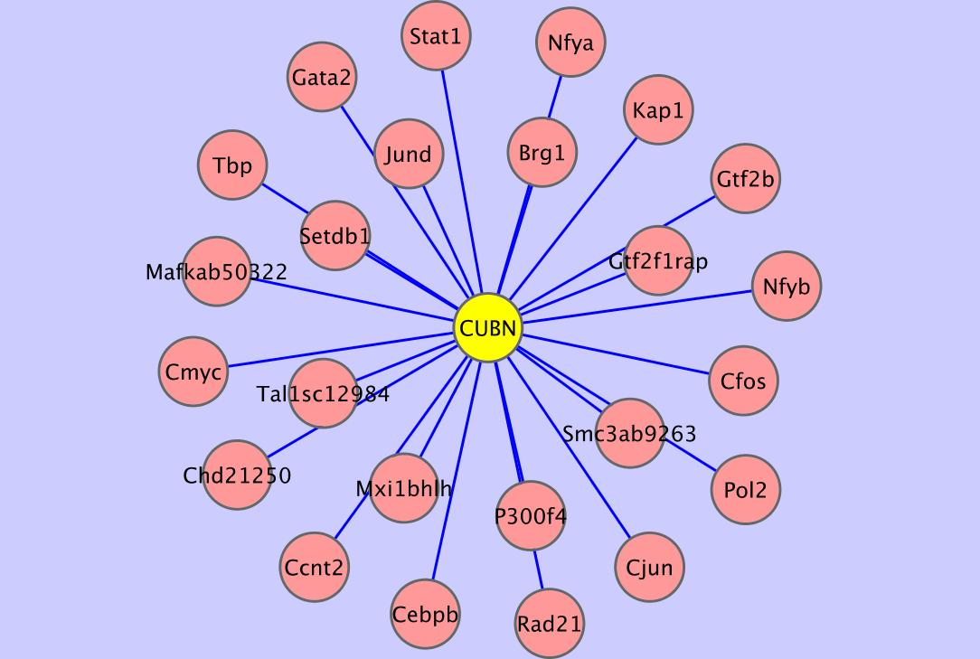
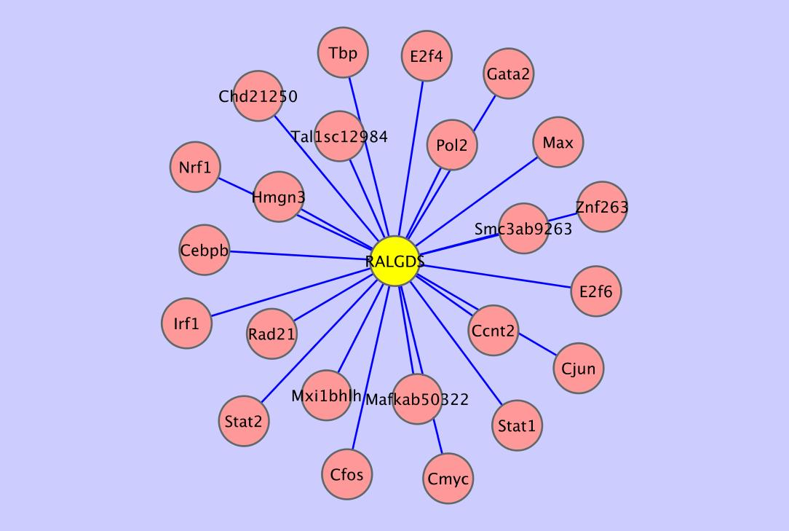
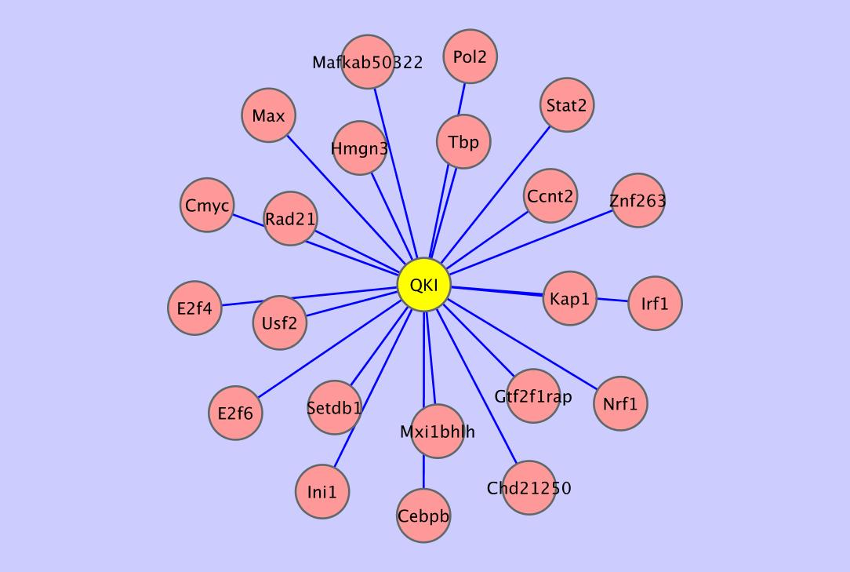
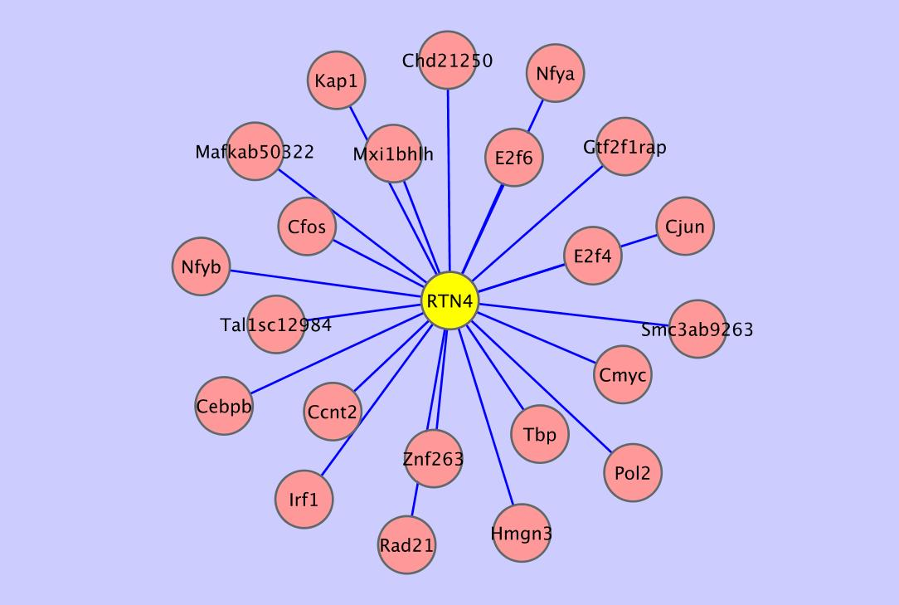
Colorectal Cancer: Most Regulated Genes
Notes:
CUX1, CUBN, RALGD5, QKI, and RTN4.

Slide 9
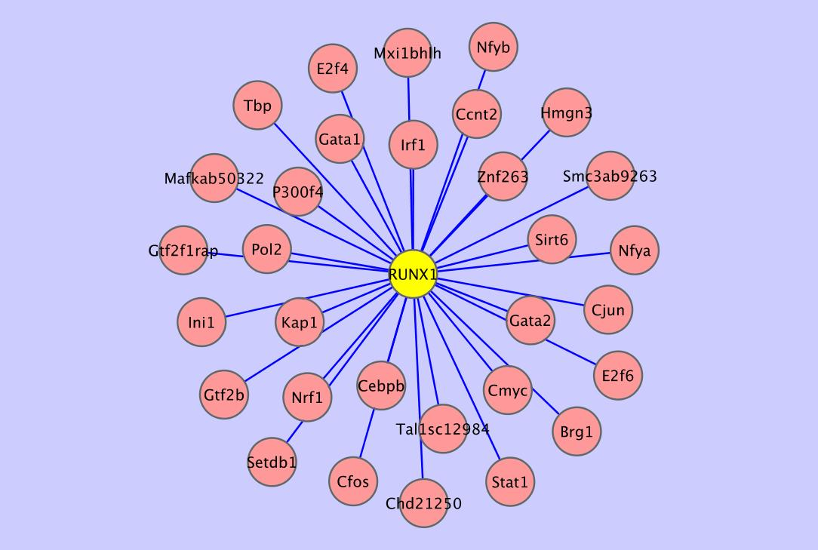
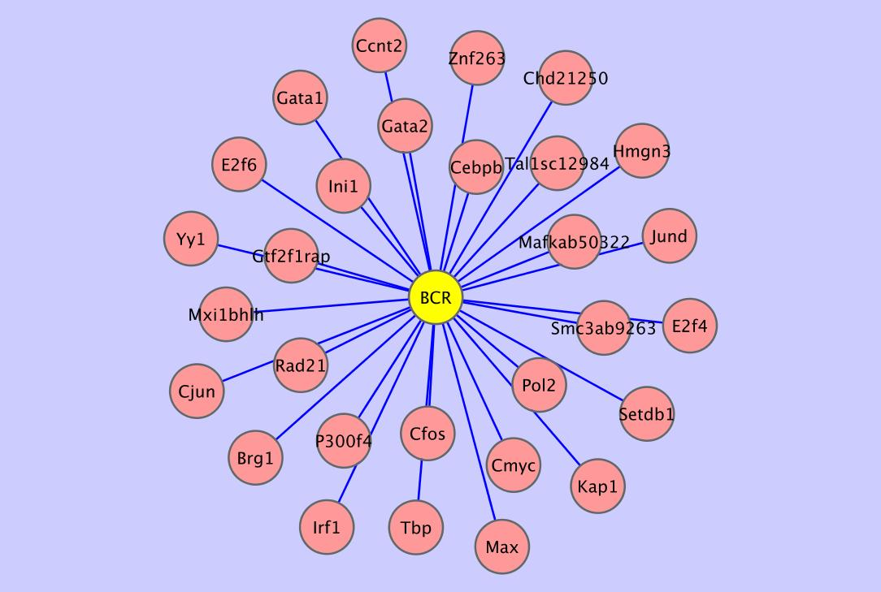
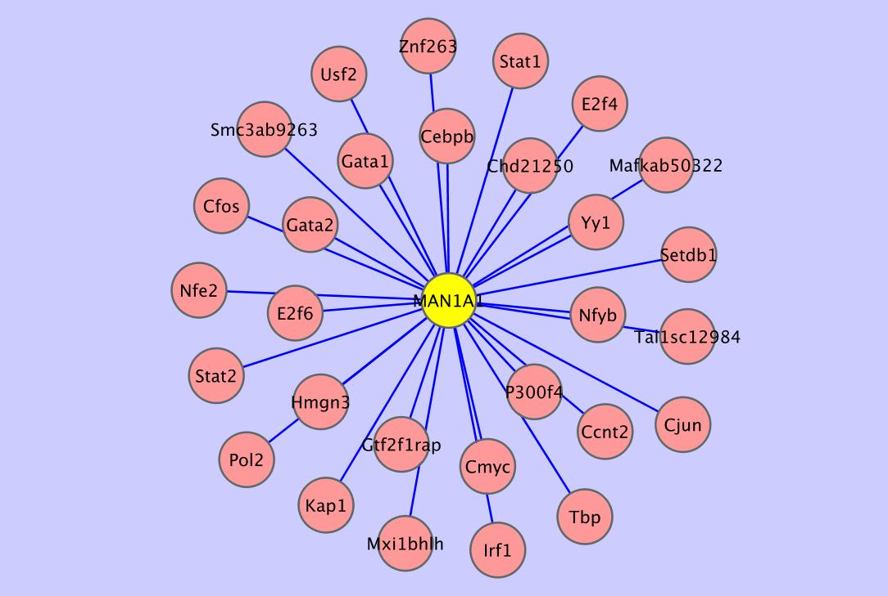
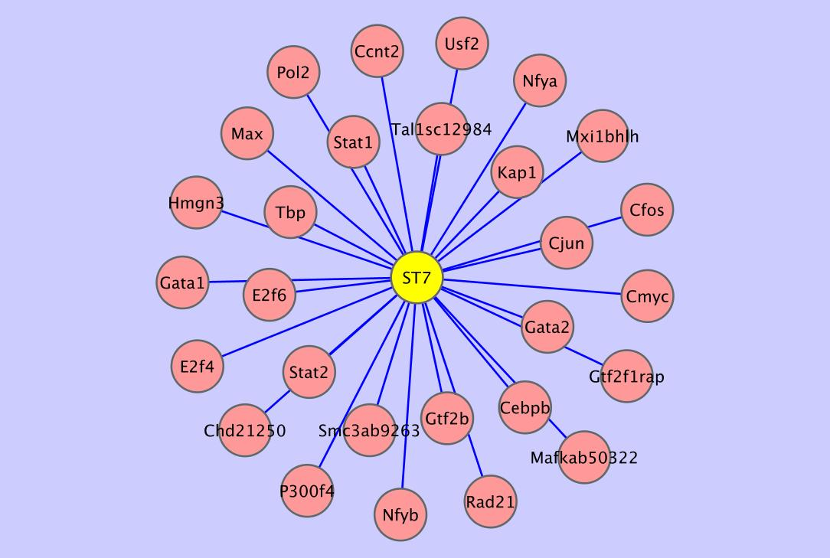
Glioblastoma: Most Regulated Genes
Notes:
NUP214, RUNX1, BCR, MAN1A1, and ST7.

Slide 10
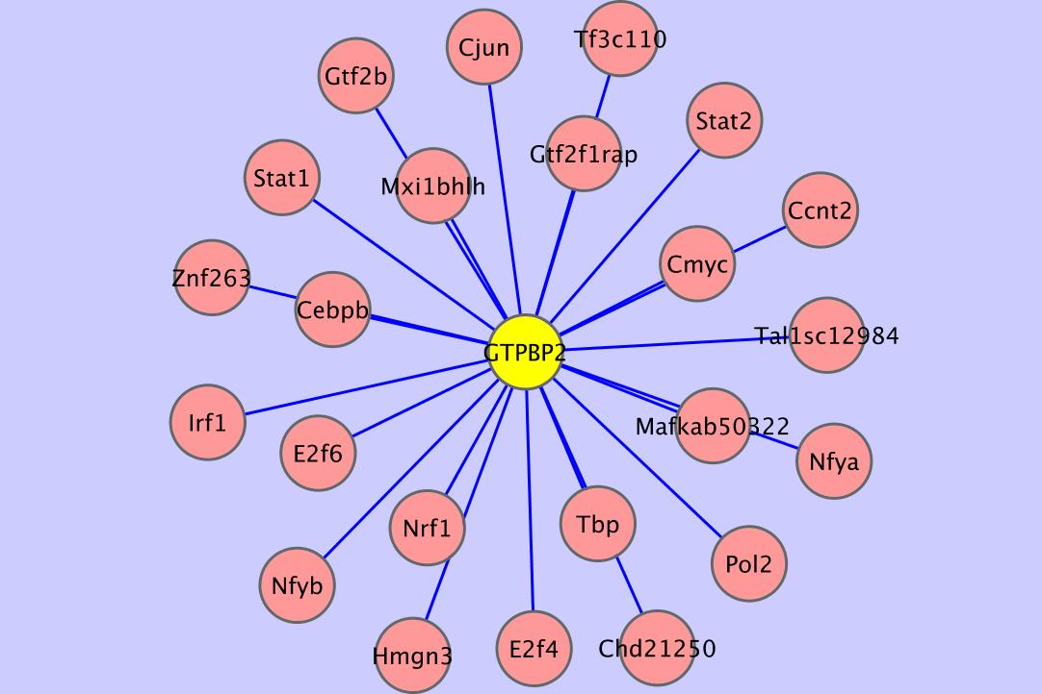
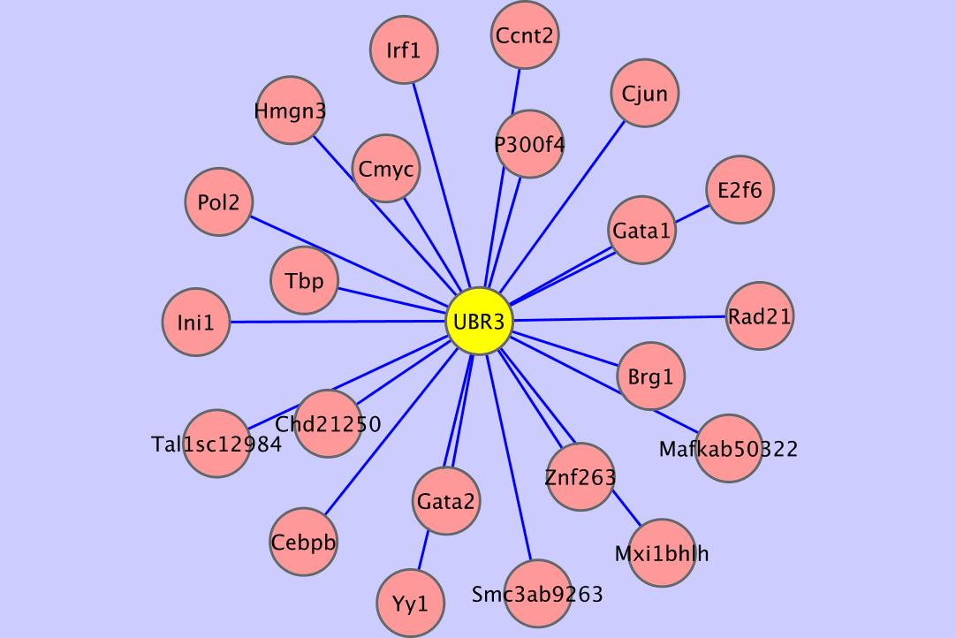
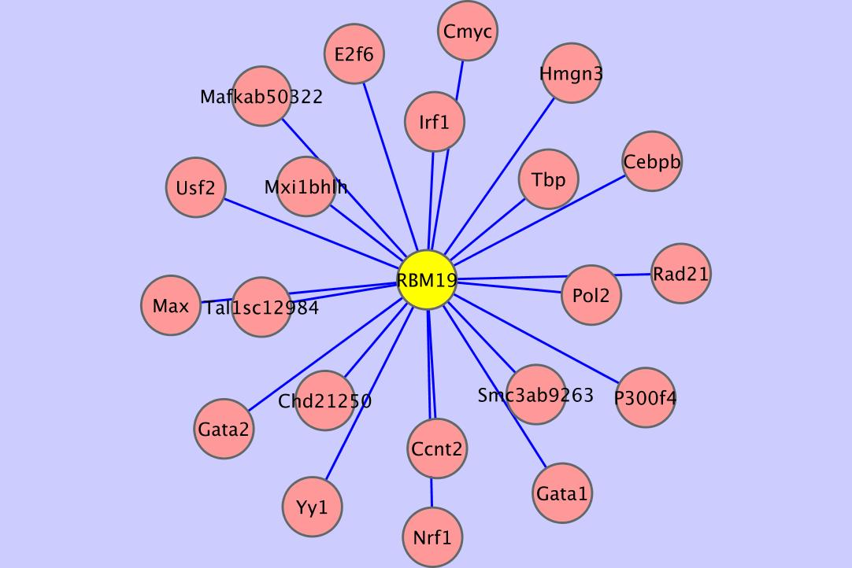
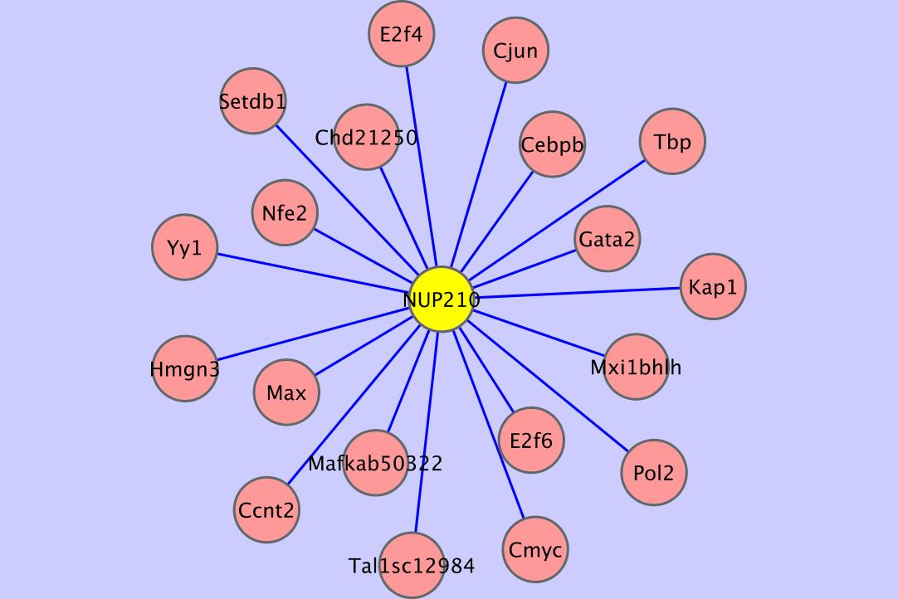
Liver Cancer: Most Regulated Genes
Notes:
ITPR1, GTPBP2, UBR3, RBM19, and NUP210.

Slide 11
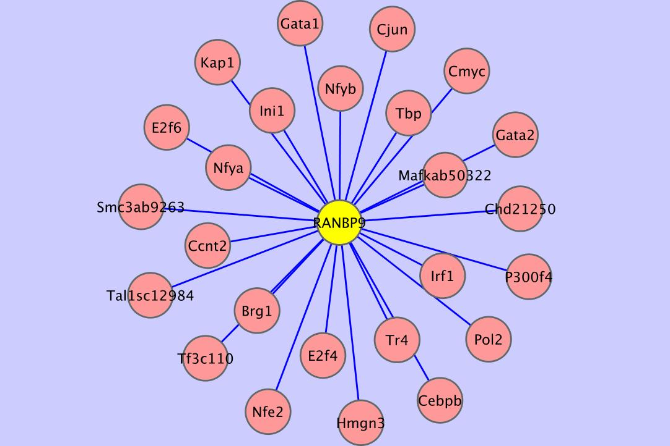
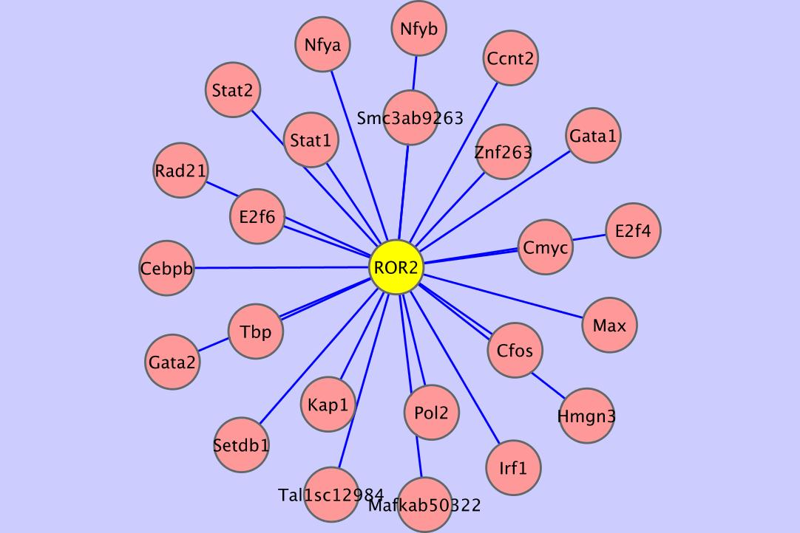
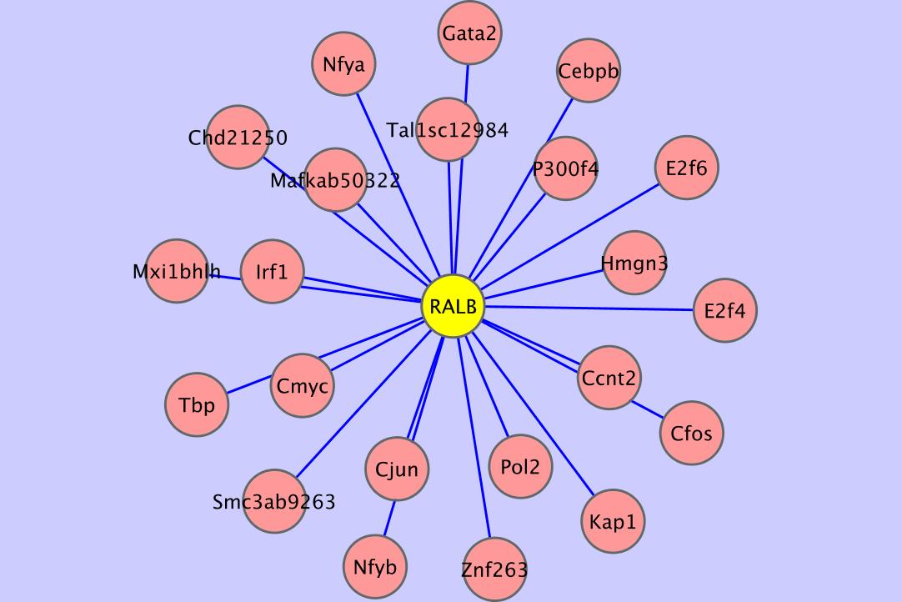
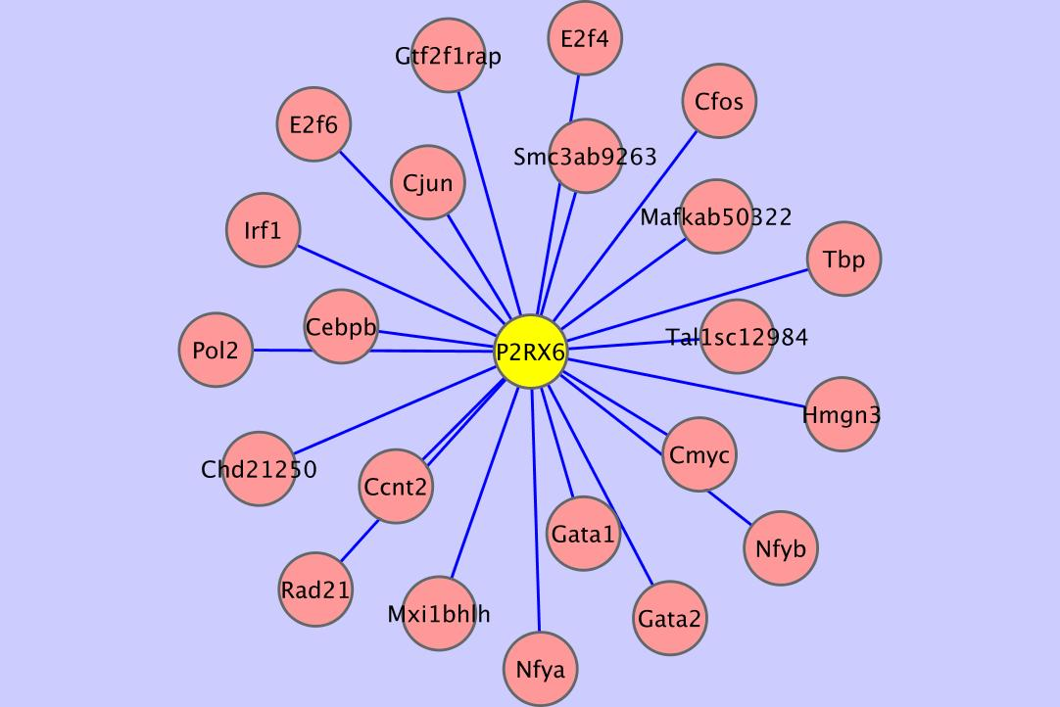
Lung Adenocarcinoma: Most Regulated Genes
Notes:
JUP, RANBP9, ROR2, RAL8, and P2RX6.

Slide 12
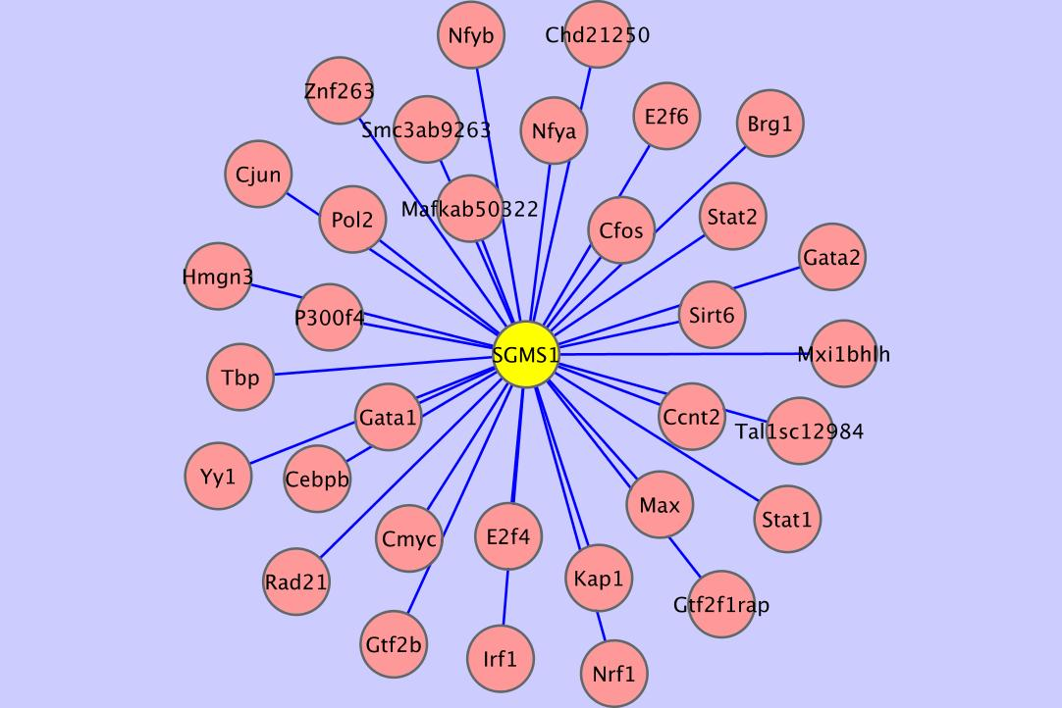
Malignant Melanoma: Most Regulated Genes
Notes:
PI4KA, SGMS1, NUP214, CDC27, and RUNX1.

Slide 13
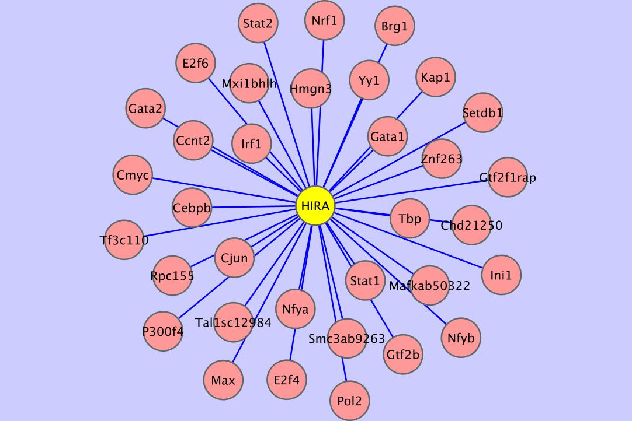
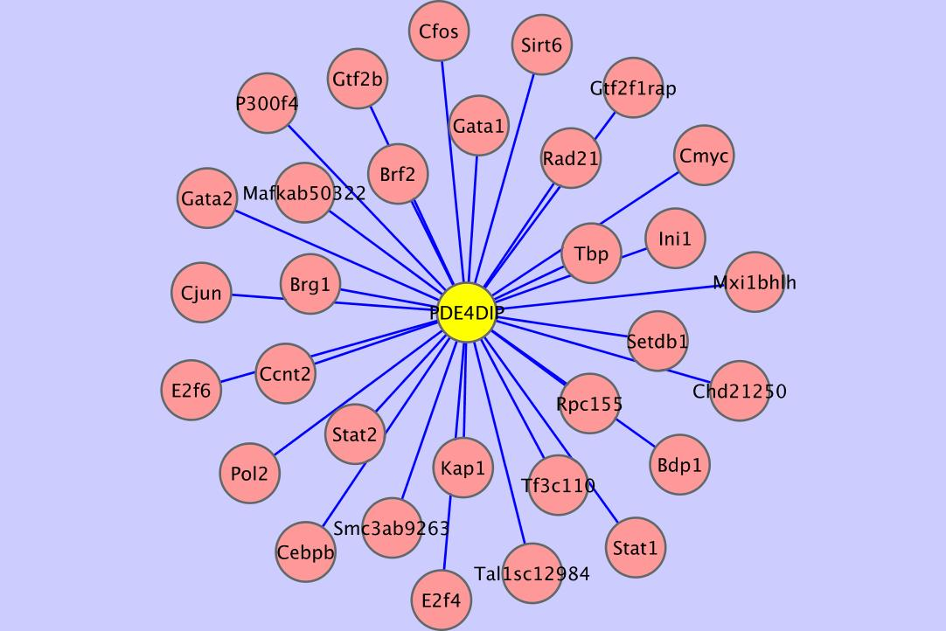
Ovarian Serous Cystadenocarcinoma: Most Regulated Genes
Notes:
JUP, HIRA, NUP214, PDE4DIP, and CDC27.

Slide 14
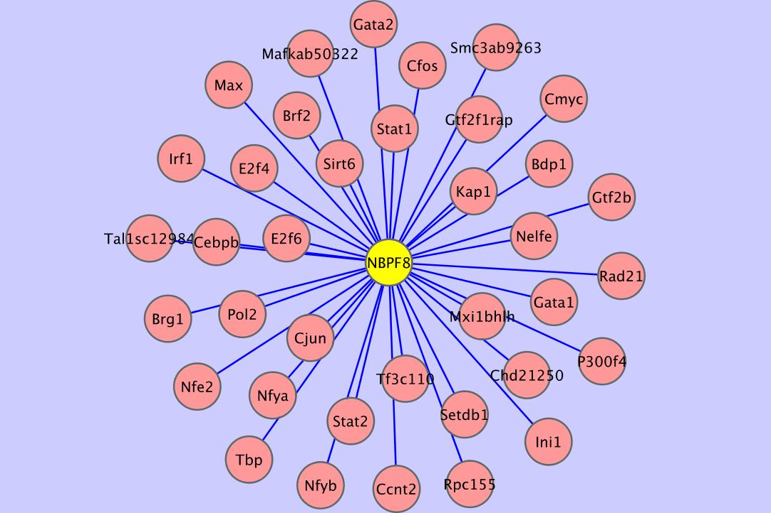
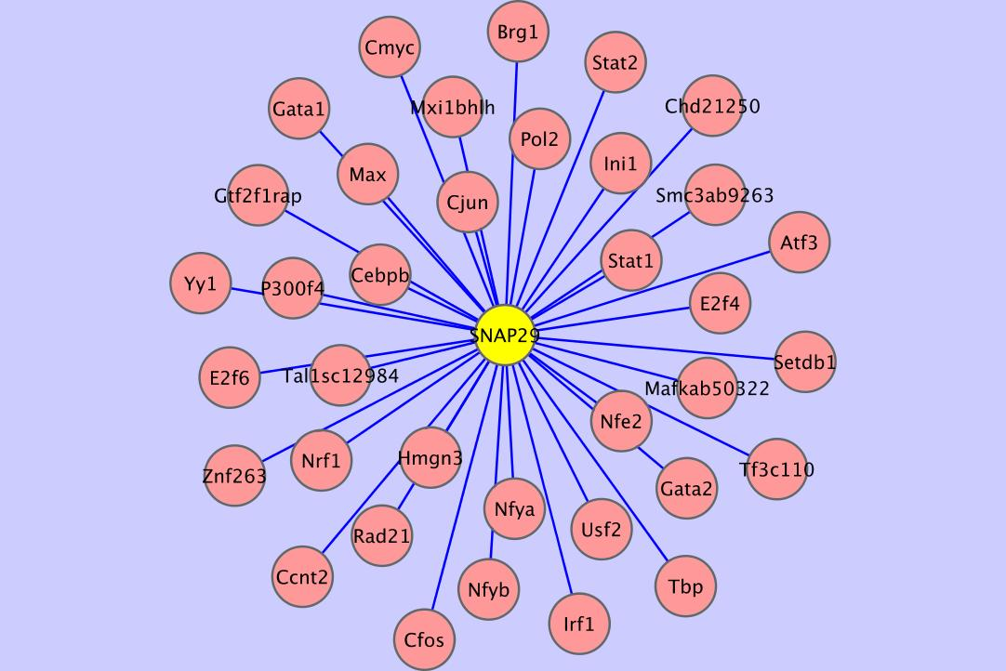
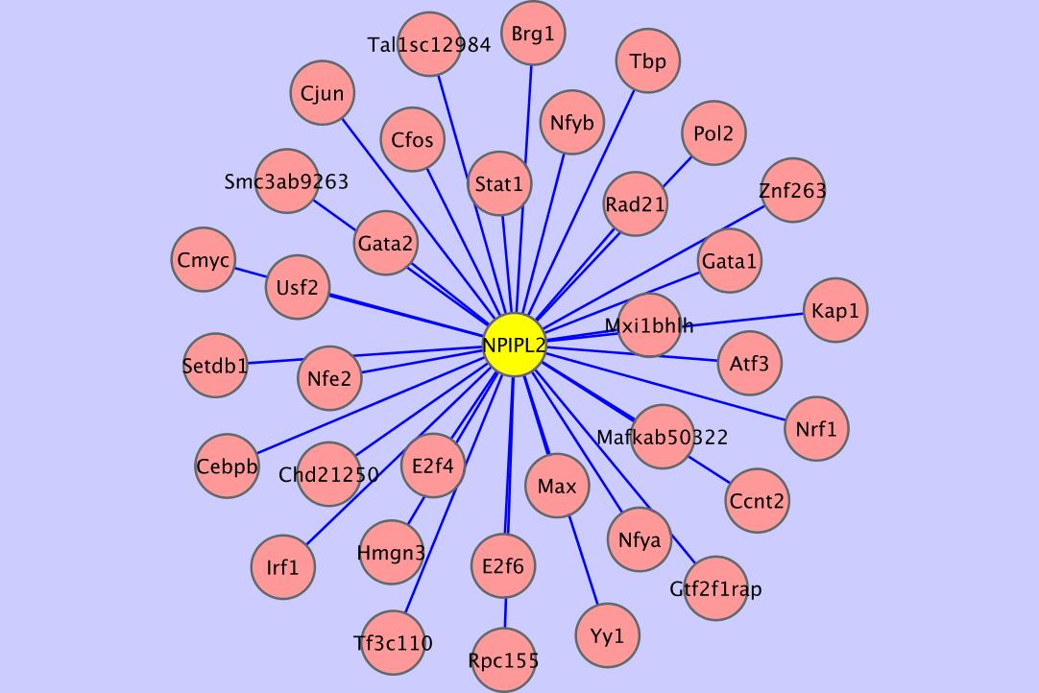
Pancreatic Cancer: Most Regulated Genes
Notes:
NBPF14, NBPF8, SNAP29, NPIPL2, and HIRA. Most of these are unique to pancreatic cancer.

Slide 15
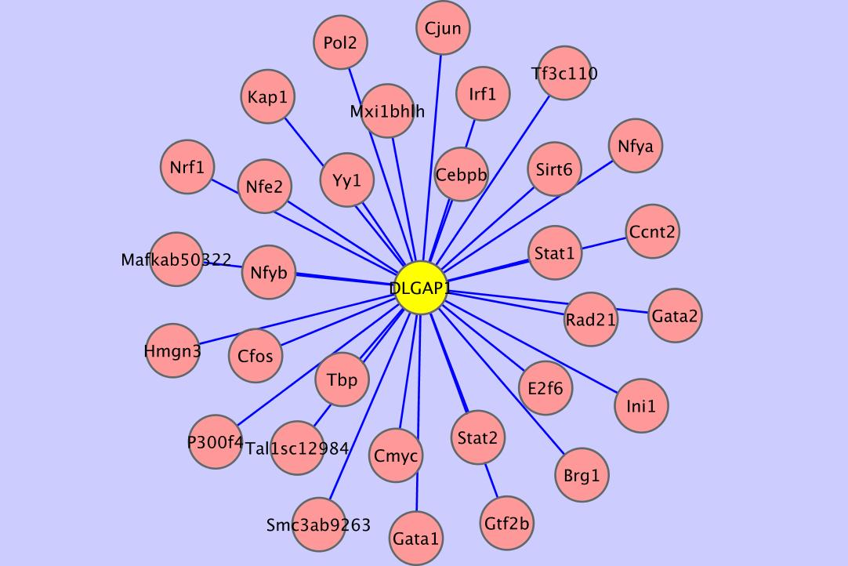
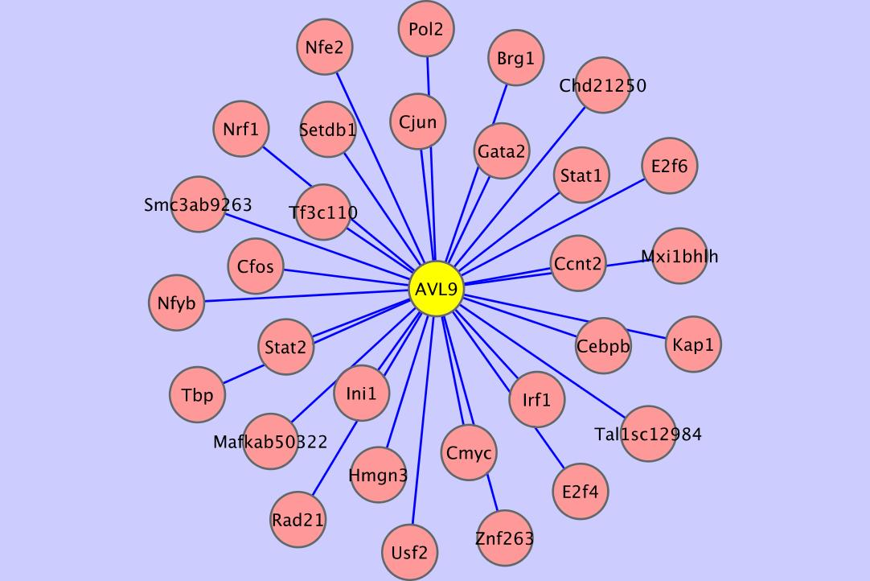
Small Cell Lung Adenocarcinoma: Most Regulated Genes
Notes:
SGMS1, DLGAP1, RUNX1, CDC27, and AVL9.

Slide 16
Busiest TFs
Breast Cancer
Colorectal Cancer
Glioblastoma
Node | Degree
Cebpb | 293
Pol2 | 288
Cmyc | 279
Tbp | 264
Smc3ab9263 | 249
E2f6 | 249
Mafkab50322 | 229
Ccnt2 | 227
Tal1sc12984 | 205
Rad21 | 186
Node | Degree
Cebpb | 218
Pol2 | 200
Cmyc | 190
Tbp | 184
E2f6 | 177
Mafkab50322 | 174
Smc3ab9263 | 169
Ccnt2 | 159
Tal1sc12984 | 147
Rad21 | 143
Node | Degree
Cebpb | 1066
Pol2 | 923
Cmyc | 907
Tbp | 843
Smc3ab9263 | 816
E2f6 | 813
Mafkab50322 | 778
Ccnt2 | 740
Tal1sc12984 | 691
Rad21 | 621
Notes:
And finally, we have the TFs that regulate the largest number of genes in each cancer. Next to each factor is its degree in each cancer network, which represents the number of cancer-disrupted genes it regulates in each given cancer type. Most cancers had the same factors in their top 10 lists, although the degree column indicates that the number of genes implicated in each cancer type can vary considerably, although this could be representational bias in iCGC.

Slide 17
Busiest TFs (cont’d)
Liver Cancer
Lung Adenocarcinoma
Malignant Melanoma
Node | Degree
Mafkab50322 | 59
Cebpb | 57
Pol2 | 52
Tbp | 47
Cmyc | 47
E2f6 | 47
Ccnt2 | 44
Tal1sc12984 | 37
Smc3ab9263 | 37
Hmgn3 | 34
Node | Degree
Cebpb | 180
Pol2 | 179
Cmyc | 168
E2f6 | 154
Tbp | 152
Ccnt2 | 151
Tal1sc12984 | 138
Mafkab50322 | 137
Smc3ab9263 | 132
Hmgn3 | 119
Node | Degree
Cebpb | 2588
Mafkab50322 | 1977
Smc3ab9263 | 1970
Pol2 | 1928
Cmyc | 1861
Tbp | 1792
Tal1sc12984 | 1775
E2f6 | 1747
Rad21 | 1670
Ccnt2 | 1575
Notes:
And this is for the remaining cancer types.

Slide 18
Busiest TFs (cont’d)
Ovarian Serous
Cystadenocarcinoma
Small Cell Lung
Adenocarcinoma
Pancreatic Cancer
Node | Degree
Cebpb | 2438
Pol2 | 2105
Cmyc | 1983
Tbp | 1941
E2f6 | 1806
Mafkab50322 | 1779
Smc3ab9263 | 1738
Ccnt2 | 1601
Tal1sc12984 | 1583
Rad21 | 1390
Node | Degree
Cebpb | 2511
Pol2 | 2020
Cmyc | 1932
Mafkab50322 | 1918
Tbp | 1879
Smc3ab9263 | 1876
E2f6 | 1760
Tal1sc12984 | 1711
Ccnt2 | 1638
Rad21 | 1607
Node | Degree
Pol2 | 10428
Cmyc | 9266
Tbp | 9154
Cebpb | 8831
E2f6 | 8588
Ccnt2 | 7211
Smc3ab9263 | 6395
Irf1 | 6079
Mafkab50322 | 6048
Tal1sc12984 | 5509
Notes:
These last three have much more substantial representation in the ICGC data.

Slide 19
The End
(People know what goes on my Acknowledgements slide by now)

