Slide 1
Nonparametric inference for functional and translational genomics
Ben Brown
Statistics, UC Berkeley

Slide 2
Part 1
A general model of feature co-association The Genome Structure Correction (GSC)
Part 2
Beyond heuristics A generic statistical tool for the analysis of *-seq assays

Slide 3
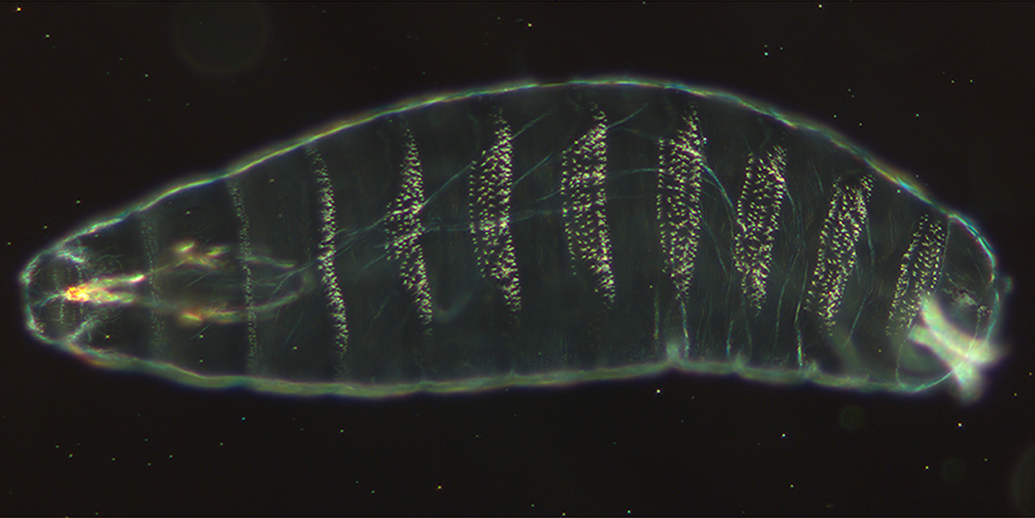
A general model of feature co-association The Genome Structure Correction (GSC)
Dr. Ben Brown,
Statistics, UC Berkeley

Slide 4
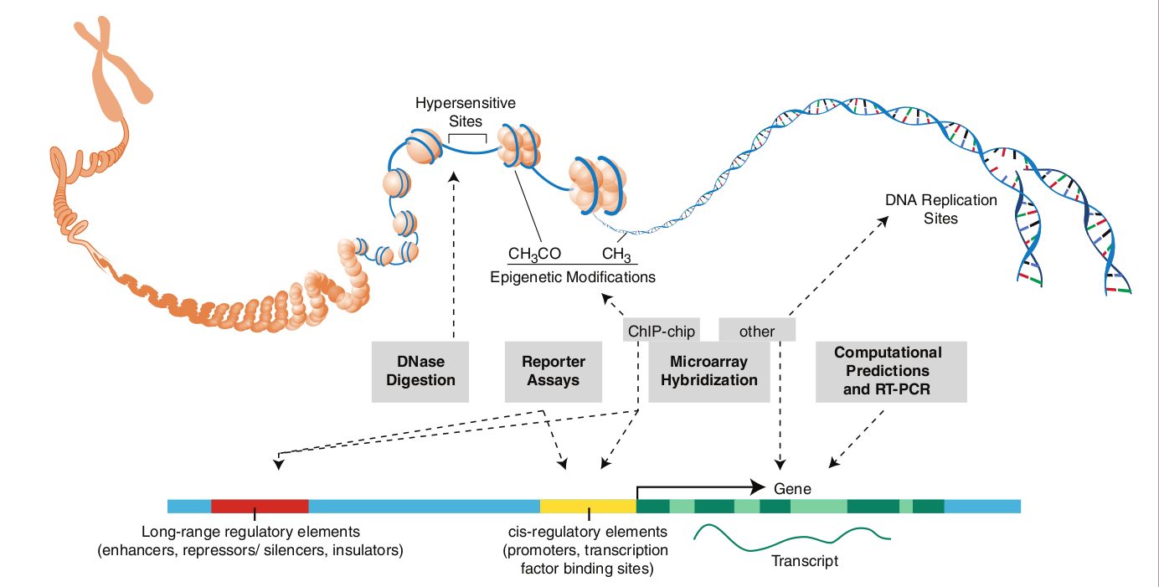
The ENCODE Project
The ENCODE Project Consortium. 2004. Science 22: 306 (5696).

Slide 5
Feature Overlap
Do a pair of features overlap more, or less than “expected at random”?
→Transcription Fragments
→ Conserved sequence
5'
3'

Slide 6
Naïve methods
Uniform feature start site shuffling
Big assumption: feature inter-arrival distances are Poisson, i.e. no big clumping, clustering, or underlying structure
Shuffle one feature, keep the other fixed
Not a consistent estimator
True distribution
Uniform Start Site Shuffling

Slide 7
Requirements
General: any other consistent estimator is a special case (submodel)
Self diagnostic: if assumptions aren’t met, it shows up during analysis
Conservative: any p-value is assured to be greater than or equal to the “true” p-value

Slide 8
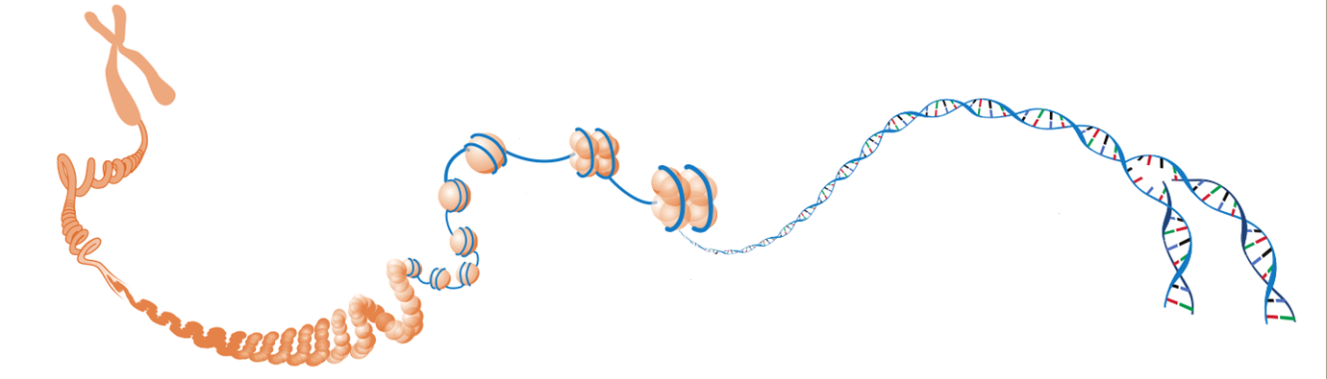
Toward a model

Slide 9
“Segmented Stationarity”
…

Slide 10
“Segmented Stationarity”
Let X_{i} = base at position i, i=1,…,n
such that for each k=1,…,r, is:
Stationary (homogeneity within blocks)
Mixing (bases at distant positions are nearly independent)‏
And, r << n
…

Slide 11
The GSC := “Segmented Stationarity”
Stationary (homogeneity within blocks)
Mixing (bases at distant positions are nearly independent)‏
And, r << n
General: any other consistent estimator is a special case (submodel)
Self diagnostic: if assumptions aren’t met, it shows up during analysis
Conservative: any p-value is assured to be greater than or equal to the “true” p-value

Slide 12
Testing Independence
Observed Sequence (Feature 1 = , Feature 2 = ):
Statistic is: (X₂)(Y₁)+(X₁)(Y₂), properly normalized and set to mean 0.
Under the null hypothesis of independence, this should be Gaussian.
Align Feature 1 of first block with Feature 2 of second block,
And vice versa.
Calculate overlap in the blocks after swapping = (X₂)(Y₁)+(X₁)(Y₂)‏
Sample two blocks of equal length.

Slide 13
Inference under Segmented Stationarity
Many genomic statistics are function of one or more sums of the form:
e.g. is 1 or 0 depending on the presence or absence of a feature or features
Under segmented stationarity,
these distributions are asymptotically Gaussian
and can be estimated from the data

Slide 14
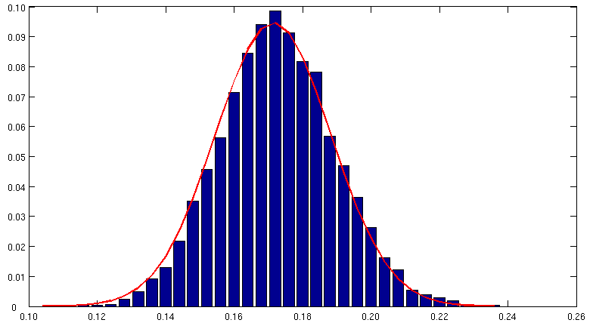
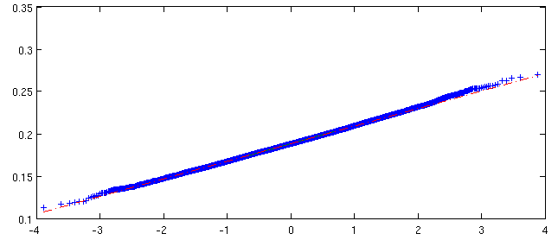
How Gaussian?
Block bootstrap distribution of the Region Overlap Statistic
Shown here with the PDF of the normal distribution with the same mean and variance
All ENCODE Pilot biochemically active elements
vs
All ENCODE Pilot conserved regions
QQplot of BB distribution vs. standard normal

Slide 15
True distribution
The GSC with the True Segmentation
The GSC without Segmentation

Slide 16
Unsegmented
The effects of segmentation on real data
(Kevin and Nitin are amazing)
Segmented

Slide 17
Dyadic Segmentation
Define,
Find j_{max} maximizing M(j) creating intervals I_{left} and I_{right}
If length of both intervals falls below a stopping criterion, stop
Else, repeat process for I_{left} and/or I_{right}, whichever are longer than stopping criterion, with redefined M(j)

Slide 18
True distribution
Uniform Start Site Shuffling
Block Bootstrap without Segmentation
Block Bootstrap with True Segmentation
Block Bootstrap with Estimated Segmentation

Slide 19
Nancy’s Dyadic Theorem (Nancy is magnificent)
$$\hat{σ}=σ+\sum{{γ\left(μ_{i}−μ_{j}\right)}^{2}}$$

Slide 20
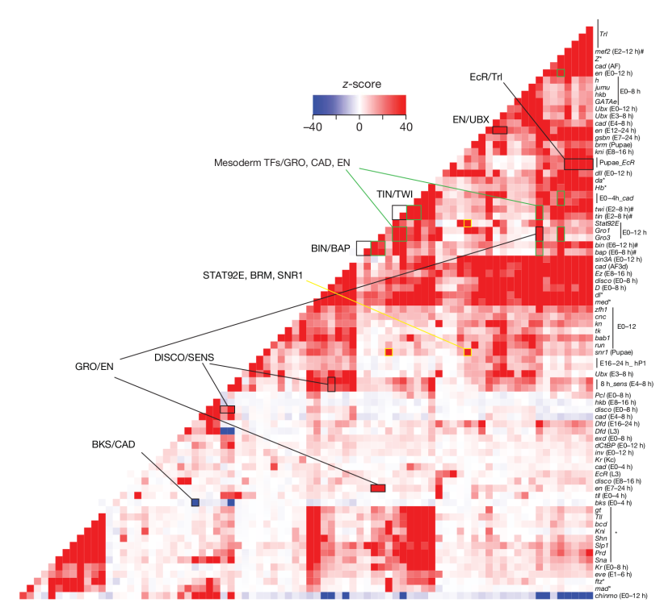
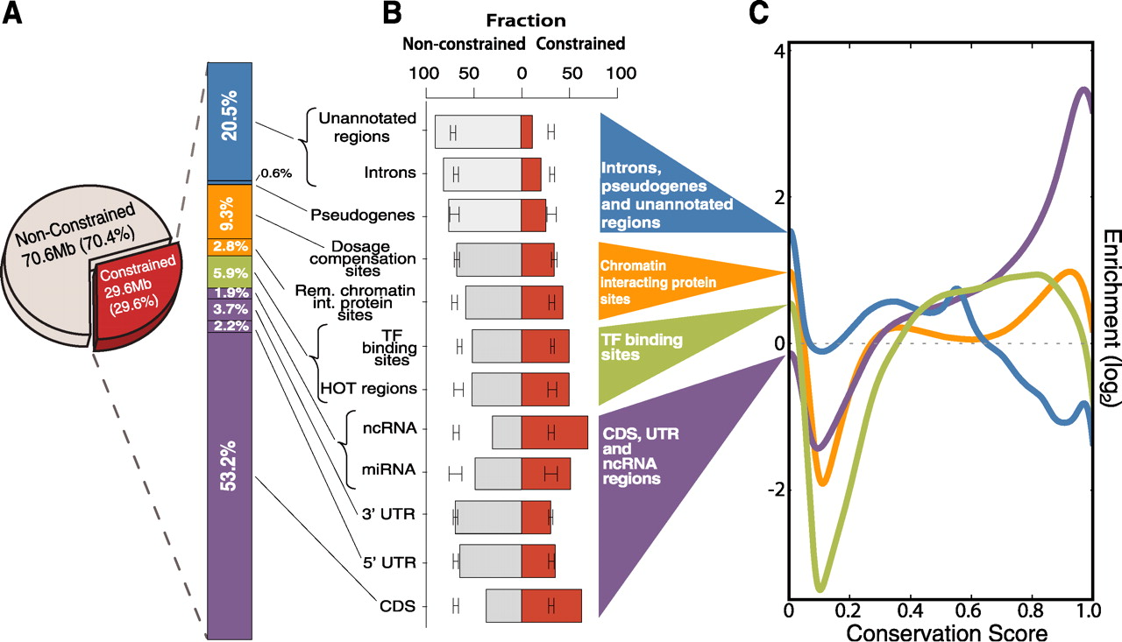
MacArthur et al, 2009, Genome Biology
Negre et al, 2011, Naure
Applied in high impact papers...
But only by the usual suspects!
Gerstein et al, 2011, Science

Slide 21
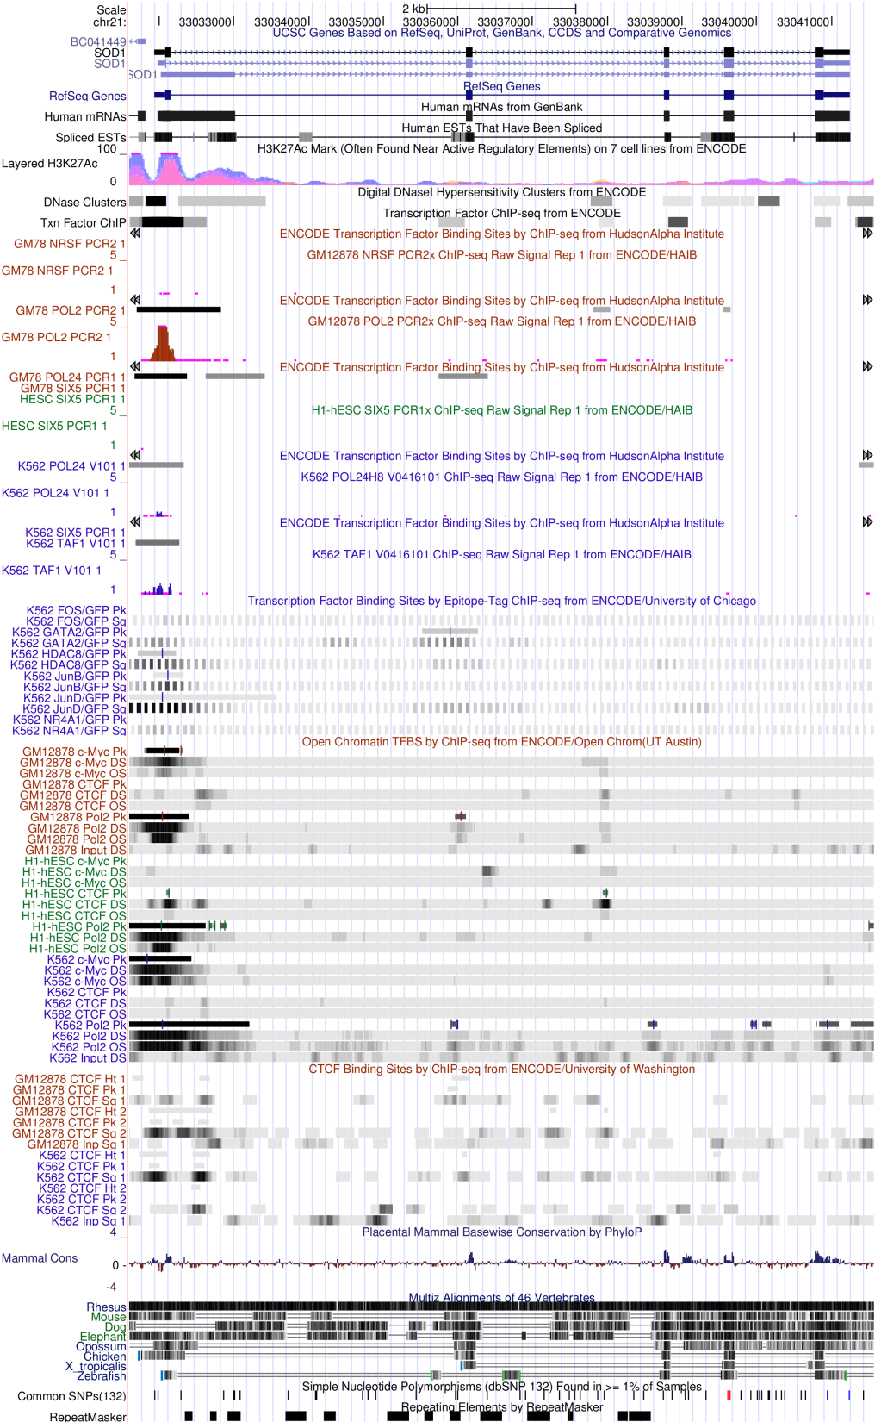
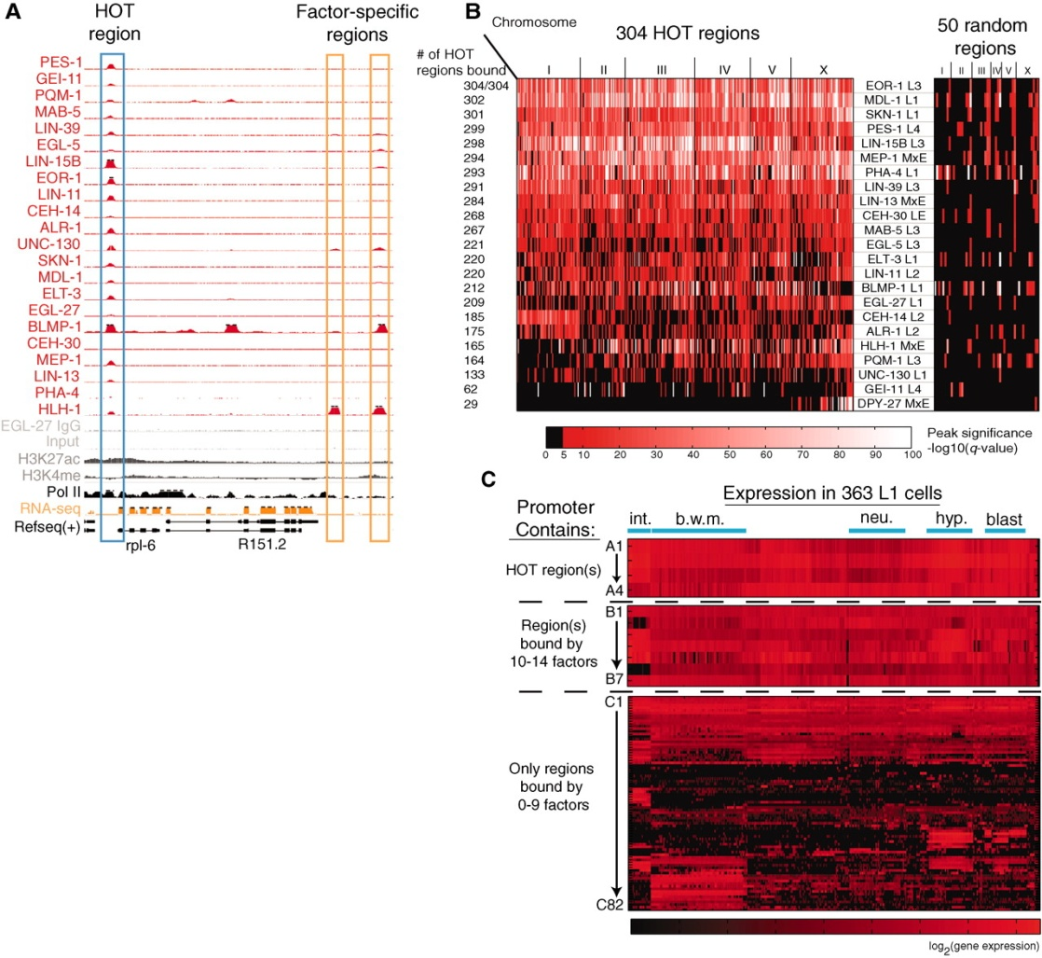
M B Gerstein et al. Science 2010;330:1775-1787

Slide 22
The Team
Nancy Zhang
Haiyan Huang
Nathan Boley
Peter Bickel
and now:
Jasmine Mu
Kevin Yip
Joel Rozowsky
and Mark Gerstein

Slide 23
Beyond heuristics A generic statistical tool for the analysis of *-seq assays
Dr. Ben Brown,
Statistics, UC Berkeley

Slide 24
Definition: *-seq assay
Input:
DNA or RNA
Selection:
interrogate the input
Output:
sequence reads
AGCTTAGCTAGCTACCTATATCTTGGTCTTGGCCG
hhHAJhha;hhhhhhhhhhhhhhhhhhhhhhhhhh
Map reads back to Input
Interpret the mapping

Slide 25
Definition: *-seq assay
Input:
DNA or RNA
Selection:
interrogate the input
Output:
sequence reads
AGCTTAGCTAGCTACCTATATCTTGGTCTTGGCCG
hhHAJhha;hhhhhhhhhhhhhhhhhhhhhhhhhh
Map reads back to Input
Interpret the mapping

Slide 26
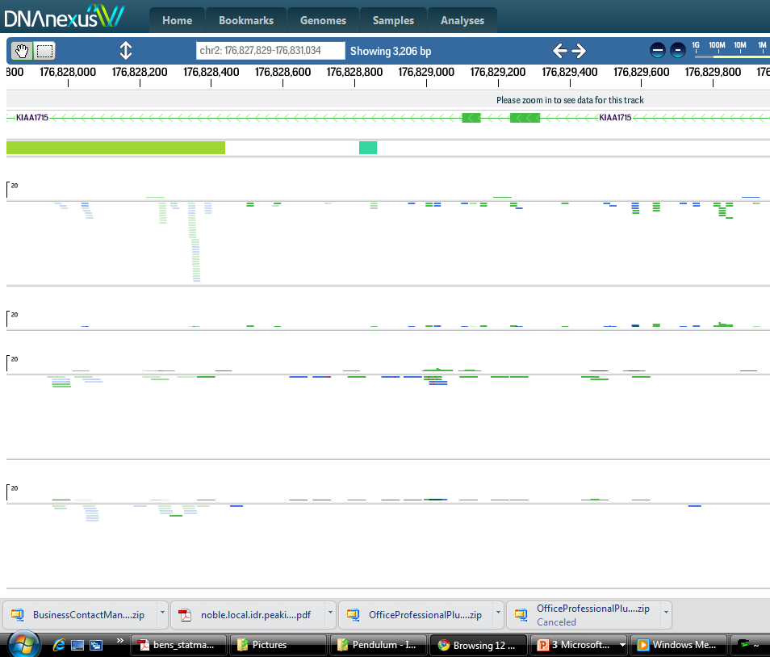
Perfect mappings
multi-mappers
non-identic mappers
Notes:
The mapping of reads is not always straight forward. Some reads appear to map to multiple loci, and some do not appear to map anywhere at all.
The ouput of *-seq assays need not be sufficient to imply a single Unique biological conclusion, but rather may provide varying levels of support for a number of possible interpretations.
In these assays, we don’t, in general, care where each read came from, rather, we attempt to infer the identify and origin of each read only as a means to an end. We are ultimately interested in drawing some sort of terminal biological conclusion, e.g. the location of transcription factor binding sites from ChIP-seq, or transcript identities and frequencies from RNA-seq, transcription start site distributions from CAGE, or patterns of nucleosome occupancy from DNase or FAIRE-seq. Statmap is all about quantifying the uncertainty associated with individual, terminal biological conclusions.

Slide 27
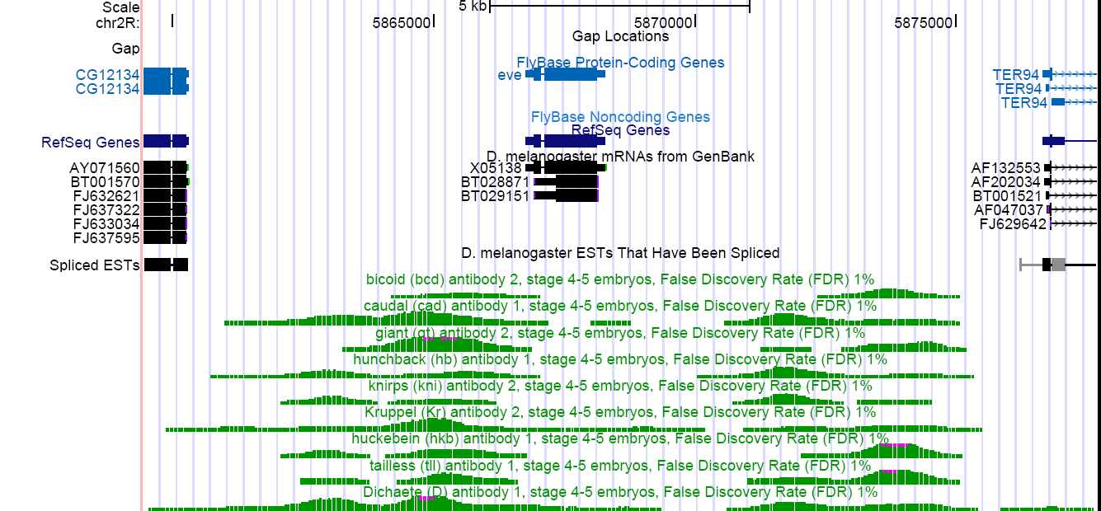
Complex statistics are computed on the mapped trace
Peaks!
Notes:
Transcription factors have complex binding patterns around target genes
In the above graphic, we see ChIP-chip data from the Biggin Lab (MacArthur et al, 2009) for several factors
The data above have been processed to reveal the significant “peaks” in the trace, and to zero regions of low signal.
For ChIP-chip data, the process of associating probe intensities to the genome was necessarily decoupled from the process of inferring regions of significant intensity, but to date the same decoupling has persisted in the analysis of ChIP-seq data.

Slide 29
toward a generic statistical framework
Candidate Mapping
Exhaustive: find every candidate mapping above some probability threshold
Correct: accurately estimate read quality scores
Parameter Estimation
Formalize assay specific knowledge
Mapping Variance
Find all “likely” mappings
Put confidence on estimated parameters
Estimate variance for a wide class of statistics
Variation
Map to non-isogenic genomes
Dynamically infer SNPs/variation

Slide 30
Statmap
Candidate Mapping
Exhaustive: find every candidate mapping above some probability threshold
Correct: accurately re-estimate base-calling error rates
Parameter Estimation
Formalize assay specific knowledge
Mapping Variance
Find ~all “likely” mappings
Put confidence on estimated parameters
Estimate variance for a wide class of statistics
Variation
Map to non-isogenic genomes
Dynamically infer SNPs/variation

Slide 31
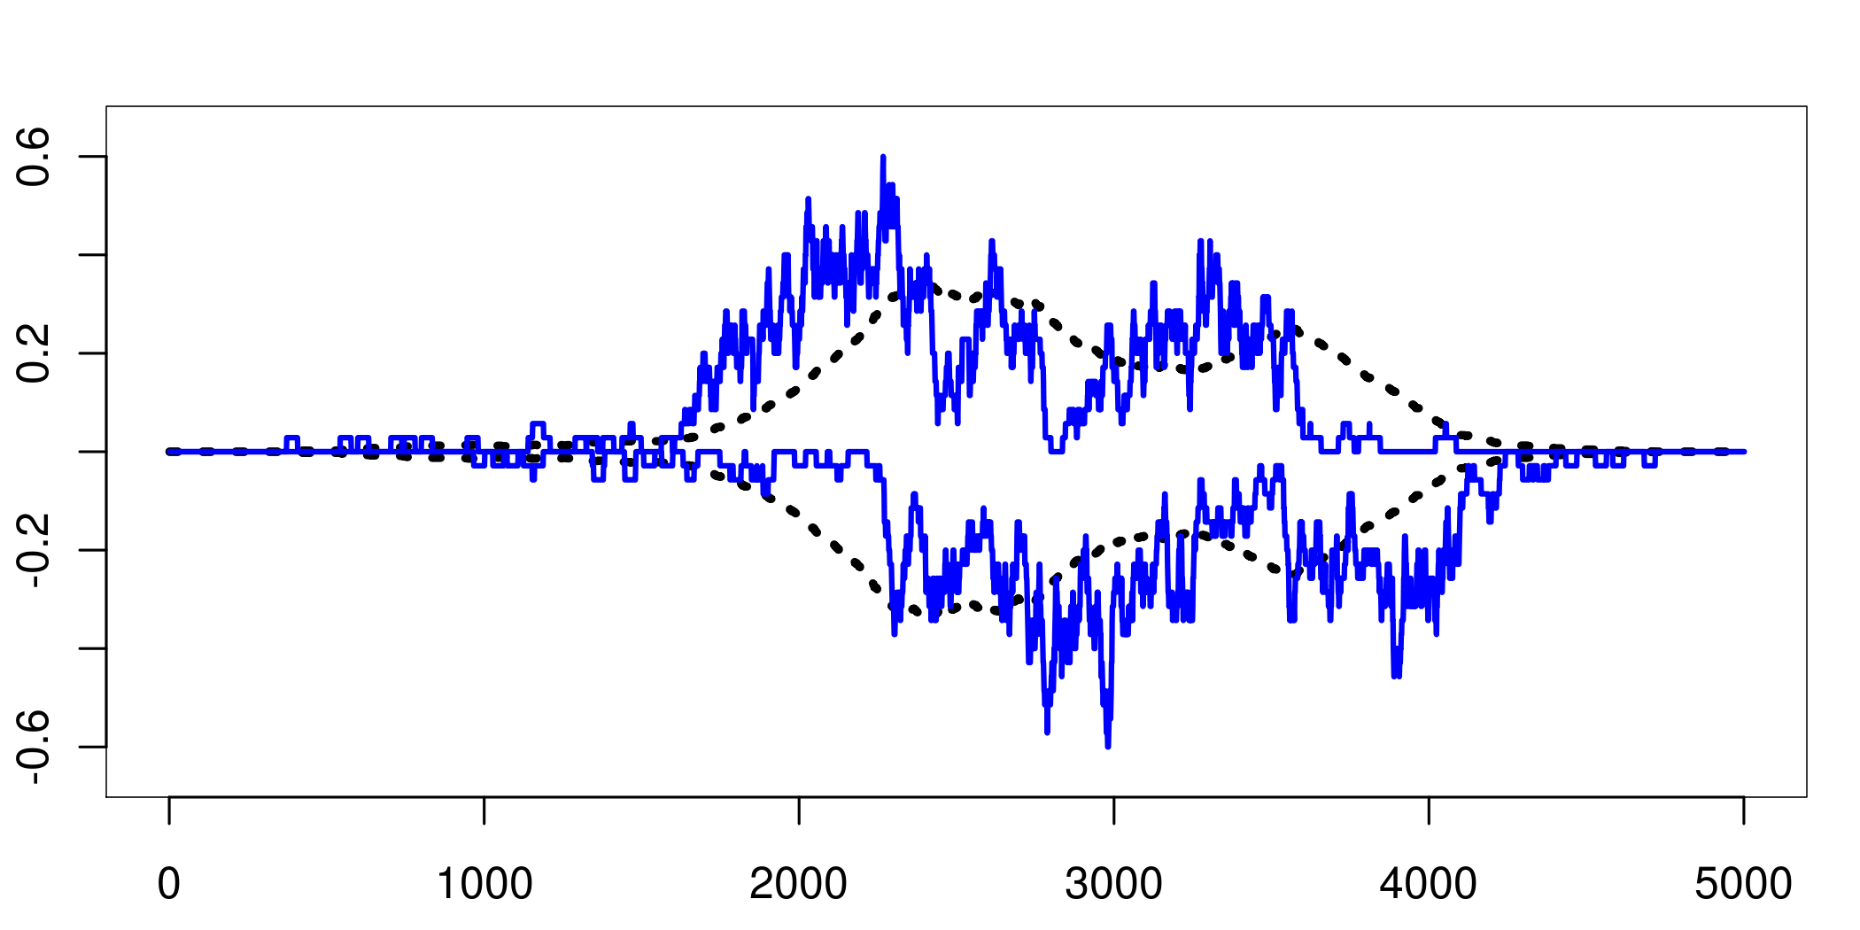
Illustrative simulation
read density after 5000 reads
+ strand
true signal density
- strand

Slide 32
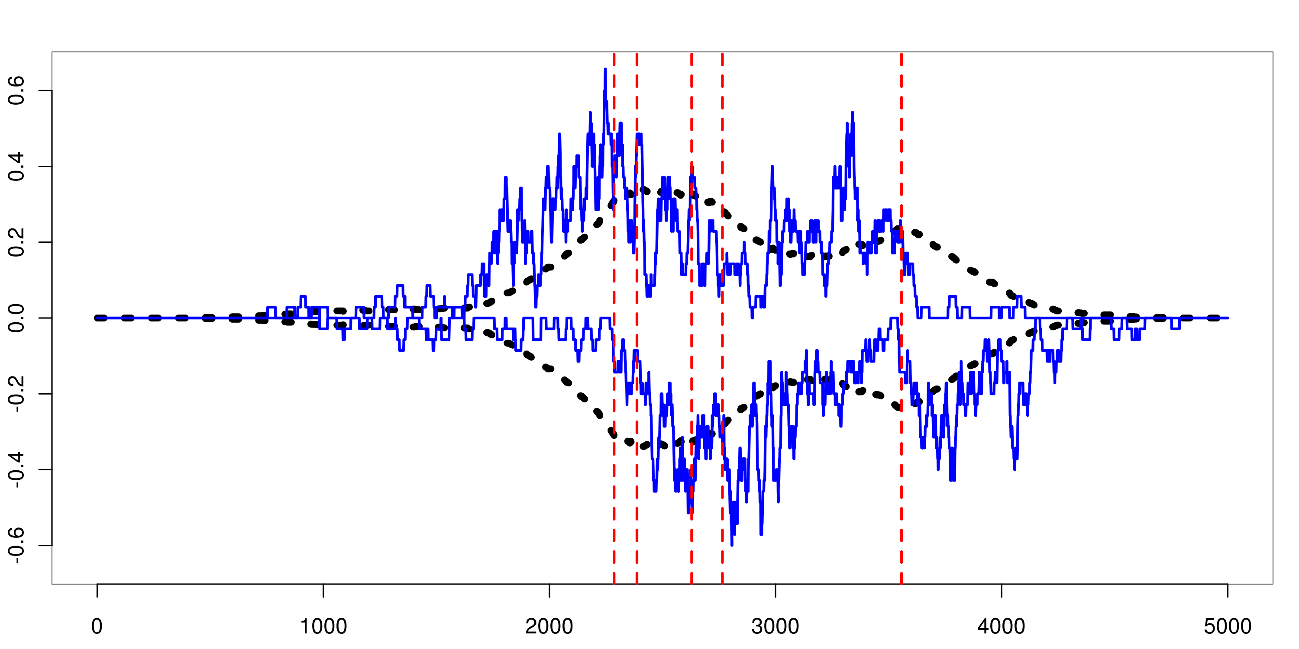
Illustrative simulation
binding sites
read density after 5000 reads
true signal density

Slide 33
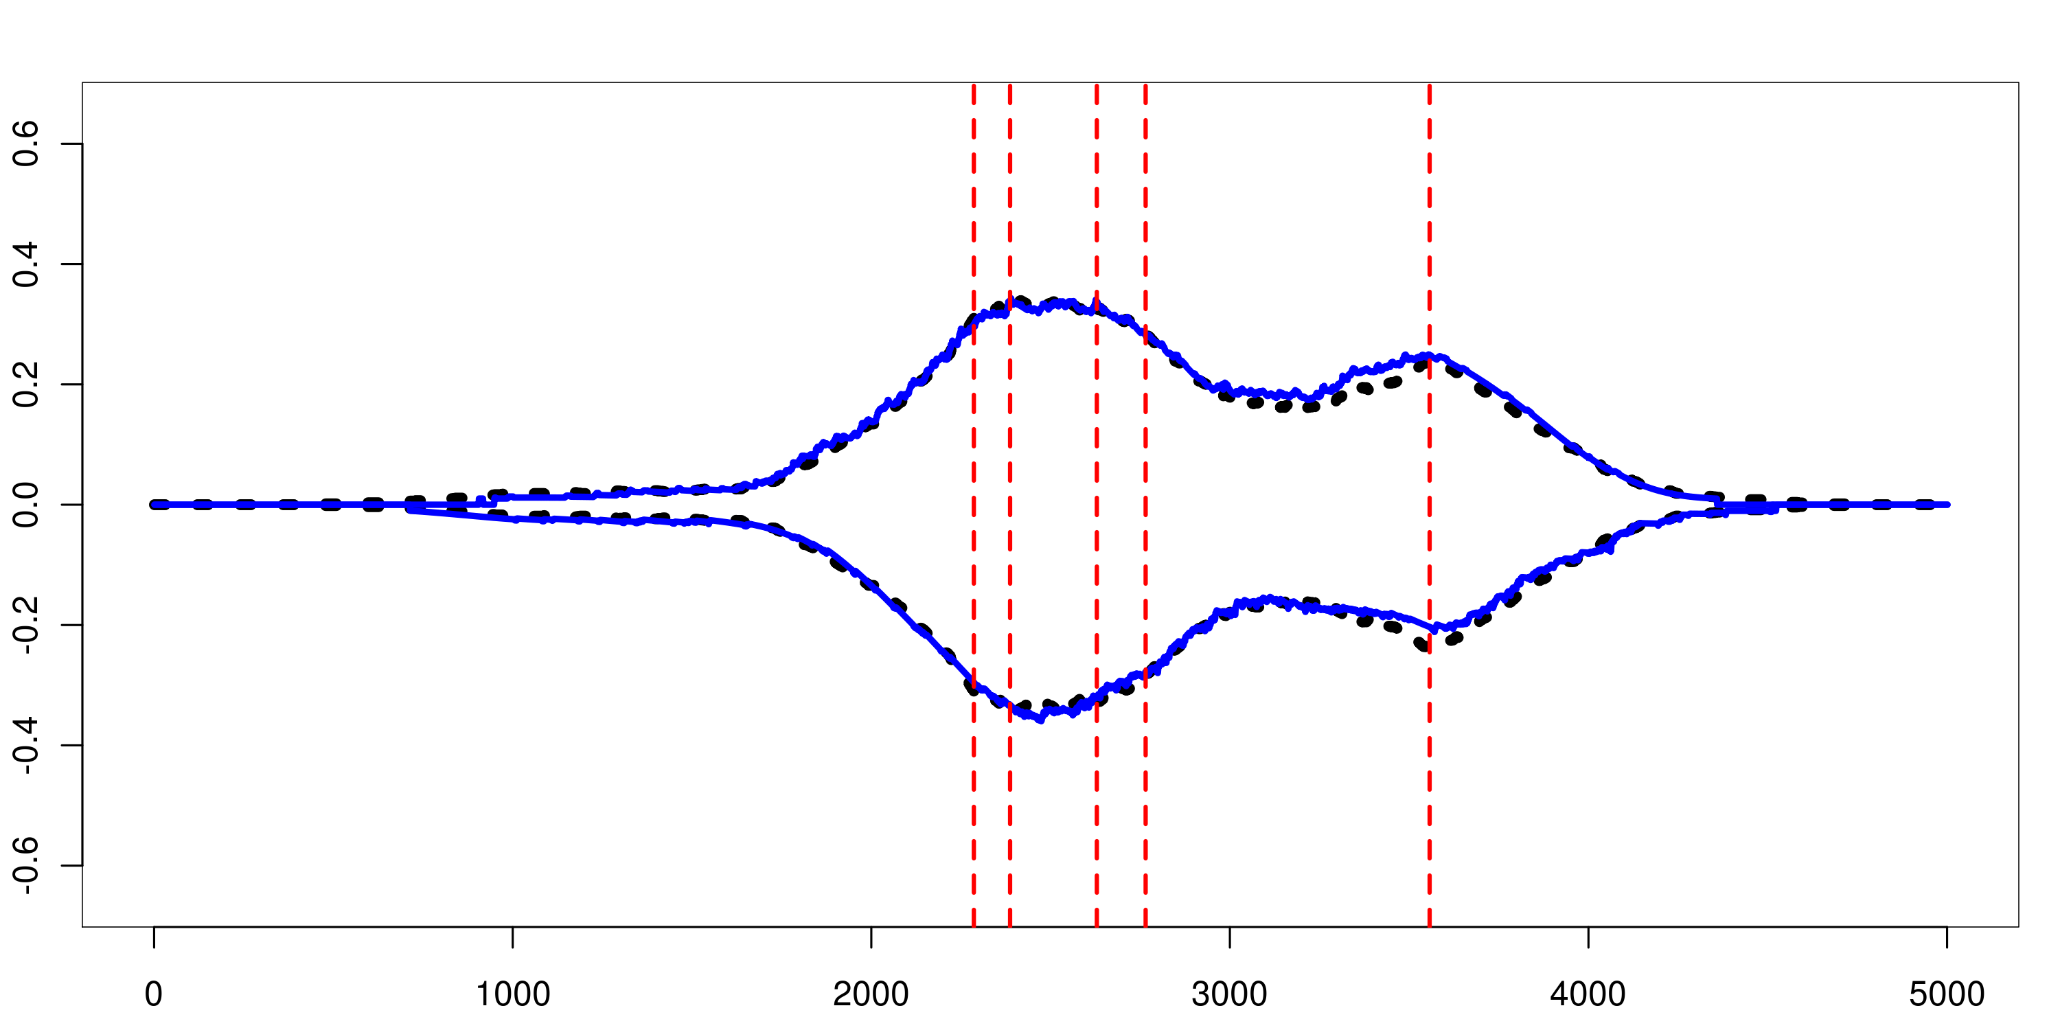
parameter estimation
“fragment density”

Slide 34
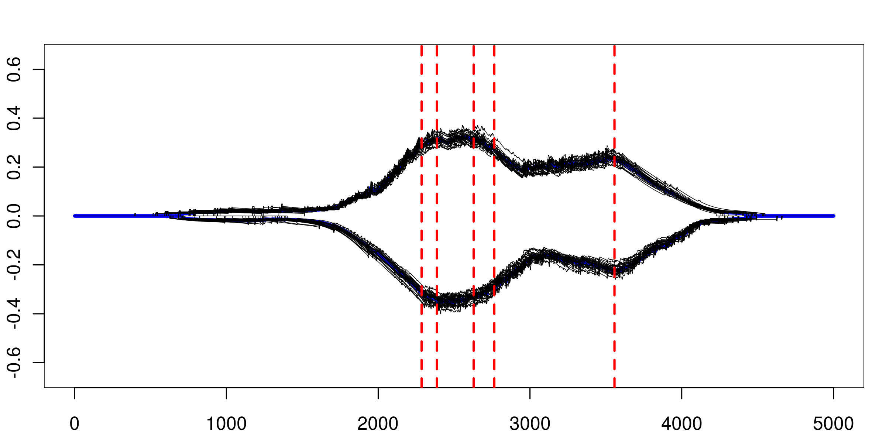
variance estimation
parametric bootstrap samples

Slide 35
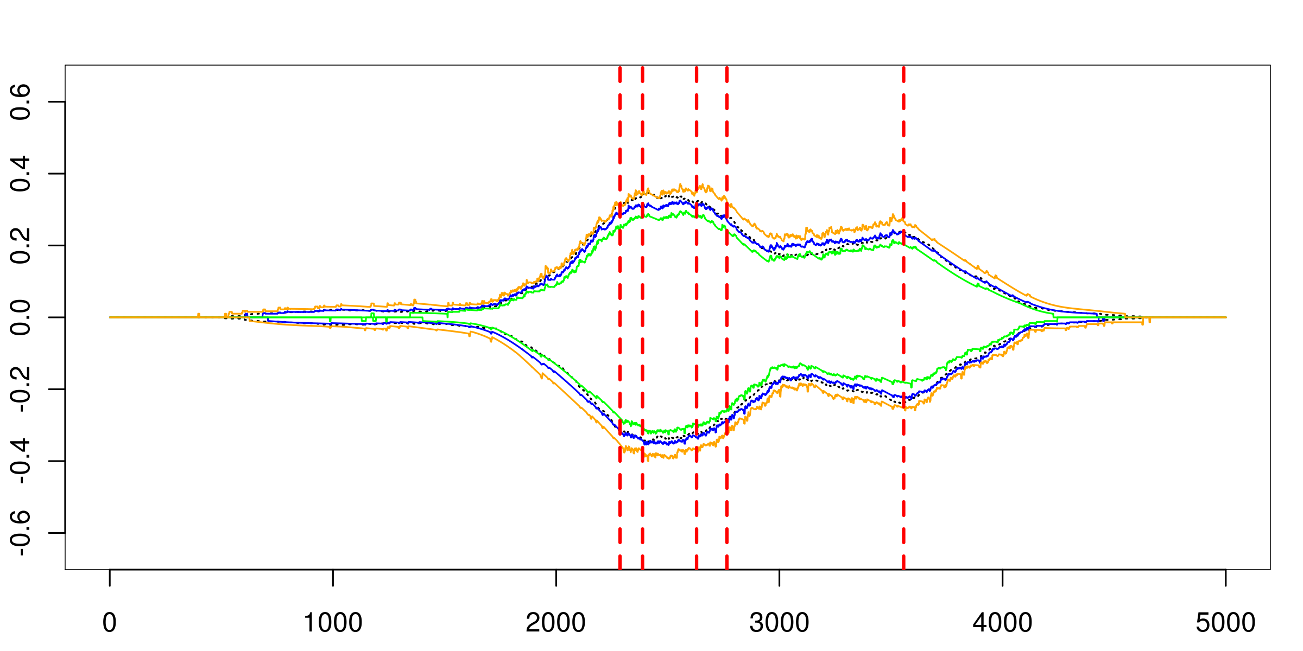
confidence bounds
empirical confidence bounds

Slide 36
What the bootstrap buys us
Place confidence bounds on fragment coverage.
More generally:
evaluate the variance of any statistic that is a function of the mapped read density by computing the statistic over all bootstrap samples
Sampling Variance

Slide 37
...and what it doesn’t
Estimates conditional on the marginal read density
when the estimated read density deviates from the truth the bootstrap estimates will be poor
When there are multiple ‘equally valid’ interpretations of an assay (mappings)
Analytical Variance

Slide 38
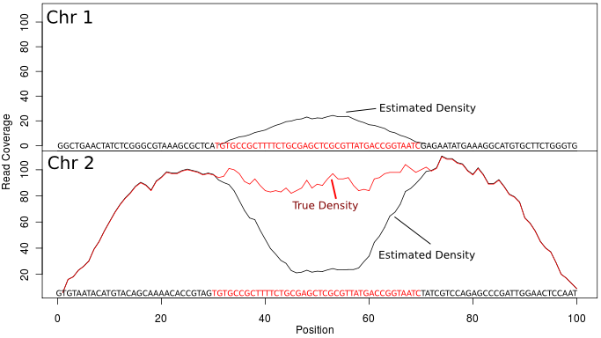
Analytical variance

Slide 39
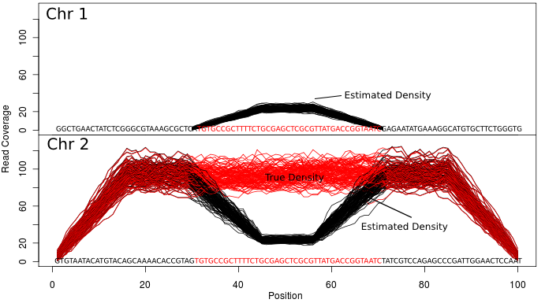
The bootstrap is condition on the marginal read density

Slide 40
Beyond the marginal read density
Assay specific knowledge
empowers us to consider dependence between reads
Notes:
Maximize the likelihood!!
We can write down the lhd, given data, the assay specific information, and the marginal read density.
Use the EM Algorithm to find a local maximum
If the likelihood has a single maximum
Use the parametric bootstrap to sample reads from the maximum likelihood estimate
Use the bootstrap estimates to assess confidence
The likelihood typically has multiple maxima
We need to do a global search for local maxima
We have developed a heuristic to find starting locations for the EM algorithm
Bootstap from each discovered local maximum

Slide 41
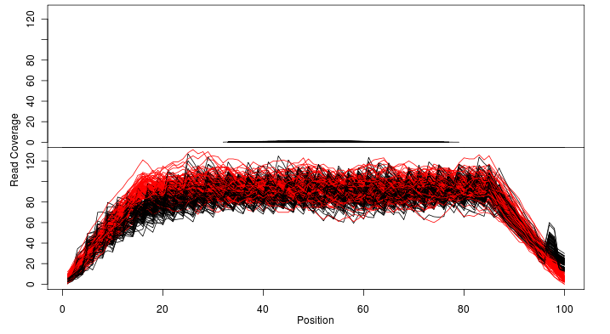
Assay specific kernels
Some reads remain (uncertainty)
most are accurately placed, and variance is accurately quantified

Slide 42
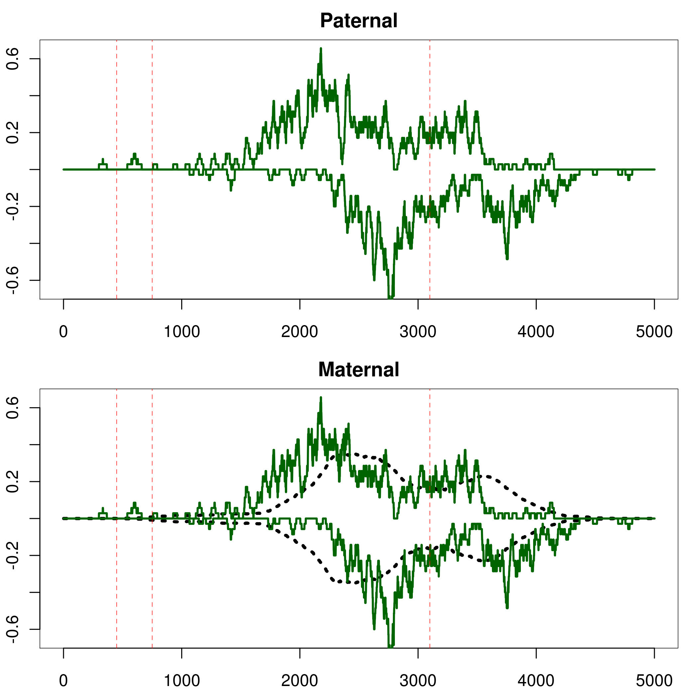
ChIP-seq in a non-isogenic background
SNPs
read density
All reads came from the maternal chromosome
true fragment density

Slide 46
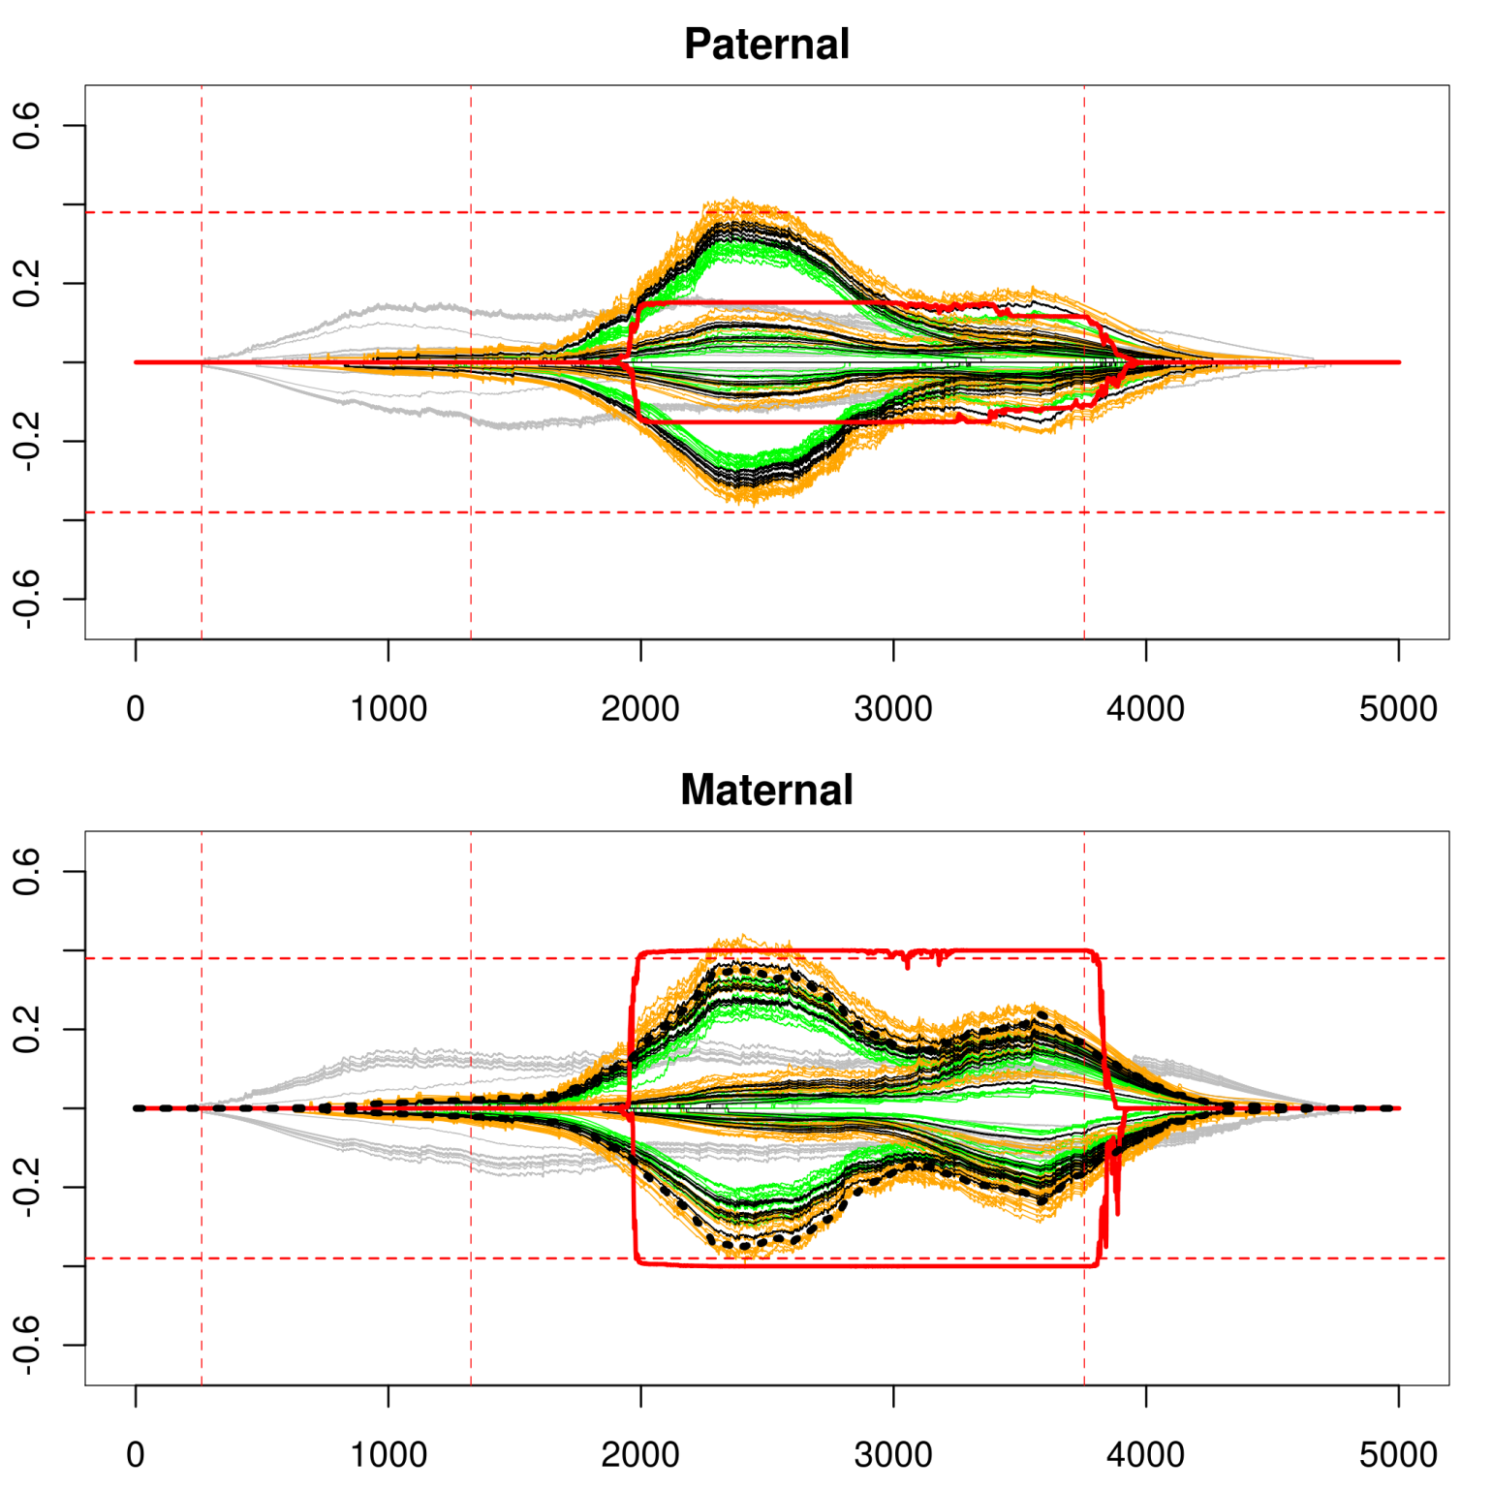

Slide 47
Confidence for any statistic: the local bootstrap + a search heuristic for likely mappings

Slide 48
CAGE: complex signal
FlyBase
CAGE
RNA-seq
(stranded)
50Kb of intergenic space
CAGE
no significant strand bias
RNA-seq (stranded)
minus strand bias

Slide 49
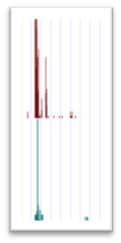
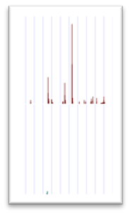
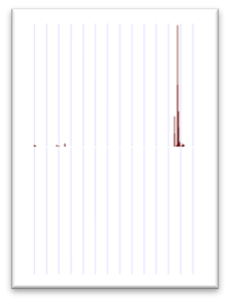
Statmapping CAGE
FlyBase
CAGE
RNA-seq
(stranded)
CAGE
peaks
RACE

Slide 50
At most 22,000 not 120,000
Failing to account for variance and background in CAGE has had consequences:
Number of active promoters in D. melanogaster embryo has been over estimated, consistently, in the literature at least 5 fold

Slide 51
A (not so) new mindset: after spending $10k+ on your assay, spend $50 to reliably interpret it on the Statmap implementation on the Amazon EC2 cluster

Slide 52
The team
Nathan Boley
Peter Bickel
Special thanks to Ewan Birney and Anshul Kundaje for many enlightening conversations

Slide 53
Questions?

Slide 54
Key concepts
$g$: a specific location in the genome
$Pr⁡[g]$: the frequency with which oligos originating at $g$ are sequenced
$Pr⁡[r|g]$: prob of observing read $r$ given that $g$ was sequenced
$\operatorname{Pr}\left[g | r\right]=\frac{\operatorname{Pr}\left[r | g\right]Pr⁡[g]}{\sum_{g′}{\operatorname{Pr}\left[r | g^{′}\right]Pr⁡[g^{′}]}}$ : assumes all reads came from the genome
EM,
M step:${Pr}_{OLD}\left[g | r\right]=\frac{{Pr}_{OLD}[g]\sum_{j=1}^{J}{π_{j}^{OLD}f_{j}\left(g|r\right)}}{\sum_{g′}{\sum_{k}{π_{k}^{OLD}f_{k}\left(g′|r\right)}}}$
E step: ${Pr}_{NEW}\left[g\right]=\sum_{r}{{Pr}_{OLD}\left[g | r\right]}Pr⁡[r]$
A likelihood function for any mapping:
$$lhd\left[\overline{r},g\right]=\prod_{r}{\sum_{g}{\operatorname{Pr}\left[r | g\right]Pr⁡[g]}}$$
assay specific kernel
Notes:
Maximize the likelihood!!
We can write down the lhd, given data, the assay specific information, and the marginal read density.
Use the EM Algorithm to find a local maximum
If the likelihood has a single maximum
Use the parametric bootstrap to sample reads from the maximum likelihood estimate
Use the bootstrap estimates to assess confidence
The likelihood typically has multiple maxima
We need to do a global search for local maxima
We have developed a heuristic to find starting locations for the EM algorithm
Bootstap from each discovered local maximum

