Slide 1
Deciphering the impact of genomic variants on coding genes
Ekta Khurana
Yale University
May 20, 2011

Slide 2
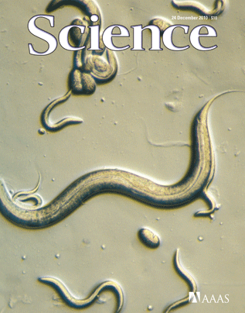
Computational Biophysics
Genomic variation
non-coding RNA prediction
Genome annotation

Slide 3
Outline
Introduction
Genomic variants
Single nucleotide polymorphisms (SNPs)
Small insertions and deletions (Indels)
Structural variants: Large deletions
Segmental duplications
Summary
Future Research

Slide 4
The Human Genome Project
Nature, Feb 2001
Science, Feb 2001
Reference human genome sequence

Slide 5
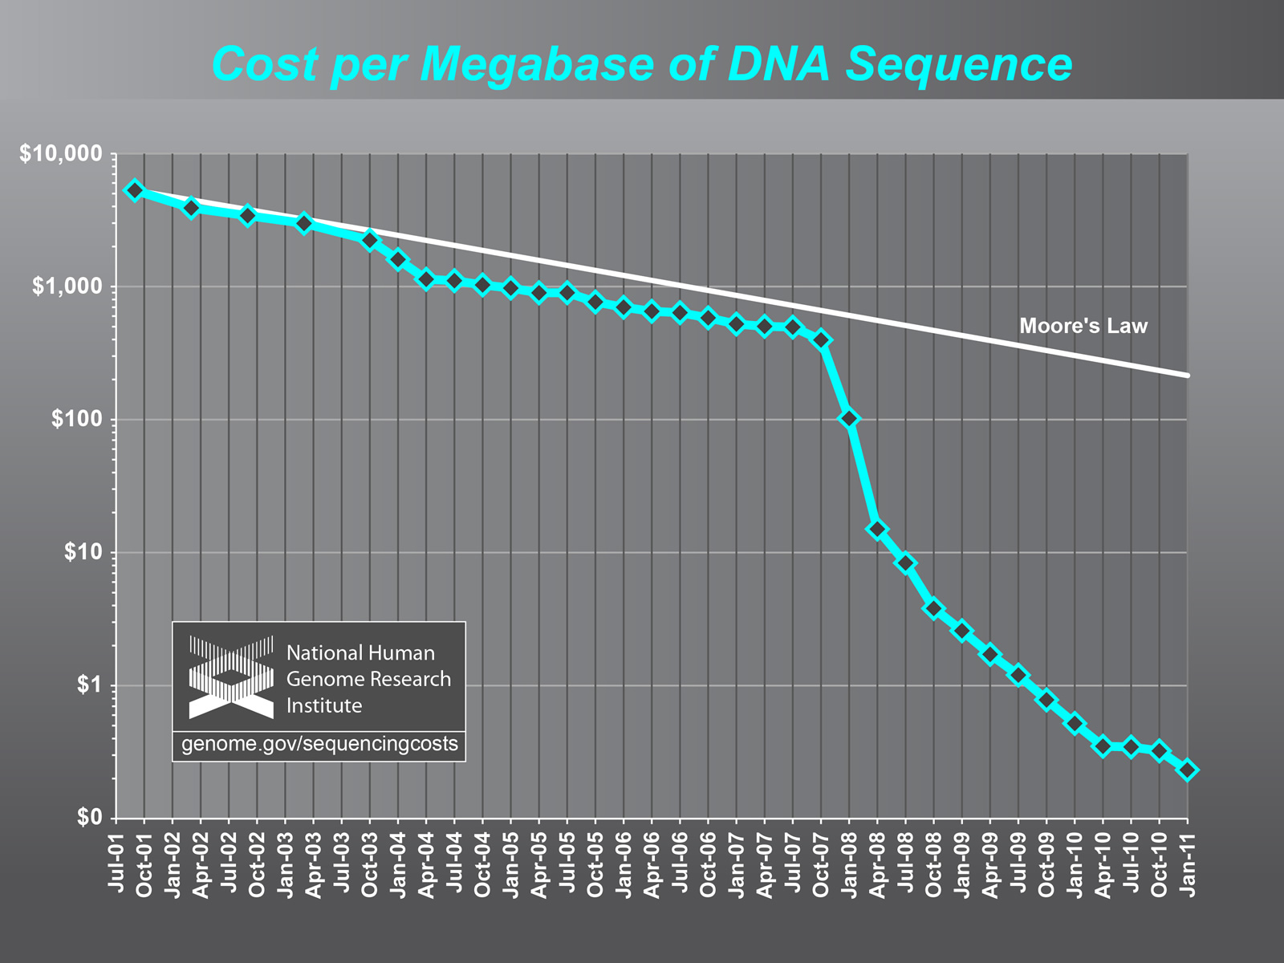
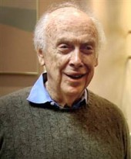
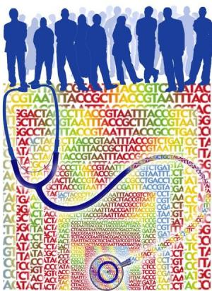
Declining sequencing costs
Genome Resequencing
Nature 2008
Nature 2010
Plos Bio 2007
Credit: Jane Ades, NHGRI
1000 Genomes Project

Slide 6
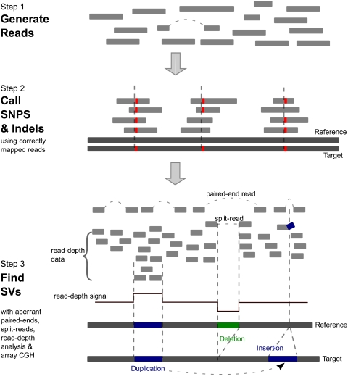
Identify variants from resequencing data
Genes Dev, 2010

Slide 7
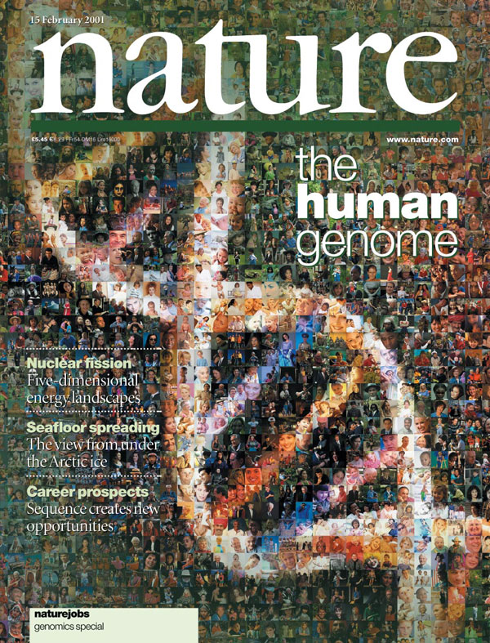
Genomic variants
Human Ref.
ATGAACTGCAATTTCCAGAAGCATGCACCCTTGGAAG - - - TCTA
ATGAACTGCAAATTCCAGAAGCATG - - - - CTTGGAAGAGTTCTA
SNP
Deletion
Insertion
Indels: Insertions and deletions from 1 to 50 bp

Slide 8
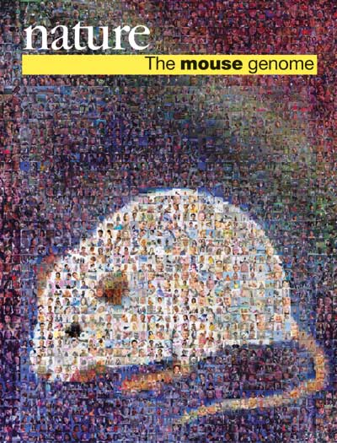
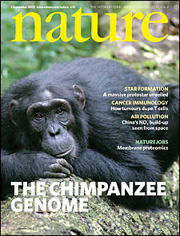
Large genomic variants: structural variation
Old duplications
Insertions w.r.t reference genome
Segmental duplications; New duplications; during primate evolution
Deletions
Inversion
Human ref.
Bailey et al, Science, 2002, 297 (1003)

Slide 9
Statistics from Human Gene Mutation database for inherited diseases
Type of variant | Number of entries
Missense/nonsense | 61,902
Splicing | 10,442
Regulatory | 1,981
Small deletions | 17,465
Small insertions | 7,226
Gross insertions/duplications | 1,511
Gross deletions | 7,202
Complex rearrangements | 1,061
Total | 108,790
www.hgmd.org

Slide 10
1000 Genomes project
Develop a catalogue of human genetic variation (no phenotypic/medical information associated with samples)
Provide reference haplotypes in different populations for disease studies
Discovery of single nucleotide variants at frequencies of 1% or higher
Variation down to frequencies of 0.5-1% in functional gene regions

Slide 11
Pilot phase
Populations
Yoruba in Ibadan, Nigeria (YRI)
Japanese in Tokyo, Japan (JPT)
Han Chinese in Beijing China (CHB)
Utah residents with Northern and Western European ancestry (CEU)
Low Coverage: (179 individuals, 3.6X coverage)
14.4 million SNPs; 1.3 million short indels; ~20,000 large SVs
High Coverage: (Two trios; 42X coverage)
5.9 million SNPs; 650,000 short indels; ~14000 large SVs
Exon sequencing: (1000 genes in 697 individuals; 56X coverage)
12,000 SNPs
Nature 2010
Nature 2011

Slide 12
Pilot phase
Populations
Yoruba in Ibadan, Nigeria (YRI)
Japanese in Tokyo, Japan (JPT)
Han Chinese in Beijing China (CHB)
Utah residents with Northern and Western European ancestry (CEU)
Low Coverage: (179 individuals, 3.6X coverage)
14.4 million SNPs; 1.3 million short indels; ~20,000 large SVs
High Coverage: (Two trios; 42X coverage)
5.9 million SNPs; 650,000 short indels; ~14000 large SVs
Exon sequencing: (1000 genes in 697 individuals; 56X coverage)
12,000 SNPs
Nature 2010
Nature 2011

Slide 13
SNPs FROM 1000 GENOMES PROJECT

Slide 14
SNPs in coding genes
An individual differs from the reference genome at an average of 10,000-11,000 non-synonymous sites
Enrichment of functional variants over synonymous SNPs in low allele frequency bins
Are most common non-synonymous SNPs functional or non-functional ?
Derived allele frequency
Nature 2010

Slide 15
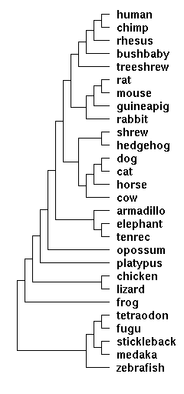
Selection pressure at coding sites
dN=number of non-synonymous substitutions per codon in alignments of orthologs
dS=number of synonymous substitutions per codon in alignments of orthologs
dN/dS < 1 (negative selection)
dN/dS = 1 (neutral selection)
dN/dS > 1 (positive selection)
Computed using phylogenetic tree and maximum likelihood approach
Yang, MBE, 2007
PAML 4

Slide 16
Selection pressure at coding sites vs SNP allele frequencies
dN/dS for sites that show SNPs higher than dN/dS for all sites
Higher allele frequency SNPs occur at sites under weaker selection pressure
Assuming neutrality implies non-functionality
Most high-allele frequency variants are non-functional
Correlation coeff=0.28
Pvalue<2.2 e-16
ALTERNATE_ALLELE_FREQ
dN/dS
Khurana et al (to be submitted)
Decreasing negative selection

Slide 17
Sites under positive selection
224 sites under likely positive selection (dN/dS >1)
Likely functional impact
Site in DARC gene. SNP causes G->D (Duffy blood group)
Site in GYPB gene. SNP causes T->M (S s blood group)
Position | dN/dS | CEU_allele_freq | YRI_allele_freq | JPTCHB_allele_freq
chr1:157441978 | 3.578 | 0.56 | 1.00 | 0.1
Position | dN/dS | CEU_allele_freq | YRI_allele_freq | JPTCHB_allele_freq
chr4:145140046 | 5.019 | 0.37 | 0.16 | 0.042
Transfusion, 2003
Notes:
PUT REFERENCE; 224 sites = ~4% of all sites that show nonsyn SNPs; Duffy antigen; SLC 24 skin pegmentation; ear wax gene

Slide 18
Indels FROM 1000 GENOMES PROJECT

Slide 19
Indels associated with diseases
A healthy individual contains on average 190-210 in-frame indels and 220-250 out-of-frame indels
17,465 small deletions and 7,226 small insertions associated with diseases in HGMD
Although many resources exist to identify disease-causing SNPs (PolyPhen, SIFT etc) no such resource exists for indels
Although most deleterious indels are out-of-frame, many in-frame indels also associated with diseases, eg Huntington’s disease
Nature 2010

Slide 20
In-frame disease-causing deletions vs deletions in healthy individuals
Evolutionary conservation of small deletions
Alignments of orthologs in 27 species
ATGCAATACC (ref. human)
ATG---TACC (human 1)
ATG---TACC (chimp)
ATGCAATACC (mouse)
ATGCAATACC (dog)
N_{i(gap)} = number of gaps
N_{i(total)} = length of deletion
n=number of orthologs
Notes:
HGMD:1781 inframe deletions

Slide 21
Small deletions that cause diseases are significantly more evolutionary conserved (pvalue<2.2e-16)
Decreasing evolutionary conservation
Khurana et al (to be submitted)

Slide 22
Gap scores vs allele frequencies
CEU
YRI
Corr coeff =0.16
Corr coeff =0.31
ALTERNATE_ALLELE_FREQ
JPTCHB
GAP_SCORE
Corr coeff =0.30
Decreasing evolutionary conservation
Deletions at evolutionary conserved sites occur at low allele frequencies
Khurana et al (to be submitted)
Notes:
Show correlation line

Slide 23
Structural variation from 1000 genomes project

Slide 24
Structural variation discovery and genotyping
~20,000 deletions and ~6000 other SVs discovered
~14000 deletions genotyped
Various approaches used for SV discovery
Mills et al, Nature, 2011

Slide 25
Population genetic properties of SVs
SVs private to populations occur at low allele frequencies
Contribution for Mills et al, Nature, 2011

Slide 26
Functional impact of SVs
Genes in high allele frequency SVs often located in segmental duplications
Significant enrichment for cell defense and sensory perception
YRI
CEU
65
52
14
170
12
30
14
CHB+JPT
Whole gene deletions

Slide 27
SEGMENTAL DUPLICATIONS AND DUPLICATED PSEUDOGENES

Slide 28
Large genomic variants: structural variation
Old duplications
Insertions w.r.t reference genome
Segmental duplications; New duplications; during primate evolution
Deletions
Inversion
Human ref.
Bailey et al, Science, 2002, 297 (1003)

Slide 29
Segmental duplications (SDs)
Regions of the genome with > 90% sequence identity and > 1kb in length
Duplicated roughly during primate evolution (~40 million years)
Comprise ~5-6% of the human genome
Enriched with genes (~17.8%)
Eichler, Nat Rev Gen, 2002
Complex architecture of SDs
Bailey et al, Science, 2002
Notes:
Purple- not targeted by HGP; golden – unique with intrachromosomal; blue- intrachromosmal; red- interchromosomal

Slide 30
Large genomic variants
Old duplications
Segmental duplications; New duplications; during primate evolution
Syntenic regions
Parent gene
Paralog
Human ref.
Pseudogene
Bailey et al, Science, 2002, 297 (1003)

Slide 31
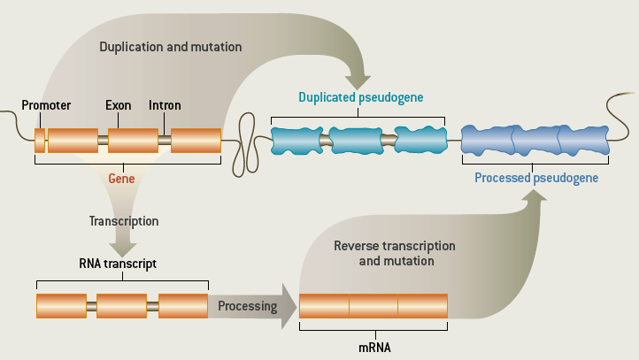
Duplicated Pseudogenes
Disablements in genes lead to loss of original protein coding function and formation of pseudogenes
Frame-shift mutation
Premature stop codon
Loss of promoter sequence
Gerstein and Zheng, 2006

Slide 32
Finding pseudogenes in the reference genome
Amino acid sequence of query proteins
Zhang et al, Bioinformatics, 2006
Six-frame blast
Remove hits overlapping exons
FASTA realignment-annotate stop codons and frameshifts
Duplicated pseudogenes
Processed pseudogenes-lack introns, possess polyA tail

Slide 33
Genomic variants also lead to loss-of- function
From 1000 Genomes data, each person is found to carry loss-of-function variants in 250-300 coding genes
Loss-of-function variants include SNPs introducing premature stop codon or splice-site disruption and frameshift indels
Genes Dev 2010

Slide 34
Association of pseudogenes with segmental duplications
Both segmental duplications (SDs) and duplicated pseudogenes are formed by the same mechanisms: block duplications in the genome

Slide 35
SDs and pseudogenes: selection pressure
Duplicating segment
Duplication
Parent gene
Pseudogene
dN/dS test to measure selection pressure
is not suitable for pseudogenes
Khurana et al, NAR, 2010

Slide 36
SDs and pseudogenes: selection pressure
Duplicating segment
Duplication
Comparison of nucleotide substitutions per site in pseudogene and larger SD block using Kimura’s two-parameter model
Parent gene
Pseudogene
Khurana et al, NAR, 2010

Slide 37
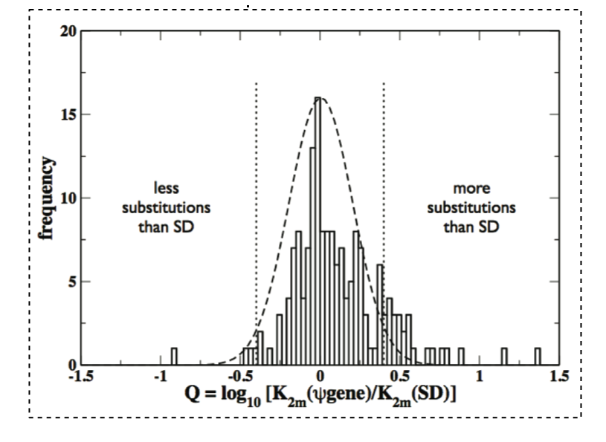
SDs and pseudogenes: selection pressure
Duplicating segment
Duplication
Comparison of nucleotide substitutions per site in pseudogene and larger SD block using Kimura’s two-parameter model
Parent gene
Pseudogene
~17% pseudogenes under selection pressure; possible functional roles
N (ψgene)< N (SD)
N (ψgene) ≈ N (SD)
N (ψgene) > N (SD)
General transcription factor, cation channel, RING finger protein, cytochrome P450
negative selection
neutral evolution
positive selection
4
139
24

Slide 38
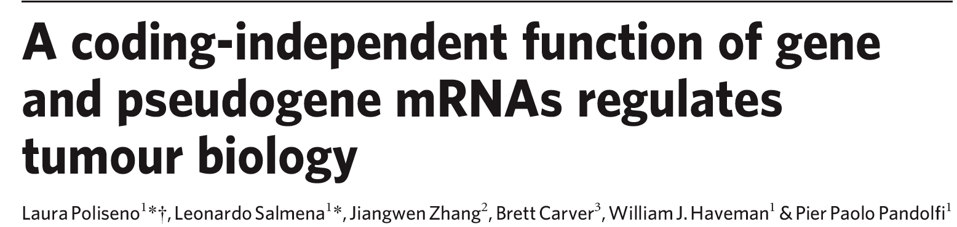
Possible functional roles of pseudogenes
Nature 2010
Nature 2008

Slide 39
SDs and pseudogenes: complex duplication architecture
Tandem duplication
Segmental duplication
841 duplicated-duplicated pseudogenes
Khurana et al, NAR, 2010
Notes:
Mark: Duplication and reduplication is complex and we can see that

Slide 40
Summary
Variants that intersect with coding genes are enriched for low allele frequencies
High allele-frequency SNPs within genes are enriched for dN/dS values close to one indicating neutral selection: most common non-synonymous SNPs in healthy individuals are non-functional
Small deletions in healthy individuals are less evolutionary conserved than those that cause diseases

Slide 41
Summary
Integration of SDs and pseudogenes reveals details of pseudogene formation
Pseudogenes under negative and positive selection; possible functional roles

Slide 42
FUTURE RESEARCH

Slide 43
More variant data will be available with main phase of 1000 Genomes project and other resequencing projects

Slide 45
P.1 Resource to identify damaging indels in coding genes
Many resources exist for SNPs (SIFT, Polyphen) but none for indels
Develop a model to predict damaging probability of candidate indels from GWAS studies
True positives: disease causing indels
True negatives: indels in healthy individuals
Set of features
Evolutionary conservation
Hydrophobicity of amino acids deleted/inserted
(lessons from SNP studies: Ng, Nat Protocol, 2009)
Allele frequencies from 1000 Genomes data

Slide 46
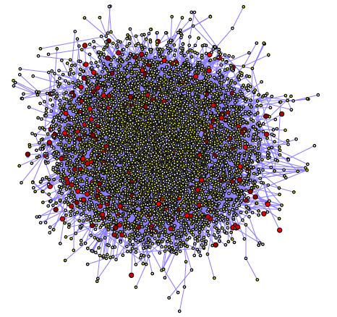
PNAS, 2007
Our results show that disease genes are connected to a higher number of proteins in the protein-protein interaction network than genes that show variation in healthy individuals.

Slide 47
Effect on protein stability at whole-genome level using algorithms for fast high-throughput computation (e.g. FoldX , NAR, 2005)
Effect on protein stability at single protein level using more rigorous algorithms (e.g. molecular dynamics simulations)

Slide 48
Acknowledgements
YALE EMBL, Germany (SVs)
Mark Gerstein, Prof Jan Korbel, Prof
Alexej Abyzov
Suganthi Balasubramanian
Chao Cheng
Yao Fu
Hugo Lam (now at Stanford)
Lukas Habegger
Xinmeng Jasmine Mu
All members of Gerstein lab
HARVARD (SVs)
Ryan E. Mills
Charles Lee, Prof
SANGER INSTITUTE, UK (Pseudogenes)
Adam Frankish
Jennifer Harrow
Funding: NIH
1000 Genomes Consortium
Notes:
BACKGROUND FIRST SLIDE; SHORTER; REVERSE THE TALK; PSEUDOGENES IN THE END; KA/KS ON PGENES WAS UNSUCCESSFUL; SVs and SDs put together; Adam: shrink SV part; pseudogenes under positive selection-what are those.
Why genes in SDs not surprising- explain; PUT CONCLUSIONS BEFORE FUTURE

Slide 49
SNP sites are enriched for higher dN/dS (KStest, Dstatistic=0.27; pvalue < 2.2e-16)

