Slide 1
Pathways & SNPs
Jieming Chen
Gerstein Lab Rotation
19th April 2011

Slide 2
Data sources
KEGG pathways → 227 pathways
CEU SNPs from 1KG → 57,457 SNPs → 14,964 genes
Ensembl → Ensembl 56, GRch37 (hg19) → dN, dS; chimp orthologs
Chong’s metabolic pathway list

Slide 3
KEGG pathways & 1KG CEU SNPs
 | # human pathways | # unique human genes in CEU 1KG that are found in the pathways | # NS genes | # S genes
metabolism | 85 | 1088 | 813 | 862
geneticInfo | 21 | 669 | 440 | 546
signaling | 16 | 1069 | 759 | 883
cellularProcesses | 14 | 878 | 636 | 725
Systems | 45 | 1560 | 1194 | 1218
Diseases | 46 | 910 | 632 | 747
Drug Dment | 0 | 0 | 0 | 0
 | 227 | 6174 | 4474 | 4981
total # unique human genes = 4093 => genes in multiple pathways
# NS+S genes = 9455 => genes can also be both NS and S

Slide 4
Ask if there is an enrichment of CEU NS genes in categories
Fisher’s exact test → # genes with NS SNPs in the category and those not in the category VS # total genes in category and those not in the category
No significance; even when without multiple hypothesis testing
Category | p-value (0.05) | Positive assoc? p-value (0.025)
Metabolic | 0.6253198 | 0.3181193
Cellular processes | 0.8373355 | 0.6017264
Genetic info | 0.06378518 | 0.9724382
Signaling | 0.4582767 | 0.779704
Diseases | 0.2440380 | 0.8856939
Systems | 0.1525428 | 0.0763678

Slide 5
Ask if there is an enrichment of CEU NS genes in individual pathways
Category | Pathway | pval (1) (greater) | pval (2) (2sided)
systems | Olfactory transduction | 0.001697 | 0.003027
signaling | ECM-receptor interaction | 0.108415 | 0.189543
diseases | Staphylococcus aureus infection | 0.198818 | 0.363251
diseases | Asthma | 0.207344 | 0.384441
signaling | ABC transporters | 0.213157 | 0.413956
systems | Protein digestion and absorption | 0.217554 | 0.413094
metab | Metabolism of xenobiotics by cytochrome | 0.219045 | 0.396462
diseases | Allograft rejection | 0.22753 | 0.407985
metab | Starch and sucrose metabolism | 0.237375 | 0.435623
diseases | Type II diabetes mellitus | 0.237375 | 0.435623

Slide 6
Ask if there is an enrichment of CEU NS genes in individual pathways
Category | Pathway | pval (1) (greater) | pval (2) (2sided)
geneticInfo | Spliceosome | 0.999342 | 0.002777
systems | Olfactory transduction | 0.001697 | 0.003027
signaling | MAPK signaling pathway | 0.956094 | 0.105653
geneticInfo | Ribosome | 0.966601 | 0.110505
diseases | Systemic lupus erythematosus | 0.953541 | 0.119114
diseases | Shigellosis | 0.943515 | 0.171401
signaling | ECM-receptor interaction | 0.108415 | 0.189543
signaling | Wnt signaling pathway | 0.923565 | 0.193841
cellular | Cell cycle | 0.882526 | 0.280309

Slide 7
Comparing NS and S genes Systems

Slide 8
Comparing NS and S genes Genetic Info

Slide 9
Comparing NS and S genes Diseases

Slide 10
Comparing NS and S genes: Metabolic

Slide 11
Ask if there is a correlation between the “importance” of genes and the dN/dS values
Data source: all unique genes in the human pathways and those that have chimp orthologs.
“Importance” is defined by the number of pathways the gene is involved in.
Spearman correlation rho = -0.0586; p-value = 3.16E-09

Slide 12
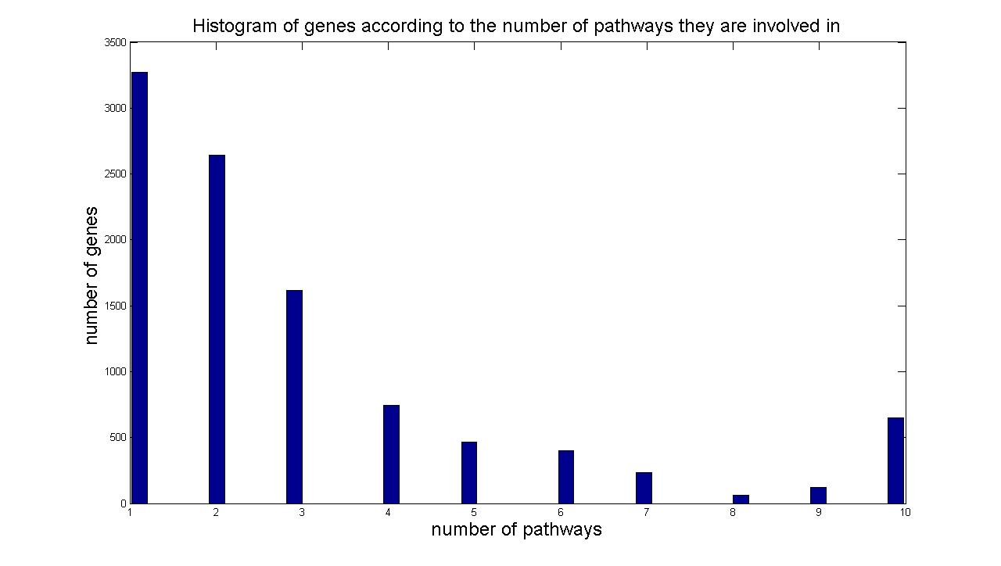
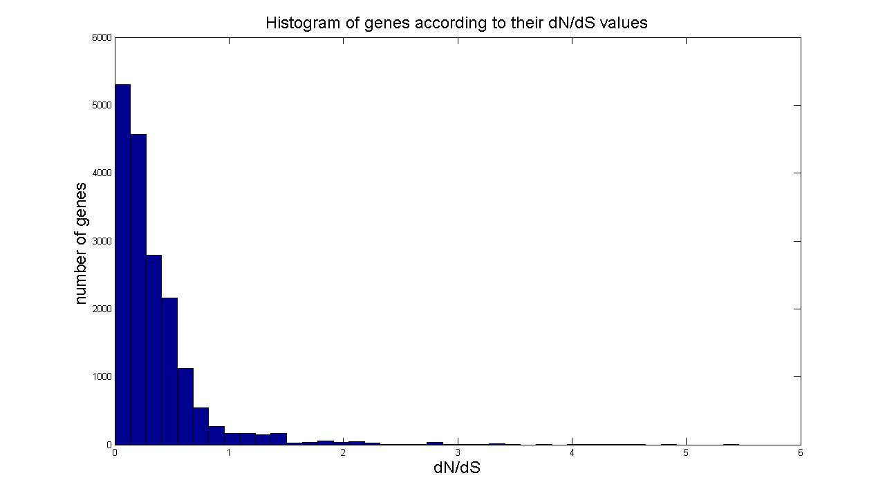
Ask if there is a correlation between the “importance” of genes and the dN/dS values

Slide 13
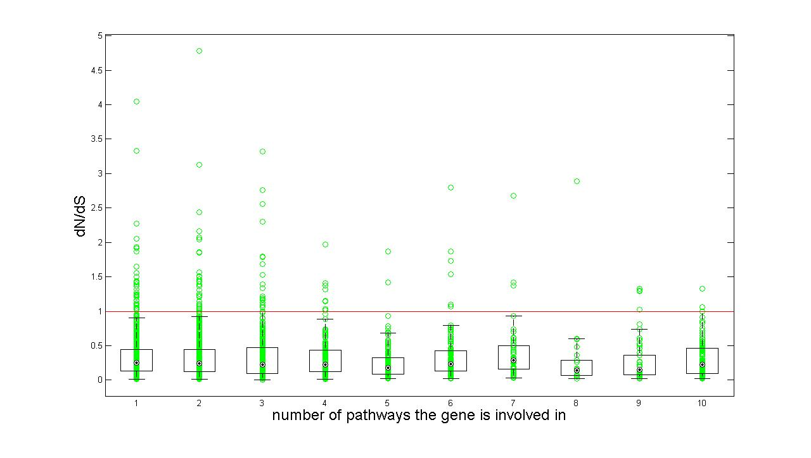
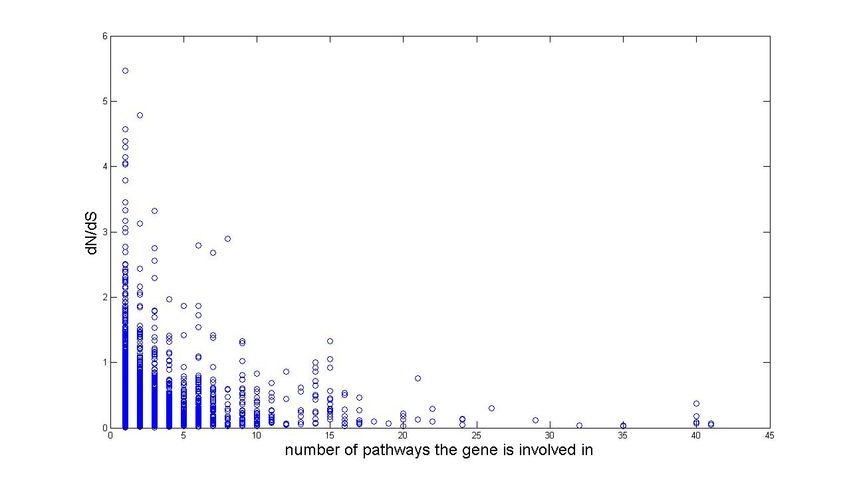
Ask if there is a correlation between the “importance” of genes and the dN/dS values
Sodium/potassium-transporting ATPase gamma chain
Myc proto-oncogene protein (c-Myc)(Transcription factor p64) Interleukin-6 Precursor (IL-6)(B-cell stimulatory factor 2)
Interferon alpha-17 Precursor

Slide 14
Involved in # of pathways | Genes
7 | Low affinity immunoglobulin gamma Fc region receptor III-a ICAM-1 (Major group rhinovirus receptor)(CD54 antigen) Pyruvate kinase isozymes
6 | Low affinity immunoglobulin gamma Fc region receptor II-a Interleukin-3 Precursor (IL-3) Bile acid-CoA:amino acid N-acyltransferase Cytochrome P450 4A22 Precursor Gamma-glutamyltransferase 6 Precursor Aldose reductase
5 | NADH dehydrogenase [ubiquinone] 1 alpha subcomplex subunit 5 Complement C1q subcomponent subunit A Precursor

Slide 15
Pairwise comparison of cumul. distrib. of dN/dS in the pathways using KS test
pathway1 |  |  | pathway2 | KS p-value
Toll-like receptor signaling pathway | systems | Porphyrin and chlorophyll metabolism | Metabolism | 2.73E-05
Allograft rejection | disease | Olfactory transduction | systems | 3.61E-05
Base excision repair | genetic | Nicotinate and nicotinamide metabolism | Metabolism | 4.62E-05
Melanoma | disease | Nicotinate and nicotinamide metabolism | Metabolism | 6.04E-05
Viral myocarditis | disease | Olfactory transduction | systems | 6.68E-05
Epithelial cell signaling in Helicobacter | disease | Porphyrin and chlorophyll metabolism | Metabolism | 7.24E-05
Olfactory transduction | systems | Antigen processing and presentation | systems | 7.50E-05
Allograft rejection | disease | Osteoclast differentiation | systems | 8.15E-05
Autoimmune thyroid disease | disease | Olfactory transduction | systems | 8.66E-05
Nucleotide excision repair | genetic | Nicotinate and nicotinamide metabolism | Metabolism | 9.15E-05
MAPK signaling pathway | signaling | Porphyrin and chlorophyll metabolism | Metabolism | 9.79E-05
pathway1 |  |  | pathway2 | KS p-value
Toll-like receptor signaling pathway | systems | Porphyrin and chlorophyll metabolism | Metabolism | 2.73E-05
Allograft rejection | disease | Olfactory transduction | systems | 3.61E-05
Base excision repair | genetic | Nicotinate and nicotinamide metabolism | Metabolism | 4.62E-05
Melanoma | disease | Nicotinate and nicotinamide metabolism | Metabolism | 6.04E-05
Viral myocarditis | disease | Olfactory transduction | systems | 6.68E-05
Epithelial cell signaling in Helicobacter | disease | Porphyrin and chlorophyll metabolism | Metabolism | 7.24E-05
Olfactory transduction | systems | Antigen processing and presentation | systems | 7.50E-05
Allograft rejection | disease | Osteoclast differentiation | systems | 8.15E-05
Autoimmune thyroid disease | disease | Olfactory transduction | systems | 8.66E-05
Nucleotide excision repair | genetic | Nicotinate and nicotinamide metabolism | Metabolism | 9.15E-05
MAPK signaling pathway | signaling | Porphyrin and chlorophyll metabolism | Metabolism | 9.79E-05

Slide 16
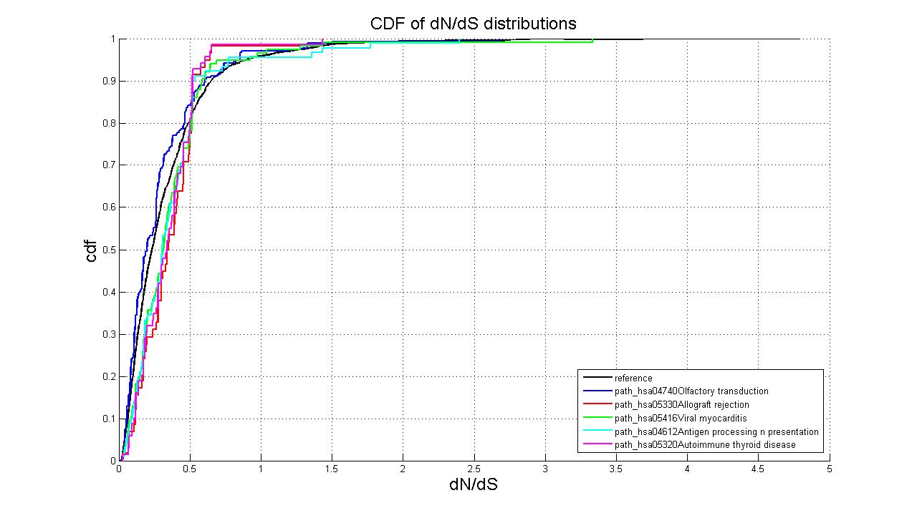
Cumul. distrib. of dN/dS in the pathways → Pairwise VS ‘reference’ CDF

Slide 17
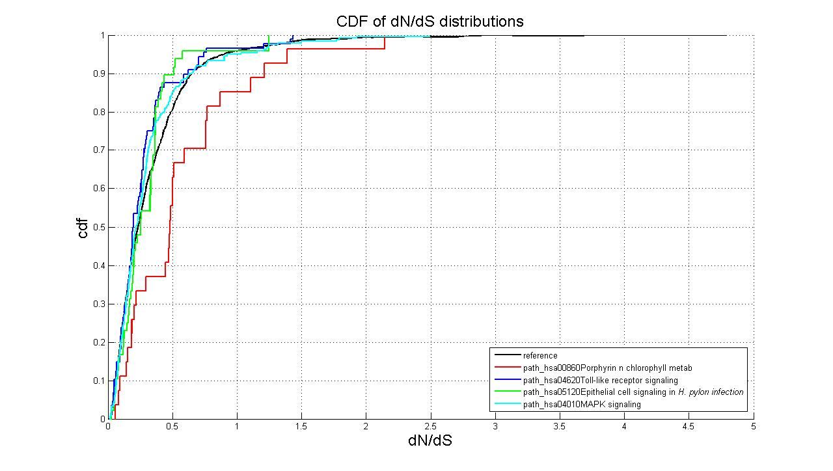
Cumul. distrib. of dN/dS in the pathways → Pairwise VS ‘reference CDF’

Slide 18
Cumul. distrib. of dN/dS in the pathways → with respect to ‘reference CDF’
pathway |  | KS p-value (unequal) | KS p-value (smaller)
Porphyrin and chlorophyll metabolism | Metabolism | 0.000358877 | 0.000179439
Nicotinate and nicotinamide metabolism | Metabolism | 0.001443047 | 0.000721523
Allograft rejection | disease | 0.001943053 | 0.000971527
PPAR signaling pathway | systems | 0.001989441 | 0.00099472
Viral myocarditis | disease | 0.003968424 | 0.001984212
Autoimmune thyroid disease | disease | 0.004868376 | 0.002434188
Antigen processing and presentation | systems | 0.005133211 | 0.002566606
Homologous recombination | genetic | 0.010818328 | 0.005409165
Type I diabetes mellitus | disease | 0.013161277 | 0.00658064
GnRH signaling pathway | systems | 0.014954023 | 0.007477015
Intestinal immune network for IgA | systems | 0.015431353 | 0.00771568
Olfactory transduction | systems | 0.018357976 | 0.733045964
Purine metabolism | Metabolism | 0.019961953 | 0.009980986
Base excision repair | genetic | 0.023316597 | 0.879466271
Oocyte meiosis | cellular | 0.024032305 | 0.012016173
Biotin metabolism | Metabolism | 0.028961421 | 0.83932774

Slide 19
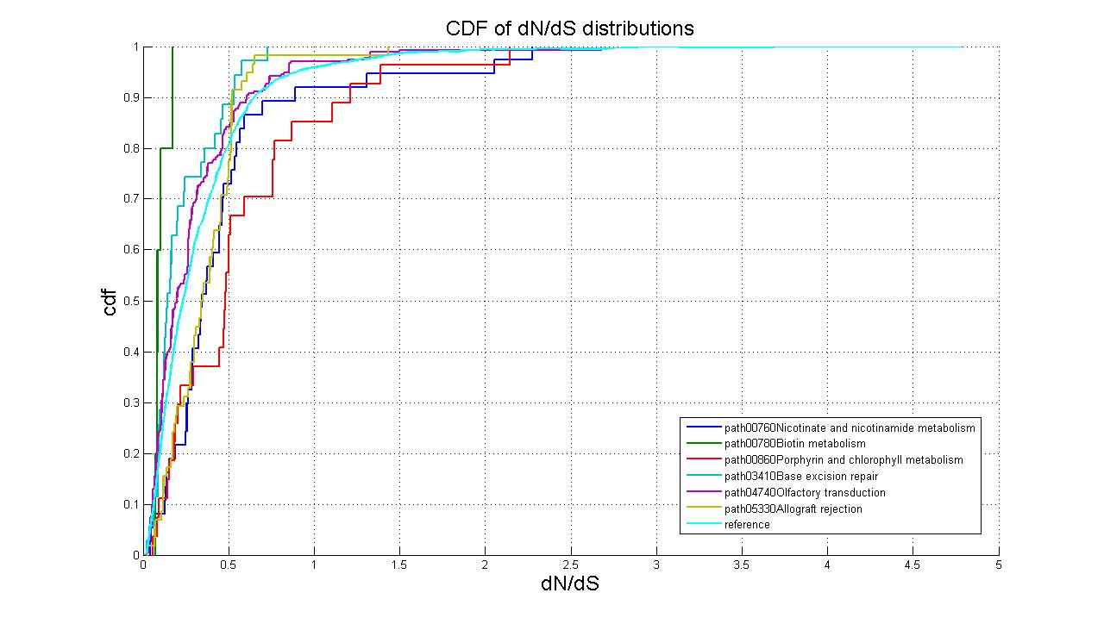
Cumul. distrib. of dN/dS in the pathways → with respect to ‘reference CDF’

Slide 20
Metabolic pathways
Upstream_Enzyme Downstream_Enzyme
ENSP00000416583 ENSP00000380068
ENSP00000416583 ENSP00000363988
ENSP00000416583 ENSP00000280605
ENSP00000380068 ENSP00000363988
ENSP00000363988 ENSP00000387123
1KG CEU SNPs
Chr 12-16002498 (SNP position on gene)
ENSP00000416583 G>A Nonsynonymous
Chr12-16004043
ENSP00000416583 C>T Synonymous
…
http://www.genome.jp/kegg-bin/show_pathway?map00620
NA10001
NA10010
NA10100

Slide 21
Ask the probability/frequency of co-occurrence
‘Co-occurrence’
→ adjacency; immediate upstream-downstream relationship
Upstream enzyme | Downstream enzyme
1) NS homozygous 2) NS heterozygous | 1) N/A (0|0) 2) Synonymous 3) NShomo 4) NShetero 5) PShomo 6) PShetero 7) RShomo 8) RShetero
Genotype | NA | synony | nonsynon | removedS | prematureS
00 | n | n | n | n | n
10 | n | s | nshetero | rshetero | pshetero
01 | n | s | nshetero | rshetero | pshetero
11 | n | s | nshomo | rshomo | pshomo

Slide 22
Ask the probability/frequency of co-occurrence: NS
Total number of unique pairs = 7618
Upstream-downstream pairs | # that has at least one individual
Nshomo>nshomo | 1072
Nshomo>nshetero | 1726
Nshetero>nshomo | 1614
Nshetero>nshetero | 3015

Slide 23
Preliminary conclusions
Ask if there is an enrichment of CEU NS genes in categories of pathways → No.
Ask if there is an enrichment of CEU NS genes in individual pathways → If we do not consider multiple testing corrections, there are some significant ones, notably olfactory transduction pathway and spliceosome formation pathway.

Slide 24
Preliminary conclusions
Slight negative correlation between dN/dS values and “importance” of genes → “importance” defined by number of pathways the gene is implicated → showing that “important” of genes are slightly more negatively selected.
Some of the “important” genes/proteins have high dN/dS are environment-interacting → e.g. immune system related proteins such as interleukins, immunoglobulin receptors
BUT → implication does not necessarily mean “heavy involvement” in the pathways → “heavy involvement” does not equate “essentiality”

Slide 25
Preliminary conclusions
Ask if how the dN/dS distributions differ in the pathways with respect to the entire dN/dS distribution → Olfactory transduction pathway has more genes with low dN/dS values (shifted left); seems to contradict to results in enrichment of NS → Seeming depletion of significant pathways from genetic processes and signaling pathways. → Pathways implicated in the immune system seem to have distribution shifted towards higher dN/dS (right).
Notes:
Caveat here is that there was no mutiple testing correction of enrichment of NS

Slide 26
Possible future directions
Normalize the number of genes to the number of genes in the pathway to give the frequency of NS genes.
Possibility of implementing a hierarchy in the pathways?
Redefining ‘co-occurrence’ (‘adjacency matrix’)
The notion of “gene importance” (in a pathway) can be redefined, depending on metric that can used to characterize pathways.

Slide 27
Possible future directions
Compare across the other 3 populations YRI, CHB, JPT and possibly other populations
To see if there are similar trends in correlation
To see if the significant pathways are also showing the comparable significance
Possible cultural, geographical, historical influence on populations’ heterogeneity or similarity.
Compare dN/dS across different species
→ Quasi-longitudinal (evolutionary time)/latitudinal (geography) map?

Slide 28
Acknowledgements
Everybody for lots of helpful discussions and inputs
Specifically,
Ekta
Chong and Chao
Mark

