Slide 1
Cancer Network Dysregulation
Pre-qualifying meeting
Lucas Lochovsky
Gerstein Lab
CBB, Yale University
April 23, 2011
Notes:
Good afternoon, and welcome to my pre-qualifying meeting. This presentation is based on my pre-prospectus research ideas involving cancer network dysregulation.

Slide 2
Outline
From Cancer Genomes to Cancer Networks
Study of Genomic Aberration Tracks using Signal Track Analysis
Computational Tools for Cancer Genome Research
Reading Topics
Notes:
Here is an outline of the material I will be talking about, covering the major domains of my research plan.

Slide 3
Outline
From Cancer Genomes to Cancer Networks
Study of Genomic Aberration Tracks using Signal Track Analysis
Computational Tools for Cancer Genome Research
Reading Topics
Notes:
First, I’m going to cover my research plans involving cancer networks.

Slide 4
The Network Perspective
Most studies focused on identifying genes aberrant in cancer
What influence do these aberrant genes have on biological networks?
  Metabolic pathways
  Protein complexes
  Signalling cascades
What genes disrupted by cancer correspond to important players in biological networks?
Notes:
The key aspect of this work is that I’m bringing a network perspective to studying the disruptions caused by cancer. Many published studies describe genes that have demonstrable disruption in cancer cells, through sequence mutation, abnormal regulation, and other aberrations. What I want to answer is how these aberrant genes affect larger entities in the molecular mix, such as metabolic pathways, protein complexes, and signalling cascades. I would like to find which of these genes have important roles to play in these networks, and how the individual gene disruptions affect how the entire network operates.

Slide 5
Definitions
Cancer genome c
  type(c)
  subtype(c)
  M(c): The set of mutations in c
Mutation m
  gene(m): The set of genes affected by m
  type(m): Is this mutation a substitution, insertion, amplification, deletion, rearrangement, or SNP? Which genomic coordinates are affected?
Notes:
So first, we need to establish the datatypes I’ll be working with. At the broadest level, I will be looking at cancer genomes, which have three important attributes. For a cancer genome c, the cancer’s type is determined by the tissue that the cancer originated in. Given that tumor cells can develop heterogeneously, the subtype attribute exists to differentiate between different variants in a heterogeneous tumor. Finally, there is the set of sequence mutations in cancer genome c, which I will refer to as M of c. A single mutation m has two attributes. gene(m) is the set of genes affected by m, and type(m) provides the type of mutation, describing how exactly the basepairs are affected, and placing exactly where in the genome this occurred.

Slide 6
Cancer Mutation Networks
Let G(c) be the set of all genes affected by the mutations in M(c)
Start with networks N = (V, E) that capture relationships between genes, and contain all the genes of G(c) (or at least a significant subset of G(c))
  Interacting proteins
  Transcription factor-target gene relationships
W⊆V is the set of nodes in V that correspond to the genes of G(c). Attributes that describe the mutations that affect these genes will be added to this network, creating a Cancer Mutation Network
Notes:
Now taking this to the network level means we need the set of all genes affected by mutations in cancer genome c, and a biological network that includes this gene set, so we can study these genes’ relationships. The data for this network will come from various established databases and data repositories that have relevant network data such as lists of interacting proteins, and transcription factor-target gene pairs. With a network N, we identify the set of nodes W that correspond to the mutated genes G of c, and we will add attributes that flag them as mutant genes.

Slide 7
Cancer Mutation Networks
Attributes added to each w∈W:
  type(c): Indicates the type of cancer in which w is disrupted
  subtype(c): Indicates the subtype of cancer in which w is disrupted
  type(m): The type of mutation that w is affected by
Each w will have one value for type(m)
If w is affected by multiple mutations, then define a new compound mutation type that represents the intersection of multiple simple mutation types
  E.g. If a gene is affected by both an amplification and a deletion, then define “ampdel” as the intersection of an amplification and a deletion
Notes:
These attributes will indicate the type of cancer in which the given gene is disrupted, the subtype of cancer in which the gene is disrupted, and the type of mutation that affects that gene. My current intention is that each mutated gene will have exactly one value for mutation type. In scenarios where a mutated gene is affected by multiple mutations, then a new, compound mutation type will be defined that represents the intersection of multiple simple mutation types. For example, if a gene was affected by both an amplification and a deletion, then define “ampdel” as the intersection of an amplification and a deletion, and use that as the mutation type.

Slide 8
Network Analyses
Use network context of disrupted genes to realize novel insights in cancer function
  Hubs (high-degree nodes)
  GO enrichment of hubs (i.e. determine functional enrichment of hubs)
  Bottlenecks (nodes through which many shortest paths between nodes in N pass)
  GO enrichment of bottleneck neighborhood
    Find functional significance of genes that communicate through the bottleneck
  Find network motifs conserved between different cancer types and subtypes
  “Interologs” and “regulogs”
Notes:
With the establishment of mutated genes in the network, we can study how the disrupted genes affect the network. These analyses include investigating which of the disrupted genes are network hubs, or have a high number of connections, and what their functional significance is. We can also look at network bottlenecks, which we measure based upon how many shortest paths between pairs of nodes in N pass through a given node. These bottlenecks may serve as important interaction interfaces between multiple modules or pathways. To that end, studying the functional significance of genes in a bottleneck’s neighborhood would be helpful for finding what modules are interacting through the bottleneck. We can also look for network motifs conserved between different cancer types and subtypes using graph matching algorithms. Finally, we could investigate these networks for conserved interactions or conserved regulatory relationships, or “interologs” and “regulogs”, respectively, which can serve as another means by which we can distinguish between different cancers.

Slide 9
Initial results
Prostate cancer genes: From Rubin-Gerstein papers
  87 gene signature associated with TMPRSS2-ERG fusion
  List of recurrent lesions in primary prostate cancer in Demichelis 2009¹
  ETS genes¹
Map these genes onto a protein-protein interaction network
  HPRD (hprd.org) release 9
  Cytoscape 2.6 (www.cytoscape.org) for organizing and visualizing network data
Investigate the network properties of these genes
  CytoHubba plugin (http://hub.iis.sinica.edu.tw/cytohubba/) used to calculate centrality measures on HPRD
    Degree: Number of edges incident on each node
  GO enrichment of hubs (using the BiNGO plugin)
    http://www.psb.ugent.be/cbd/papers/BiNGO/Home.html
  Highly Interconnected Clusters (using the MCODE plugin)
    http://baderlab.org/Software/MCODE
¹F. Demichelis et al., others, “Distinct genomic aberrations associated with ERG rearranged prostate cancer,” Genes, Chromosomes and Cancer 48, no. 4 (2009): 366–380.
Notes:
So I’ve already begun working with lists of prostate cancer genes that have been studied in recent Gerstein lab work done in collaboration with the lab of Dr. Mark Rubin at the Weill Cornell Medical College in New York. This gene list includes an 87 gene signature associated with TMPRSS2-ERG fusion, a list of recurrent lesions in primary prostate cancer, and ETS genes. I mapped these genes onto the Human Protein Reference Database interaction network, and investigated the network properties of these genes, with the aid of Cytoscape, a popular biological network software tool originally developed at the University of Toronto. Cytoscape has a fairly mature plugin ecosystem, which I used to analyze network properties. I used CytoHubba to calculate various centrality measures on the nodes in HPRD, including finding degree to identify hubs. Having identified hubs, I used the Bingo plugin to find Gene Ontology enrichments in the hubs I found. Finally, I looked for highly interconnected clusters with the MCODE plugin. These clusters can correspond to protein complexes, or coordinately regulated gene sets, or other biologically relevant clusters.

Slide 10
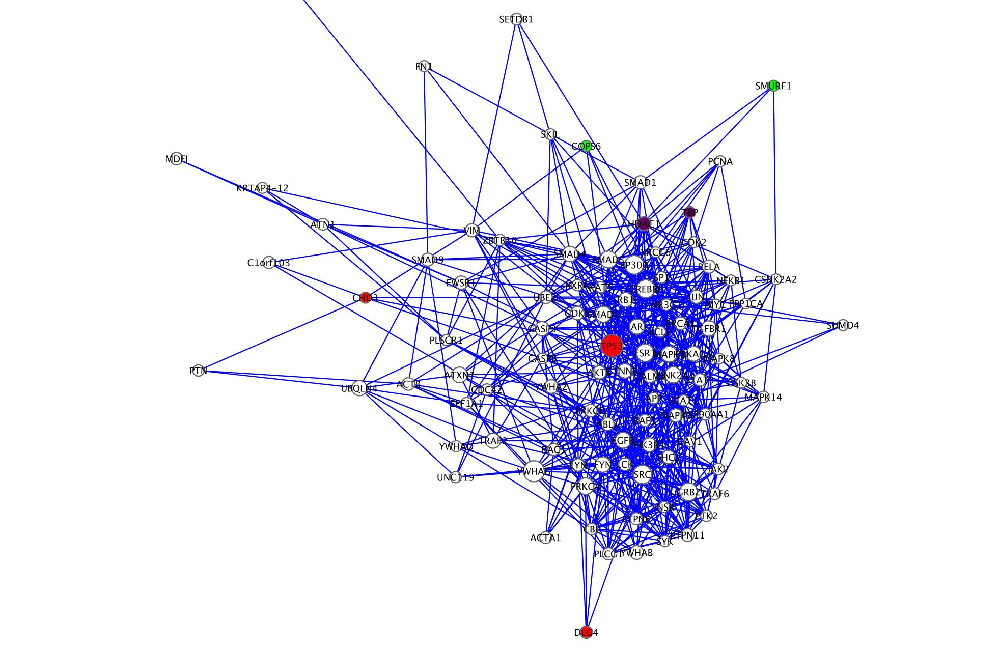
Prostate Cancer Hubs
Seven aberrant genes fall in
top 100 HPRD hubs
Node | Mutation type | Degree
TP53 | deletion | 269
HDAC1 | - | 127
DLG4 | deletion | 97
TBP | - | 84
SMURF1 | amplification | 74
CHD3 | deletion | 73
COPS6 | amplification | 72
Notes:
So I mapped the mutant genes onto HPRD and identified which of those genes fell into the top 100 hubs of HPRD. I identified seven such genes, which are listed here.

Slide 11
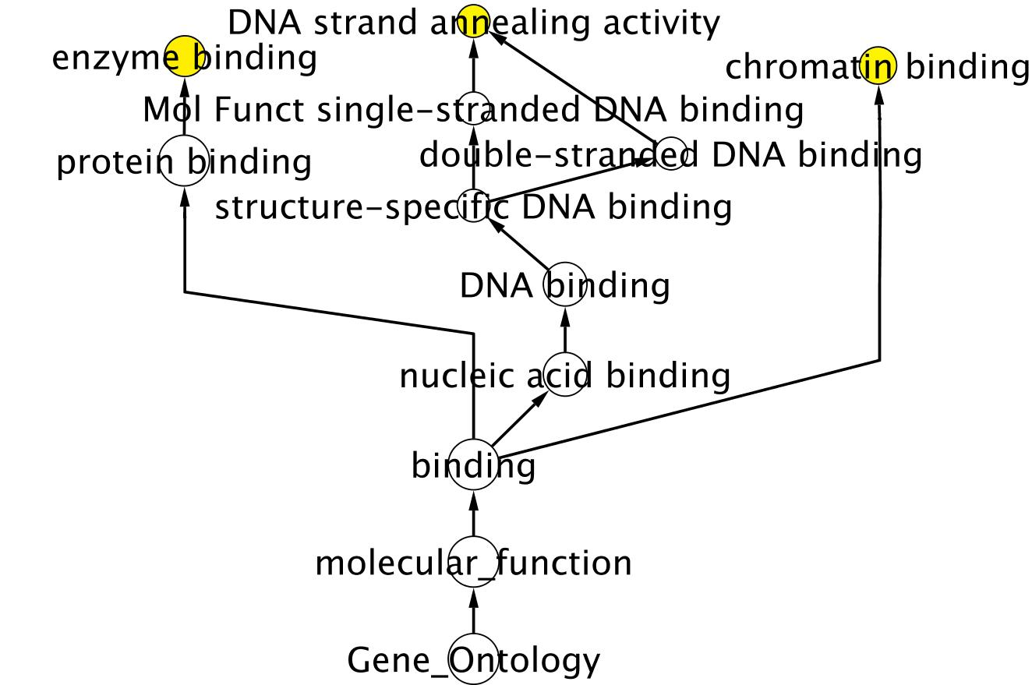
Prostate Cancer Hubs
GO MF Enrichment
Notes:
When the bingo plugin does GO enrichment analysis, it presents a network that represents a portion of the GO hierarchy. Terms that were found to be significantly enriched are highlighted in yellow, and all their ancestor nodes are displayed to help place these terms’ specificity. For the statistical significance test, users are given an option of using either a hypergeometric test or a binomial test. Multiple testing correction is done with Benjamini-Hochberg, or Bonferroni, as specified by the user. This is what I got from doing enrichments in the molecular function ontology, which include enzyme binding, DNA strand annealing activity, and chromatin binding.

Slide 12
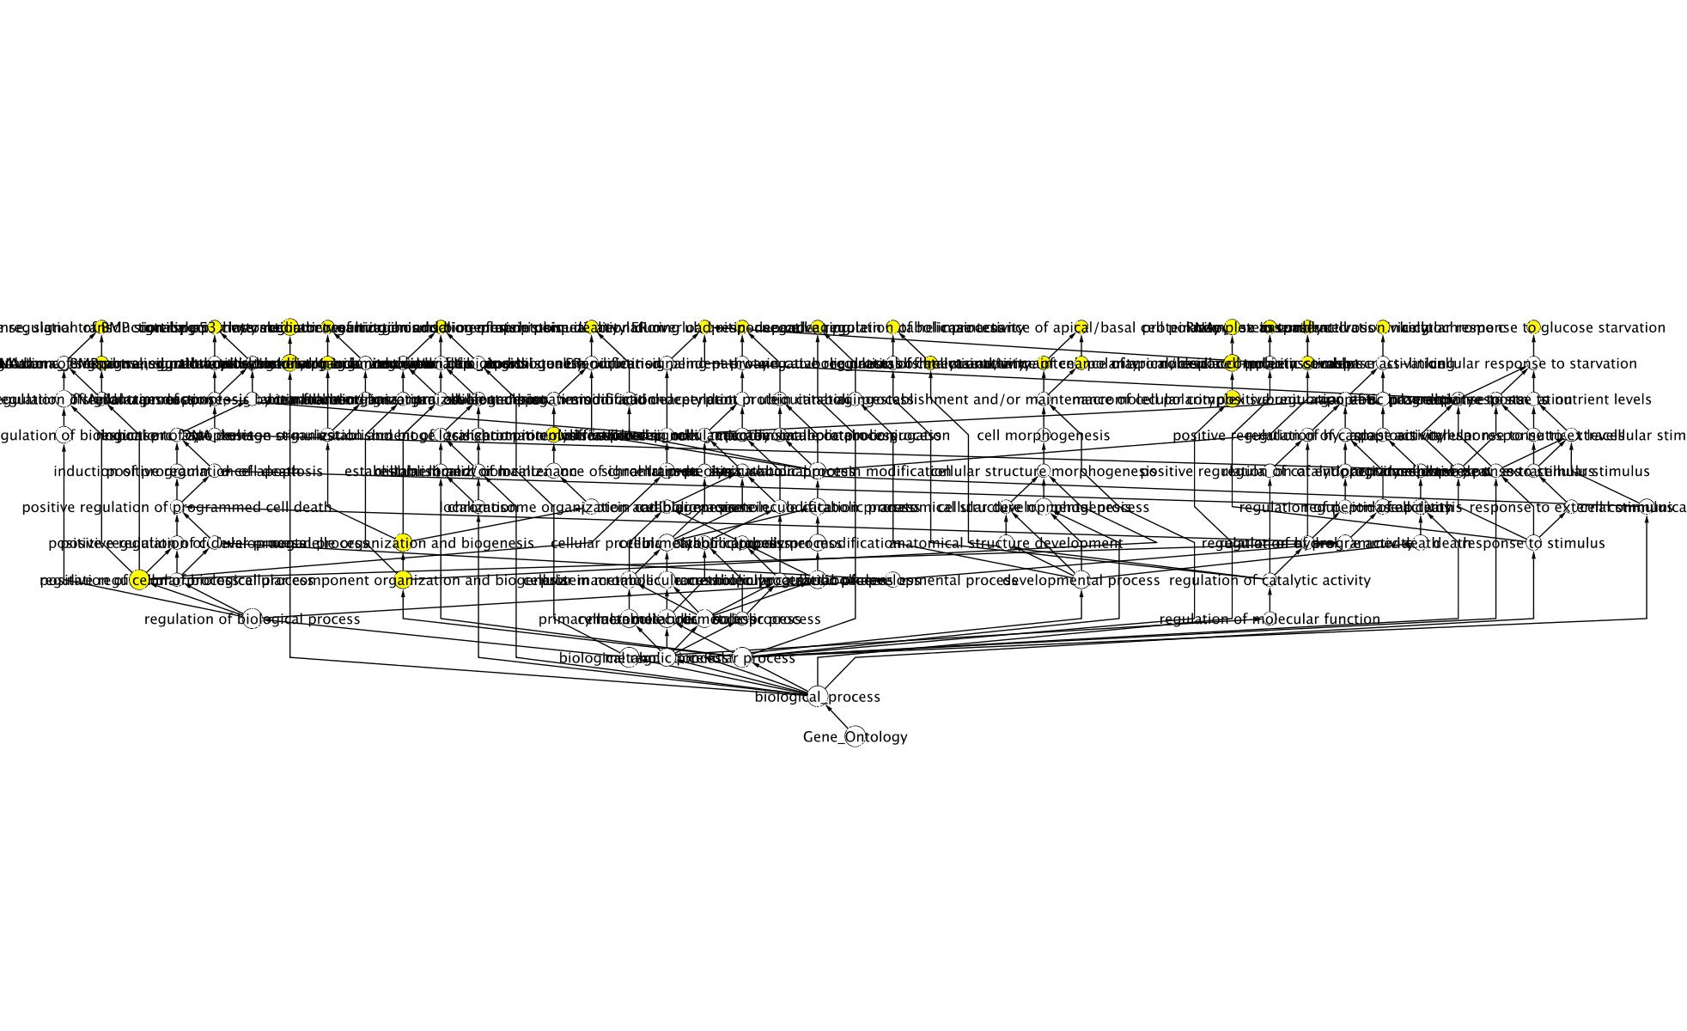
Prostate Cancer Hubs
GO BP Enrichment
Summary of BP enrichments: DNA damage response, signalling
involving BMP and ER, histone and protein regulation.
Notes:
Now sometimes I found a large quantity of enriched terms, making it hard to find informative patterns. The enriched terms in the biological process ontology primarily covered DNA damage response, signalling involving BMP and estrogen receptor, histone and protein regulation.

Slide 13
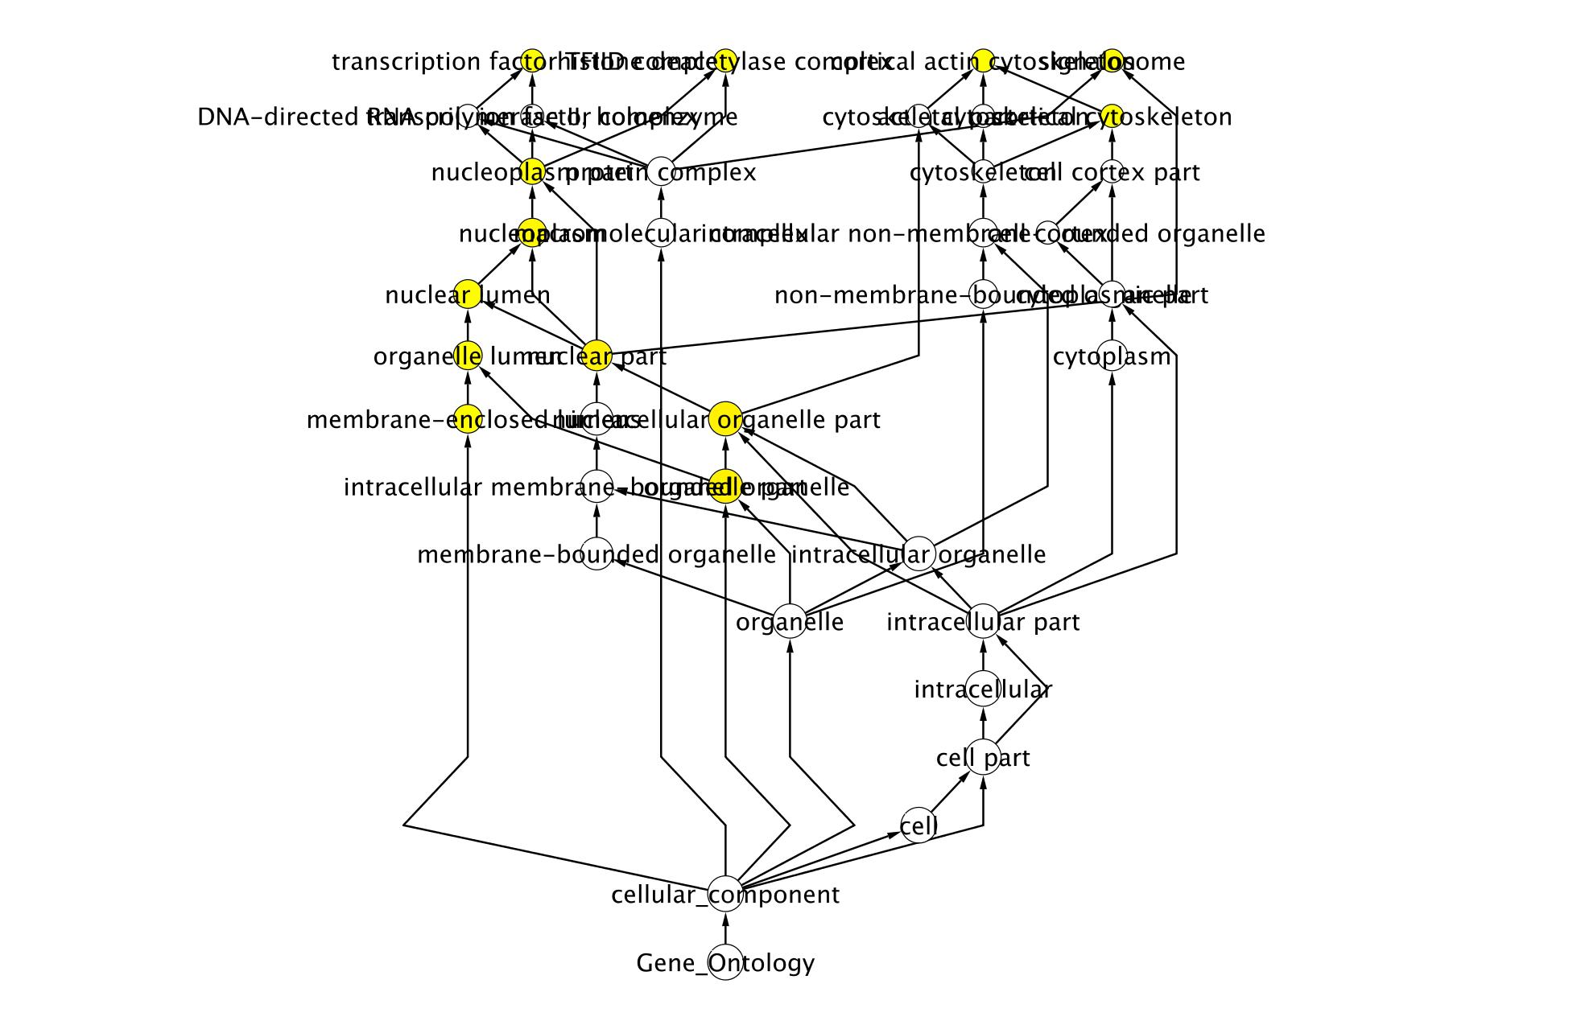
Prostate Cancer Hubs
GO CC Enrichment
Summary: TFIID complex, histone deacetylase complex, cortical actin
cytoskeleton, and signalosome
Notes:
Finally, the cellular component ontology had four enriched leaf terms, which were TFIID complex, histone deacetylase complex, cortical actin cytoskeleton, and signalosome.

Slide 14
Prostate Cancer Hubs:
Highly Interconnected Clusters
Among the deleted genes, MCODE predicted a complex between TNFRSF10B, TNFRSF10A, and TNFRSF10D
NCBI indicates that this complex is responsible for transducing the cell death signal and inducing cell apoptosis
Notes:
For finding protein complexes, the MCODE plugin found one cluster among the deleted genes. This cluster includes TNFRSF10A, B and D. NCBI indicates that this complex is responsible for transducing the cell death signal and inducing cell apoptosis.

Slide 15
Future Directions
Incorporate additional mutation data from the Rubin lab
Investigate cancer-associated genes that are network bottlenecks
ENCODE TF-target gene network analysis
Investigate CNV genes and gene expression of genes connected to those CNVs
Investigate co-occurrences of CNVs in cancer
Notes:
Followup for this particular line of work involves the incorporation additional gene mutation data from the Rubin lab into my analyses. I would also like to expand my analyses to include the investigation of network bottlenecks that have cancer associations. Additional plans include mapping cancer-associated genes to the ENCODE TF-target gene network and look at disruptions in that network. I also plan to look at copy number variants and the effects they have on gene expression and other characteristics of their neighboring genes. Finally, I would like to look at which CNVs tend to co-occur in cancer, sort of like a CNV linkage disequilibrium analysis.

Slide 16
Outline
From Cancer Genomes to Cancer Networks
Study of Genomic Aberration Tracks using Signal Track Analysis
Computational Tools for Cancer Genome Research
Reading Topics
Notes:
So now we come to the next topic in my outline, which involves signal track analysis.

Slide 17
Genomic Aberration Tracks
Create signal tracks from cancer genomes based on the presence or absence of a particular feature
Definition: Genomic Aberration Track t(c)
  Defined on cancer genome c
  Consists of a signal over all the basepairs of the reference genome
  Signal represents the presence or absence of a particular feature at each genomic position in c
E.g. The signal could be 1 over genes that are deleted in c, and 0 otherwise
For amplifications, the signal magnitude can be used to represent the number of times a region was amplified
Notes:
Given my experience with working with signal track analysis software in the Gerstein lab, I would like to employ signal track analysis for the study of cancer genomes. To that end, I plan to create signal tracks based on the presence or absence of a particular feature. These signal tracks will be called Genomic Aberration Tracks, and use a signal of 1 over genome positions where a feature is present, and 0 where a feature is absent. For amplifications, one can take advantage of the signal magnitude to represent the number of times a region was amplified, providing additional data for comparison.
[Motivation: Easier than sequence alignment, better focus on the key features, maybe help guide a more focused analysis with additional data]

Slide 18
Signal Track Analyses
Use signal track analyses to find patterns in cancer genome features
Inspired by the Aggregation and Correlation Toolbox (ACT) developed in the Gerstein lab¹
  Aggregation: Identify average signal around a set of genomic “anchor” points
  Correlation: Compute the Pearson correlation of two signal tracks
  Saturation: For multiple tracks, start with one track and add additional tracks, keeping track of the union of all features. Find how many new features are added with subsequent tracks.
¹Jee J, Rozowsky J, Yip KY, Lochovsky L, Bjornson R, Zhong G, Zhang Z, Fu Y, Wang J, Weng Z, Gerstein M., “ACT: Aggregation
and Correlation Toolbox for Analyses of Genome Tracks,” Bioinformatics (2011).
Notes:
The analyses that can be done with these tracks are inspired by the analyses of the Aggregation and Correlation Toolbox, or ACT, developed last year in the Gerstein lab. Now this tool was originally designed for ChIP-seq and RNA-seq signal tracks, so it might be necessary to make some adaptations for Genomic Aberration Tracks. These analyses include aggregation, which is designed to compute the average signal around a set of genomic anchor points. So far, these anchor points have usually been transcription start and end sites. Another is correlation, which is simply computing the Pearson correlation coefficient between two signal tracks. The third analysis is saturation, and this is designed to find at what point we’ve saturated discovery of a particular feature. It takes multiple signal tracks, and progressively combines the data on features implied by these tracks, and finds out how many novel features are identified when subsequent tracks are added. We expect that at some point adding a new track will contribute only a vanishingly small fraction of new information, at which point we say that we’ve achieved saturation of that particular feature.
[Bill ACT as the inspiration, rather than the end goal.]

Slide 19
Outline
From Cancer Genomes to Cancer Networks
Study of Genomic Aberration Tracks using Signal Track Analysis
Computational Tools for Cancer Genome Research
Reading Topics
Notes:
Next up is computational tools for cancer genome research.

Slide 20
Computational Tools
Software developed for the analyses in section I and II can be packaged for public release
  Facilitate additional Cancer Mutation Network and Genomic Aberration Track research
  Make it easy to incorporate into other workflows
    Integrate into existing tools like Galaxy
    Create a workflow organizer that allows users to chain analyses together, similar to how shell commands can be chained together with Unix pipes
  Facilitate data translation
    Generate networks or tracks from raw data
    Export findings to other formats or programs
Notes:
The software developed for the research described in the previous sections can be packaged as a software suite for public release to facilitate additional network and signal track research. To support that goal, features can be added that make it easy to incorporate this analysis software into other workflows. For example, it could be made an option in existing Web-based toolsets like Galaxy, or it could be hooked up to a workflow organizer where users can combine multiple analyses, passing the output of one to the input of another like Unix pipes. This software can also facilitate data translation by generating networks or tracks from raw data, or exporting findings to other formats or programs.

Slide 21
Database
Store Cancer Mutation Networks and Genomic Aberration Tracks in a repository to facilitate further research
Access for two types of users:
  Users with programming experience can access the data with APIs or SQL directly to leverage the full power of the database system
  Other users may use a web-based GUI to query and retrieve information
Notes:
Furthermore, we can create a database for keeping track of all cancer mutation networks and genomic aberration tracks created so far, along with other relevant attributes. I envisioned two levels of access. Users that are comfortable with programming can write scripts that call APIs or SQL directly on the database to leverage its full power. All other users can use a web-based GUI to query the database.

Slide 22
Queries
Primary Entity Types:
  Genes
  Curated Biological Networks
  Cancer types/subtypes
  Biological pathways
  Protein complexes
  Network motifs
  Cancer Mutation Networks
  Genomic Aberration Tracks
There will be various binary relations between these entities
  (Gene) disrupted in (Cancer type)
  (Genomic Aberration Track) describes features in (Cancer type)
Users should be able to query using an instance of one entity type, and a valid binary relation, and the database should return all instances of other entity types that complete the binary relation
  User queries a gene looking for cancers in which that gene is disrupted
  User queries a cancer looking for all Genomic Aberration Tracks that describes features in that cancer
Notes:
Under the current design, this database will track information on all the types of entities involved in cancer mutation networks and genomic aberration tracks, including genes, curated biological networks, cancer types and subtypes, biological pathways, protein complexes, network motifs, and the networks and tracks themselves. Connections between these entities will mostly take the form of various binary relations, such as genes disrupted in a cancer type, or saying that a genomic aberration track describes a feature in a type of cancer. Basic queries would consist of using an instance of one entity type, and a valid binary relation, and then the database should return all instances of other entity types that complete the binary relation.

Slide 23
Outline
From Cancer Genomes to Cancer Networks
Study of Genomic Aberration Tracks using Signal Track Analysis
Computational Tools for Cancer Genome Research
Reading Topics
Notes:
Finally, I’m going to present my current reading list.

Slide 24
Reading Topics
Cancer Genomics
  Christopher Greenman et al., “Patterns of somatic mutation in human cancer genomes,” Nature 446, no. 7132 (2007): 153-158.
  Michael F. Berger et al., “The genomic complexity of primary human prostate cancer,” Nature (2011).
  Philip J. Stephens et al., “Massive Genomic Rearrangement Acquired in a Single Catastrophic Event during Cancer Development,” Cell 144, no. 1 (2011): 27-40.
  Pierre-Jean Lamy et al., “Quantification and clinical relevance of gene amplification at chromosome 17q12-q21 in human epidermal growth factor receptor 2-amplified breast cancers,” Breast Cancer Research (2011).
  S. Bea et al., others, “Uniparental disomies, homozygous deletions, amplifications, and target genes in mantle cell lymphoma revealed by integrative high-resolution whole-genome profiling,” Blood 113, no. 13 (2009): 3059.

Slide 25
Reading Topics (cont’d)
Biological Network Analysis
  A. Ferro et al., “NetMatch: a Cytoscape plugin for searching biological networks,” Bioinformatics 23, no. 7 (2007): 910.
  H. Yu et al., “Annotation transfer between genomes: protein–protein interologs and protein–DNA regulogs,” Genome research 14, no. 6 (2004): 1107.
  Melissa S Cline et al., “Integration of biological networks and gene expression data using Cytoscape,” Nature Protocols 2, no. 10 (2007): 2366-2382.
  P. M Song et al., “Bioinformatics analysis of metastasis-related proteins in hepatocellular carcinoma,” World journal of gastroenterology: WJG 14, no. 38 (2008): 5816.
  P. Shannon, “Cytoscape: A Software Environment for Integrated Models of Biomolecular Interaction Networks,” Genome Research 13, no. 11 (2003): 2498-2504.
  Sean D Hooper et al., “Identification of tightly regulated groups of genes during Drosophila melanogaster embryogenesis,” Molecular Systems Biology 3 (2007), http://www.nature.com/doifinder/10.1038/msb4100112.
  Sol Efroni et al., “Detecting Cancer Gene Networks Characterized by Recurrent Genomic Alterations in a Population,” ed. Toshi Shioda, PLoS ONE 6, no. 1 (2011): e14437.
  S. Volinia et al., “Reprogramming of miRNA networks in cancer and leukemia,” Genome Research 20, no. 5 (2010): 589-599.
  Y. J Huang et al., “Targeting the human cancer pathway protein interaction network by structural genomics,” Molecular & Cellular Proteomics 7, no. 10 (2008): 2048.

Slide 26
Reading Topics (cont’d)
Genome Tools & Databases, including Genome Signal Track Analysis
  B. Giardine, “Galaxy: A platform for interactive large-scale genome analysis,” Genome Research 15, no. 10 (2005): 1451-1455.
  Da Wei Huang, Brad T Sherman, and Richard A Lempicki, “Systematic and integrative analysis of large gene lists using DAVID bioinformatics resources,” Nature Protocols 4, no. 1 (2008): 44-57.
  D. W Huang, B. T Sherman, and R. A Lempicki, “Bioinformatics enrichment tools: paths toward the comprehensive functional analysis of large gene lists,” Nucleic acids research 37, no. 1 (2009): 1.
  Gene Ontology Consortium, The. “Gene Ontology: tool for the unification of biology.” Nature Genet. (2000) 25: 25-29.
  Jee J, Rozowsky J, Yip KY, Lochovsky L, Bjornson R, Zhong G, Zhang Z, Fu Y, Wang J, Weng Z, Gerstein M., “ACT: Aggregation and Correlation Toolbox for Analyses of Genome Tracks,” Bioinformatics (2011).
  Kanehisa, M., Goto, S., Furumichi, M., Tanabe, M., and Hirakawa, M.; “KEGG for representation and analysis of molecular networks involving diseases and drugs.” Nucleic Acids Res. 38, D355-D360 (2010).
  L. Habegger et al., “RSEQtools: a modular framework to analyze RNA-Seq data using compact, anonymized data summaries,” Bioinformatics 27, no. 2 (2011): 281.
  Online Mendelian Inheritance in Man, OMIM (TM). McKusick-Nathans Institute of Genetic Medicine, Johns Hopkins University (Baltimore, MD) and National Center for Biotechnology Information, National Library of Medicine (Bethesda, MD), 1 April, 2011. World Wide Web URL: http://www.ncbi.nlm.nih.gov/omim/
  W. J. Kent et al., “The Human Genome Browser at UCSC,” Genome Research 12, no. 6 (2002): 996-1006.
  Xiong X, Song H, On T, Lochovsky L, Provart NJ and Parkinson J. “Phylopro: A web based tool for the generation and visualization of phylogenetic profiles across Eukarya,” Bioinformatics 27, no. 6 (2011): 877-878.
  Zdobnov E.M. and Apweiler R. "InterProScan - an integration platform for the signature-recognition methods in InterPro" Bioinformatics, 2001, 17(9): p. 847-8.

Slide 27
Acknowledgements
Andrea Sboner
Lukas Habegger
Dr. Mark Gerstein
Dr. Mark Rubin + lab members
Gerstein lab nets subgroup
Dr. Kei-Hoi Cheung
Dr. Paul Lizardi
Dr. Jing Zhang
UC’s (Uncredited Contributors)

