Slide 1
Update on PPDs finding
Alexej Abyzov
April 5, 2011

Slide 2
Selection for good mapping
Using hg18
Using 2x100 junction sequences
Junction interval is at least 70 bp
Reads span for at least 5 + (read_len – 35)/20 bp on each side of junction
Consider reads mapping to exact same location redundant (amplification of optical duplicates)
Calling novel Ψgene for a gene with read mapping to at least two non-overlapping junctions with at least one having two mapped reads

Slide 3
Pilot | Pop. | Individuals | Analysis | # of genes with Ψgene |  | Previous
Pilot 1 low cov. | CEU | 49 | pool | 36 |  | 48
 | YRI | 57 | pool | 49 |  | 80
 | CHBJPT | 58 | pool | 33 |  | 43
Pilot 2 high cov. | CEU | NA12891 (father) | per person | 27 | 15 | 16
 |  | NA12892 (mother) | per person |  | 19 | 22
 |  | NA12878 (daughter) | per person |  | 18 | 23
 | YRI | NA19239 (father) | per person | 20 | 15 | 18
 |  | NA19238 (mother) | per person |  | 15 | 22
Pilot 3 exon high cov. | CEU | 65 | per person (pool) | 63 (303) |  | 158
 | CEU* | 57 | per person (pool) | 13 (36) |  | N/A
 | YRI | 70 | per person (pool) | 8 (32) |  | 38
 | CHB | 46 | per person (pool) | 6 (10) |  | 14
 | JPT | 89 | per person (pool) | 6 (17) |  | 16
 | CHBJPT | 136 | per person (pool) | 7 (24) |  | N/A
 | CHD | 28 | per person (pool) | 6 (8) |  | 12
 | TSI | 66 | per person (pool) | 6 (12) |  | 11
* Excluding NA06986, NA11829, NA11831, NA11832, NA12045, NA07346, NA11920, NA11994

Slide 4
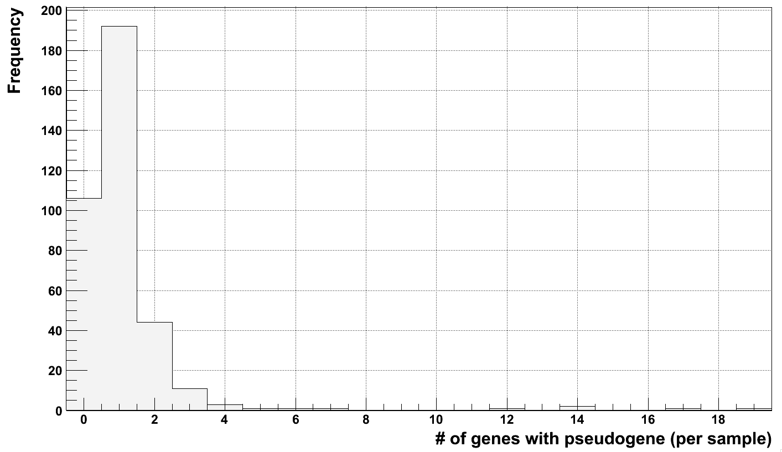
Utah outliers
NA11920, NA07346
YRI - NA18856
NA11829
NA11832
NA12045
NA06986
NA11831

Slide 5
Pilot 3
RNA-seq contamination?
Inefficient junction capture?
Pop. | Approach | # of individuals | # of genes with novel Ψgenes | # of in target genes with novel Ψgenes | Total # of genes with novel Ψgenes*
CEU | per person (pool) | 65 | 63 (303) | 53 (265) | 1060
CEU* | per person (pool) | 57 | 13 (36) | 8 (24) | 160
YRI | per person (pool) | 70 | 8 (32) | 5 (20) | 100
CHB | per person (pool) | 46 | 6 (10) | 2 (4) | 40
JPT | per person (pool) | 89 | 6 (17) | 3 (6) | 60
CHBJPT | per person (pool) | 136 | 7 (24) | 3 (10) | 60
CHD | per person (pool) | 28 | 6 (8) | 1 (1) | 20
TSI | per person (pool) | 66 | 6 (12) | 3 (4) | 60
* Assuming 20,000 in human genome and knowing that ~1000 genes were targeted

Slide 6
Intersection
Pilot 1
CEU trio (pilot 2)
CEU
CHBJPT
Father
Mother
1
1
5
3
2
6
27
10
3
2
2
2
17
4
YRI
Child
Total of 58 genes
Total of 27 genes

Slide 7
Intersection
CEU, 334
Pilot 1
Pilot 2
18
10
3
YRI, 76
6/3
2/1
0/0
Pilot 1
Pilot 2
16
295 (264) / 59 (52)
27
1
Pilot 3
3/1
3/0
0/0
CHBJPT, 48
Pilot 1
Pilot 3
26 (20) / 7 (5)
24
9/2
15 (10)/
5 (3)
Pilot 3
Pool / per person
In target

Slide 8
CEU population
Sub selected
CEU, 334
CEU, 68
Pilot 1
Pilot 2
Pilot 1
Pilot 2
18
18
10
3
11
3
6/3
6/3
2/1
0/0
1/1
0/0
295 (264) / 59 (52)
29 (23) / 9 (7)
Pilot 3
Pilot 3

Slide 9
Null

