Slide 1
Data
target genes [-1000, 500] bp around TSS
324 TFs in different cells
min target number: 3
max target number: 11,063
median target number: 1533.5
mean target number: 2322.5

Slide 2
K562 TF→TF regulatory network
824 TF-TF interactions; 24 auto-regulation (67 unique TFs)
E2F6 E2F6
FOSL1 FOSL1
HDAC2 HDAC2
HEY1 HEY1
MAX MAX
SP1 SP1
SP2 SP2
SRF SRF
THAP1 THAP1
YY1 YY1
ZBTB7A ZBTB7A
CCNT2 CCNT2
GTF2B GTF2B
IRF1 IRF1
JUND JUND
NFYA NFYA
NFYB NFYB
NRF1 NRF1
STAT1 STAT1
STAT2 STAT2
TAL1 TAL1
GATA1 GATA1
HDAC8 HDAC8
JUNB JUNB

Slide 3
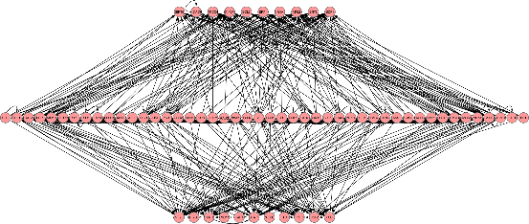
10→46→11

