Slide 1
GO Enrichments of Prostate Cancer-Associated Network Hubs
Lucas Lochovsky
iNets subgroup presentation
April 20, 2011
Notes:
Today I’m going to be presenting additional work I’ve done with the cancer networks I introduced previously in group meeting. Specifically, I’ve been investigating GO anntation enrichments for the hub genes in my lists of prostate cancer-associated genes.

Slide 2
Overview
More fun with cancer iNets!
Protein interactions derived from HPRD (hprd.org)
Cancer gene lists
87 gene signature associated with TMPRSS2-ERG fusion
List of recurrent lesions in primary prostate cancer in Demichelis 2009¹
ETS genes
COSMIC release v52
Identify top hubs and do GO enrichment analysis
¹F. Demichelis et al., others, “Distinct genomic aberrations associated with ERG rearranged prostate cancer,” Genes, Chromosomes and Cancer 48, no. 4 (2009): 366–380.
Notes:
So essentially, it’s more fun with cancer iNets! I figured we could make networks sound snazzier by calling them iNets. As with my previously reported results, interaction data was derived from HPRD, and prostate cancer-associated genes from Rubin-Gerstein work. This time, analysis with data from the latest release of COSMIC, a.k.a. the Catalogue of Somatic Mutations in Cancer, is included here. GO enrichment was performed with the Cytoscape plugin bingo.

Slide 3
ERG 87 Hubs
Notes:
Hubs were picked out by looking at node degrees and visually mapping them to node size, making it easy to pick out nodes with the largest number of connections. For this network, I used the top 7 hubs, all with degree of at least 50.

Slide 4
ERG 87 Hubs GO MF Enrichment
Primary enrichments are: caspase activity, transcription repression,
growth factor activity, and histone deacetylase activity
Notes:
Now for every hub list, I checked for annotation enrichments in all three GO ontologies, but not all of these analyses were informative. Sometimes the bingo plugin didn’t find any significantly enriched terms, and sometimes it found so many terms that covered such a broad range of processes, it was like these genes had a hand in everything, so it’s hard to derive useful details from that. The ERG hubs seemed to cover everything in the biological process ontology, but the molecular function ontology enrichments cover a relatively small group. The main enrichment clusters include: caspase activity, transcription repression, growth factor activity, and histone deacetylase activity.

Slide 5
ERG 87 Hubs GO CC Enrichment
Primary enrichments are for nuclear protein complexes including transcription factor TFIIA
and TFIID complexes, exosome, Sin3, and Nerd, oops I mean NuRD (nucleosome remodelling
and deacetylase complex
Notes:
When I looked at cellular component annotation enrichments, the terms covered nuclear protein complexes including TFIIA, TFIID, exosome, Sin3, and apparently there’s a NuRD complex, which stands for nucleosome remodelling and deacetylase complex)

Slide 6
Primary Prostate Cancer Lesions (Amplifications) Hubs
Notes:
Turning to the primary prostate cancer lesions, I looked at the top 10 hubs in the amplification network.

Slide 7
Primary Prostate Cancer Lesions (Amplifications) Hubs GO CC Enrichment
Enrichments cover transcription, histone, ATP, and
signalling complexes.
Notes:
The bingo plugin did not find any significant enrichments in the BP or MF ontologies, but the cellular component ontology shows that these genes primarily localize to complexes involved in transcription, histone, ATP, and signalling.

Slide 8
Primary Prostate Cancer Lesions (Deletions) Hubs
Notes:
So these are the top 11 hubs in the deletion network.

Slide 9
Primary Prostate Cancer Lesions (Deletions) Hubs GO BP Enrichment
Regulation of protein modification, interleukin signalling,
DNA-dependent transcription, helicase activity, imaginal disc pattern
formation, and primary spermatocyte growth
Notes:
The MF terms for these hubs were all over the place, but the BP terms fell into a small number of groups, which include protein modification, interleukin signaliing, DNA-dependent transcription, helicase activity, imaginal disc pattern formation, and primary spermatocyte growth.

Slide 10
Primary Prostate Cancer Lesions (Deletions) Hubs GO CC Enrichment
Complexes include: nucleosome remodelling, interleukin, oncostatin,
insulin response, RNAPII core, and glutamate receptors
Notes:
In the cellular component ontology, the trend of being part of protein complexes is still going strong. These complexes cover the functions of nucleosome remodelling, interleukin, oncostatin, insulin response, RNAPII core, and glutamate receptors.

Slide 11
ETS Gene Hubs
Notes:
So here are the ETS hubs. This covers the three genes that have more than 10 connections in the network.

Slide 12
ETS Hubs GO BP Enrichment
Primary categories are macrophage differentiation, regulation of
macromolecule biosynthesis, and DNA-dependent regulation of transcription
Notes:
These genes cover the biological processes of macrophage differentiation, regulation of macromolecule biosynthesis, and DNA-dependent regulation of transcription.

Slide 13
ETS Hubs GO MF Enrichment
The two main activities are transcription factor activity and
sequence-specific DNA binding
Notes:
The specific molecular functions of these genes cover only two primary activities. These are: transcription factor activity and sequence-specific DNA binding.

Slide 14
COSMIC breast gene hubs
Notes:
So now, we’re going from a few genes to the thousands of genes in COSMIC. Among the breast cancer genes, I selected the top 14 hubs. Now you may have noticed that there’s one particularly large hub here that isn’t highlighted. That’s because, when I looked at the gene name, all I saw was a dash, which I think is supposed to represent a null or missing information, and I guess HPRD and COSMIC use the same null character, so this big node is a fluke that doesn’t really represent anything biologically.

Slide 15
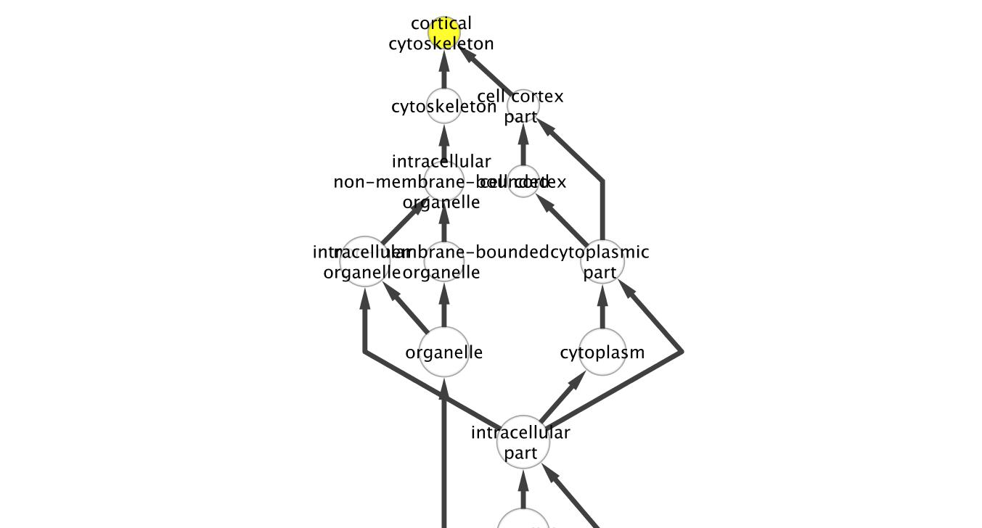
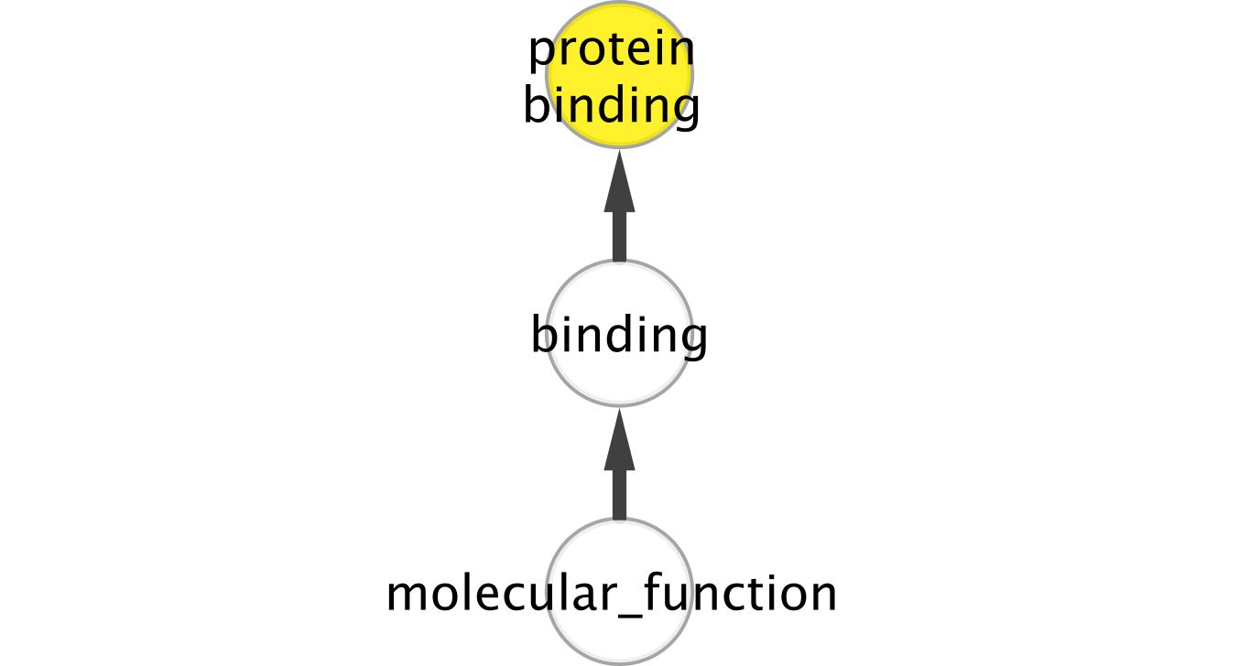
COSMIC breast gene hubs GO enrichment
BP ontology
MF ontology
CC ontology
Note: This has nothing to do with Chao
Notes:
Now unlike most of the other hub lists that I worked with, the COSMIC breast hubs were all focused on a single term in each GO ontology. In the BP ontology, the enriched term was “establishment or maintenance of apical basal cell polarity”. In the MF ontology, it was “protein binding”, and in the CC ontology, the enriched term is “cortical cytoskeleton”.

Slide 16
COSMIC breast genes Highly Interconnected Clusters
Cluster 1 are members of eukaryotic translation initiation factor 3, the largest eIF
Cluster 2, HLA-DRB1 is involved in presenting extracellular peptides for immune system recognition. The rest are T cell receptor components
Cluster 3 are members of a mediator complex responsible for activating transcription
Cluster 4 is involved in sorting proteins to lysosomes/vacuoles → protein degradation control
Notes:
One other thing I did with the COSMIC breast genes was use the MCODE plugin to find highly interconnected clusters of genes. MCODE found four clusters that cover eukaryotic translation initiation, T cell receptor components, transcription activation, and protein degradation control.

Slide 17
COSMIC lung gene hubs
Notes:
So now we come to COSMIC’s lung genes, which include a much larger number of genes. Here, I took the top 10 hubs from this network, the largest of which is P53.

Slide 18
COSMIC lung gene hubs GO MF enrichment
Primary enrichment clusters are transcription regulation,
phosphotransferase activity, acyltransferase activity, signal
transduction, receptor binding, enzyme binding, transcription factor
binding, and DNA strand annealing activity
Notes:
The BP enrichments numbered in the hundreds, and the MF enrichment tree looked slightly easier to handle, so I tried to find the major enrichment clusters in the molecular function ontology. These clusters transcription regulation, phosphotransferase activity, acyltransferase activity, signal transduction, receptor binding, enzyme binding, transcription factor binding, and DNA strand annealing activity.

Slide 19
COSMIC lung gene hubs GO CC enrichment
Mostly nuclear complexes
Notes:
Cellular component enrichments were mostly nuclear protein complexes.

Slide 20
COSMIC lung genes Highly Interconnected Clusters
Using default MCODE parameters, found 45 clusters
A lot of these clusters have many members with a very broad range of GO enrichments
Investigating use of stricter parameters to find a smaller set of more meaningful clusters
Notes:
Now when I turned MCODE on the lung genes with default parameters, the plugin returned 45 clusters. A lot of these clusters had many members with a very broad range of GO enrichments. Therefore, I’m investigating the use of stricter parameters to find a smaller set of more meaningful clusters, which you might hear about in the future. If anyone has any ideas how to filter these clusters more strictly, feel free to let me know.

Slide 21
COSMIC prostate gene hubs
Notes:
Finally, I did the same analyses on COSMIC’s prostate gene network’s top 10 hubs.

Slide 22
COSMIC prostate gene hubs GO MF enrichment
Main clusters of enrichment terms include: phosphatase binding,
signalling receptor binding, phosphotransferase activity, protein
kinase activity, DNA binding, lipid binding, enzyme regulator activity,
ATP binding, and hormone receptor binding
Notes:
Again, the GO BP enrichments were too broad, so I focused on the MF ontology. The main clusters here include phosphatase binding, signalling receptor binding, phosphotransferase activity, protein kinase activity, DNA binding, lipid binding, enzyme regulator activity, ATP binding, and hormone receptor binding.

Slide 23
COSMIC prostate gene hubs GO CC enrichment
Localizations include a large number of protein complexes,
cytoskeleton, replication fork, lateral plasma membrane, cell-cell
adhesion, microvillus membrane, and nuclear matrix
Notes:
Cellular localizations included a large number of protein complexes, cytoskeleton, replication fork, lateral plasma membrane, cell-cell adhesion, microvillus membrane, and nuclear matrix.

Slide 24
COSMIC prostate genes Highly Interconnected Clusters
Cluster 1 has two genes involved in epidermal growth factor, and two genes involved in cytokine receptor signalling pathways
Not clear what the theme is for cluster 2, each gene appears to function in a distinct pathway
Need stricter cluster parameters?
Notes:
When I ran the complete prostate cancer-associated gene list through MCODE, two clusters were identified. Cluster 1 has two genes involved in epidermal growth factor, and two genes involved in cytokine receptor signalling pathways. Cluster 2, however, appeared to consist of genes that each operated in a distinct pathway or function with no connection to the other genes in the cluster. So again, I wondered if I need stricter cluster parameters.

Slide 25
Future Directions
Investigate cancer-associated genes that are network bottlenecks
Investigate CNV genes and gene expression of genes connected to those CNVs
Investigate co-occurrences of CNVs in cancer
ENCODE TF-target gene network analysis
Notes:
In the future, I plan to expand my analyses to include the investigation of network bottlenecks that have cancer associations. I also plan to look at copy number variants and the effects they have on gene expression and other characteristics of their neighboring genes. I would also like to look at which CNVs tend to co-occur in cancer, sort of like a CNV linkage disequilibrium analysis. Finally, I plan to map cancer-associated genes to the ENCODE TF-target gene network and look at disruptions in that network.

Slide 26
Acknowledgements (Alphabet Soup 2011 Edition)
ASB
LH
MG
MR e.u. (et underlings)
GenoTech subgroup
iNets subgroup
UC’s (Uncredited Contributors)
Notes:
And since this was such a hit last time, I’m bringing out the Alphabet Soup of Acknowledgements again.

