Slide 1
Different ways to compare
Gene => ACTGatgatt…ttcaGGCTGTTTTatcggaa…ttcgaGGGGGG
Way #1
Ψgene => ACTG|GGCTGTTTT|GGGACGGG
Position => …9 87654321
Gene => ACTGatgatt…ttcaGGCTGTTTTatcggaa…ttcgaGGGGGG
Way #2
Ψgene => ACTG|GGCTGTTTT|GGGACGGG
Position => …98 765 4321

Slide 2
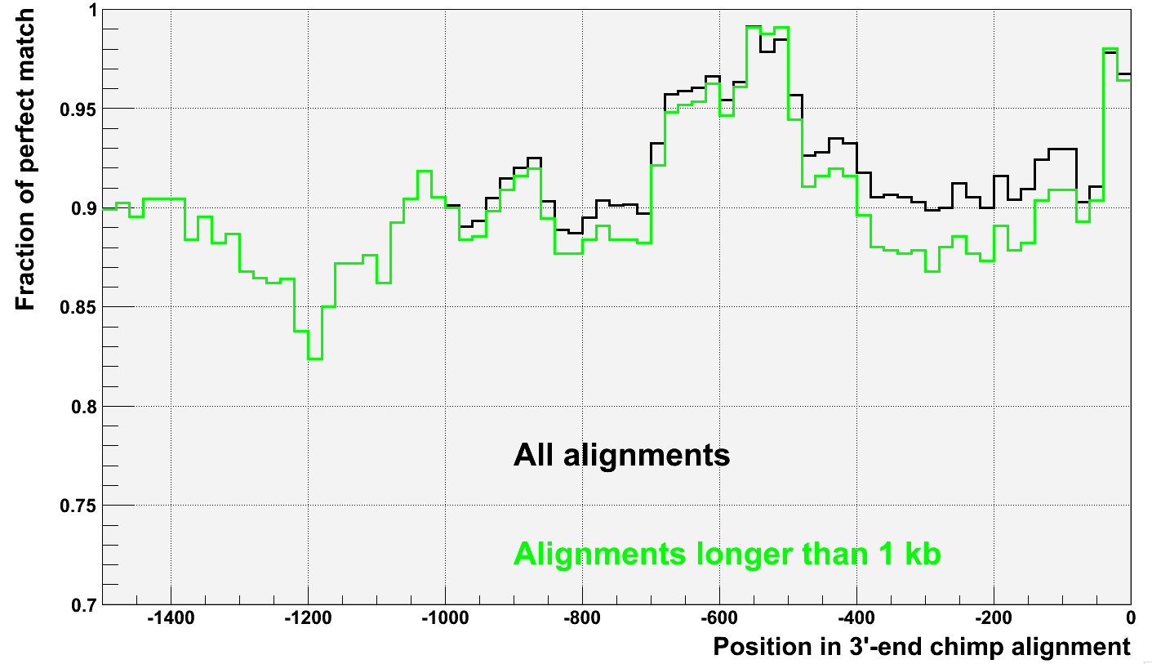
Chimp conservation (way #1)

Slide 3
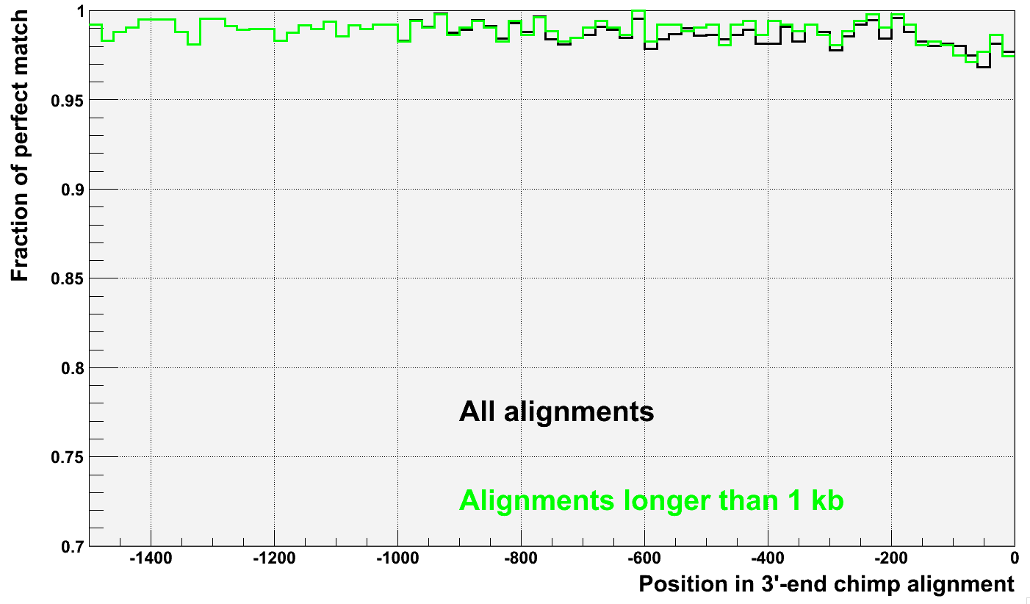
Chimp conservation (way #2)

Slide 4
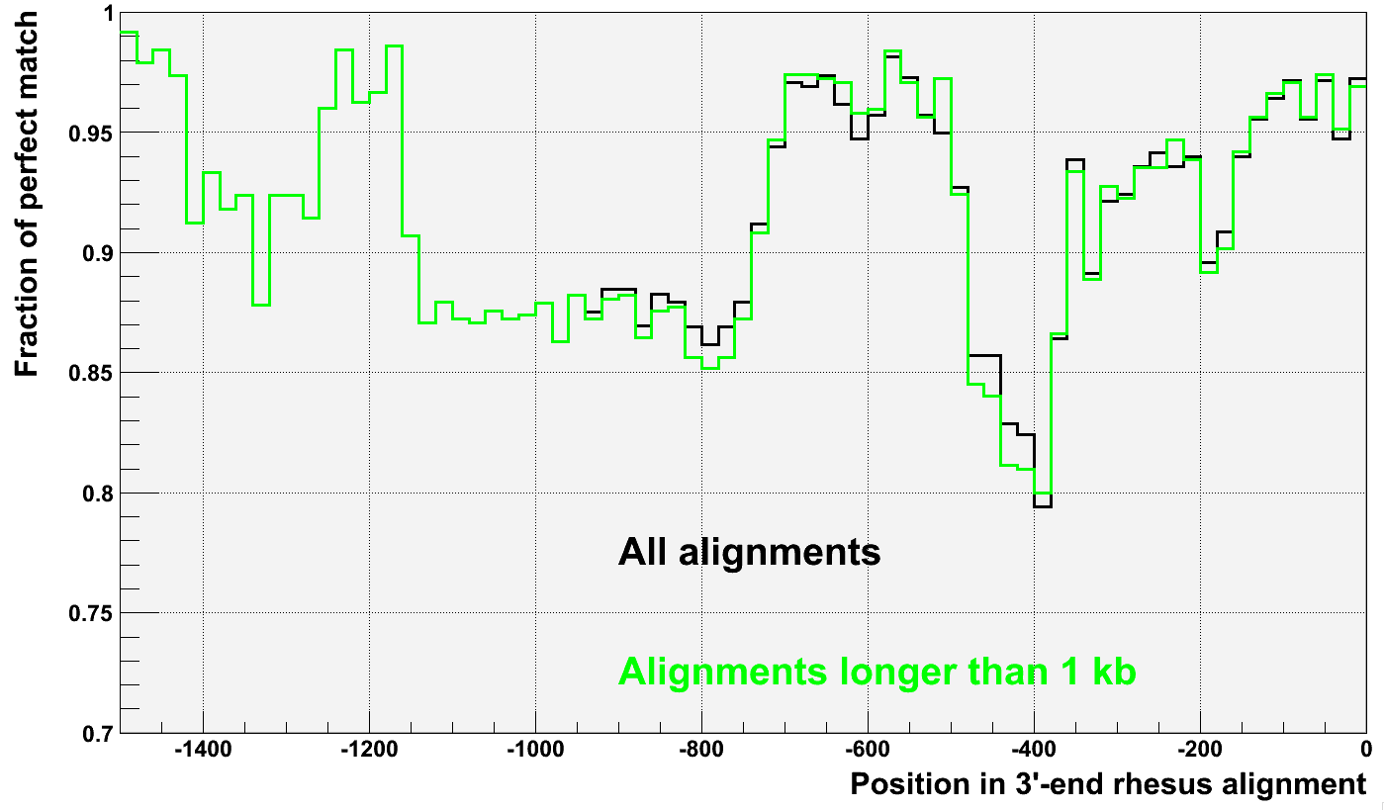
Rhesus conservation (way #1)

Slide 5
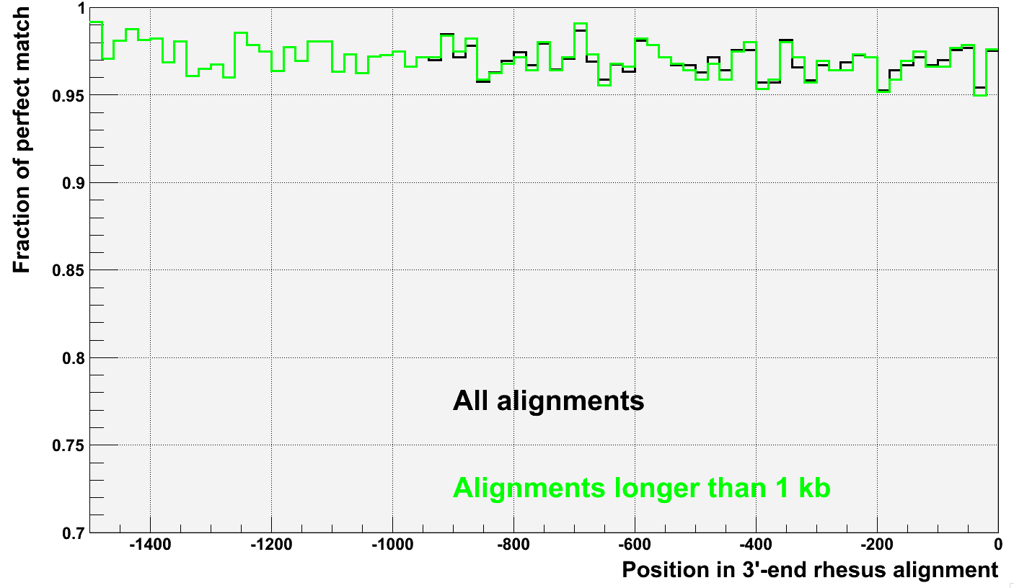
Rhesus conservation (way #2)

Slide 6
Chimp
 | # of positions | # of substitutions | Deviation by Poisson | Conservation
Chimp
3’-UTR | 11722 | 132 | 11.5 | 98.9+-0.1%
The rest | 17689 | 145 | 12 | 99.2+-0.07%
 |  |  |  | Z-score = 2.45
Rhesus
3’-UTR | 6440 | 167 | 13 | 97.4+-0.2%
The rest | 15787 | 477 | 22 | 97.9+-0.1%
 |  |  |  | Z-score = 2.24

Slide 7
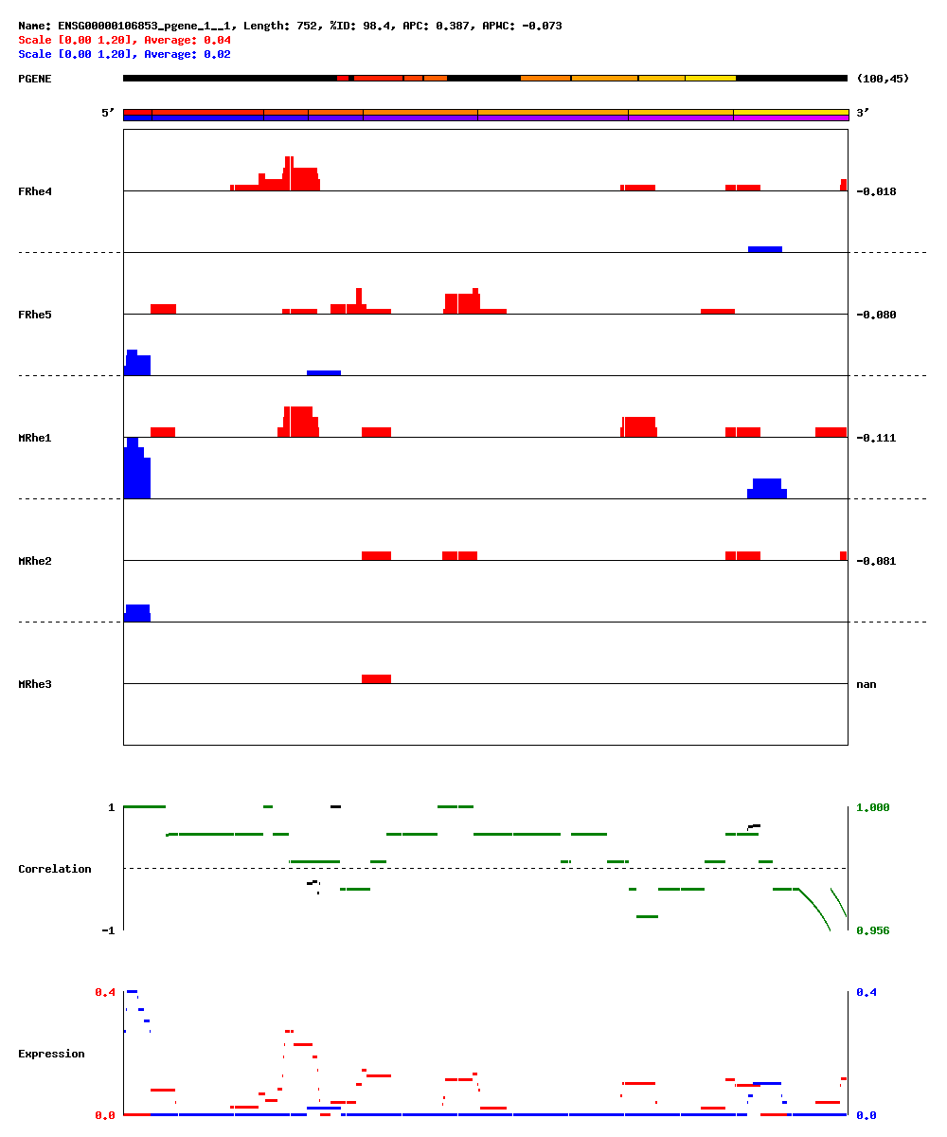
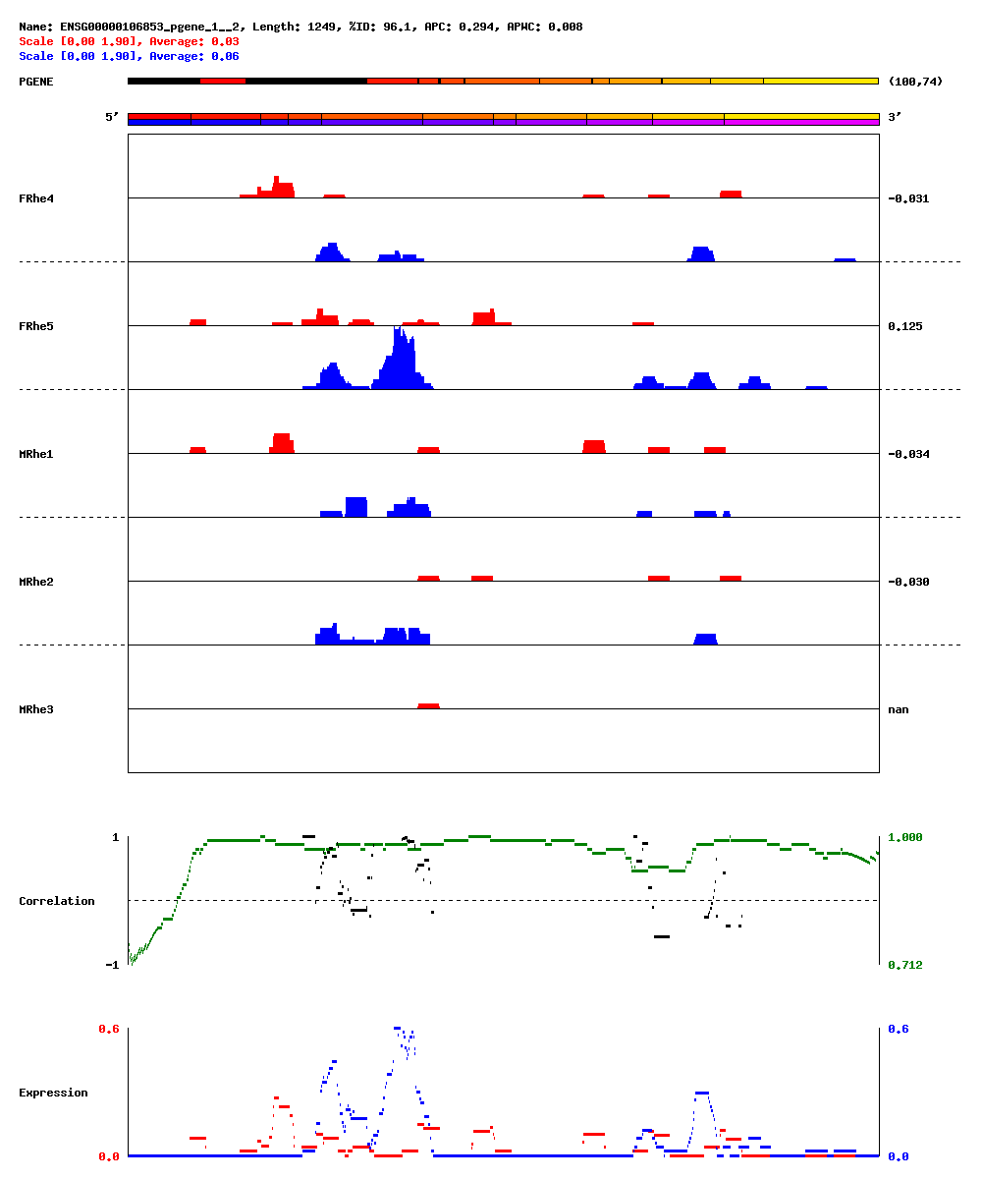

Slide 8
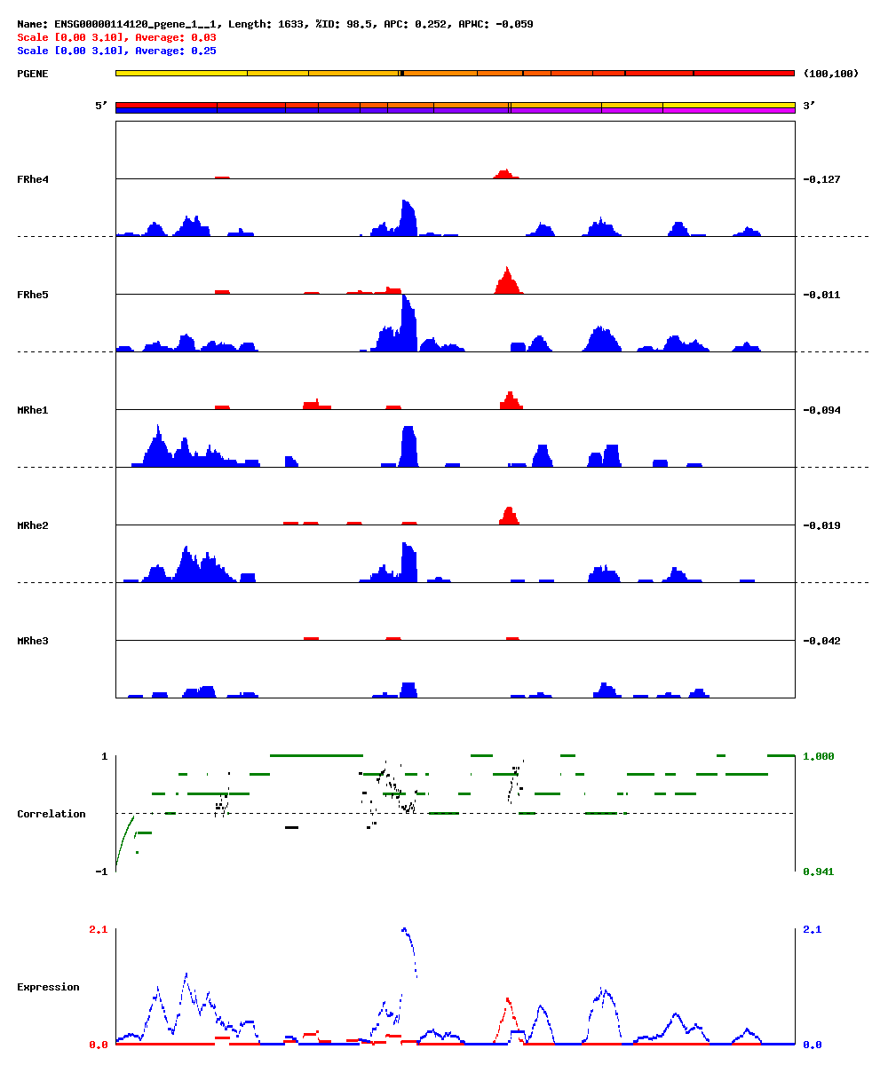

Slide 9
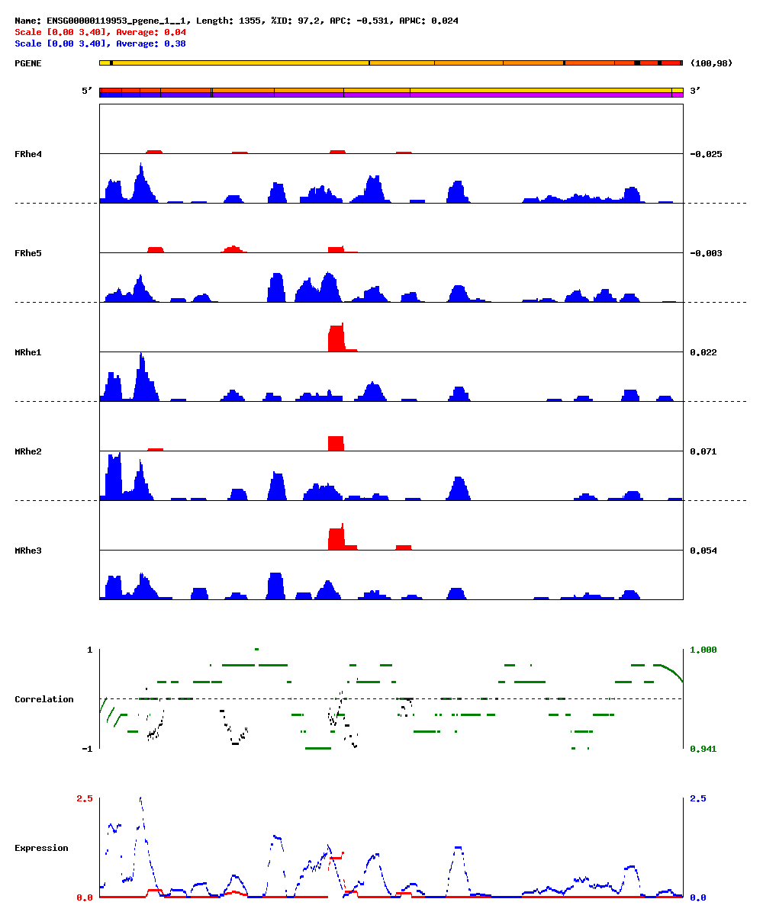
Candidate

Slide 10
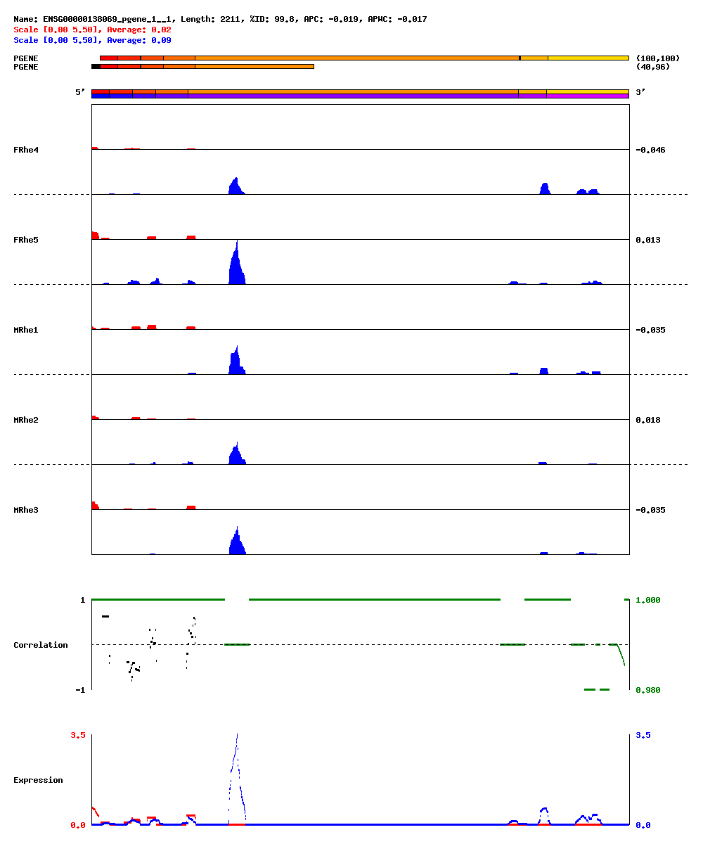
Candidate?

Slide 11
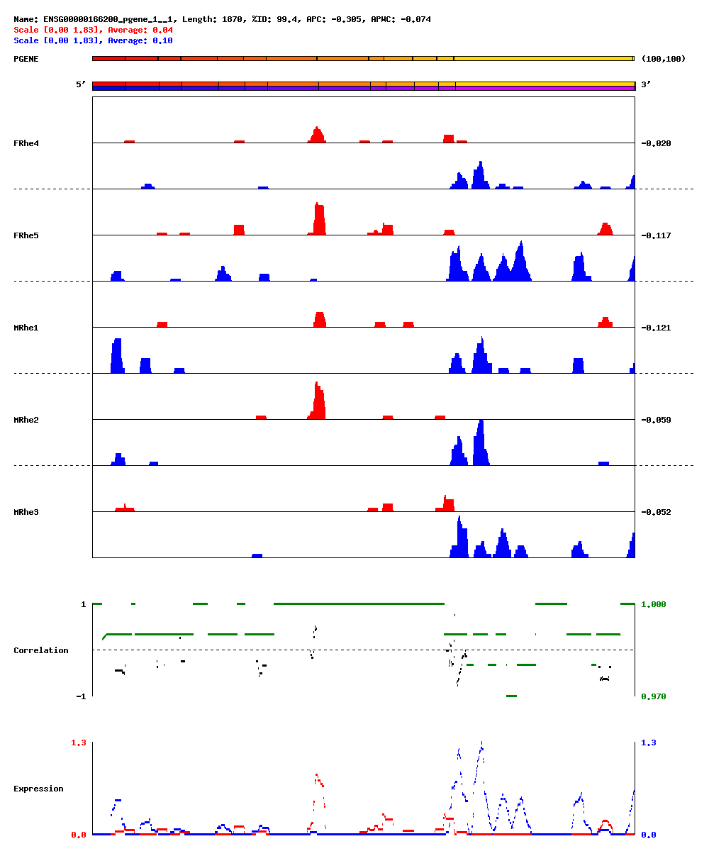
Candidate

