Slide 1
A bias in RD analysis
Alexej Abyzov
April 12, 2011

Slide 2
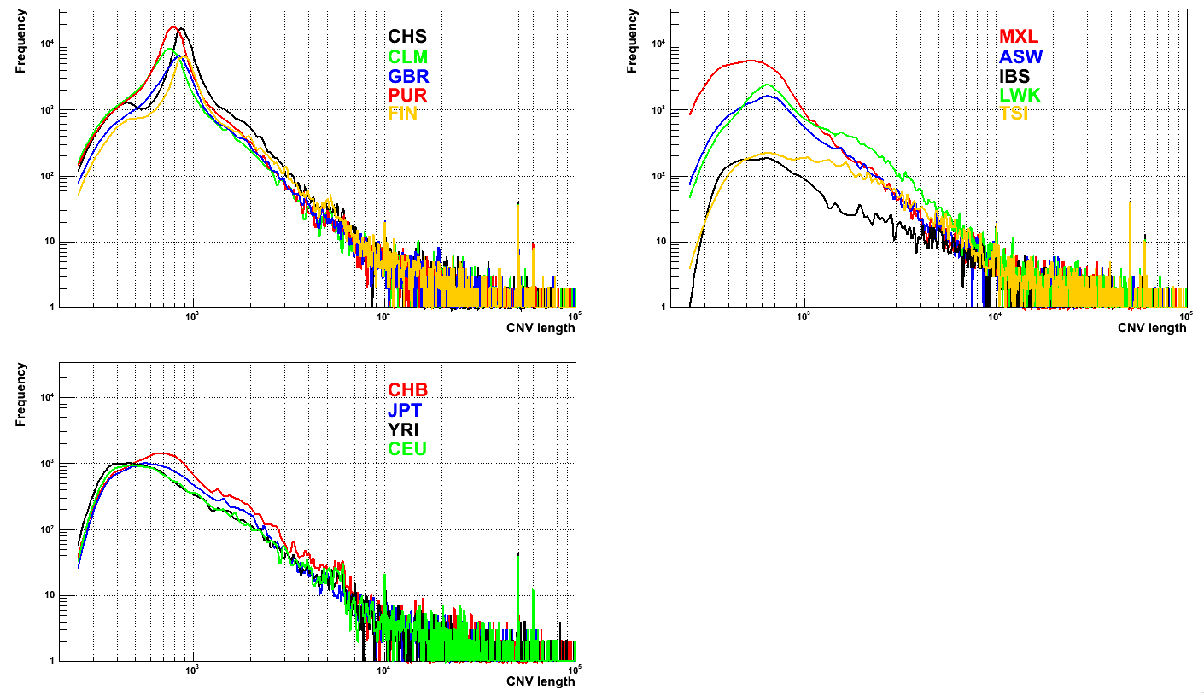
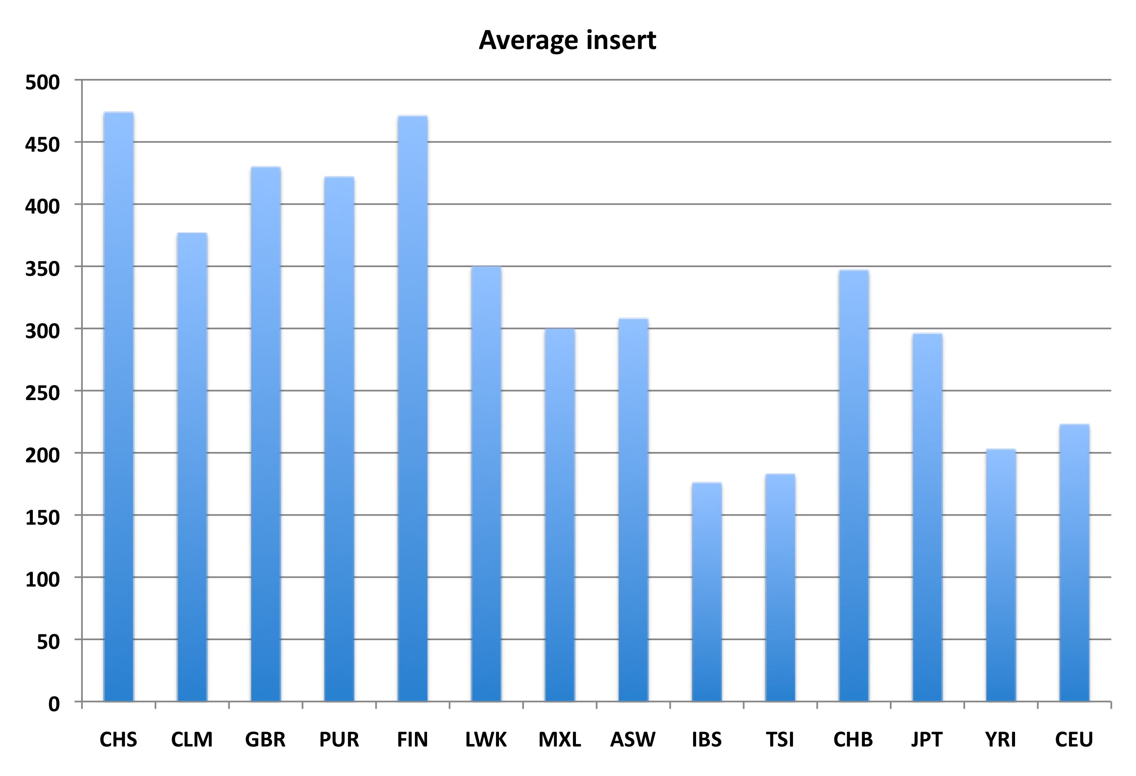
Size distribution

Slide 3
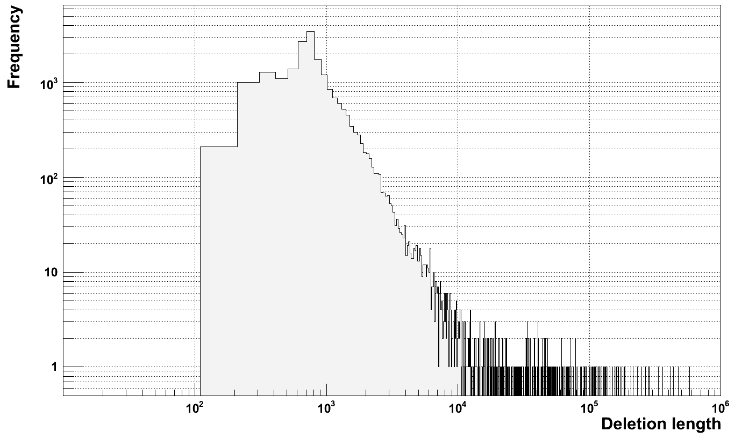
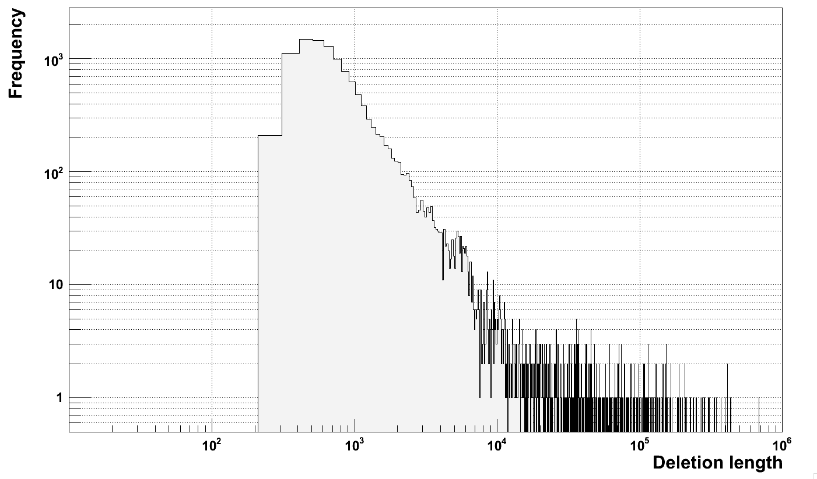
???
Deletion size
Distribution
for NA12878
on hg18
HiSeq
GAII

Slide 4
Why artificial
Only deletions
No mechanism are know to suggest the existents of deletion of the size 600-1000 bp
>90% of those events don’t intersect with anything (DGV SVs and indels, 1KG CNVs and SVs, TEI)
All heterozygous (HW disequilibrium)
Correlation of peak location with insert size

Slide 5
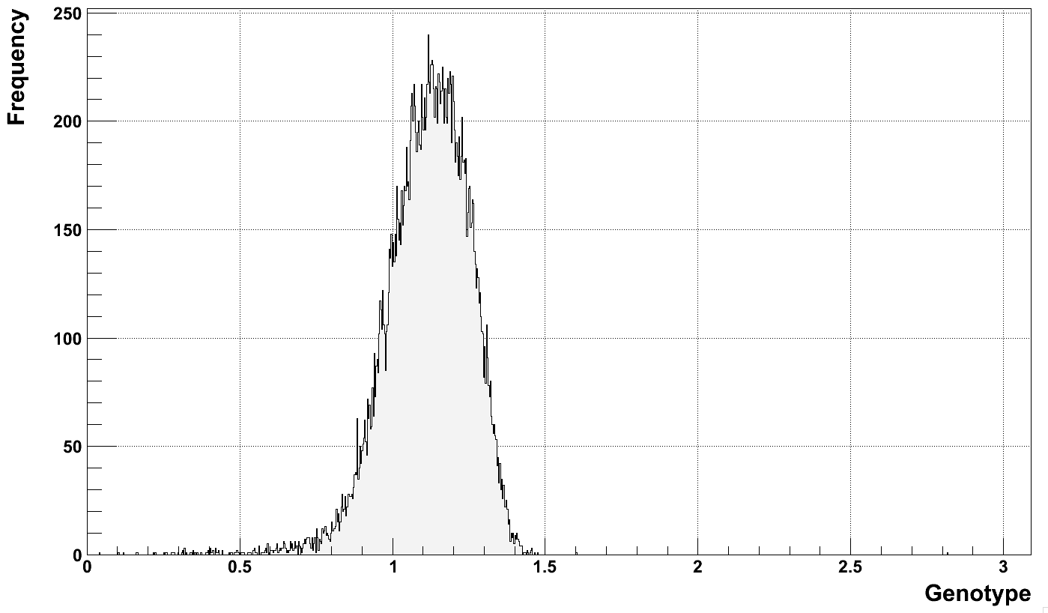
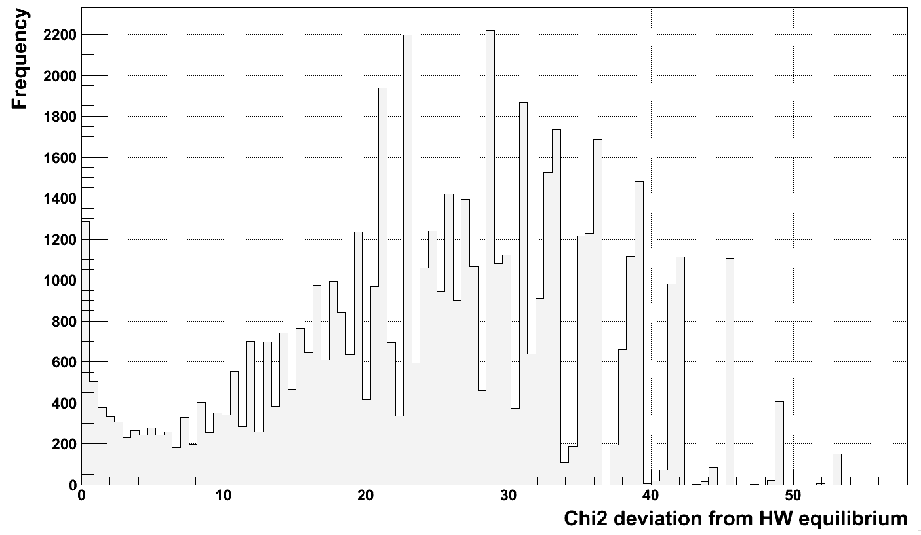
HW disequilibrium for “weird” events

Slide 6
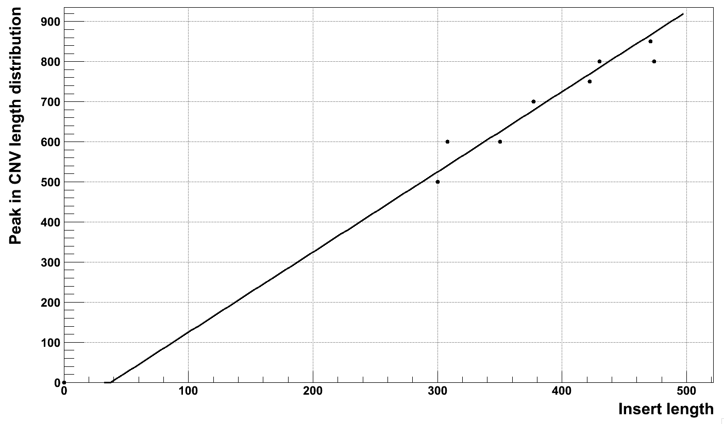
Peak and fragment length correlation
y=2*x-75

Slide 7
Tested hypotheses
Repeats
GC bias
BWA mapping artifact
Non reference contigs (insertion)
TEI insertions
Something going on in the middle

Slide 8
Testing paired reads for “weird” events
RP over middle
RP over breakpoints
Individual genome
Assuming deletion:
# of RP over middle is half the # of RP over breakpoint

Slide 9
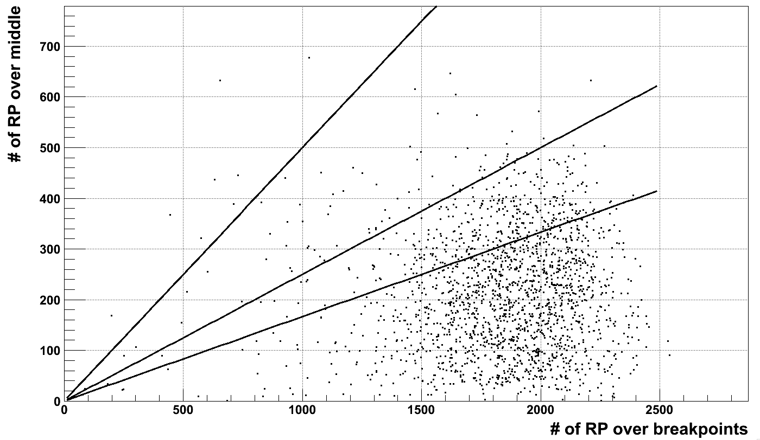
Over middle vs over breakpoints (“weird” events)
x/2
x/4
x/6

Slide 10
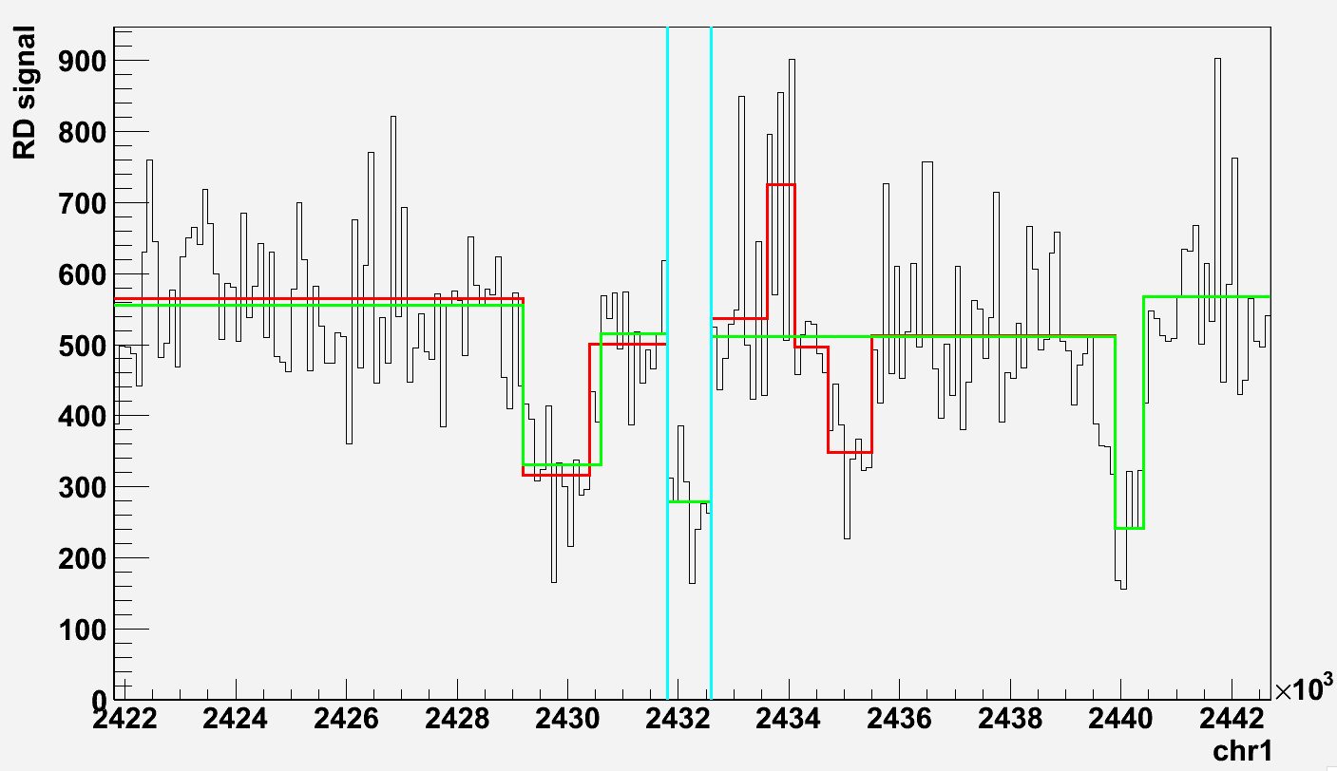
Testing paired reads for “weird” events
RP over middle
RP over breakpoints
Individual genome
What is in the middle?

Slide 11
Rechecking for GC bias
Deletion
Individual genome
Sliding window of 100 bp =>
Finding location of a windows with maximum GC

Slide 12
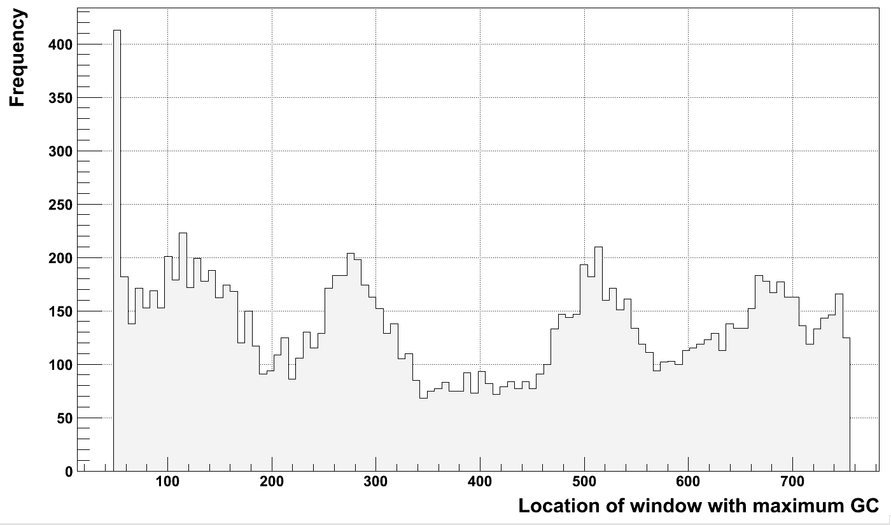
GC bias (“weird” deletions of 800 bp in length)

Slide 13
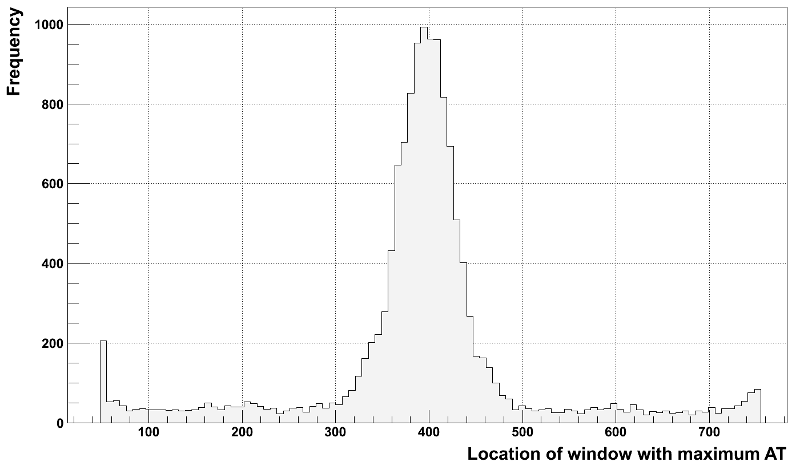
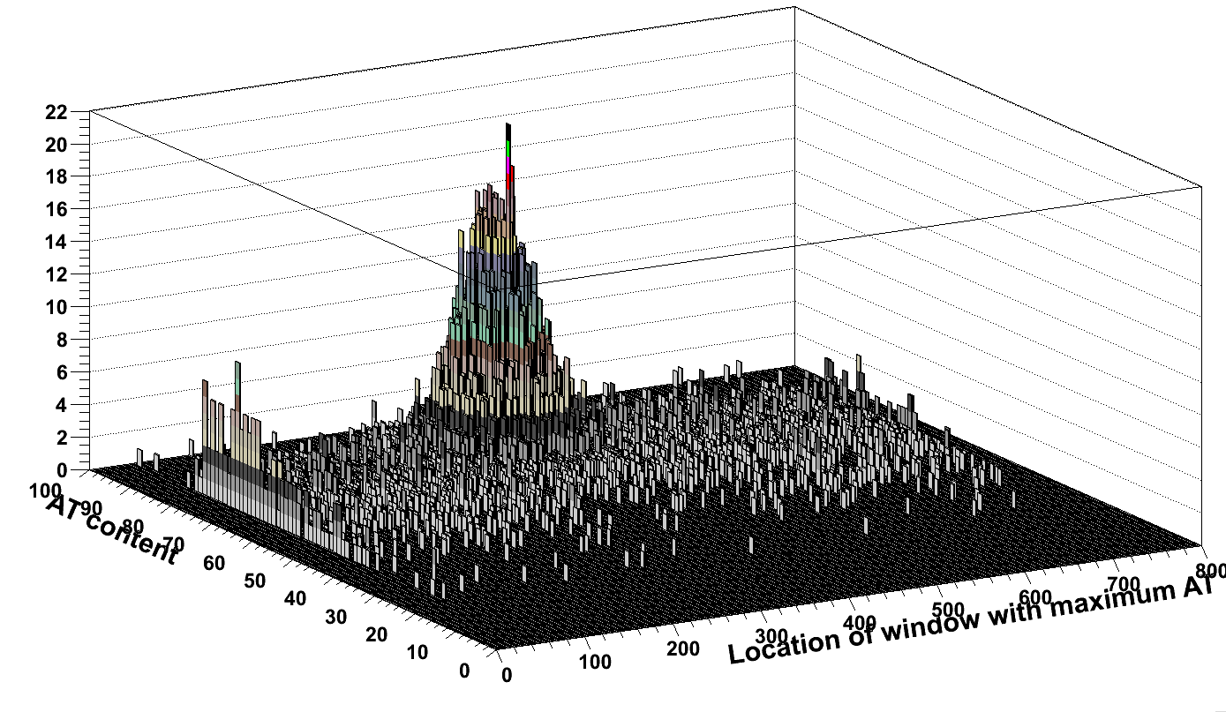
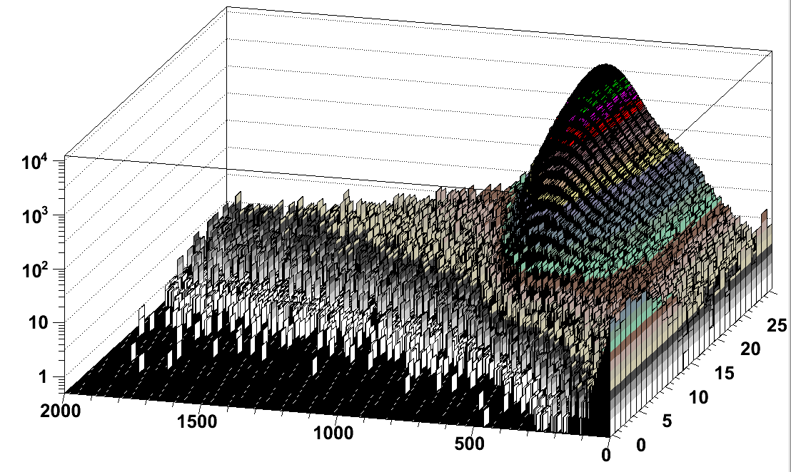
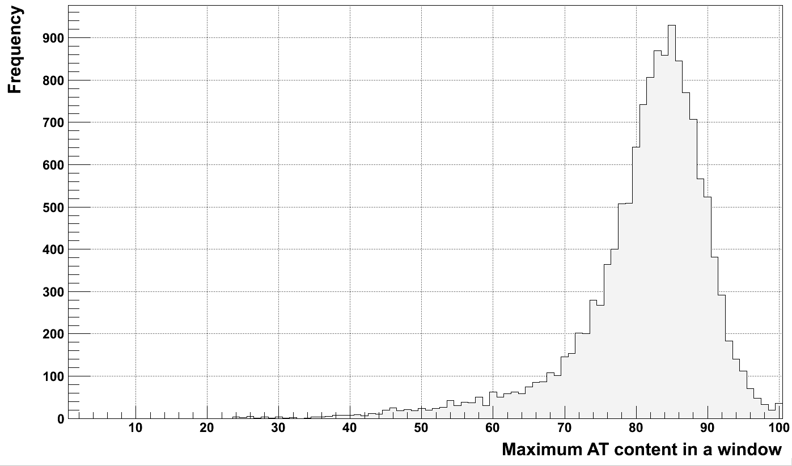
AT bias (“weird” deletions of 800 bp in length)

Slide 14
Hypothesis
AT-rich related region
Individual genome
Sequenced fragment
No sequenced fragment
Read depth signal
Zero level

Slide 15
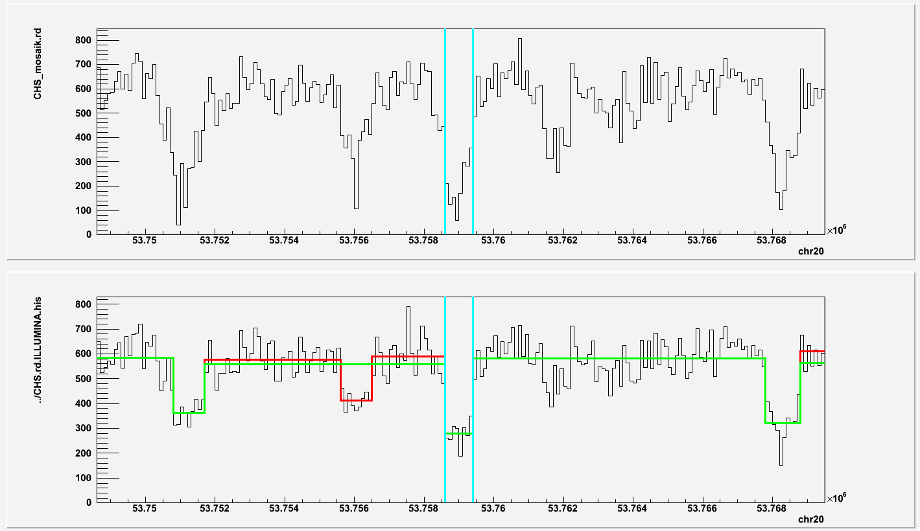
The bias is not mapper specific

Slide 16
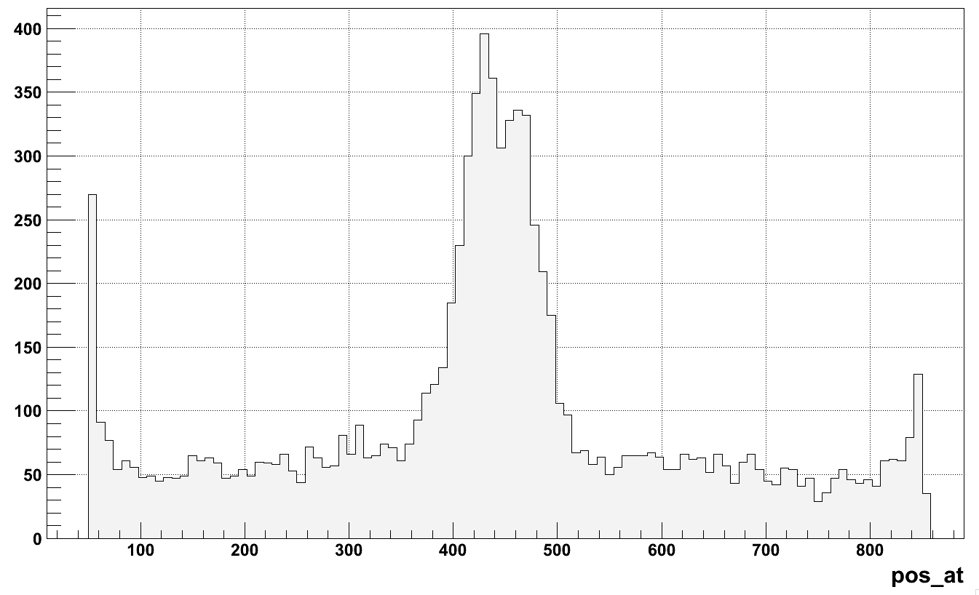
AT bias (deletions of 900 bp)

Slide 17
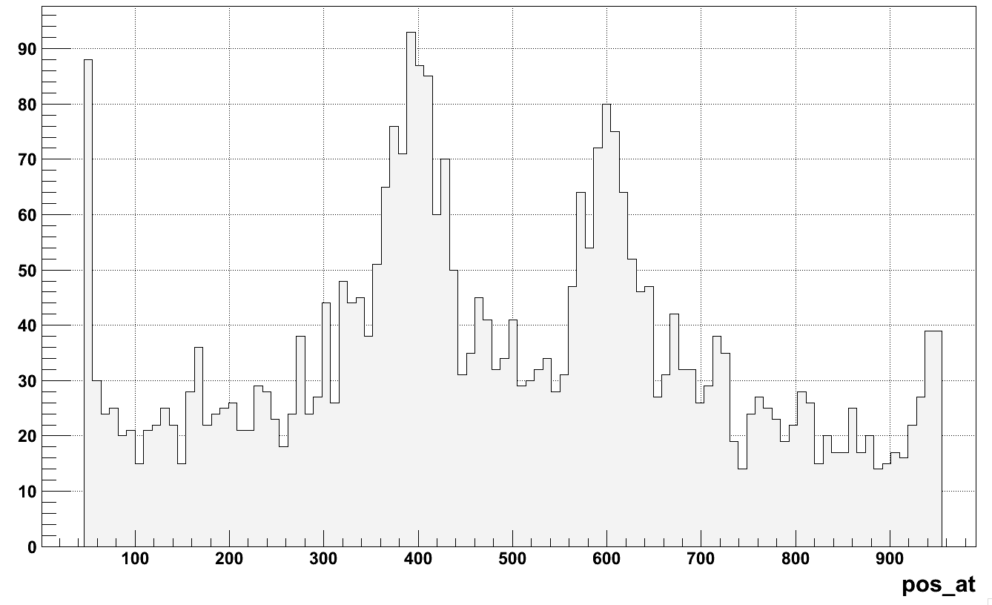
AT bias (deletions of 1000 bp)

Slide 18
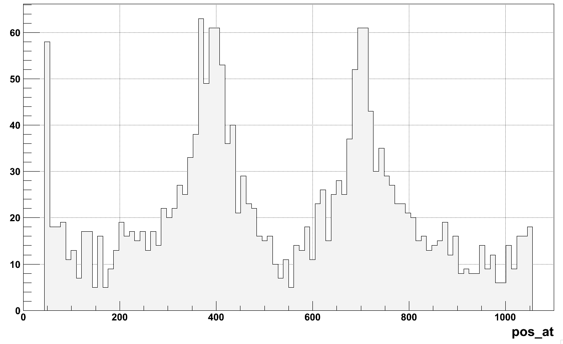
AT bias (deletions of 1100 bp)

Slide 19
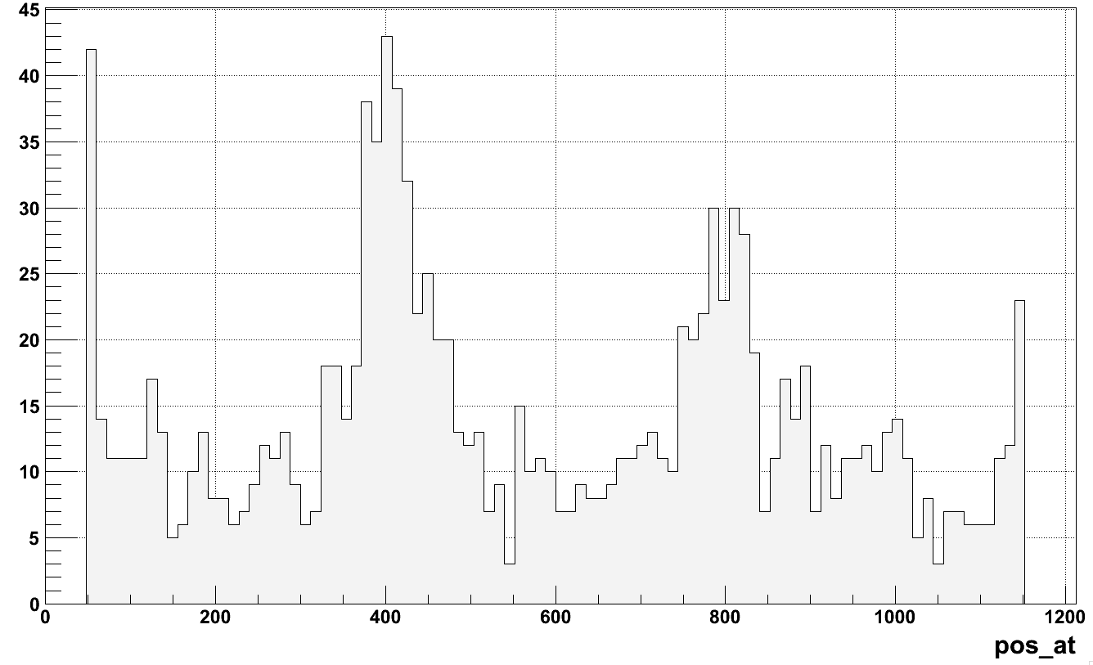
AT bias (deletions of 1200 bp)

Slide 20
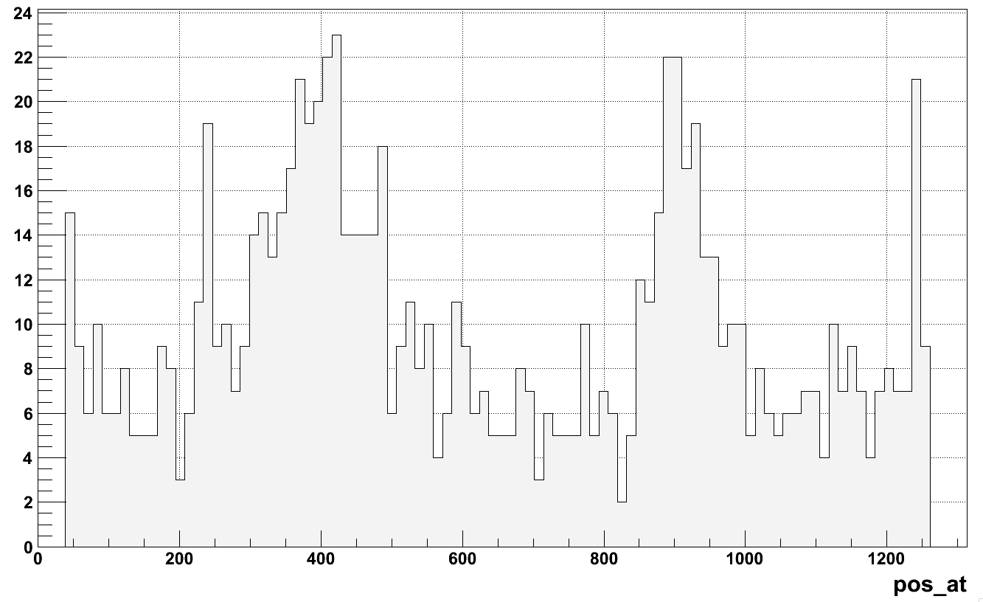
AT bias (deletions of 1300 bp)

Slide 21
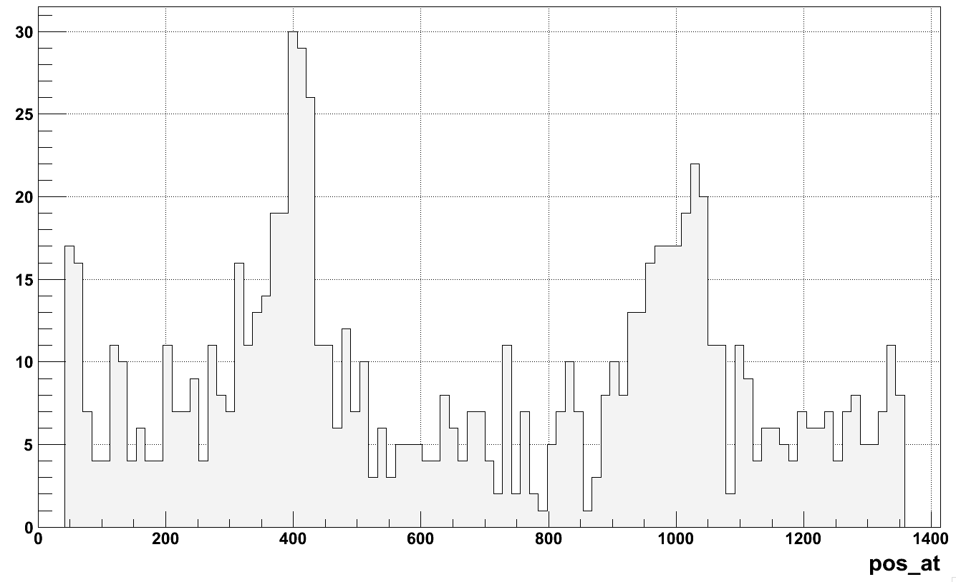
AT bias (deletions of 1400 bp)

Slide 22
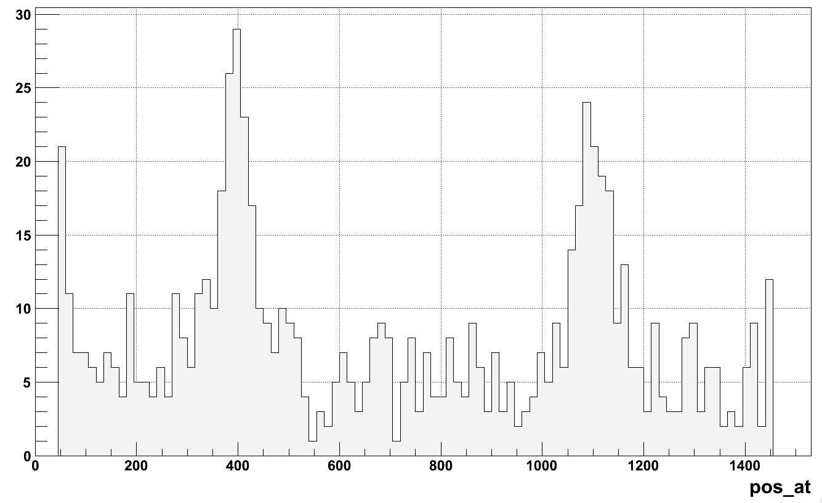
AT bias (deletions of 1500 bp)

Slide 23
AT-bias is also noticed by
Whole-genome sequencing and variant discovery in C. elegans. Hillier et al. Nat Methods. 2008 Feb;5(2):183-8. Epub 2008 Jan 20.
Analyzing and minimizing PCR amplification bias in Illumina sequencing libraries. Aird et al. Genome Biol. 2011 Feb 21;12(2):R18. [Epub ahead of print]

