Slide 1
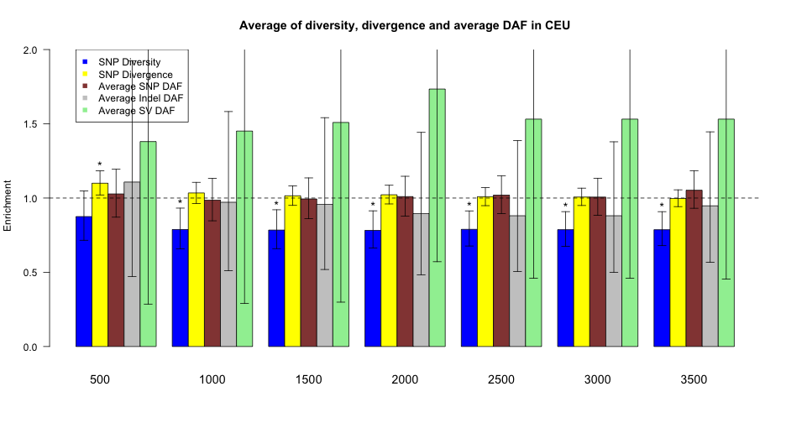
TF motif proximal/distal to genes
Notes:
no change

Slide 2
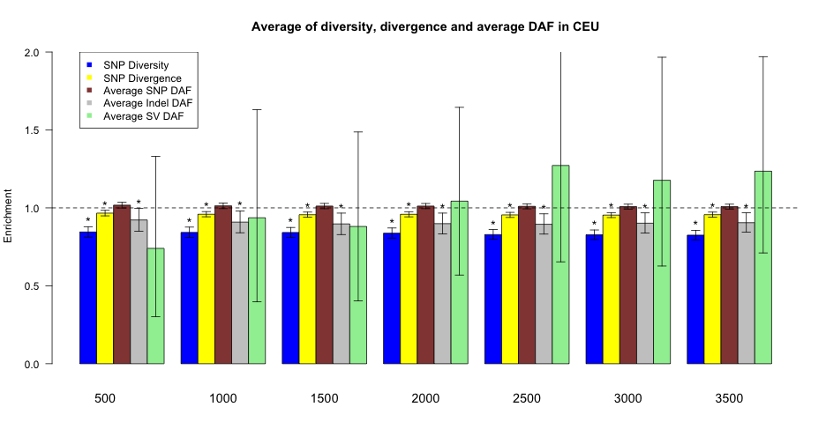
TF peak proximal/distal to genes
no change

Slide 3
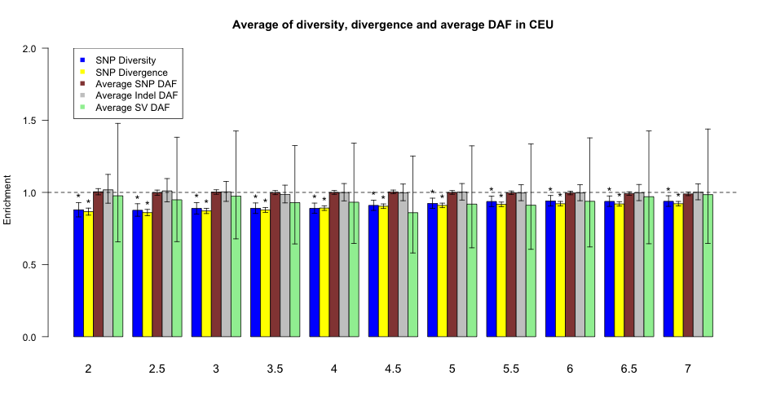
TF peak stronger/weaker
no change

Slide 4
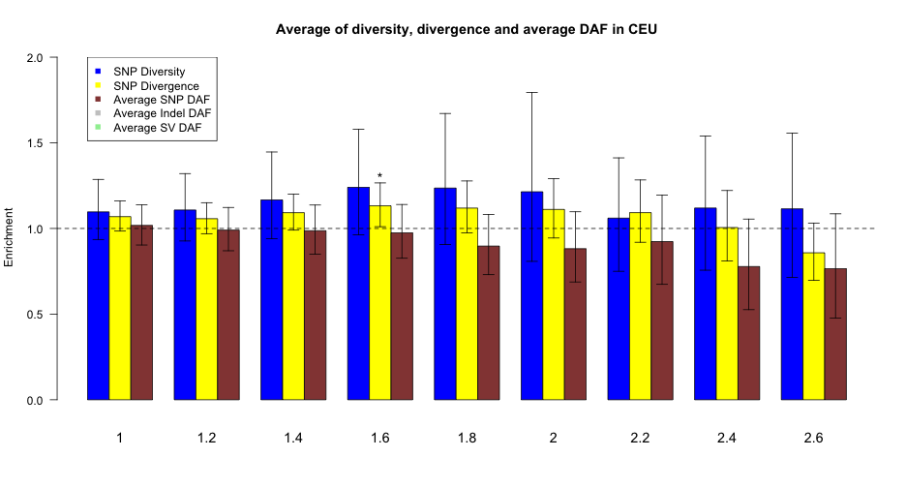
3’UTR more/less structured
no change

Slide 5
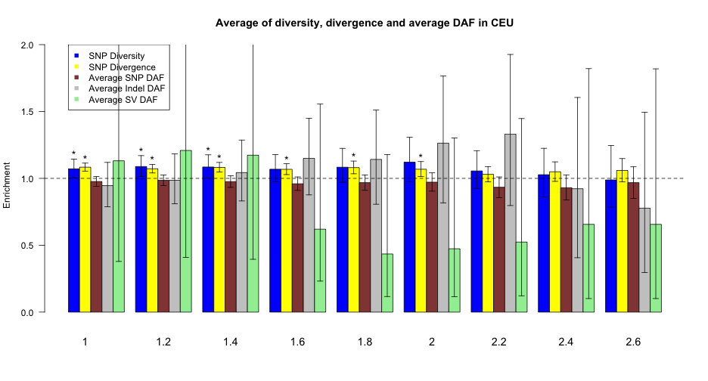
5’UTR more/less structured
no change

Slide 6
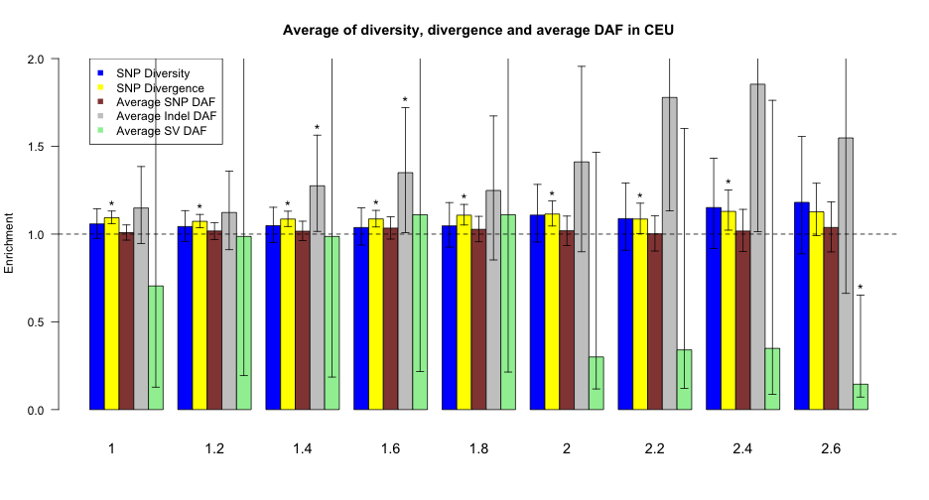
intron more/less structured
no change

Slide 7
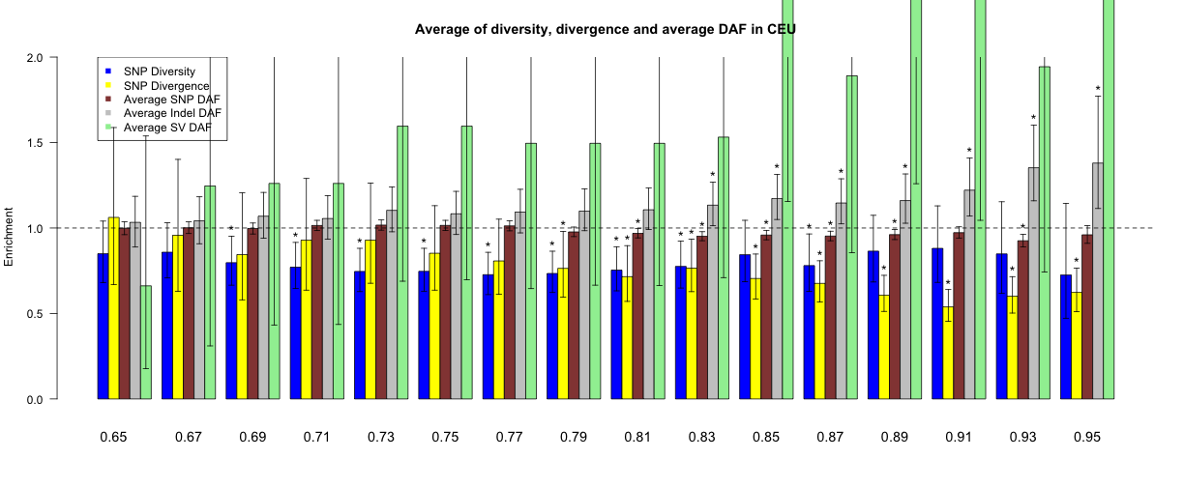
Pseudogene duplicated old/young
percent identity to parent gene

Slide 8
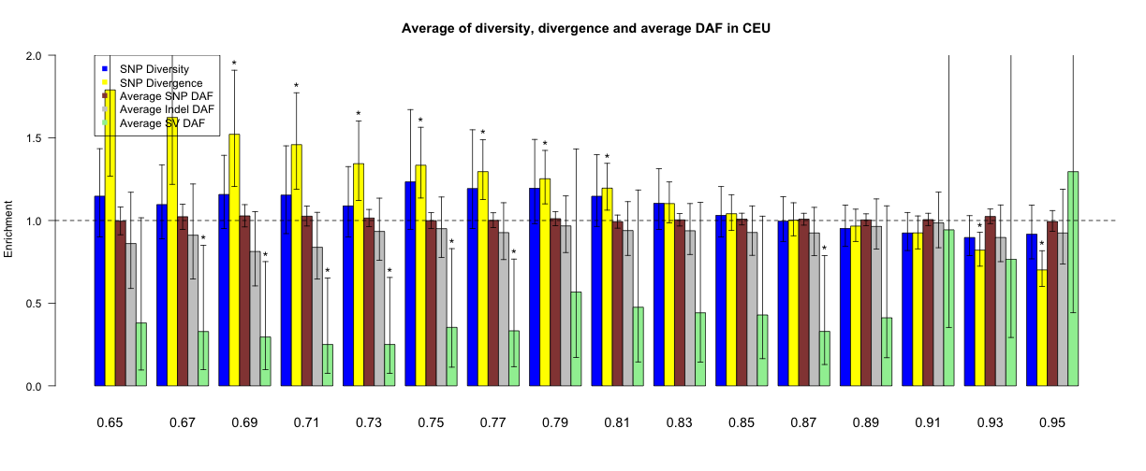
Pseudogene processed old/young
percent identity to parent gene

Slide 9
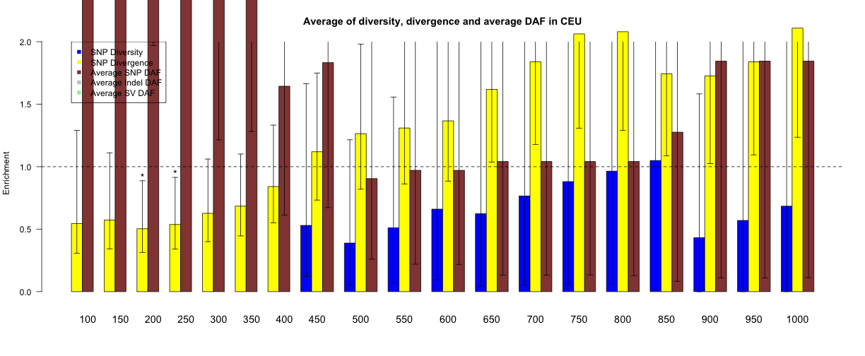
miRNA more/fewer targets

