Slide 1
PPDs in pilot project of 1KG
Alexej Abyzov
April 5, 2011

Slide 2
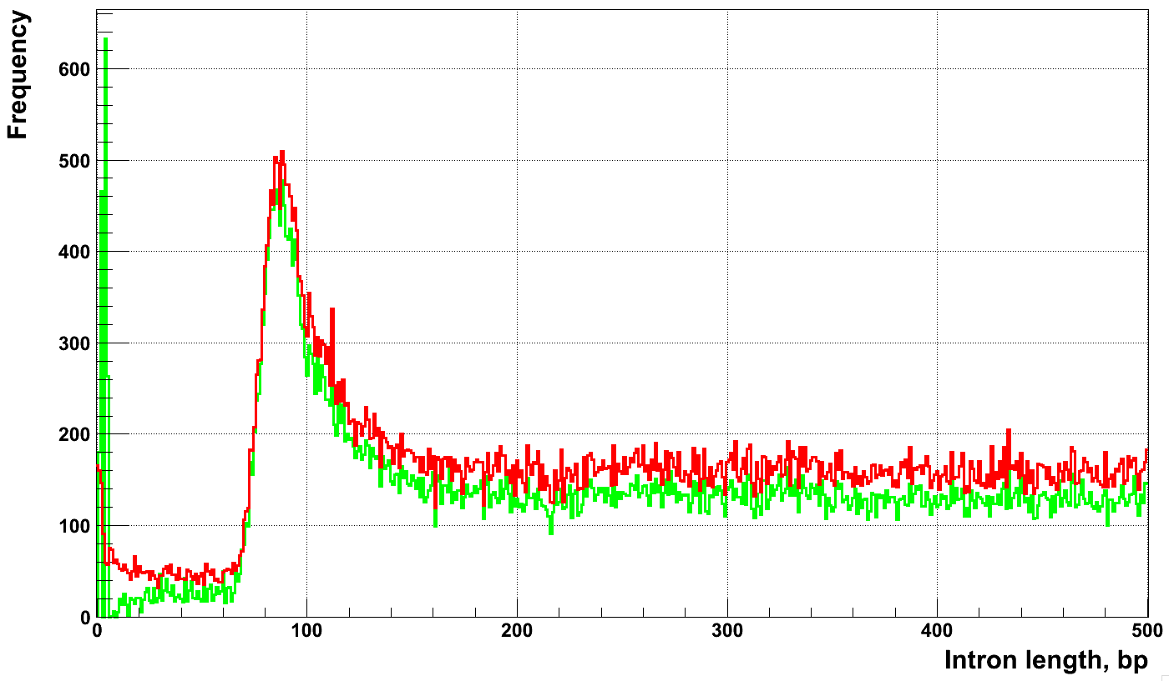
Junction size
UCSC
Gencode v3b
Junction length, bp

Slide 3
Selection for good mapping
Using hg18
Using 2x100 junction sequences
Junction interval is at least 60 bp
Reads span for at least 5 bp on each side of junction

Slide 4
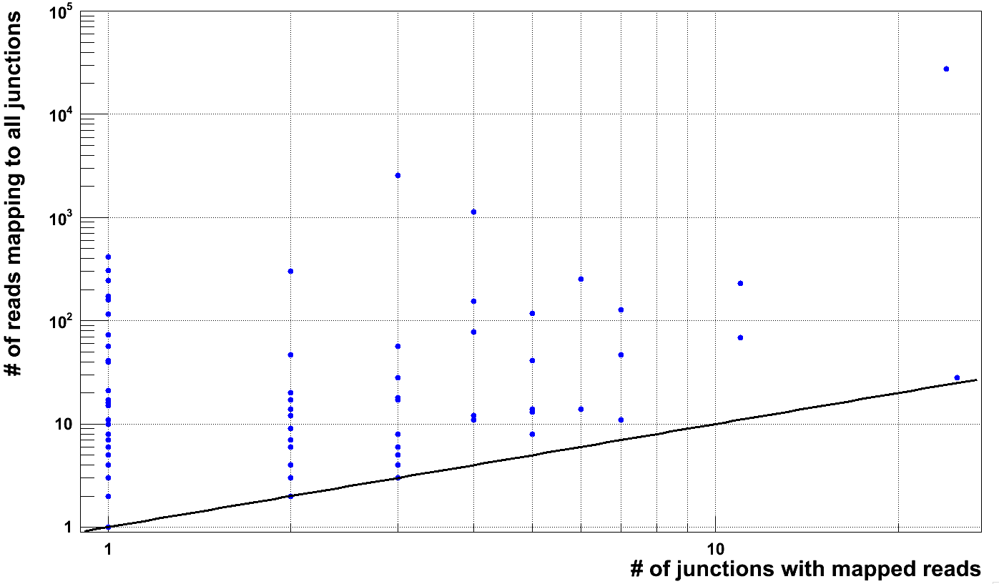
CEU population (pilot 1)
CDC27

Slide 5
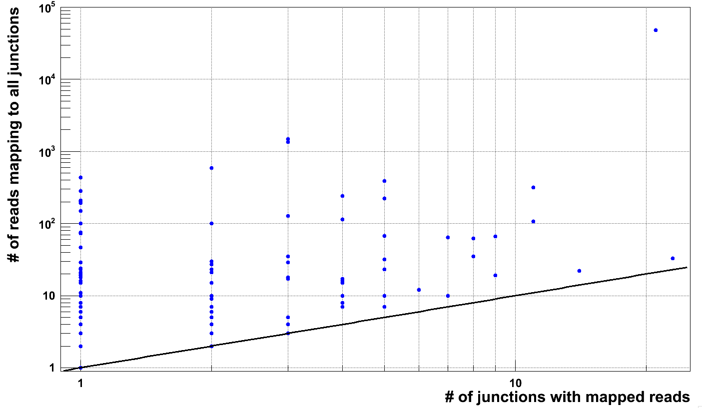
YRI population (pilot 1)

Slide 6
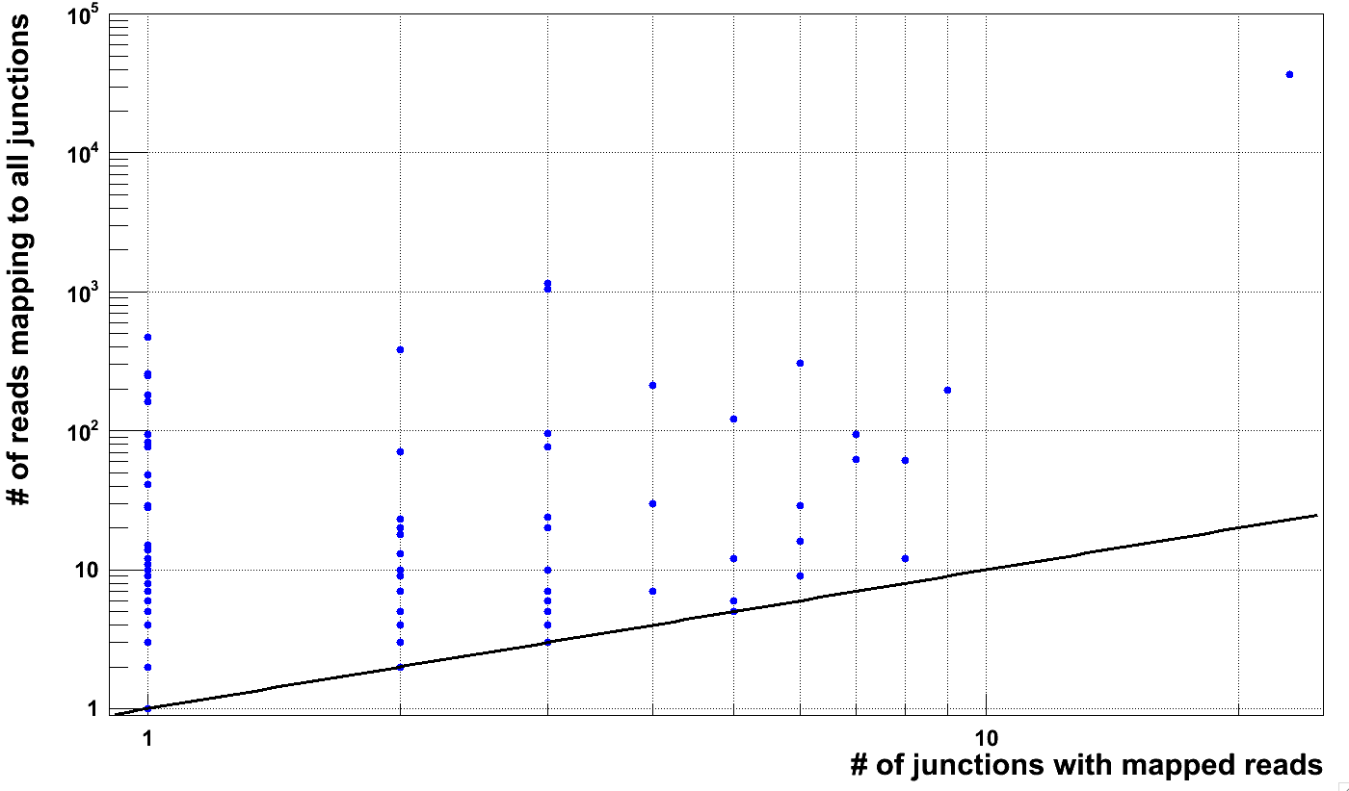
CHBJPT population (pilot 1)

Slide 7
Summary of findings
Pilot | Population | Individuals | # of genes with Ψgene
Pilot 1 | CEU | NA12891 (father) | 16
 |  | NA12892 (mother) | 22
 |  | NA12878 (daughter) | 23
 |  | All three | 32
 | YRI | NA19239 (father) | 18
 |  | NA19238 (mother) | 22
 |  | NA19230 (daughter) | N/A
 |  | All two | 27
Pilot 2 | CEU | 49 | 48
 | YRI | 57 | 80
 | CHBJPT | 58 | 43
At least two junction have mapped reads && at least one junction with > 1 mapped read

Slide 8
Intersection
Pilot 1
CEU trio (pilot 2)
CEU
CHBJPT
Father
Mother
2
1
10
4
2
6
31
10
5
6
3
5
38
5
YRI
Child
Total of 96 genes
Total of 32 genes

Slide 9
Child specific
 | Father NA12891 |  | Mother NA12892 |  | Child NA12878 |  | Gene | Conclusion
 | J | R | J | R | J | R
chr2:37179857-37237712 | - | - | 2 | 2 | 3 | 4 | EIF2AK2 | Thresholding
chr12:102883723-102906785 | - | - | - | - | 3 | 7 | TDG | False positive or de novo*
chr5:172967123-172976269 | 2 | 2 | - | - | 2 | 8 | BOD1 | Thresholding
chr18:19950786-19968058 | - | - | 1 | 2 | 3 | 4 | AC090772.3 | Thresholding
chr13:22123072-22147392 | 1 | 3 | 1 | 3 | 2 | 6 | AL354828.1 | Thresholding
*Evidence for unknown Ψgene for TDG is found in all three populations
TDG is not false positive and not de novo
J -- # of junctions with mapped reads, R -- # of reads mapped to all junctions

Slide 10
Parent specific
 | Father NA12891 |  | Mother NA12892 |  | Child NA12878 |  | Gene | Conclusion
 | J | R | J | R | J | R
chr1:33246172-33275180 | 1 | 1 | 2 | 6 | 1 | 9 | AK2 | Thresholding
chr8:101784320-101803491 | 2 | 2 | 5 | 7 | - | - | PABPCP5 | Thresholding
chr5:150050549-150060817 | - | - | 2 | 5 | 1 | 1 | RBM22 | Thresholding
chr14:20747135-20807478 | - | - | 2 | 4 | 1 | 1 | HNRNPC | Thresholding
chr7:23316353-23476611 | 1 | 1 | 2 | 9 | 1 | 3 | IGF2BP3 | Thresholding
chrX:70255131-70279028 | 1 | 1 | 2 | 3 | - | - | MED12 | Thresholding
chr8:98856985-98934002 | 3 | 11 | - | - | - | - | LAPTM4B | Specific
chr8:30040946-30060252 | 2 | 5 | - | - | - | - | TMEM66 | Specific
J -- # of junctions with mapped reads, R -- # of reads mapped to all junctions

Slide 11
Pilot 1 vs. Pilot 2
YRI
CEU
Pilot 1
57 samples
Pilot 1
49 samples
55
19
25
29
Pilot 2
2 samples
Pilot 2
3 samples
2
3
Pilot 1 seems to be much more informative

Slide 12
Pilot 3
Population | # of individuals | # of genes with novel Ψgenes | # of in target genes with novel Ψgenes | Total # of genes with novel Ψgenes*
CEU | 65 | 158 | 135 | N/A
YRI | 70 | 38 | 28 | 560
CHB | 46 | 14 | 8 | 160
JPT | 89 | 16 | 9 | 180
CHD | 28 | 12 | 3 | 60
TSI | 66 | 11 | 4 | 80
???
* Assuming 20,000 in human genome and knowing that ~1000 genes were targeted

Slide 13
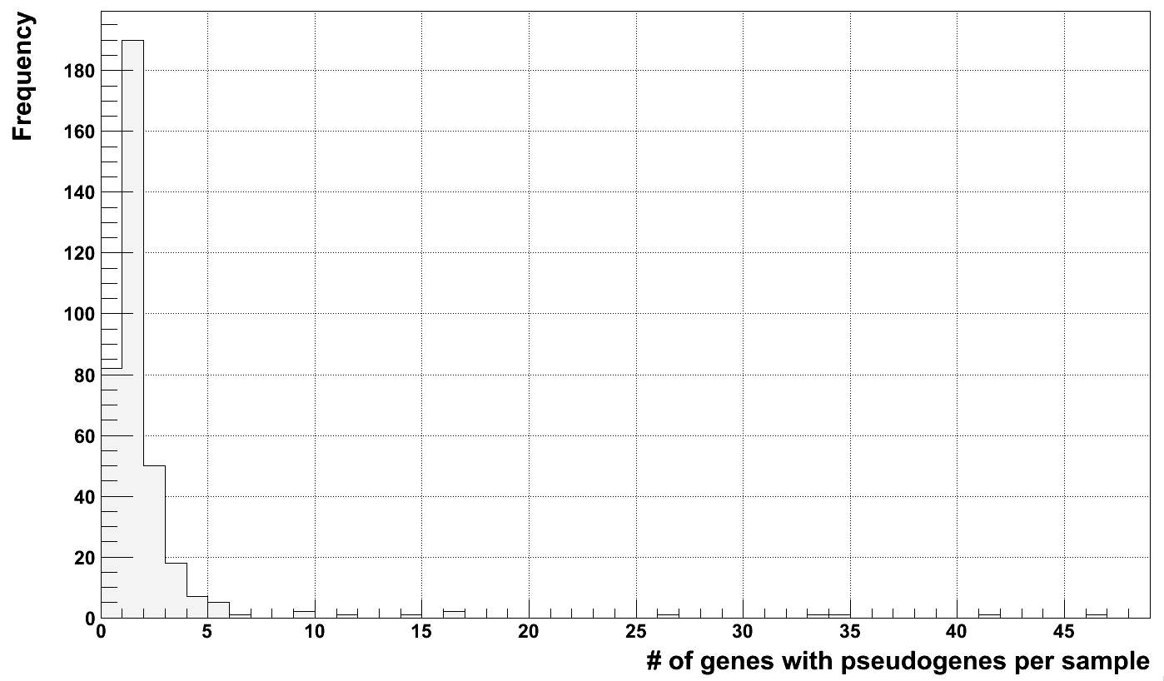
Outliers or Mormons?
YRI
CEU, Utah
NA12273, NA19092
NA11829
NA18856
NA11920, NA11994
NA12045
NA06986, NA11832
NA11831
NA07346

Slide 14
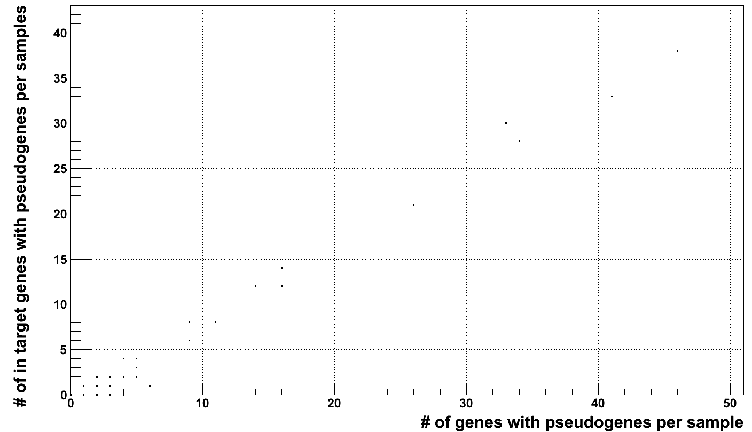
Outliers drive counts

Slide 15
Methodology
Unknown Ψgene
Gene model
( )
( )
( )
Splice junction
library
Unique sequences
Bowtie mapping
Not mapped reads
( )
( )
( )
Data: 1KG Pilot 2
How to count junctions?

Slide 16
Pilot 2 vs. Pilot 3
Pop. | Individual | # of genes with novel Ψgenes (Pilot 2) | # of genes with novel Ψgenes (Pilot 3) | # of gene common to the two pilots
CEU | NA12891 (father) | 16 | 2 | 2
 | NA12892 (mother) | 22 | 2 | 1
 | NA12878 (daughter) | 23 | 1 | 1
YRI | NA19239 (father) | 18 | 1 | 1
 | NA19238 (mother) | 22 | 5 | 1
 | NA19230 (daughter) | N/A | 1 | N/A

