Slide 1
Network Dysregulation in Prostate Cancer
Identifying Novel Alternative Exons in Mouse (Mus musculus) DSCAM
and
Work that was
Work that is to come
Lucas Lochovsky
group.meeting@gersteinlab
April 4, 2011
Notes:
Good afternoon. It seems you caught me in between projects, so I’m going to presenting on some work that was, and some work that is to come. The work that was is “Identifying Novel Alternative Exons in Mouse DSCAM” and the work that is to come is “Network Dysregulation in Prostate Cancer”

Slide 2
DSCAM Alternative Splicing: Introduction
DSCAM = Down Syndrome cell adhesion molecule
Fly version known to have extensive alternative splicing, what about mammalian version?
Want to computationally predict new splice variants and verify in wet lab analysis
Notes:
So first I’m going to talk about my alternative splicing work, which I did in collaboration with the Stein lab. For the purpose of quickly recapping the motivation behind this work, here’s a brief introduction. DSCAM stands for Down Syndrome cell adhesion molecule, a gene whose fly version is known to have extensive alternative splicing. In the second half of 2010, I was working on to computationally predicting new splice variants of the mammalian version, which can then be verified in a wet lab analysis.

Slide 3
Investigating Which Program to Use
Knapp K and Chen YP. “An evaluation of contemporary hidden Markov model genefinders with a predicted exon taxonomy.” Nucleic Acids Research, 2007, Vol. 35, No. 1, 317–324
Review of best HMM-based gene/exon finding programs released in the past decade
Strongest programs were Twinscan and Genomescan
Notes:
So we have the sequence, and we know where the annotated exons are. My first step was to look at a review of recently developed gene finders with exon prediction to determine the best one to use. This study found that Genomescan was the best overall program, but Twinscan was the best on identifying features within a gene, so I opted to see what results I’d get from both of these programs.

Slide 4
Program Results
Twinscan
Found all annotated exons
Also found three novel exons
But one of these has an alternate start codon, and one has an alternate stop codon
DSCAM exons are split across two “predicted” genes
First three annotated exons + two novel exons
One novel exon (with alternate start codon) + remaining 30 annotated exons
Exon # | Start | End | Length
1 | 149,507 | 149,622 | 116
2 | 162,734 | 162,811 | 78
3 | 303,649 | 303,723 | 75
Notes:
What I found was that Twinscan found all the annotated exons, and also found three novel exons. These exons are split across two “predicted” genes. Twinscan thinks the first three annotated exons, plus the first two novel exons, form one gene, and the second gene starts with the third novel exon, and contains the remaining 30 annotated exons. Genomescan, however, produced some really weird results, for example it thought that there were 14 short genes within DSCAM’s coding region, most of which didn’t line up with known exons. Therefore, I’ve decided not to trust Genomescan’s results henceforth.

Slide 5
Investigating Novel Exons
Ran these exons through Website for Alternative Splicing Prediction (WASP; http://www.psi.toronto.edu/wasp)
Takes exon sequence and determines regulatory features and alternative splicing patterns across tissue types
These exons are not in the WASP database
Have the exons studied by hand? (will take several days)
Alternate means of studying these exons?
Notes:
The next thing I did was use the website for alternative splicing prediction, or WASP, produced and maintained at the Probabilistic and Statistical Inference Group at the University of Toronto. This system was trained on known exons and regulatory features so that it can make de novo splicing predictions for new exons. However, on running my novel exons on WASP, it could not find any analogous exons in its database, and therefore produced no results. It’s possible to ask for these exons to be manually curated, but that can take several days. I instead looked into alternate means of determining if my exons have any biological significance.

Slide 6
More Novel Exon Investigation
Wanted to see if there are any proteins homologous to the splice variants implied by the novel exons
BLASTX
Mostly just discovered versions of DSCAM in other species
Also determine if those novel splice variants form any meaningful structure
HHpred, one of the highest scoring prediction software in the bi-annual CASP8 benchmark
Notes:
To determine if there are any proteins homologous to the splice variants implied by the novel exons, I ran the nucleotide sequences of the putative splice variants through BLASTX. I constructed these sequences by taking DSCAM’s annotated exons, adding some combination of the novel exons in the appropriate places, and seeing if the overall sequence formed an open reading frame. These potential splice variants, however, did not have any significant match with any proteins other than DSCAM variants in other species. I also used a protein structure prediction software to determine if these novel splice variants form any meaningful structure. In picking a program, I looked at the latest CASP benchmark, which is a bi-annual analysis of protein structure prediction software that tests and ranks all the leading solutions at the time. The latest one, CASP8, was conducted in 2008. Not all of the programs in CASP are freely available to use, so I couldn’t just pick the best one. I settled on one called HHpred, given its availability, accuracy, and speed.

Slide 7
HHpred Results
Most splice variants just matched the mammalian DSCAM structure
Exception: Splice variant involving the first three annotated exons + two novel exons (alternate stop codon)
Although this variant’s strongest match was with the DSCAM structure, it also had fairly strong matches with a tyrosine protein kinase receptor → unlikely since this hypothetical gene has no transmembrane domain
Notes:
What I found with HHpred was that most splice variants’ structures ended up matching the mammalian DSCAM structure. Although there was one variant that also had a fairly strong match with another class of proteins. This is the variant that includes the first three annotated exons + two novel exons. In addition to matching the DSCAM structure, it also matched the structure of a tyrosine protein kinase receptor. However, we later decided this was a spurious results, because the hypothetical receptor gene doesn’t include a transmembrane domain.

Slide 8
InterProScan
Attempted to identify functional domains in the putative novel splice variants using InterProScan (EBI database of known protein domains)
InterProScan did not find any new functional domains when the novel exons were included in the search
Novel exons either represent previously undiscovered functional domains, or are spurious
Notes:
I also tried to characterize these putative splice variants by looking for InterProScan protein domains in the sequences of these variants. However, InterProScan did not find any new functional domains when the novel exons were included in the search. Therefore, these novel exons either represent previously undiscovered functional domains, or are spuroius.

Slide 9
RNAseq Validation
Find RNAseq support for novel exons in mouse and human DSCAM genes
For mouse, used RNAseq data for mouse brain tissue from the Wold lab
For human, used Yale RNAseq data for ENCODE Tier 1 human cell lines (GM12878, K562)
Visualized with the UCSC Genome Browser
Notes:
The last validation method I used was to look for support for these exons in existing mouse and human RNAseq data. For mouse, I used RNAseq data for mouse brain tissue from the Wold lab, and for human data, I used the Yale RNAseq data for ENCODE tier 1 human cell lines. I put these tracks into the UCSC Genome Browser to examine the signals at DSCAM’s coordinates.

Slide 10
Mouse brain RNAseq
Mostly recapitulates known exons
Small peak (height 2) between last and second last known exon
Does this correspond to the novel exon Alice (from the Stein lab) found in her own analyses?
Most peak heights seem to fall between 5 and 10
Notes:
Now the mouse data mostly recapitulates known exons, however I did find a small peak at the end of the gene between the last two exons, which was interesting, because my collaborator in the Stein lab found RT-PCR evidence for a possible novel exon in the same region. On the other hand, most peak heights fall between 5 and 10, so it’s possible this could be a false positive signal.

Slide 11
Human K562 RNAseq
86 annotations from K562 bed signal file fall within the human DSCAM gene coordinates
Only one has any overlap with a known exon
Most are small regions (20-30 bp) with a score of 1 or 2
Two exceptions:
chr21:41055579-41055613 (avg. score ~44.08, maps to intron 1)
chr21:41140556-41140589 (avg. score ~4.43, maps to exon 1)
Plan was to confirm with RT-PCR
Notes:
In the human K562 RNAseq track, most of the annotations in the DSCAM region are small, low-scoring peaks. However, there were two peaks with a significantly higher score that fall within exon 1 and intron 1 of DSCAM. We passed this along to the Stein lab for confirmation with RT-PCR, but we haven’t heard anything back yet.

Slide 12
Human GM12878 RNAseq
Again, only one annotation has any overlap with a known exon
Most peaks have score 1, only a couple have score 2 or 3
No high-scoring peaks → spurious?
Notes:
And in GM12878, we saw all the small, low-scoring peaks, and nothing with a high score, so that wasn’t very informative.

Slide 13
So Where Is This Now?
Intended followup was to obtain confirmation of these computational predictions through wet lab analysis
No word from my contact in the Stein lab since December
Current project status: Meat popsicle (a.k.a. cryogenic stasis)
Notes:
Now unfortunately, this project has kind of been left dangling for the last little while. In December, I was conferring with my collaborator in the Stein lab to followup with these computational predictions with RT-PCR confirmation. However, I have received no word from the Stein lab since that time. Therefore, I’m sorry to say that right now, this project is a meat popsicle.

Slide 14
Interlude
Comparing the output of dindel and the Broad Institute’s GATK
Found most of GATK’s indels are contained within the dindel list
Wrote an efficient read deduplicator for seqViz in Fusion-seq
If a large number of reads map to the same genomic location, collapse them down to one read
Waiting to discuss with the original author of seqViz
Proofreading various supplements, editing various images (Illustrator monkey)
Notes:
Now before I get into my network dysregulation work, I’m going to quickly sound off on some of the smaller stuff I’ve been working on. So essentially it was like I’d spend a few weeks on this, a few days on that, and so on and so forth. So I spent some time comparing the indel calling of two indel callers, dindel and the Broad Institute’s Genome Analysis Toolkit, or GATK, or you can call it Gattaca. My analysis found that most of Gattaca’s indels are contained in the dindel list, although full disclosure, this was only done with one sample’s chromosome 22. Another mini-project I worked on was writing an efficient read deduplicator for the seqViz visualizer in Fusion-seq. Before, if a large number of reads mapped to the same genomic location, seqViz would process all of them, and it would finish after the web connection had timed out, meaning the user would never get to see the final picture. My code will quickly collapse these overlapping reads into a single record for seqViz to process. It has not been integrated into seqViz yet, as I’m waiting to discuss this with the original author of seqViz. And finally, there’s been random proofreading and Illustrator stuff I’ve had to do to help get papers out the door on time, yada yada yada.

Slide 15
Network Dysregulation: Overview
Goal: Understand prostate cancer by investigating interactions between cancer-associated aberrant genes
Cancer genes: From Rubin-Gerstein collaboration
87 gene signature associated with TMPRSS2-ERG fusion
List of recurrent lesions in primary prostate cancer in Demichelis 2009¹
ETS genes
¹F. Demichelis et al., others, “Distinct genomic aberrations associated with ERG rearranged prostate cancer,” Genes, Chromosomes and Cancer 48, no. 4 (2009): 366–380.
Notes:
So now we come to my current project, which involves studying cancer network dysregulation. The aim of this work is to understand prostate cancer by investigating interactions between cancer-associated aberrant genes. Lists of cancer-associated genes were obtained from data coming out of our longstanding collaboration with the Rubin lab, and includes an 87 gene signature associated with TMPRSS2-ERG fusion, a list of recurrent lesions in primary prostate cancer, and ETS genes.

Slide 16
Overview (cont’d)
Map these genes onto a protein-protein interaction network
HPRD (hprd.org)
Investigate the network properties of these genes
Local hubs
Global hubs
GO enrichment (using the BiNGO Cytoscape plugin)
Protein complexes (using the MCODE Cytoscape plugin)
Notes:
I mapped these genes onto the Human Protein Reference Database interaction network, and investigated the network properties of these genes. Specifically, I looked for local hubs, global hubs, Gene Ontology enrichment, and protein complexes.

Slide 17
ERG 87 Gene Signature: Local Hubs
Only three edges between nodes within the 87 gene signature
TBP-NCOA1
TBP-FOXF2
MTA1-HDAC1
Have transcription regulation functions
Notes:
So here’s the ERG network, and what’s immediately obvious is that between the genes in this set, there are only 3 edges. Most of these genes are in fact isolated from each other. Of note, TBP is the TATA box-binding protein, and MTA1 is correlated with metastatic potential of carcinomas.

Slide 18
ERG 87 Gene Signature: Global Hubs
Local hubs also play important roles in the global network.
Additional global hubs include:
BMPR1B
LRP1
TLE1
Notes:
Now this is the same network, but the node sizes represent how many edges each node has with any node in the HPRD network. Nodes with connections within the ERG network also have many connections in the global network. Additional global hubs include BMPR1B encodes a member of the bone morphogenetic protein (BMP) receptor family of transmembrane serine/threonine kinases. LRP1 is involved in endocytic receptor intracellular signalling, lipid homeostasis, and clearance of apoptotic cells. TLE1 is a transducin-like enhancer.

Slide 19
ERG 87 Gene Signature: GO MF enrichment
Notes:
Here I used Bingo to find GO molecular function enrichments in the ERG network, which constructs a hierarchical network of the terms that it found enrichments for. Here, I found enrichments for transcription factor binding, nucleotide binding, protein binding, and NAD or NADH binding.

Slide 20
ERG 87 Gene Signature: GO CC enrichment
Notes:
In the cellular compartment ontology, I found enrichments for plasma membrane, nucleoplasm, and protein complexes, including chromatin remodelling, transcriptional repressor, and a complex used for histone deacetylation and chromatin remodelling.

Slide 21
Prostate cancer recurrent lesions
Green: Amplified genes
Red: Deleted genes
Notes:
And this is the network for prostate cancer recurrent lesions. Here, there are two types of mutant genes we’re keeping track of: amplified genes are in green, deleted genes are in red. For the amplified genes, there is only one edge between two amplified genes, so most of the amplified genes are isolated from each other, but there are a fair number of interactions between deleted genes, and between genes of different types. The larger number of deleted genes also implies that deletions have a larger role in prostate cancer.

Slide 22
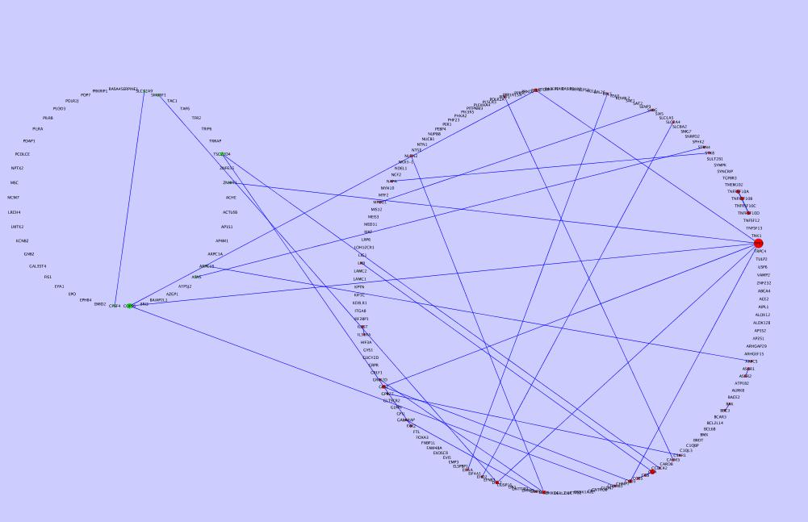
Prostate cancer recurrent lesions: Local hubs
Notes:
Here, the node sizes are mapped to the local degree, or number of edges between just the nodes in this network. The node with the largest degree is TP53, which has a well documented tumor suppressor role. Other high-degree nodes include CGA, which is the alpha subunit of a glycoprotein hormone, and COPS6, a subunit of a signalling complex that functions as an important regulator in multiple signalling pathways.

Slide 23
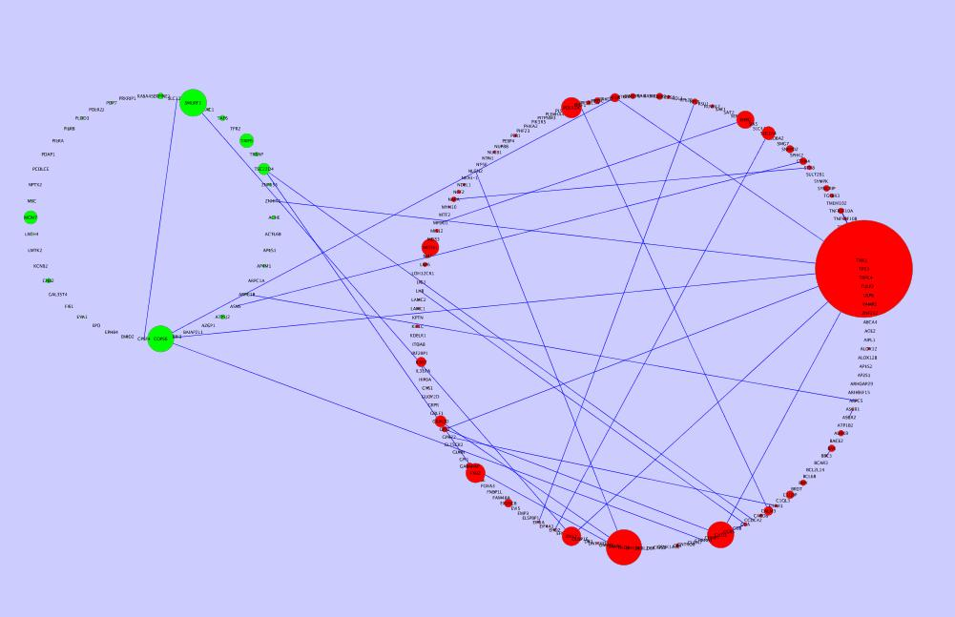
Prostate cancer recurrent lesions: Global hubs
Again, local hubs are also global hubs. Top 4 are TP53, DLG4, SMURF1, and COPS6.
Notes:
Again, hubs in the local network are also hubs in the global network (i.e. all of HPRD). TP53 and COPS6 are in the top 4 global hubs. The others are DLG4, which is a membrane-associated guanylate kinase, and SMURF1, a ubiquitin ligase specific to the bone morphogenetic protein (BMP) pathway.

Slide 24
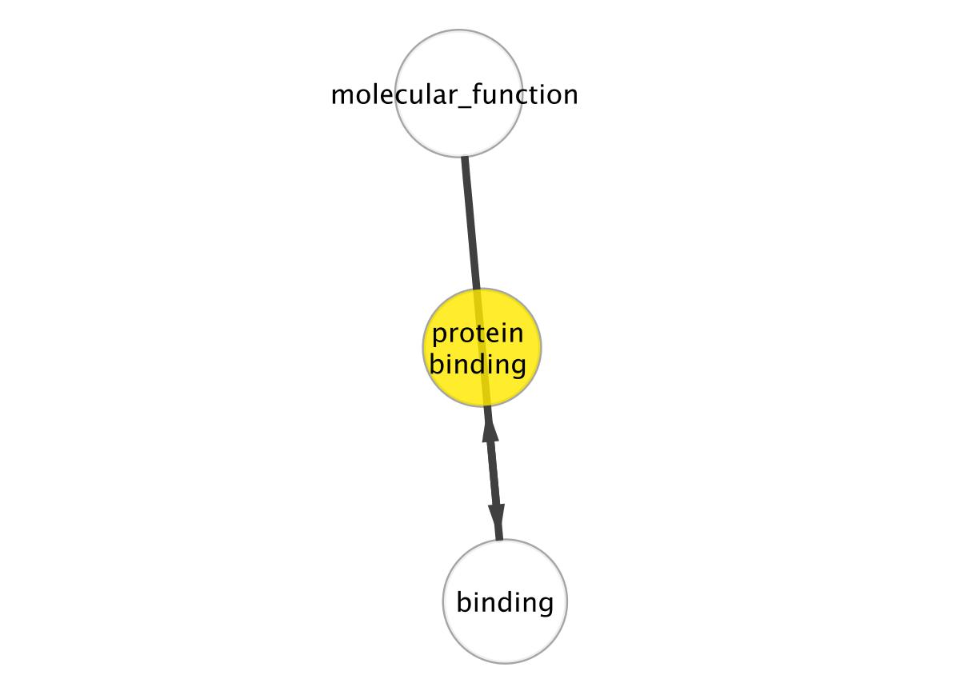
Amplified genes GO BP and MF enrichment
GO Biological Process
GO Molecular Function
Notes:
For GO enrichments, I studied amplified and deleted genes separately. This is what I found when I looked for GO biological process enrichment in amplified genes. The only enriched annotation was regulation of cholinergic synaptic transmission. Molecular function enrichment wasn’t particularly informative either, I just got enrichment in the very broad “protein binding” term.

Slide 25
Deleted genes GO BP enrichment
Notes:
Deleted genes were more interesting. In GO biological process, the two major enrichment clusters were positive regulation of peptidases (caspases) and cellular membrane organization. [indicate with laser pointer or mouse?]

Slide 26
Deleted genes GO MF enrichment
Notes:
In the molecular function ontology, I found enrichments in a number of distinct branches in the ontology network. These clusters include TRAIL binding, arachidonate 12-lipoxygenase activity, asialoglycoprotein receptor activity, C5a anaphylatoxin receptor activity, and protein phosphatase 2A binding, and caspase activator activity.

Slide 27
Protein complexes in deleted genes
Used MCODE, which looks for highly interconnected regions in a network
Among the deleted genes, MCODE predicted a complex between TNFRSF10B, TNFRSF10A, and TNFRSF10D
NCBI indicates that this complex is responsible for transducing the cell death signal and inducing cell apoptosis
Notes:
For finding protein complexes, I used the MCODE plugin for Cytoscape, which identifies complexes by finding highly interconnected regions in a network. Among the deleted genes, MCODE predicted a complex between TNFRSF10B, TNFRSF10A, and TNFRSF10D. NCBI indicates that this complex is responsible for transducing the cell death signal and inducing cell apoptosis.

Slide 28
ETS gene network
Purple: Can be amplified or deleted
Green: Amplified genes
Red: Deleted genes
Orange: Partial loss genes
Notes:
The last gene list I worked with was ETS gene list. Relatively few of these genes mapped to HPRD, but here we have four mutation types to investigate: amplified genes, deleted genes, genes that can be either amplified or deleted, and genes that are only partially lost in prostate cancer. Given the scarcity of edges, there aren’t really any local hubs here to investigate. The one edge that is there is between ERG and ETS2. ETS2 is a regulator of stem cell development, cell senescence, cell death, and tumorigenesis.

Slide 29
ETS gene network: Global Hubs
Notes:
Looking at the global degree of these nodes, ERG and ETS2 also have a number of connections with the entire HPRD network.

Slide 30
Amplified genes GO BP enrichment
Notes:
So then I did GO enrichment analysis on each network. In the amplified gene network, there were biological process enrichments for transcription regulation from RNAPII promoter, and macrophage differentiation.

Slide 31
Amplified genes GO MF enrichment
Notes:
In the GO molecular function ontology, enrichments were found for sequence-specific DNA binding and transcription regulation.

Slide 32
Deleted genes GO BP enrichment
Notes:
Turning to the deleted gene network, BP enrichments were in DNA-dependent transcription regulation, regulation of RNA metabolism, and regulation of nitrogen compound metabolic processes, and negative regulation of T cell receptor signalling pathway.

Slide 33
Deleted genes GO MF enrichment
Notes:
In the molecular function ontology, the deleted genes were enriched for transcription cofactor activity, transcription repressor activity, RNAPII transcription factor activity, purine-rich negative regulatory element binding, phosphotransferase activity, and protein histidine kinase activity.

Slide 34
Partial loss genes GO BP enrichment
Notes:
Finally, I looked at GO enrichments in the partial loss genes. Biological process enrichments covered amino acid methylation, cell proliferation, DNA-dependent transcription regulation, regulation of protein complex disassembly, and regulation of translational termination.

Slide 35
Partial loss genes GO MF enrichment
Notes:
In the molecular function ontology, enrichments covered translation release factor activity, sequence-specific DNA binding, specific RNAPII transcription factor activity, ligand-regulated transcription factor activity, and ribosome binding.

Slide 36
Future Directions
Map the cancer-associated genes from the most recent COSMIC release to HPRD
Do other annotation enrichments analyses (OMIM, KEGG, InterPro)
Look for similar/dissimilar network motifs between different types of cancer (requires graph matching)

Slide 37
Acknowledgements (Alphabet Soup 2011 Edition)
ASB
LH
MG
MR e.u. (et underlings)
GenoTech subgroup
iNets subgroup
UC’s (Uncredited Contributors)

