Slide 1
Haplotype phasing
by fosmid pool approach
Journal Club
Jasmine Mu
March 30, 2011
http://www.nature.com/nbt/journal/v29/n1/abs/nbt.1740.html

Slide 2
Terminology
Haplotype – the specific set of alleles observed on a single chromosome, or part of a chromosome.
Phasing - the assignment of alleles to homologous chromosomes.

Slide 3
Methods for phasing
Experimental phasing
- various forms of PCR (1990-2006)
- atomic force microscopy with carbon nanotubes (2000)
- hybridization of probes to single DNA molecules (2009)
- mate-pair next-gen sequencing (almost all <3.5kb, the insert size in a SOLiD paper – McKernan 2009)
- fosmid/cosmid pool + PCR +Mass Spectrometry (2003)
Limitations for above:
- Haplotype block has limited size - tens of kilobases apart and/or a limitation in the number of markers that could be phased in a single assay
Whole genome haplytoping:
- microdisection (2010) - time-consuming, expensive
- somatic cell hybrids (2001) - requires specialized and expensive equipment
- microfluidic direct deterministic phasing (2010) – a single cell in metaphase

Slide 4
Methods for phasing
Statistical phasing (e.g. HapMap and 1000G)
- population-based linkage disequilibrium data
- pedigree analysis
Limitations:
- when linkage disequilibrium is not high
- for rare variants
- pedigree analysis requires many related individuals, increasing costs and limiting practical application.

Slide 5
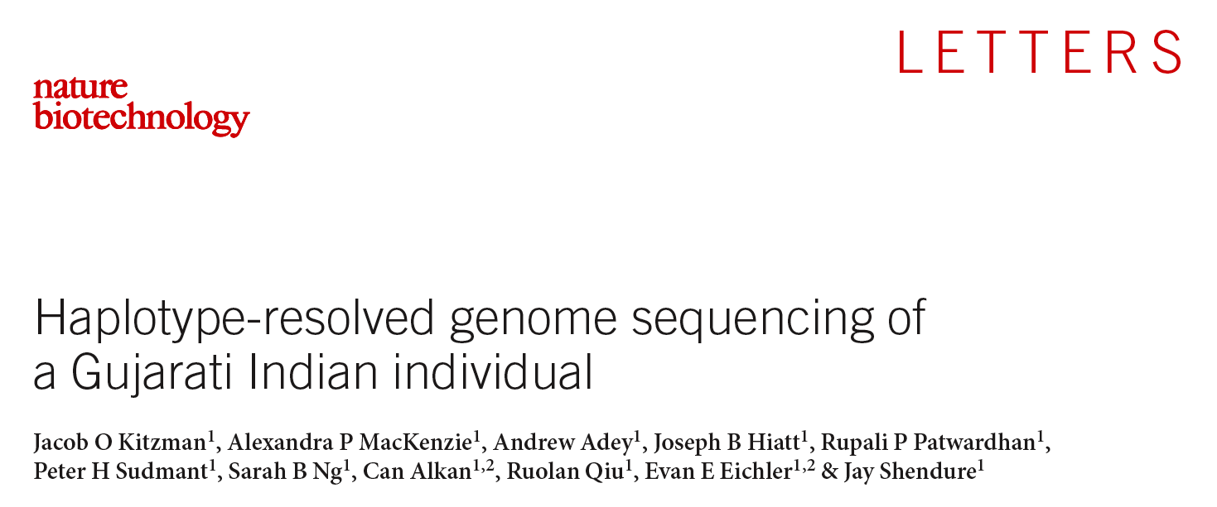

Slide 6
Introduction
Haplotypes have heretofore been intractable to genome-wide, experimental determination in the context of massively parallel sequencing.
A cost-effective method for determining long-range haplotypes at a genome-wide scale by massively parallel sequencing of complex, haploid subsets of an individual genome.

Slide 7
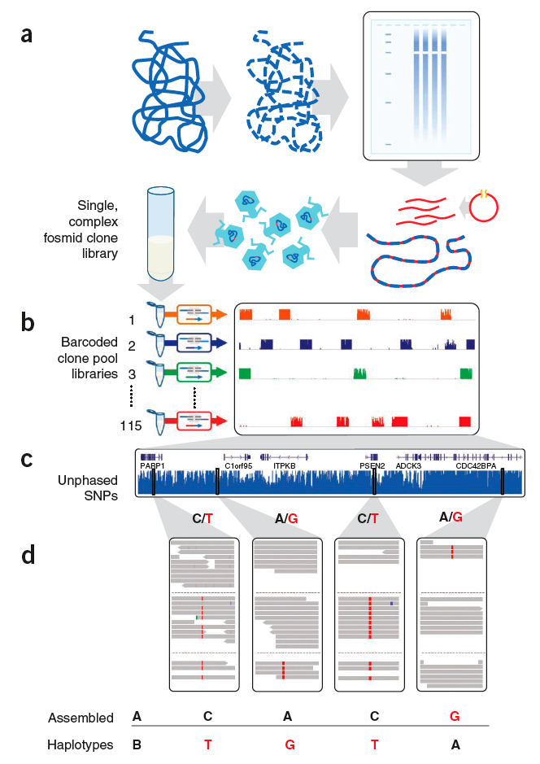
Figure 1 Haplotype-resolved genome sequencing. (a,b) A single, highly complex fosmid library was constructed (a) and split into 115 pools (b), each representing ~3% physical coverage of the diploid human genome. Barcoded shotgun libraries from each pool were constructed, then combined and sequenced. As expected, reads from each library map to ~5,000 • ~37 kbp blocks, minimally redundant within each library. (c) Whole-genome shotgun sequencing of the same individual generated unphased variant calls. (d) Unphased variant calls were combined with haploid genotype calls to assemble haplotype blocks using a maximum parsimony approach (reference allele in black, nonreference allele in red).

Slide 8
Fosmid pools
Fosmid library (~37kb insert) of 115 barcoded pools.
~5,000 independent clone for each pool.
Each pool covers ~3% of the diploid genome (5000 x 37kb / 6G = ~3%).
Fosmid pools sequences with Illumina GAIIx, PE76 or PE101 reads.
99.1% reads from each pool are from only one haplotype.
Sequenced to 2.4X depth of coverage for each fosmid clone.
98.6% of the genome covered by at least one fosmid clone.

Slide 9
Whole genome shotgun sequencing (WGS)
NA20847, a HapMap female of Gujarati Indians in Houston (GIH) panel.
WGS to 15X depth of coverage, Illumina HiSeq, PE50 reads.
Called 3.3 x 10⁶ SNPs and 3.4 x 10⁵ short indels using GATK – unphased variant calls.

Slide 10
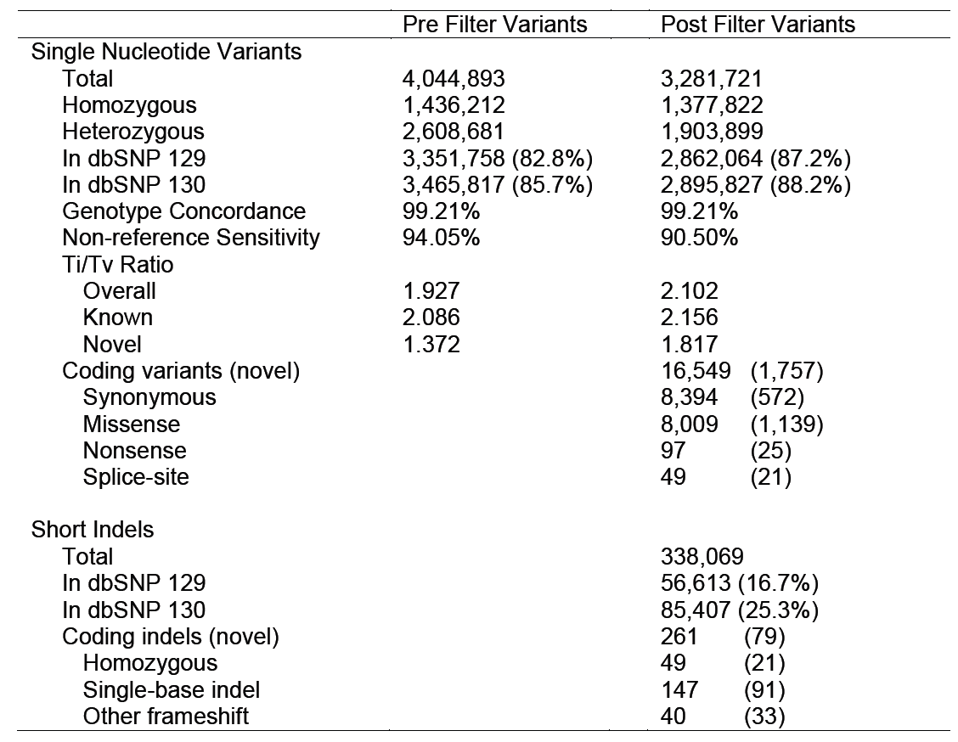
Supplementary Table 2. Variant discovery in whole-genome sequencing of NA20847. Single nucleotide substitutions and short indels called in NA20847. Genotype concordance refers to concordance with Hapmap Phase 3 genotyping calls (obtained from the International Hapmap Project website), and novel is defined as not being in dbSNP130 unless otherwise specified.

Slide 11
Combine phasing with unphased variant calls
For each fosmid pool, the positions of fosmid inserts are identified by read depth.
Haploid SNP genotyping- each clone pool separately genotyped at all intersecting unphased heterozygous SNPs previously identified by WGS. Using GATK.
Haplotype assembly – Using HapCUT.
94% heterozygous SNPs are resolved into haplotype blocks.
To access accuracy of phasing, compare with HapMap results that only use population-based LD information.

Slide 12
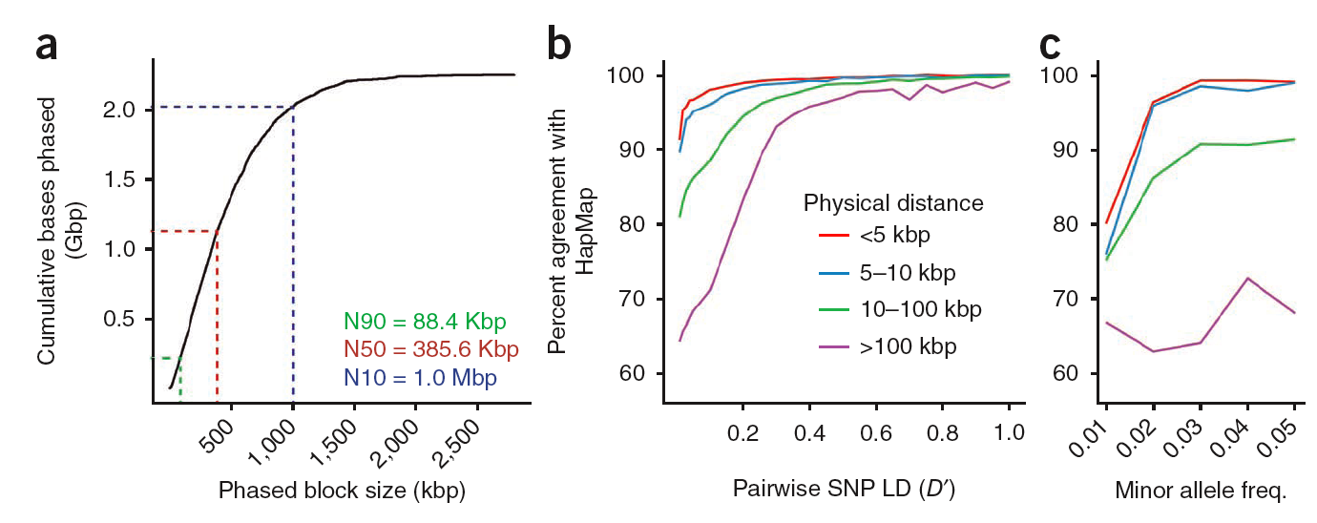
Figure 2 Haplotype assembly results. (a) Size distribution of blocks within the haplotype assembly up to a maximum block size of 2.79 Mbp. Half of the assembly comprised blocks longer than 386 kbp (N50). (b) Comparison of experimental phasing with HapMap population-based inference for NA20847, with agreement of pairwise haplotype predictions as a function of physical distance and linkage disequilibrium. (c) Agreement of pairwise haplotype predictions as a function of physical distance and minor allele frequency (defined as the lower allele frequency of the pair in GIH). Key is the same as for b.
Notes:
Errors in HapMap phasing

Slide 13
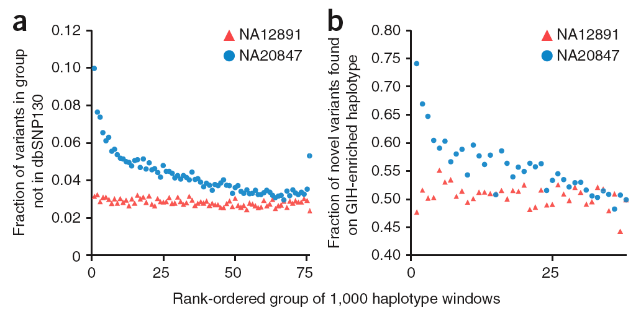
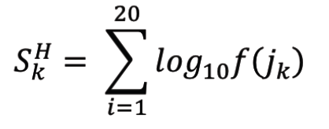
Sliding windows of 20 HapMap3 variants.
Similarity score S for a given window and haplotype H
compared to a population k, was calculated as the sum
of the log10 allele frequency f of allele j in population k.
rank all haplotype windows by the difference between the similarity score to GIH HapMap3 frequencies and the score to CEU HapMap3 frequencies.
rank windows by
GIH-like blocks and other well-differentiated haplotypes may be derived from more poorly ascertained ancestral populations, and therefore enriched for novel variants.
Notes:
We propose that GIH-like blocks and other well-differentiated haplotypes may be derived from more poorly ascertained ancestral populations, and therefore enriched for novel variants. Such haplotypes may represent a valuable source of information about human history on the South Asian subcontinent.

Slide 14
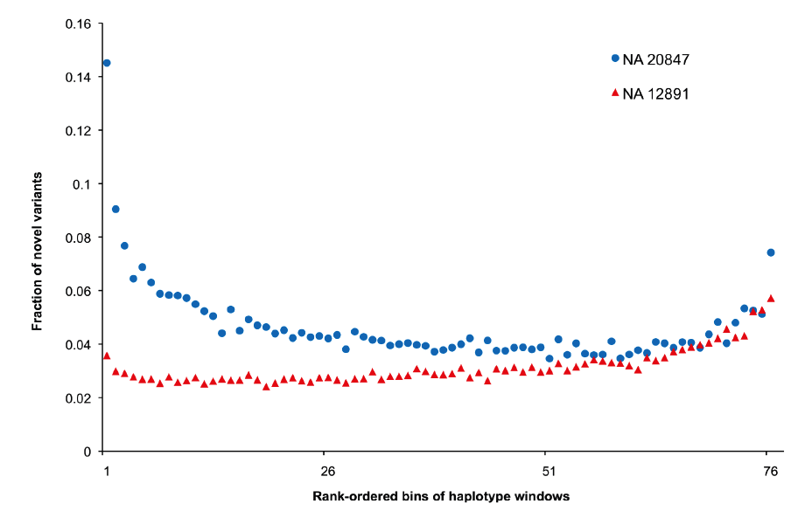
Supplementary Figure 3. Similarity scores to three representative populations from the 1000 Genomes Pilot 1 study were aggregated within windows sliding across haplotype-phased blocks from individual NA20847 and the CEU individual NA12891. Windows were ranked from least related to representative populations (left) to most related (right, x-axis). For each individual, the fraction of novel SNPs is shown (not in dbSNP v130), and demonstrates enrichment for novel alleles in haplotypes that are highly differentiated between NA20847 and well-ascertained populations.

Slide 15
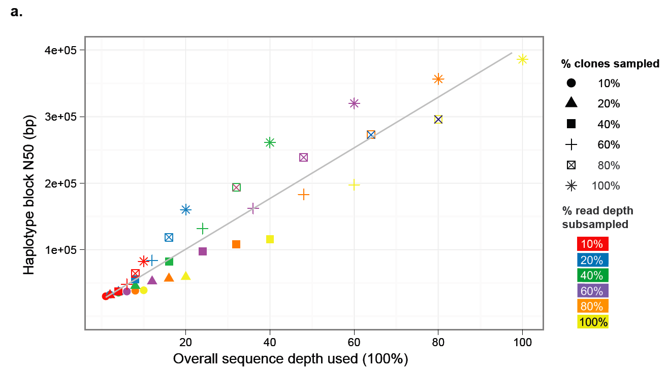
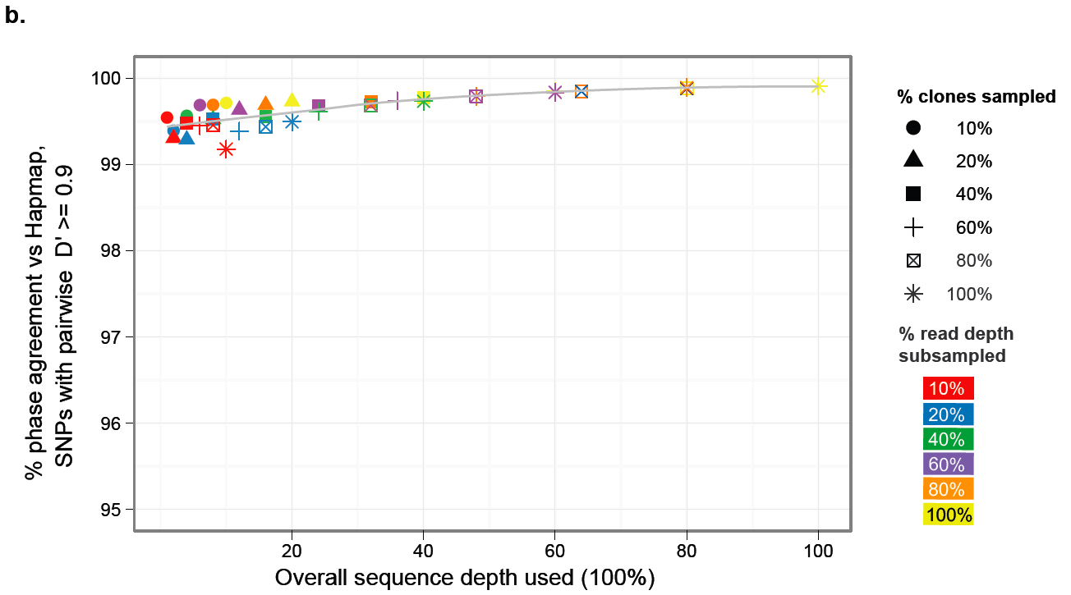
Supplementary Figure 7. Downsampling analysis of haplotype phase assembly size and accuracy as a function of reduced sequence coverage. Point shape indicates percent of clones randomly sampled; point color indicates percentage of read depth sampled within each clone. (a) N50 phased haplotype block size in bp, (b) percent agreement with HapMap phase predictions for SNPs in high LD (pairwise D’ >= 0.9)
Notes:
The primary effect was a reduction in the length of assembled haplotype blocks, rather than any decay in accuracy. For example, at 80% of clones and 60% of sequencing depth (which is 48% as much clone-based sequencing), the N50 dropped from 386 kbp to 238 kbp. However, most ascertained heterozygous variants remained phased (85.4%), and phasing remained highly concordant with HapMap (>99% at D′ > 0.9).

Slide 16
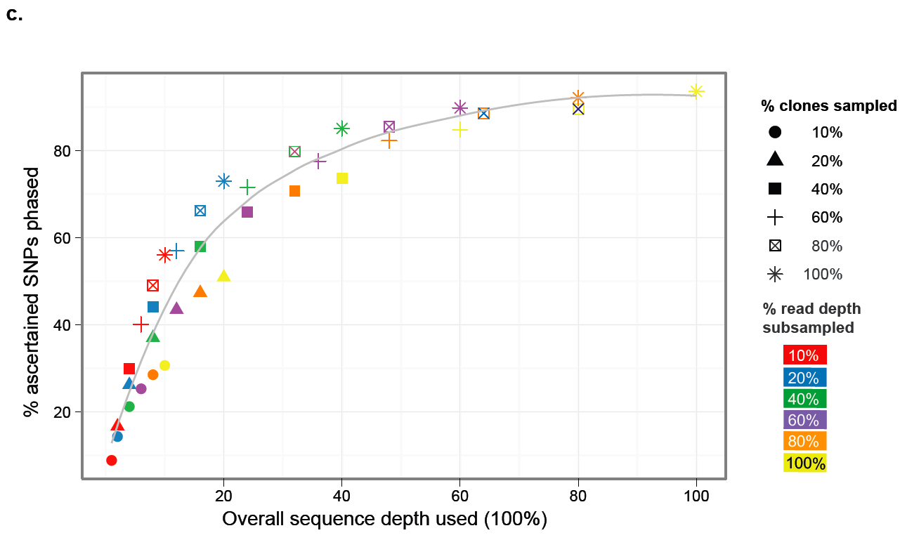
Supplementary Figure 7. Downsampling analysis of haplotype phase assembly size and accuracy as a function of reduced sequence coverage. Point shape indicates percent of clones randomly sampled; point color indicates percentage of read depth sampled within each clone. (c) percentage of total ascertained heterozygous SNPs phased, all with respect to percentage of overall sequence depth (product of subsampled percentages of clones and reads within each clone).
Notes:
The primary effect was a reduction in the length of assembled haplotype blocks, rather than any decay in accuracy. For example, at 80% of clones and 60% of sequencing depth (which is 48% as much clone-based sequencing), the N50 dropped from 386 kbp to 238 kbp. However, most ascertained heterozygous variants remained phased (85.4%), and phasing remained highly concordant with HapMap (>99% at D′ > 0.9).

Slide 17
Values of haplotype-resolved genome sequencing
Population genetics - eliminates the need for population or pedigree-based haplotype inference. Most useful in populations that are poorly ascertained (e.g., South Asians) or have low LD (e.g., Africans), and for rare variants.
Genetic anthropology, e.g. critical to the observation of a Neanderthal contribution to some modern humans.
Medical genetics of rare and common phenotypes - analysis of recessive Mendelian disorders, the determination of the parent of origin for de novo mutations, and the study of complex interactions among multiple SNPs.
Structural variation in both germline and cancer genomes, sequencing the whole insert.
Allele-specific expression and methylation.
De novo genome assembly.

Slide 18
Thank you
for listening!

Slide 19
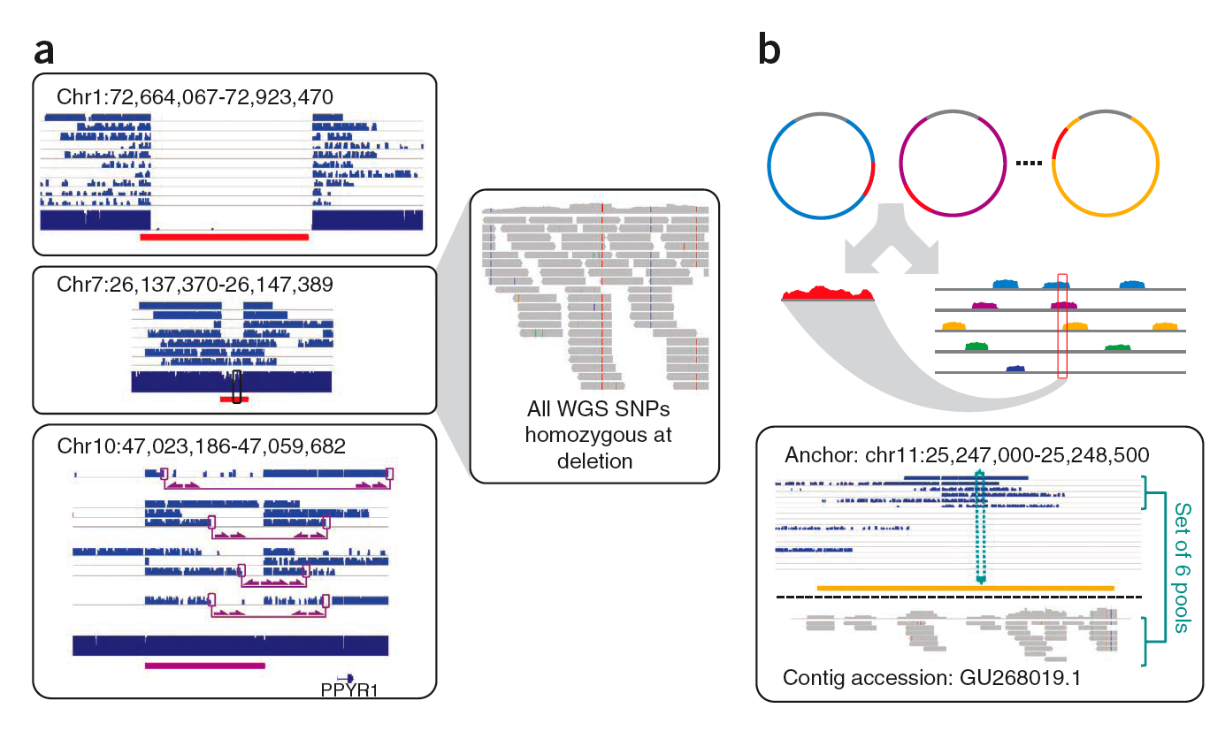
Figure 4 Insertion anchoring and structural variation detection. (a) Homozygous deletion (top), hemizygous deletion (middle) and inversion (bottom) with fosmid clone support. Deletion calls were made using read depth and paired-read discordance. Inversions were called by paired-read discordance. SNPs within hemizygous deletions appear as stretches of hemizygosity by whole-genome shotgun sequencing. Purple connections indicate the additional support of strand discordance of read pairs spanning genomic DNA and the vector backbone. (b) Novel contigs not present in the reference assembly (red) but detected among clone pool–derived reads (light blue, purple, yellow) are anchored by searching for positions in the reference common to those pools but missing from most or all other pools. This approach anchors 1,733 recently reported insertion sequence including contig GU268019.

Slide 20
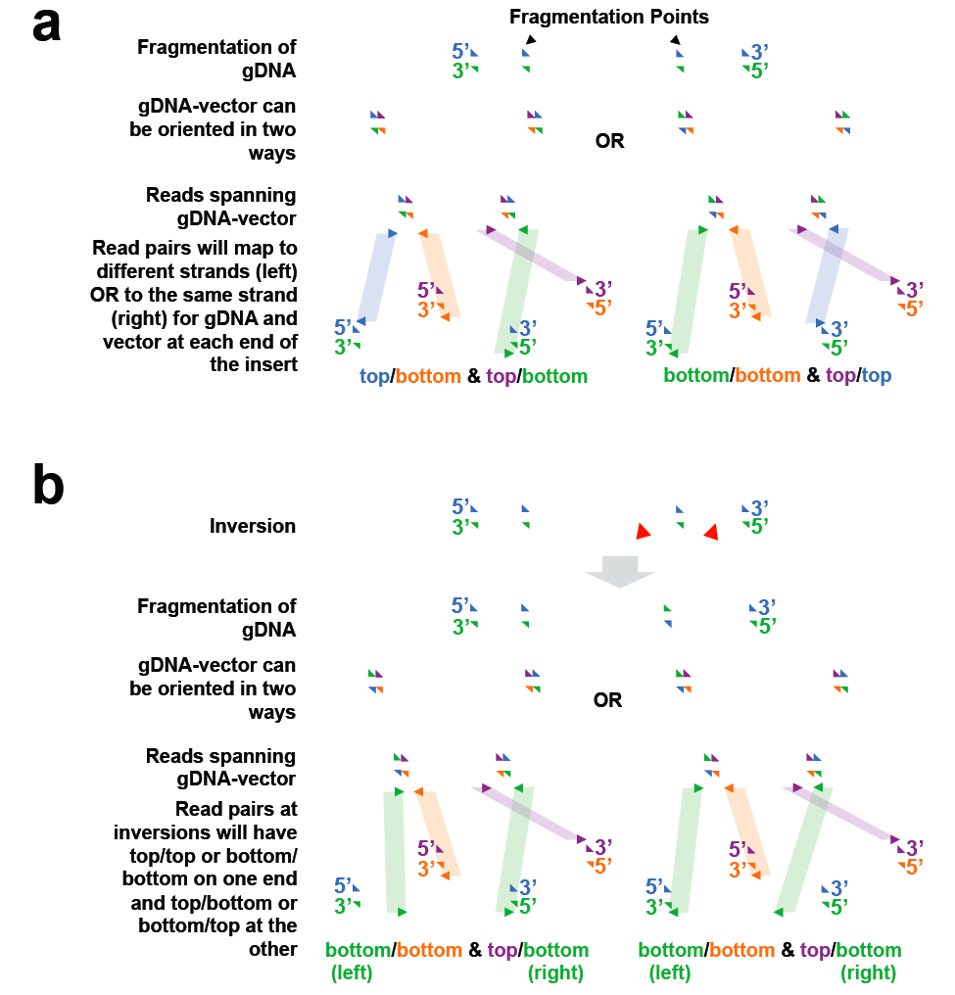
Supplementary Figure 4 (a). Based on the mechanism of fosmid library construction, each clone can have a large genomic DNA insert in either the forward or reverse direction (top left or right). This results in a constraint on the possible combinations of read strandedness between the read ends mapping to the vector backbone and the reference genome. For clones in which the backbone and genomic insert are both forward oriented, anchoring read pairs will map to opposite strands for each end of the clone, whereas those in which the backbone is forward and genomic DNA reverse, anchoring read pairs will map to the same strand for each end of the clone. (b) In the case of an inversion in which one but not both of the break points lies within the clone (bottom), the strandedness of the anchoring read pairs become discordant between the two fosmid ends.

