Slide 1
PRO-SNP-NET
EK, 29 March 2011

Slide 2
Variable sites in coding genes
Most sites that show interspecies variation are assumed to be fixed in humans
Most sites that show intraspecies variation in humans also show interspecies variation
Sites can be divided into three classes
    Strong negative selection (dN/dS << 1)
    Weak negative selection or weak positive selection (dN/dS≈1)
    Strong positive selection (dN/dS >> 1)
Hypothesis: Sites that show intraspecies variation should be enriched for dN/dS≈1

Slide 3
Computation of dN/dS per codon
Can not compute exact number of substitutions due to multiple substitutions in divergent species- hence use a maximum likelihood approach - PAML
Take into account transitions are more common than transversions
Data used
  Multiple sequence alignment of Ensembl transcripts on Chr 1 with 10 vertebrates
  Pilot1 CEU SNPs

Slide 4
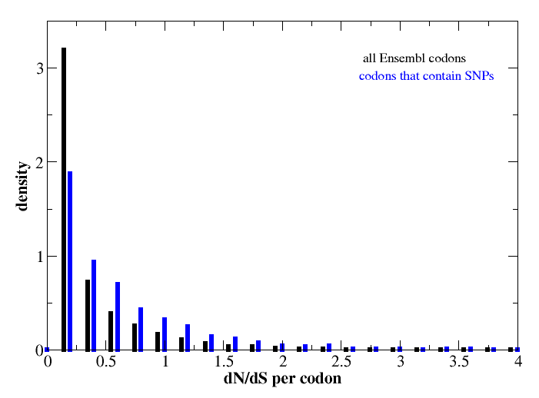
SNP sites are enriched for higher dN/dS (KStest, Dstatistic=0.27; pvalue < 2.2e-16)

Slide 5
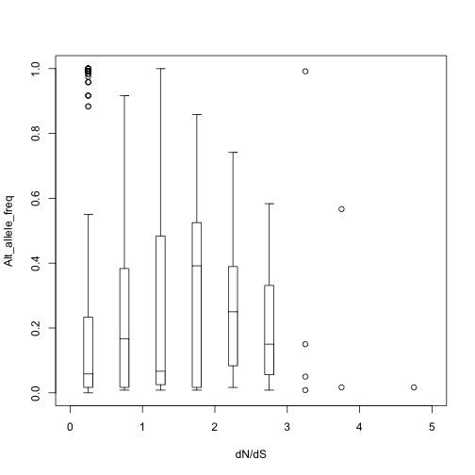
SNPs with highest allele freq have dN/dS close to 1
dN/dS<1
corr coeff=0.24, pvalue=1e-14
dN/dS>1
corr coeff=0.08, pvalue=0.29
dN/dS<1.5
corr coeff=0.223, pvalue=1.4e-13
dN/dS>1.5
corr coeff=-0.19, pvalue=0.106
Overall corr coeff=0.23, pvalue=3.14e-16

Slide 6
To do
Compute dN/dS
  For all chromosomes
  For 28 species

Slide 7
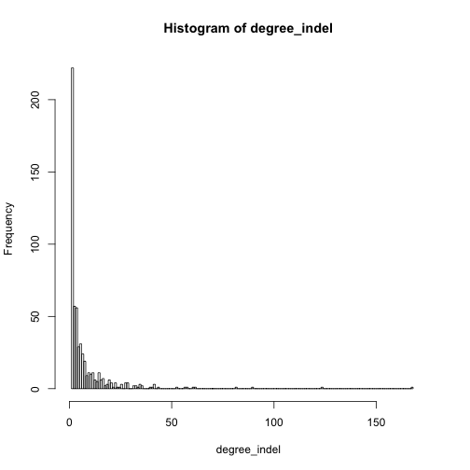
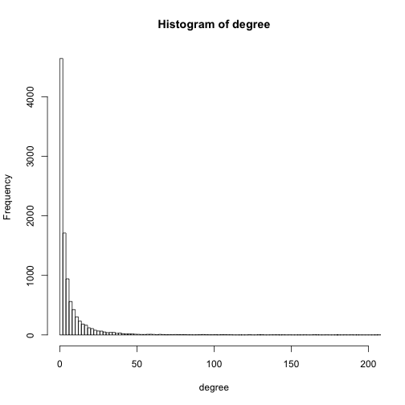
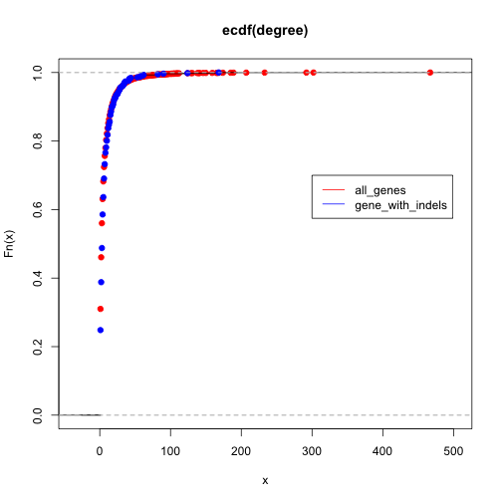
Degree of genes with indels higher
Kstest: D statistic=0.073,pvalue=0.003

