Slide 1
Pathways & Genetic Variations
Jieming Chen
Netz subgroup meeting

Slide 2
Data sources
KEGG pathways
→ 227 pathways
CEU SNPs from 1KG
→ 57,457 SNPs
→ 14,964 genes
Ensembl
→ Ensembl 56, GRch37 (hg19)
→ dN, dS; chimp orthologs

Slide 3
KEGG pathways
 | # human pathways | # unique human genes in CEU 1KG that are found in the pathways | # NS genes | # S genes
metabolism | 85 | 1088 | 813 | 862
geneticInfo | 21 | 669 | 440 | 546
signaling | 16 | 1069 | 759 | 883
cellularProcesses | 14 | 878 | 636 | 725
Systems | 45 | 1560 | 1194 | 1218
Diseases | 46 | 910 | 632 | 747
Drug Dment | 0 | 0 | 0 | 0
 | 227 | 6174 | 4474 | 4981
total # unique human genes = 4093 => genes in multiple pathways
# NS+S genes = 9455 => genes can also be both NS and S

Slide 4
Comparing NS and S genes:
Metabolic

Slide 5
Comparing NS and S genes
Systems

Slide 6
Comparing NS and S genes
Genetic Info

Slide 7
Comparing NS and S genes
Diseases

Slide 8
Ask if there is an enrichment of CEU NS genes in categories
Fisher’s exact test
No significance

Slide 9
Ask if there is an enrichment of CEU NS genes in individual pathways
 |  |  | metab_ns |  | total # genes |  | pval (1) (greater) | pval (2) (2sided)
path:hsa04740 | systems | Olfactory transduction | 309 | 2684 | 338 | 3755 | 0.001697 | 0.003027
path:hsa04512 | signaling | ECM-receptor interaction | 65 | 2928 | 71 | 4022 | 0.108415 | 0.189543
path:hsa05150 | diseases | Staphylococcus aureus infection | 38 | 2955 | 42 | 4051 | 0.198818 | 0.363251
path:hsa05310 | diseases | Asthma | 24 | 2969 | 25 | 4068 | 0.207344 | 0.384441
path:hsa02010 | signaling | ABC transporters | 36 | 2957 | 40 | 4053 | 0.213157 | 0.413956
path:hsa04974 | systems | Protein digestion and absorption | 58 | 2935 | 68 | 4025 | 0.217554 | 0.413094
path:hsa00980 | metab | Metabolism of xenobiotics by cytochrome | 43 | 2950 | 49 | 4044 | 0.219045 | 0.396462
path:hsa05330 | diseases | Allograft rejection | 26 | 2967 | 28 | 4065 | 0.22753 | 0.407985
path:hsa00500 | metab | Starch and sucrose metabolism | 29 | 2964 | 32 | 4061 | 0.237375 | 0.435623
path:hsa04930 | diseases | Type II diabetes mellitus | 29 | 2964 | 32 | 4061 | 0.237375 | 0.435623

Slide 10
Ask if there is an enrichment of CEU NS genes in individual pathways
 |  |  | metab_ns |  | total # genes |  | pval (1) (greater) | pval (2) (2sided)
path:hsa03040 | geneticInfo | Spliceosome | 27 | 2966 | 72 | 4021 | 0.999342 | 0.002777
path:hsa04740 | systems | Olfactory transduction | 309 | 2684 | 338 | 3755 | 0.001697 | 0.003027
path:hsa04010 | signaling | MAPK signaling pathway | 103 | 2890 | 172 | 3921 | 0.956094 | 0.105653
path:hsa03010 | geneticInfo | Ribosome | 9 | 2984 | 23 | 4070 | 0.966601 | 0.110505
path:hsa05322 | diseases | Systemic lupus erythematosus | 38 | 2955 | 71 | 4022 | 0.953541 | 0.119114
path:hsa05131 | diseases | Shigellosis | 18 | 2975 | 37 | 4056 | 0.943515 | 0.171401
path:hsa04512 | signaling | ECM-receptor interaction | 65 | 2928 | 71 | 4022 | 0.108415 | 0.189543
path:hsa04310 | signaling | Wnt signaling pathway | 51 | 2942 | 88 | 4005 | 0.923565 | 0.193841
path:hsa04110 | cellular | Cell cycle | 48 | 2945 | 80 | 4013 | 0.882526 | 0.280309

Slide 11
Ask if there is a correlation between the “importance” of genes and the dN/dS values
Data source: all unique genes in the human pathways and those that have chimp orthologs.
“Importance” is defined by the number of pathways the gene is involved in
Spearman correlation
rho = -0.05727789; p-value = 1.17E-14

Slide 12
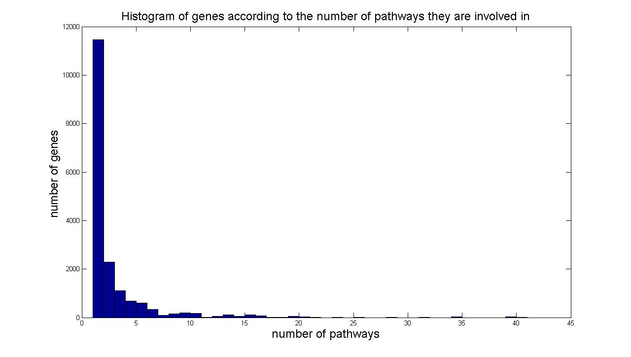
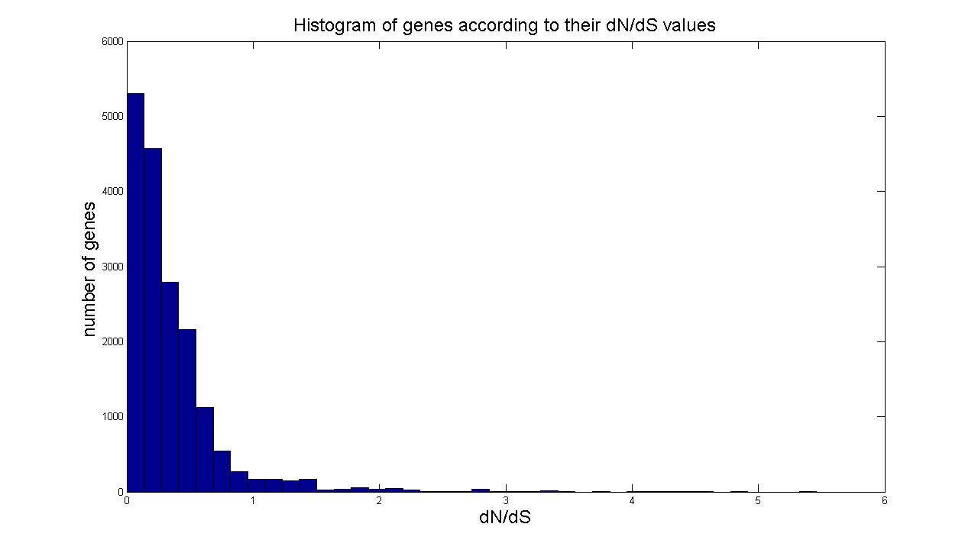
Ask if there is a correlation between the “importance” of genes and the dN/dS values

Slide 13
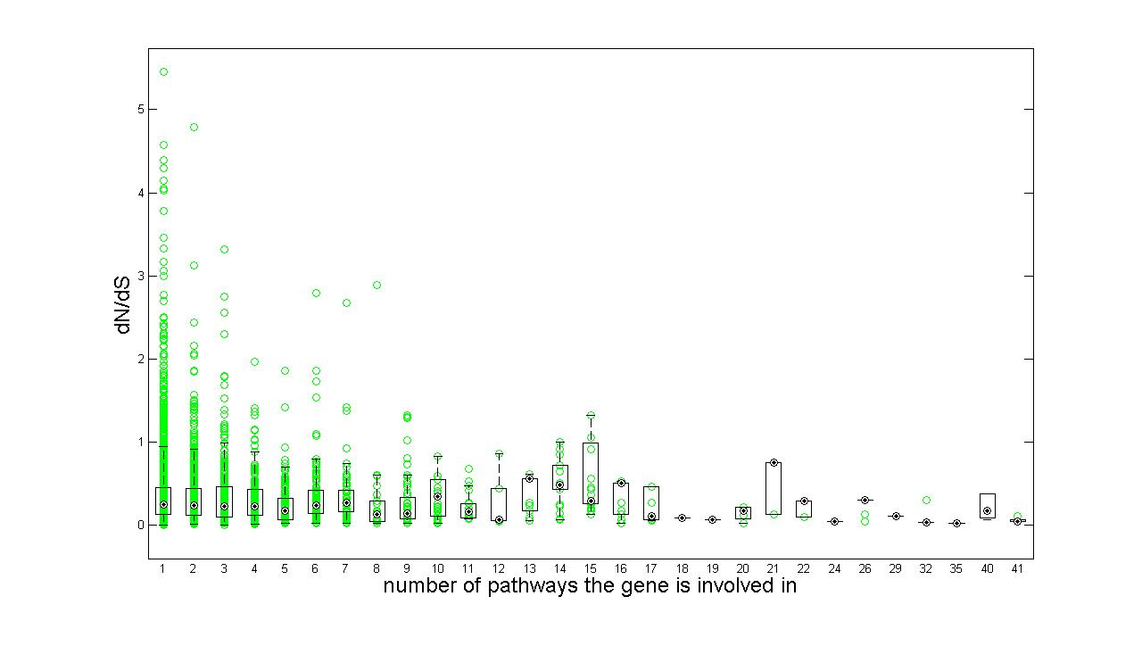
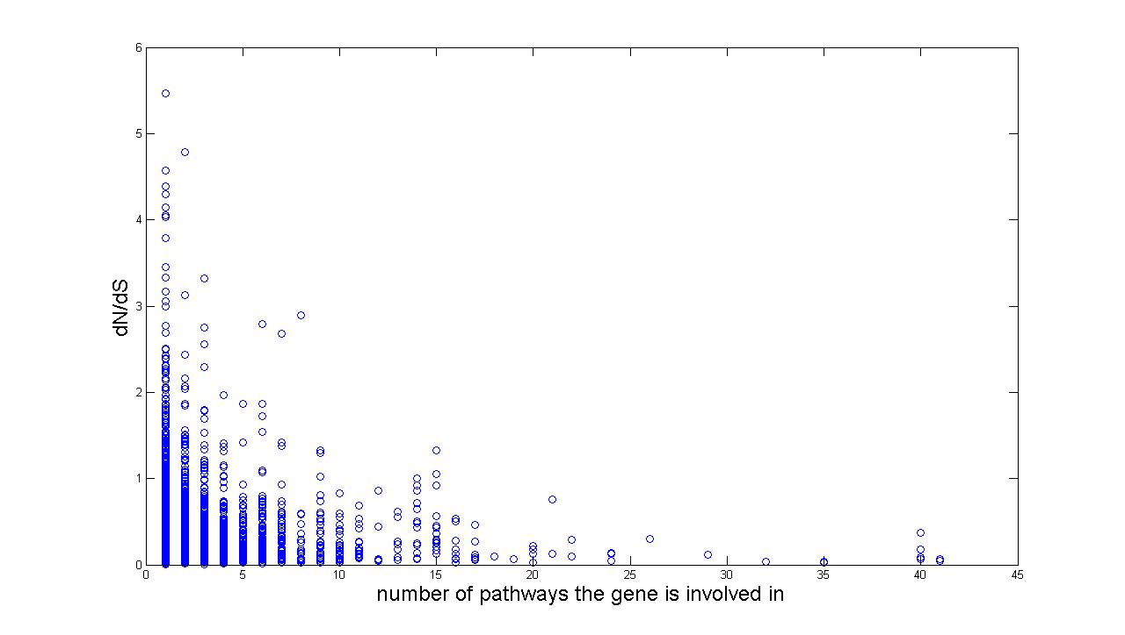
Ask if there is a correlation between the “importance” of genes and the dN/dS values

Slide 14
Moving on…
Normalize the number of genes to the number of genes in the pathway to give the frequency of NS genes? Would it be the same?
Extend analyses to 1KG CHB/JPT and YRI.
Looking into the pathways itself:
→ Taking Chong’s list of enzymes in metabolic pathway
→ Ask if there is a trend that a NS upstream enzyme, there will be NS downstream enzymes
→ Possibility of implementing a ‘hierarchy’ in the pathway?

