Slide 1
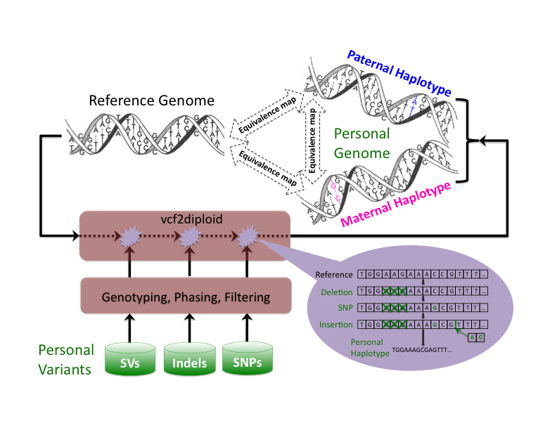
Figure 1a
Notes:
Construction of personal genome by vcf2diplod tool is made by incorporating personal variants into the reference genome. Personal variants may require addition pre-processing, i.e., filtering, genotyping, and/or phasing. The output is the two (paternal and maternal) haplotypes of personal genome. During the construction step the reference genome is represented as an array of nucleotides with each cell representing a single base. Iteratively the nucleotides in the array are being modified to reflect personal variations. Once all variation have been applied a personal haplotype is constructed by reading though the array. Simultaneously, equivalence map (MAP-file) between personal haplotypes and reference genome is being constructed.

Slide 2
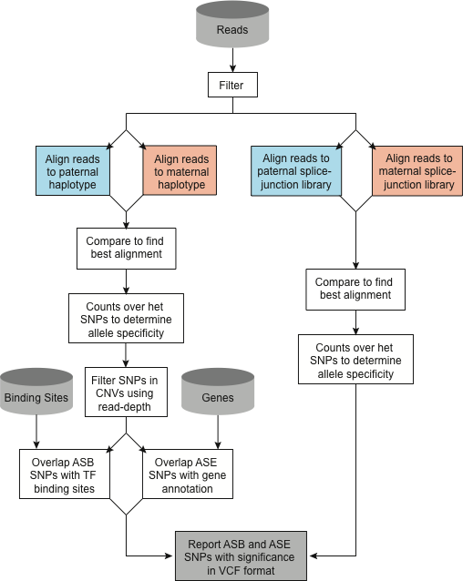
Figure 1b

Slide 3
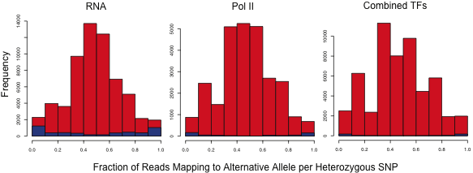
Figure 2
Notes:
After 1.5>=CNV>=0.5 filtering

Slide 4
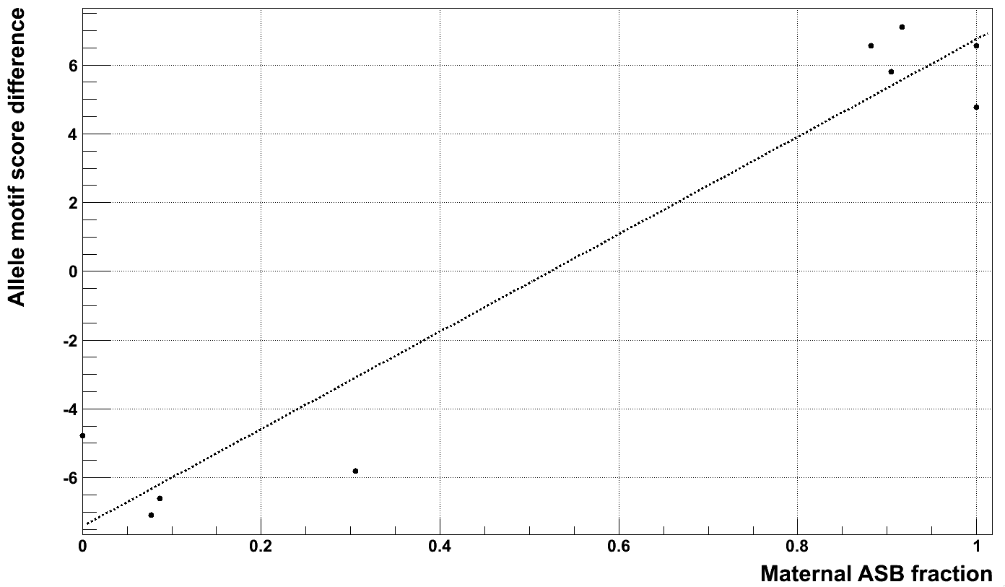
Difference in cMyc Motif Scores
Between Maternal and Paternal Alleles
Fraction of Maternal Reads per ASB SNP
in cMyc motifs in Max Binding Sites
Figure 3
Notes:
Myc in Max binding sites.

Slide 5
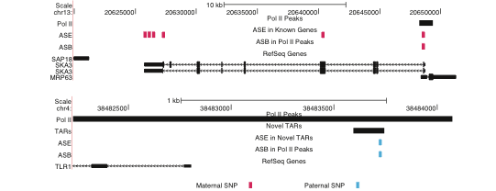
Figure 4

Slide 6
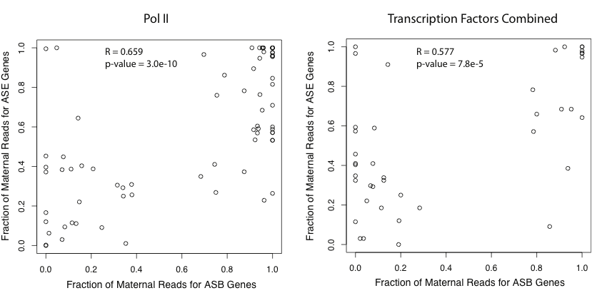
A
B
Figure 5

Slide 7
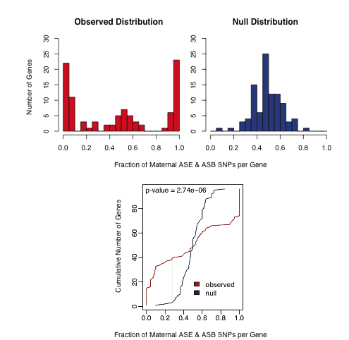
Figure 6

Slide 8
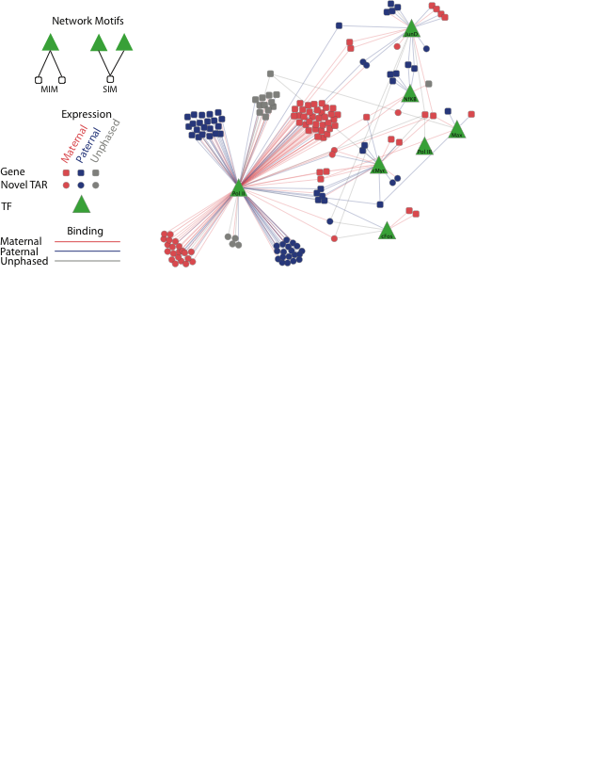
Figure 7

Slide 9
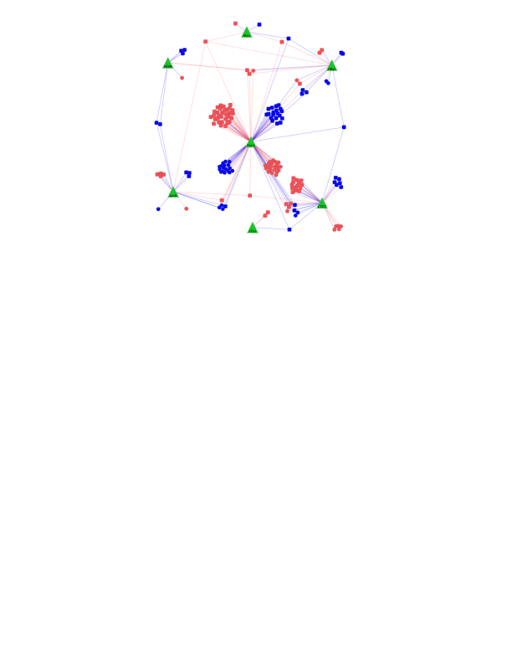
Figure 7

Slide 10
Supplementary Figures

Slide 11
Alignment MAP-file
Example
P M R
X X X
X X X
X X X P1 M1 R1
X X - P4 M4 -1
X X - P5 M5 -1
- X - -1 M6 -1
X X X P6 M7 R4
X X X …
- X X
…
1 1 1
233714 -1 233714
233715 -1 233715
233716 -1 233716
233717 -1 233717
233718 233714 233718
768166 768162 -1
768167 768163 -1
768168 768164 768166
780562 780558 -1
…
Supplementary Figure 1
Notes:
MAP file establishes equivalence of bases between reference haplotypes of personal genome and reference genome. Paternal haplotypes denoted as R, maternal as M, and reference as R. Nucleotides in each sequence are denoted as X. Ungapped block that ispresent in all three haplotypes isrecorded by indices of the first bases in a block for each haplotype. Each position absent in either haplotype is recorded by base indices for haplotype(s) having a nucleotide in the position and by -1 for haplotype(s) with gap. Base numbering starts from 1.

Slide 12
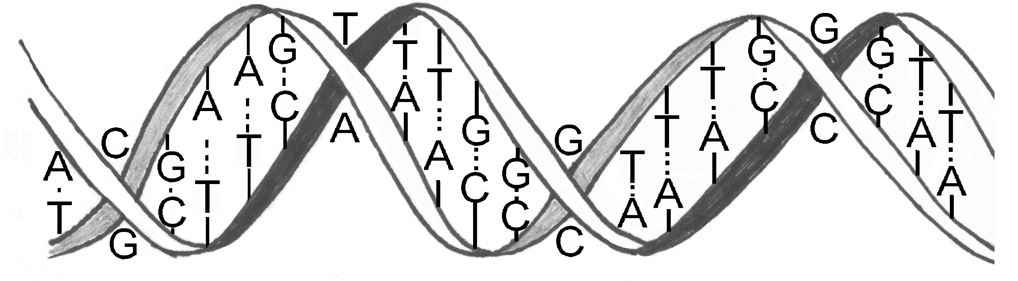
Pol II & CTCF Chip-Seq reads
Bowtie
Bowtie
Bowtie
Reference genome
Paternal haplotype
Maternal haplotype
Unique best mapping
Haplotype A
Haplotype B
Equivalent positions
Equivalent positions
Equivalent positions
Equivalent mapping
Different mapping
Not mapped
Supplementary Figure 2
Notes:
Procedure to compare read mapping to reference genome and haplotypes of NA12878. Pol II Chip-Seq reads were mapped to each haplotype using Bowtie. Then, for any pair of compared haplotypes read mappings were classified as i) equivalent, if a read maps at the equivalent positions; ii) different, if a read maps to non-equivalent positions; iii) not mapped, if a read does not map to either of the compared haplotypes.

Slide 13
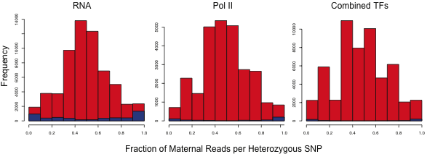
Supplementary Figure 3
Notes:
After 1.5>=CNV>=0.5 filtering

Slide 14
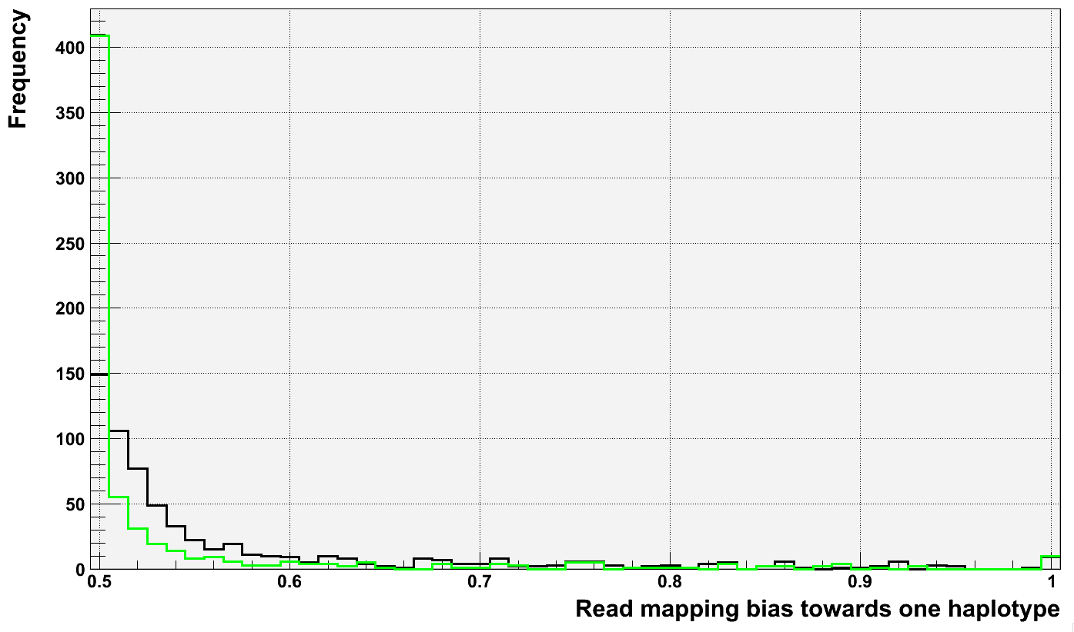
Supplementary Figure 4

Slide 15
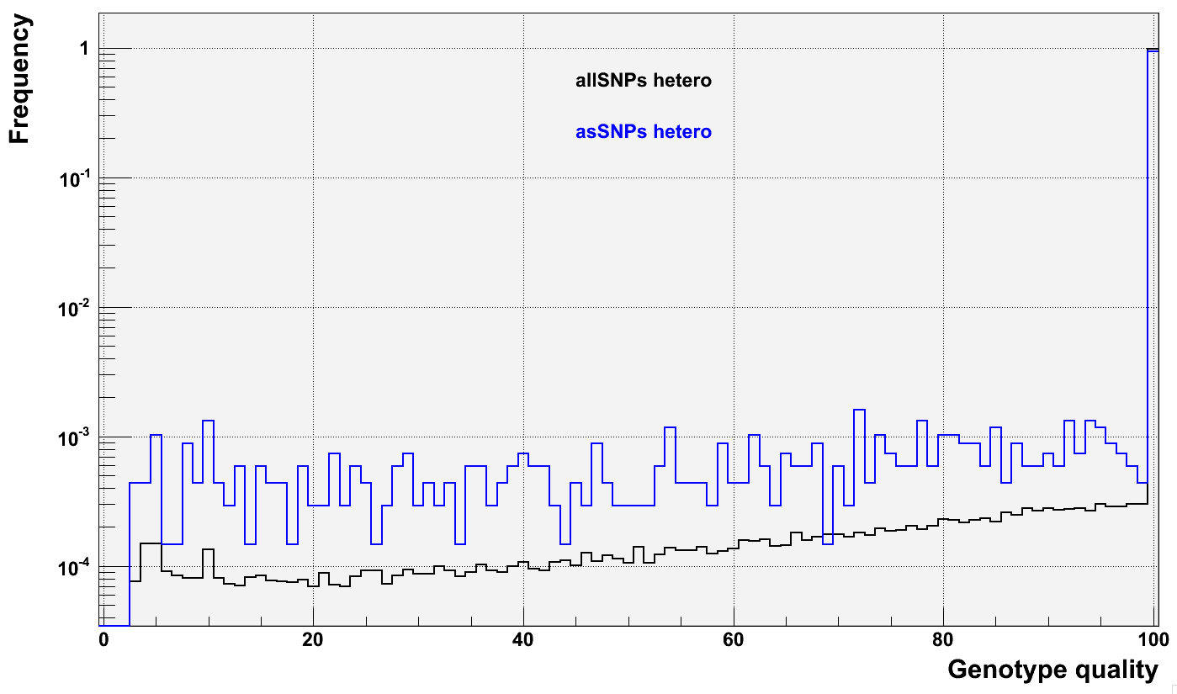
Supplementary Figure 5

Slide 16
Naive
Modified
Supplementary Figure 6

Slide 17
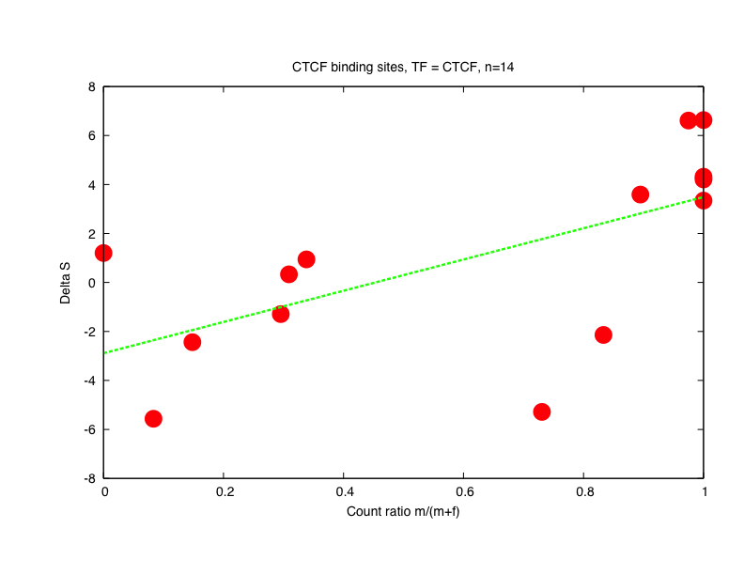
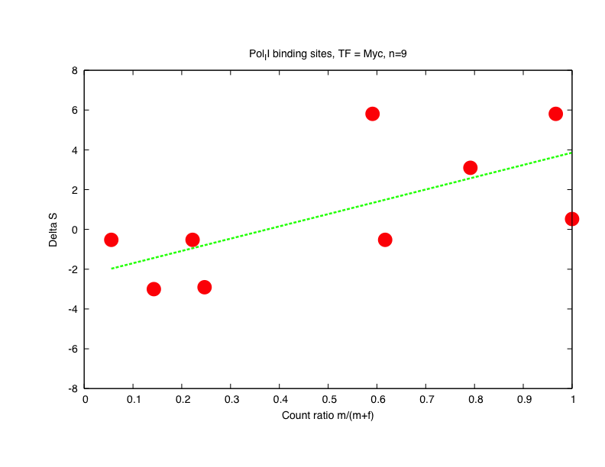
CTCF motifs in CTCF sites
cMyc motifs in Pol II sites
Supplementary Figure 7

