Slide 1
Analysis of SVs in 1000 Genomes Project
Alexej Abyzov & Mark Gerstein
Meeting in Lee lab
March 31, 2011

Slide 2
Variation in Ψgenes

Slide 3
Methodology
Gene model
Splice junction
library
Bowtie mapping
Not mapped reads
Data: 1KG Pilot 2
Special thanks to Lukas H.

Slide 4
Genes with non-reference Ψgenes (CEPH trio)
All
At least 2 supportive reads
Father
Father
5
Mother
0
Mother
8
25
0
10
10
8
5
13
3
5
17
5
Child
Child
Misannotation
indels

Slide 5
Misannotation/indels
chr17|31352759|31352767
chr17_random|2327799|2327801

Slide 6
Common
 | NA12891 |  | NA12892 |  | NA12878 |  | Gene | Conclusion
 | S | R | S | R | S | R
chr11:47595443-47620640 chr11:47595443-47620673 | 1 4 | 8 16 | 1 3 | 4 16 | 1 3 | 8 25 | MTCH2 | Real
chr17:42550309-42621664 | 6 | 683 | 6 | 2523 | 6 | 2891 | CDC27 | Real
chr3:13565624-13654923 | 1 | 1 | 1 | 1 | 1 | 1 | FBLN2 | indel
chr3:14161648-14195143 | 1 | 1 | 1 | 1 | 2 | 2 | XPC | indel
chr3:44769530-44778158 | 1 | 1 | 1 | 1 | 1 | 2 | KIAA1143 | indel
chr2:74585677-74588329 | 2 | 3 | 4 | 17 | 3 | 14 | PCGF1 | Real
chr17:23745787-23757355 | 1 | 1 | 1 | 1 | 1 | 1 | SARM1 | indel
chr6:136619693-136652682 | 3 | 4 | 6 | 12 | 6 | 8 | BCLAF1 | Real
chr11:48323475-48330575 | 1 | 1 | 1 | 6 | 1 | 3 | OR4C45 | Long indel
S -- # of splice junctions, R -- # of reads

Slide 7
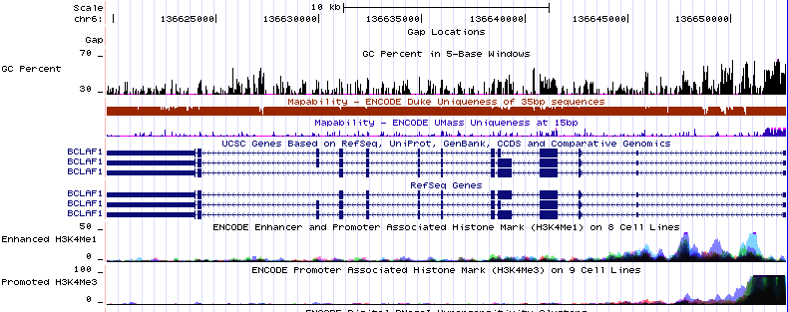
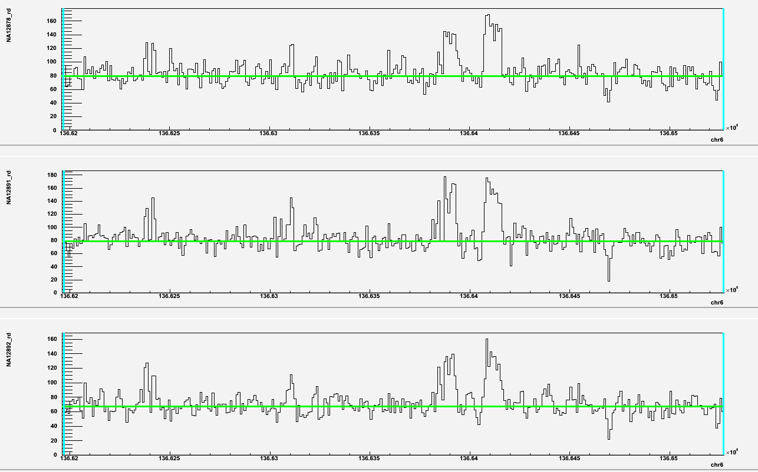
BCL2-associated transcription factor
Confirmed
junctions
Mother Father Child
Found in HuRef

Slide 8
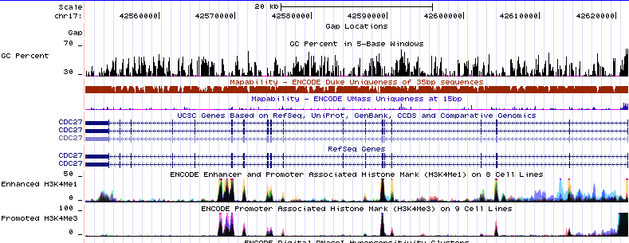
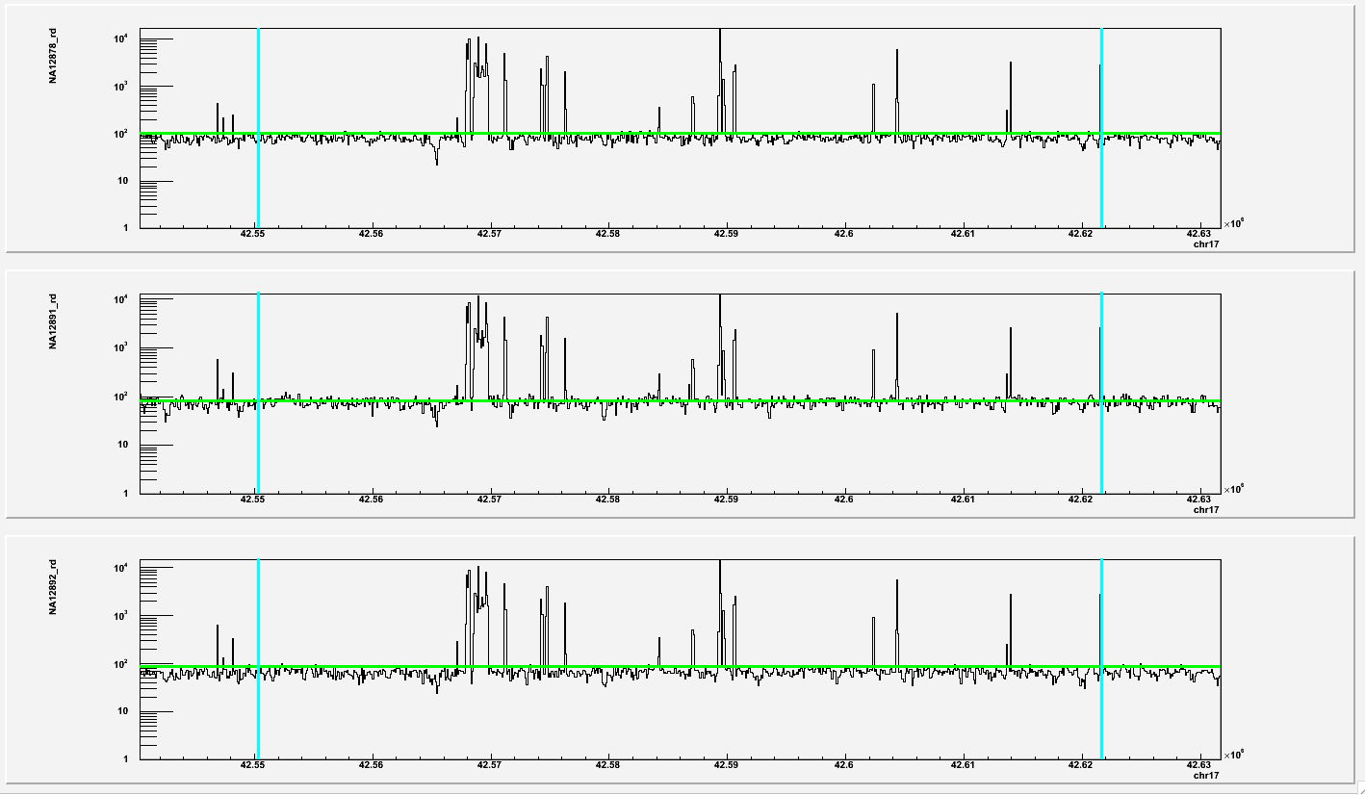
Cell division cycle protein 27
Confirmed
junctions
Mother Father Child

Slide 9
Balancing and other selection of SVs

Slide 10
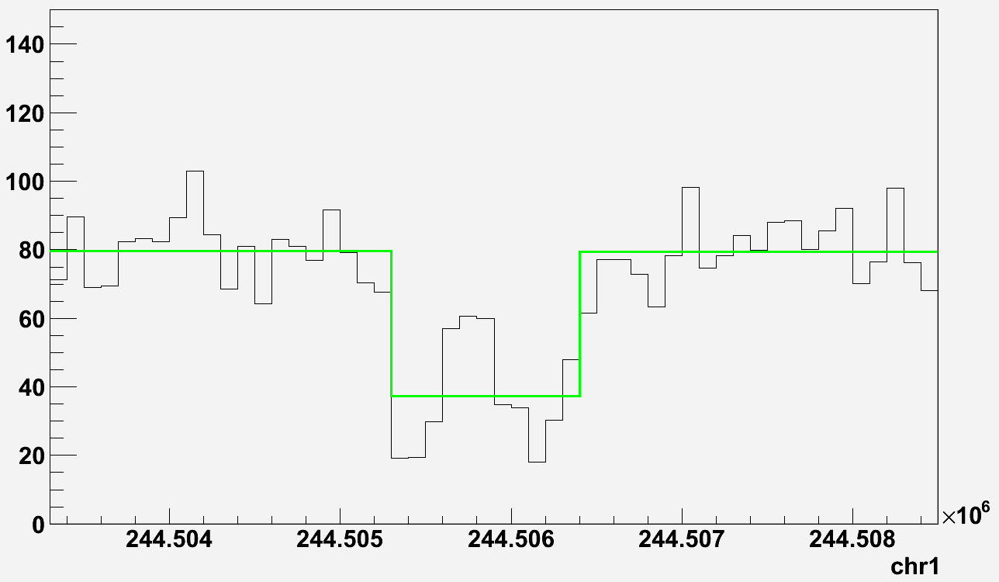
Detecting common CNVs
Yoruba
CEPH
CHB/JPT
…
…
…
Pooled RD signal
Pooled RD signal
Pooled RD signal
CNV calls
CNV calls
CNV calls
3859 common CNV calls (Pilot 1)

Slide 11
Selecting CNV under balancing selection
Yoruba
CEPH
Prediction
Select CNV
with > 90%
of samples
heterozygous
Genotype
CHB/JPT
169 candidates (larger than 1 kb)
32 candidates after q0 filter

Slide 12
Are those regions real?
Description | Counts/supports | Approach
BS candidate regions > 1kb | 32 | N/A
Local AGE realignment | 0 | 454 split-read
1KG master validation table (P1 + P2) | 1 (not confident) | De novo assembly
Conrad09 | 3 (>80% reciprocal overlap; NOT genotyped) | aCGH
Park10 | 2 (>80% reciprocal overlap) | aCGH
Database of Genomic Variants (DGV) | 6 (>50% reciprocal overlap) | Various
20 intersect with genes:
- 21 genes
- 50 exons
37 UTR
enriched for functional elements
Are these 32 regions:
- complex SVs?
- false positives?

Slide 13
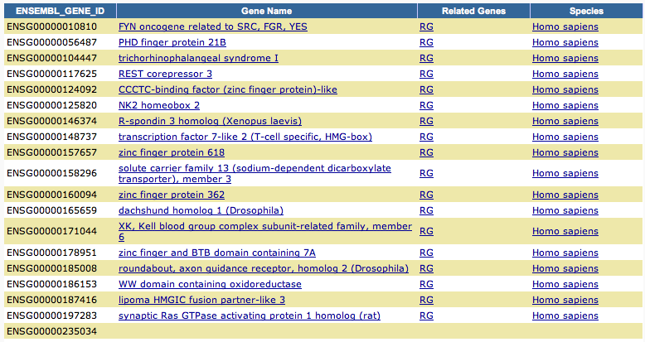
GO intersection (using David)

Slide 14
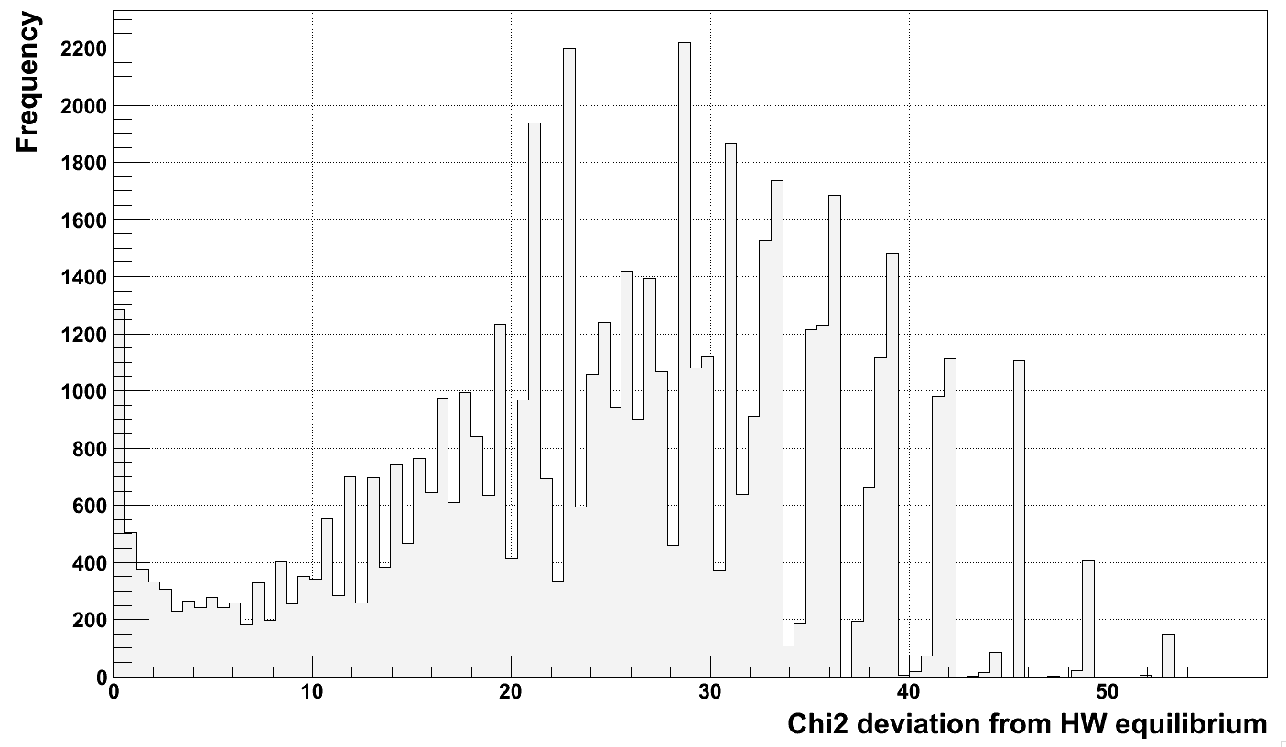
Phase 1 data
Potential regions
under balancing
selection

Slide 15
Acknowledgements
Gerstein lab
Jasmine (Xinmeng) Mu
Ekta Khurana
Lukas Habegger
Suganthi Balasubramanian

Slide 16
Deletion or rare duplications?
Sample genome
Reference genome
…
Read mapping
Read mapping
Read count
Zero level
Deletion
Duplication

Slide 17
q0 filter
Count proportion of reads that have zero mapping quality, i.e. are randomly placed
Consider a region to be deleted in a sample if fraction of q0 is < 0.5
32 CNV pass the threshold
Heterozygous in almost all individuals
Are NOT duplications in HGR

