Slide 1
ncVAR : Characterizing 1000 Genomes SNPs, indels and SVs in ENCODE non-coding elements
Jasmine Mu and Mark Gerstein

Slide 2
ncVar : framework for integrative analysis for genomic variations and non-coding elements
Genomic variations detected and genotyped for for 179 individuals in 3 populations in 1000 Genome pilot phase:
SNP: single nucleotide polymorphism
- Indel: short deletions and insertions (< 50bp)
- SV: structure variations (large deletions≥50bp)

Slide 3
Diversity vs. divergence
Diversity (π) is the number of nucleotide differences per site between two randomly chosen chromosomes within the human population. Calculated from the per-site heterozygosity (2pq) across the portion of the region that is ‘accessible’ (passing all the filters for SNP detection, including depth of read coverage, uniqueness of mapping, and gaps in the human reference genome), where p is the allele frequency from the genotyping files and q = 1 – p.
Divergence (D_{xy}) is calculated as the number of differences per site between human hg18 and chimp pantro2 assembly across the accessible and alignable human genome. Corrected by Jukes-Cantor correction for multiple hits.
Jukes-Cantor correction: D_{xy} = -(3/4)*ln (1-4*d/3),
where d is the observed number of differences per site.

Slide 4
(D_{xy} x 100)
(π x 1,000)
All p-values < 0.05 by MK test

Slide 5
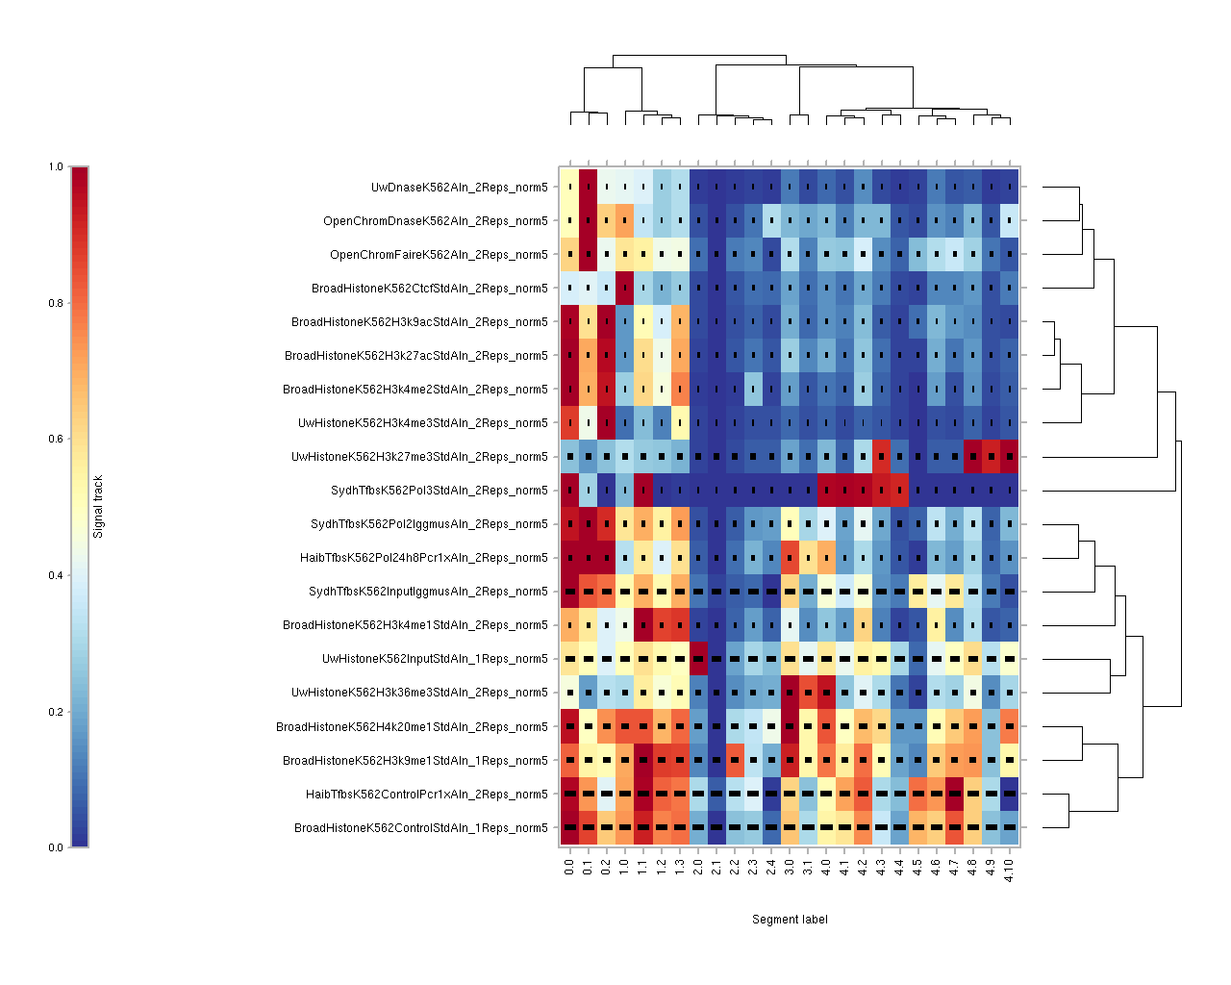
TSS
M. Hoffman- http://noble.gs.washington.edu/~mmh1/2011/outbox/encode/0113-segtools-jul2010-no_tfs-k562/segtools/

Slide 6
Mcdonald-Kreitman (MK) test
Mcdonald-Kreitman test 2x2 table:
Group | Polymorphism (P) – Number of SNPs | Number of Fixed differences (D)
Neutral region n | P_{n} | D_{n}
Sample region i | P_{i} | D_{i}
Fisher’s exact test or chi-square test can be performed upon the table to uncover the significance of natural selections.
Neutrality (NI) = (P_{i}/P_{n}) / (D_{i}/D_{n}), a qualitative measure of natural selection.
NI>1, an excess of polymorphism over divergence, i is under purifying selection.
NI<1, a deficit of polymorphism over divergence, i is under positive selection.
NI=1, neutrality.
Notes:
add slides of definition of different terms.

Slide 7
Variant allele frequency spectrum

Slide 8
ε: excess of low frequency alleles (DAF<0.05) compared to neut. ref.

Slide 9
Comparison between subgroups of elements

Slide 10
Element-aware aggregation plot for SNP and indel diversity within and around coding genes
Confidence intervals estimated by block bootstrapping
Red box blow-out: estimation by simple bootstrapping

Slide 11
TF-binding motif

Slide 12
miRNAs

Slide 13
Summary
ncVar: framework for integrative analysis of genomic variation in non-coding elements.
Selective constraints in TF-binding sites and ncRNAs are less than CDSs, but more than a neutral reference.
TF-binding sites and ncRNAs are more selectively constrained for indels than SNPs, compared to CDSs.
Extent of selection is associated with the genomic properties of each (sub)class of elements.
Developed element-aware aggregation plot; showed stronger selection pressure at coding genes, as well as miRNAs (particularly the seeds) and their binding targets than their immediate genomic surroundings.
Substitutions in TF-binding motifs inversely correlate with site conservation; SNPs unfavorable for motifs are under more selective constraints than favorable SNPs.
SVs have the tendency to use distinctive modes and mechanisms when they interact with genomic elements.

Slide 14
Future plans
Examine SNP, indel and SVs in other TF-binding sites in multiple cell lines.
Examine SNP, indel and SVs in relation to long RNAs.
Use 1000 Genomes data from Phase I of the full project.

Slide 15
Acknowledgements
Ben Brown
Peter Bickel
Haiyan Huang
Michael Hoffman

