Slide 1
Variation in PPD
Alexej Abyzov
March 22, 2011

Slide 2
Methodology
Special thanks to Lukas H.

Slide 3
Common
 | NA12891 |  | NA12892 |  | NA12878 |  | Gene | Conclusion
 | S | R | S | R | S | R
chr11:47595443-47620640 chr11:47595443-47620673 | 1 4 | 8 16 | 1 3 | 4 16 | 1 3 | 8 25 | MTCH2 | Real
chr17:42550309-42621664 | 6 | 683 | 6 | 2523 | 6 | 2891 | CDC27 | ???
chr3:13565624-13654923 | 1 | 1 | 1 | 1 | 1 | 1 | FBLN2 | indel
chr3:14161648-14195143 | 1 | 1 | 1 | 1 | 2 | 2 | XPC | indel
chr3:44769530-44778158 | 1 | 1 | 1 | 1 | 1 | 2 | KIAA1143 | indel
chr2:74585677-74588329 | 2 | 3 | 4 | 17 | 3 | 14 | PCGF1 | Real
chr17:23745787-23757355 | 1 | 1 | 1 | 1 | 1 | 1 | SARM1 | indel
chr6:136619693-136652682 | 3 | 4 | 6 | 12 | 6 | 8 | BCLAF1 | Real
chr11:48323475-48330575 | 1 | 1 | 1 | 6 | 1 | 3 | OR4C45 | Long indel
S -- # of splice junctions, R -- # of reads

Slide 4
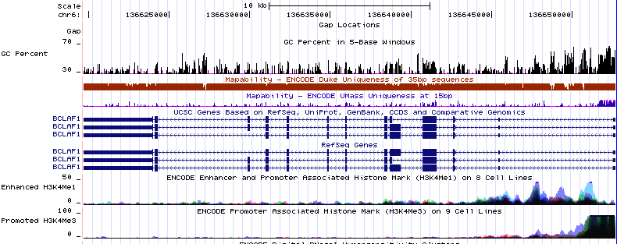
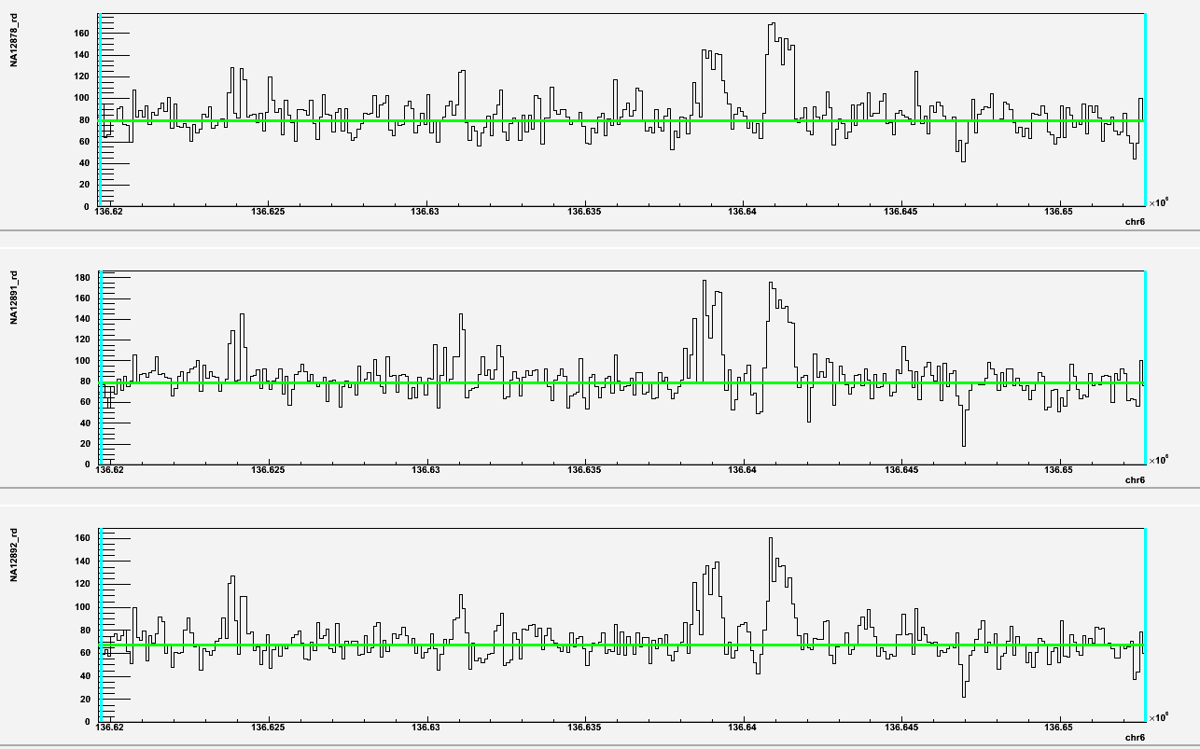
Mother Father Child
BCL2-associated transcription factor

Slide 5
Identifying location
No success!

Slide 6
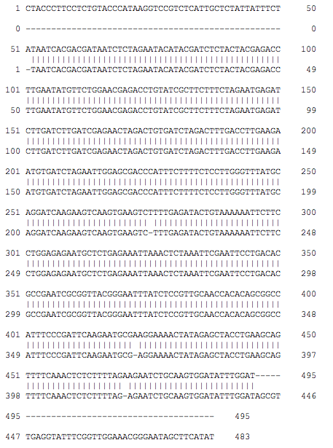
454 analysis of BCLAF1
3’
5’
Gene in
reference
Blast
Pgene in
reference
1KG 454 read alignments
Trace archive
~92%
Blat
Perfect match to HuRef
to contig not present
in reference
3’
5’
97.3% and 98.3%
Chr16, NW_001838285.2
20468-23505, 99.1%
But ends do not map
Take reads

Slide 7
BCLAF1
136,623,728
136,652,642
Pseudogenized region
chr6

Slide 8
Conclusions
Mapping to splice to identify pseudogenes works
Identifying location of pseudogenes is complicated by already existing psedogenes and incomplete reference
Analysis or variation in Ψgene should probably be done without identifying their locations

