Slide 1
Monkey project (update)
AAN, LH, SB, Show
March 22, 2011

Slide 2
Predicting Ψgene expression
Use unique mapping reads from RNAseq
Gene
Ψgene
Polymorphism
Current results are for chimps

Slide 3
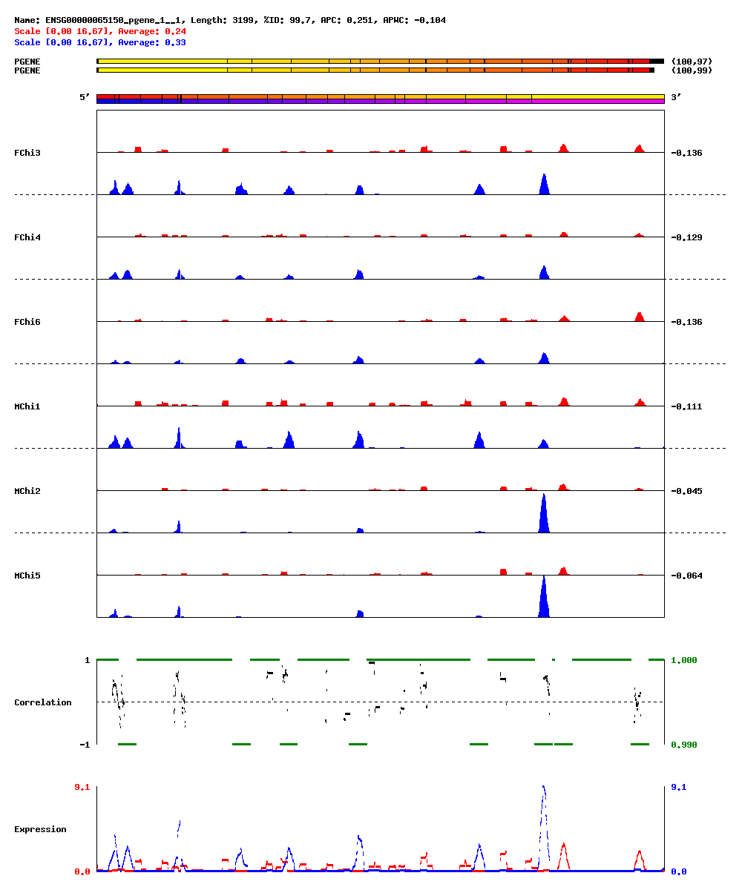

Slide 4
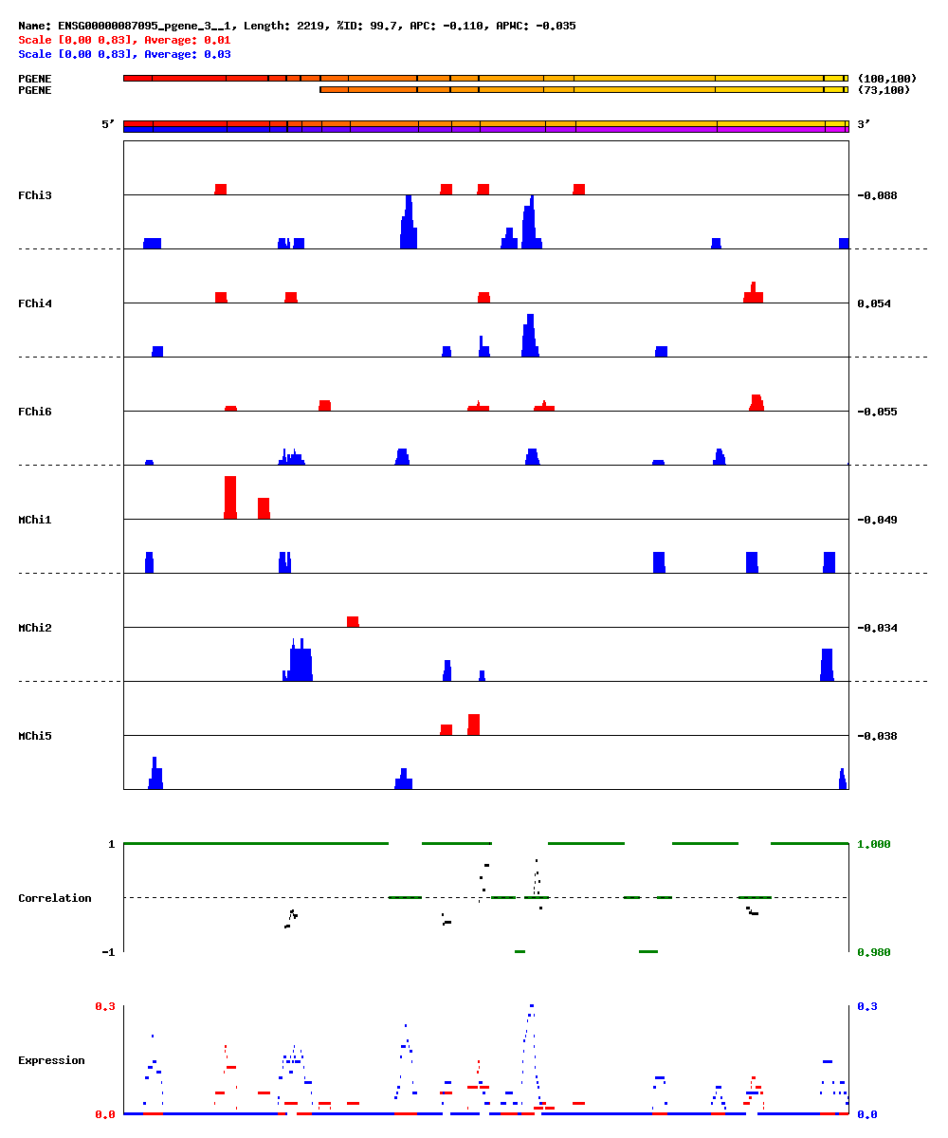

Slide 5
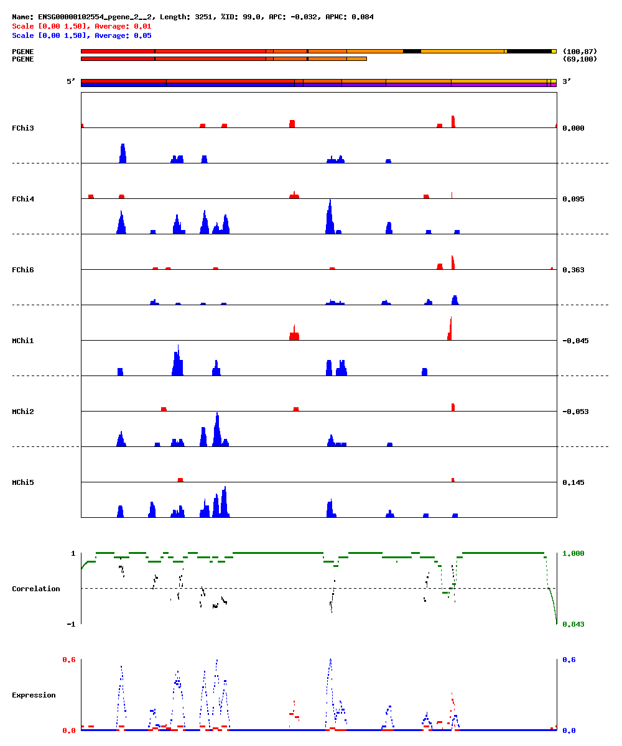

Slide 6
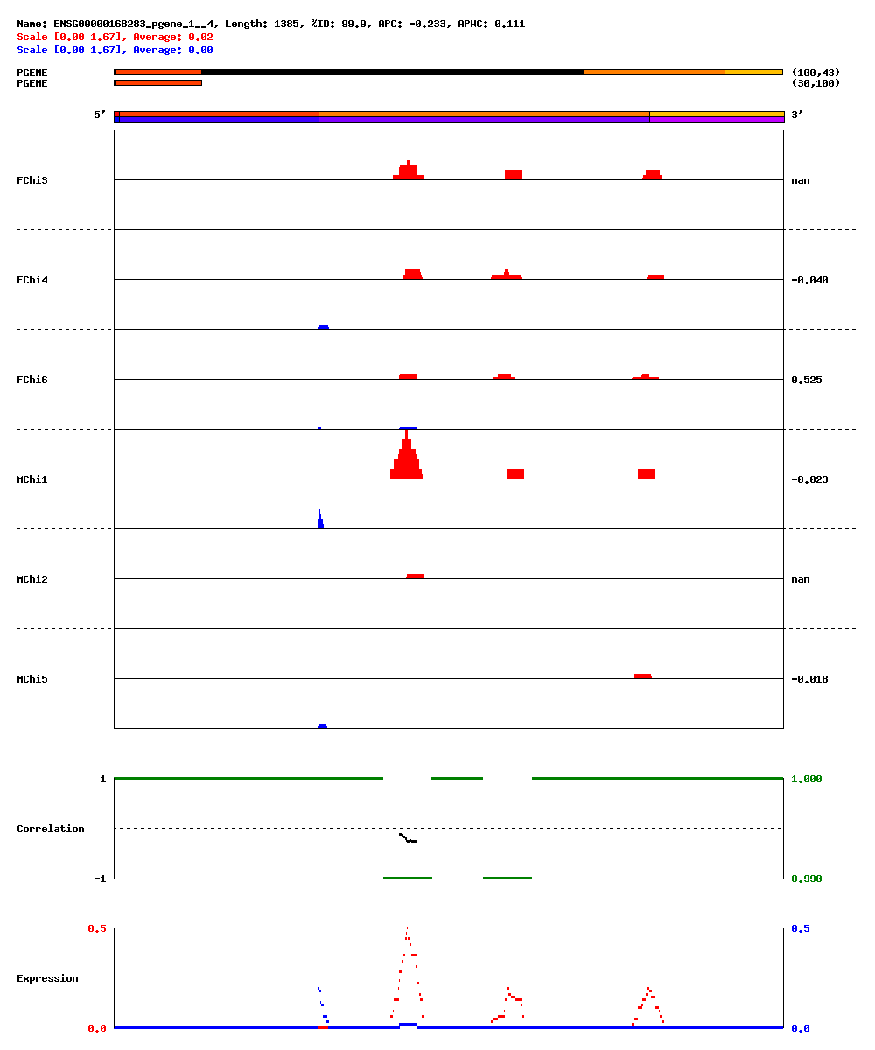

Slide 7
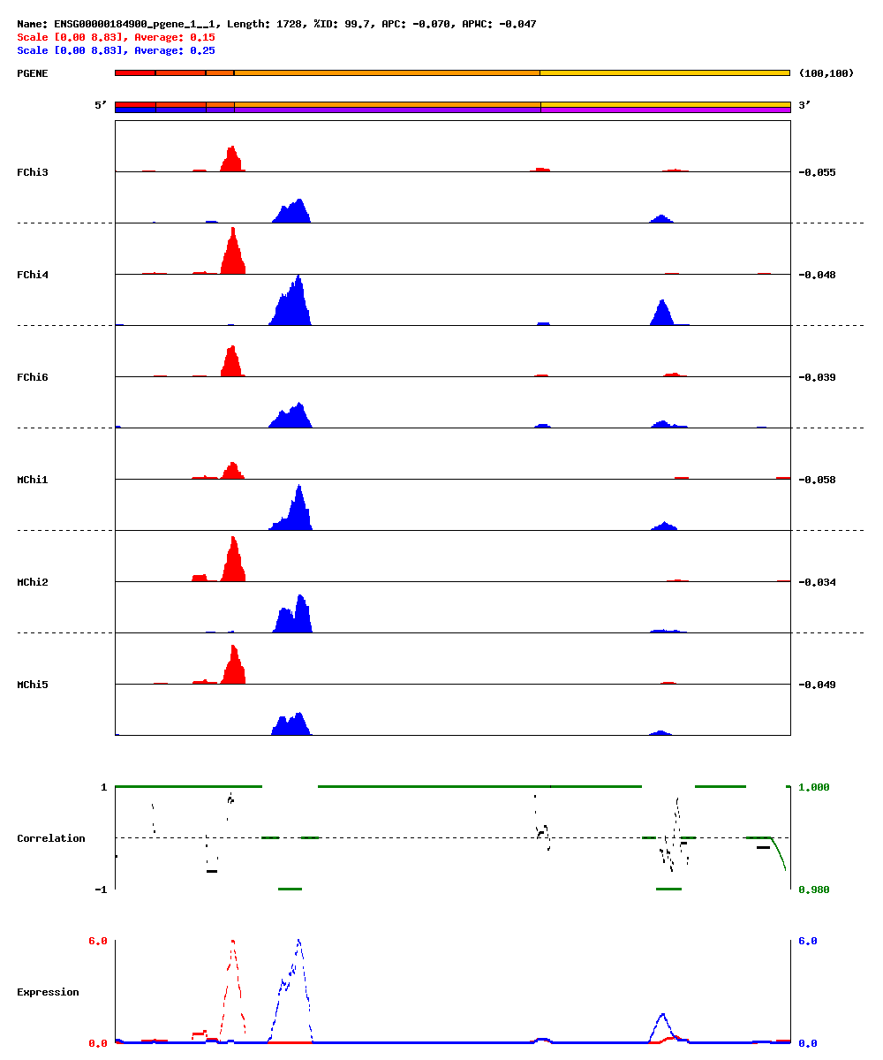

Slide 8
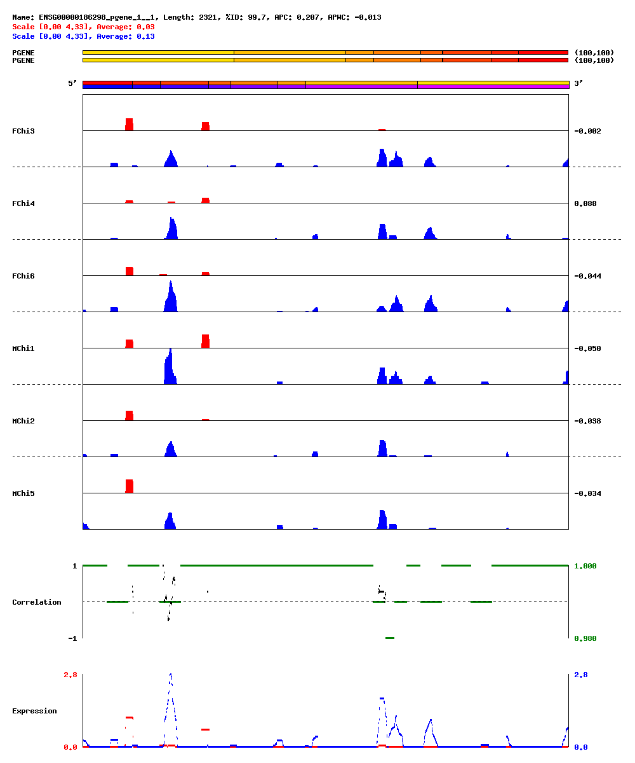

Slide 9
Summary
Human gene name | Chimp gene name | Chimp gene locus | Ψgene locus | Ψgene strand
ENSG00000065150 | ENSPTRG00000005984 | chr13:98744120-98785608 | chr12:20287032-20290231 | -
ENSG00000087095 | ENSPTRG00000008904 | chr17:29170883-29321016 | chr9:87174717-87176940 | +
ENSG00000102554 | ENSPTRG00000005928 | chr13:73276131-73294430 | chr1:113222654-113226403 | +
ENSG00000168283 | ENSPTRG00000002353 | chr10:22871590-22874658 | chr7:123648134-123651355 | +
ENSG00000184900 | ENSPTRG00000013991 | chr21:44452013-44465671 | chr1:229704642-229706370 | +
ENSG00000186298 | ENSPTRG00000005448 | chr12:112009685-112032801 | chr6:58092601-58094923 | -

Slide 10
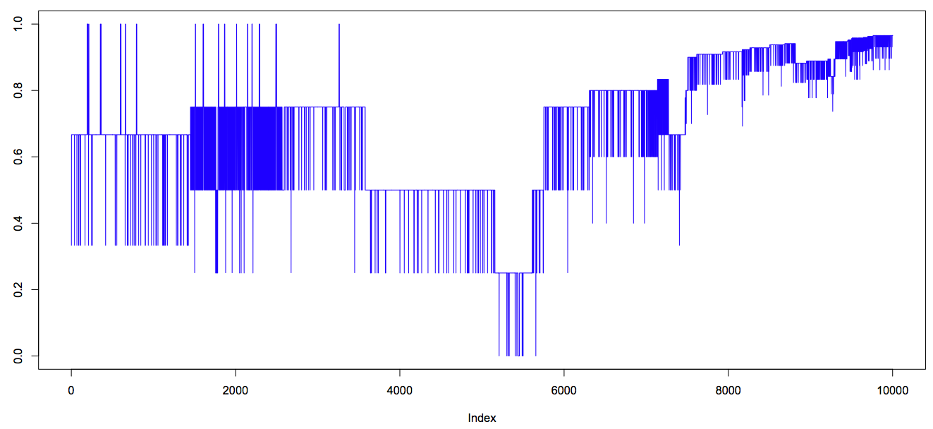
3’-conservation (chimp)
SB&Show

Slide 11
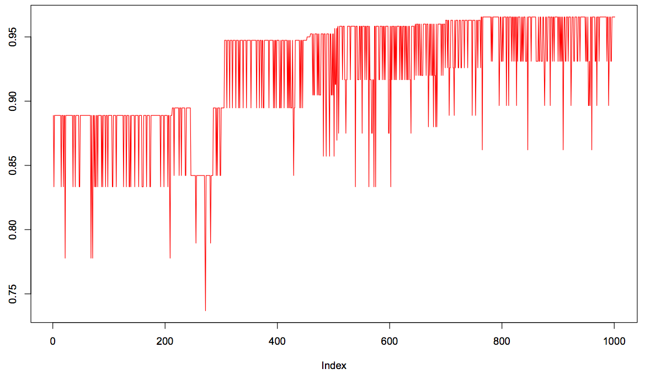
3’-conservation (chimp)
SB&Show

Slide 12
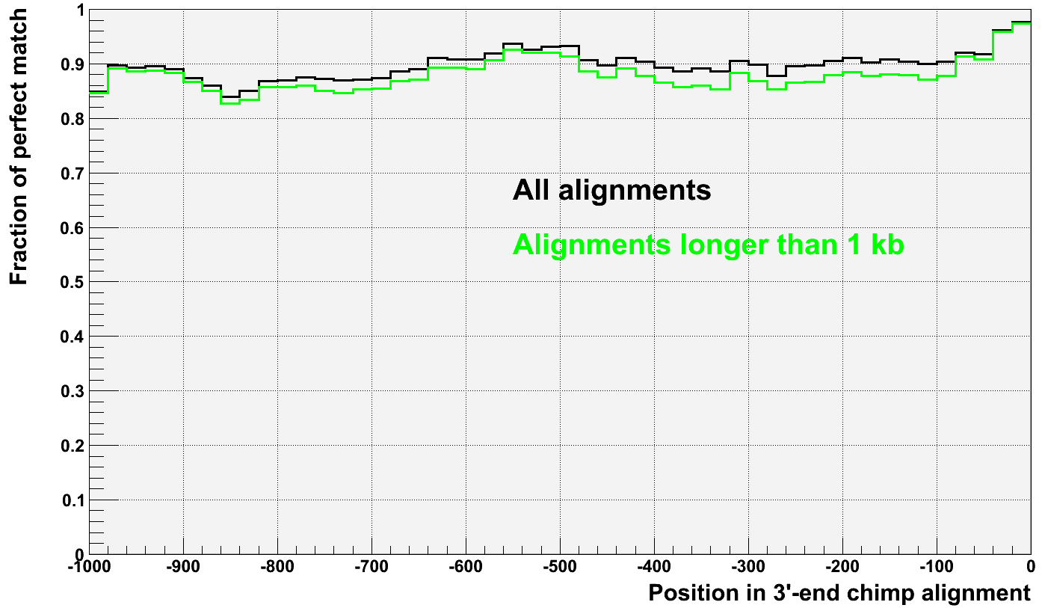
3’-conservation (chimp)

Slide 13
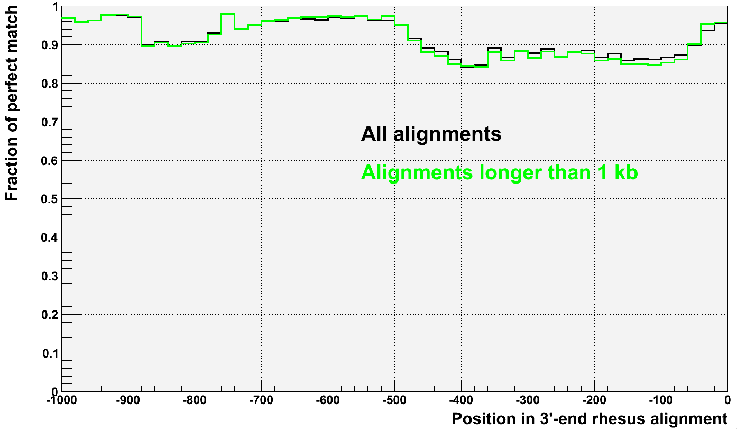
3’-conservation (rhesus)

