Slide 1
PRO-SNP-NET
EK, 15 March 2011

Slide 2
Structure vs Sequence conservation scores
Structural alignment of proteins containing SNPs with proteins of the same SCOP family
Computation of sequence conservation scores for residues that show SNPs and align structurally. seq_score from BLOSUM62 matrix

Slide 3
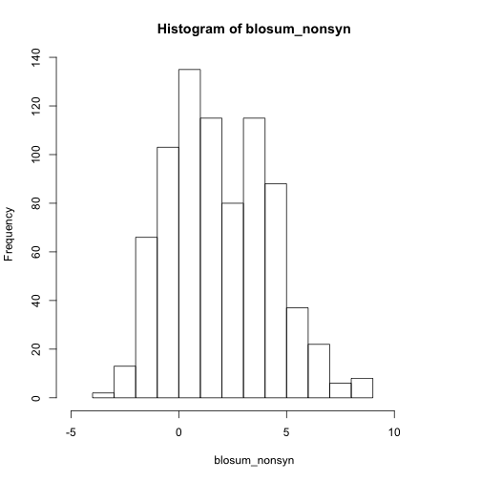
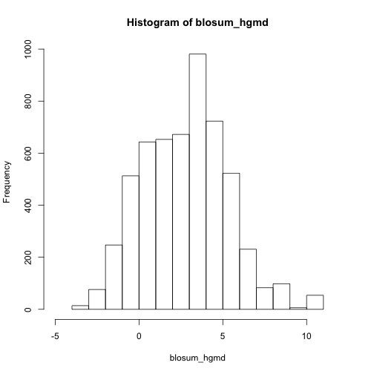
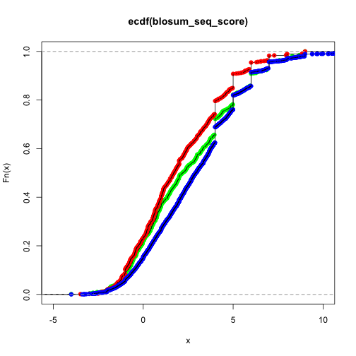
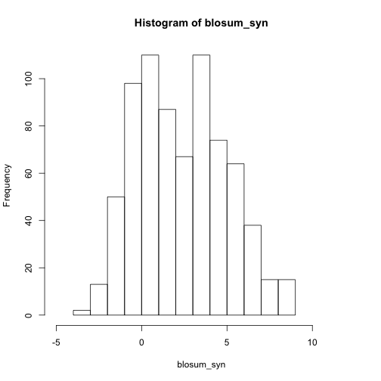
Kstest:
Hgmd scores > syn scores > nonsyn scores significant
Similar results with t-test

Slide 4
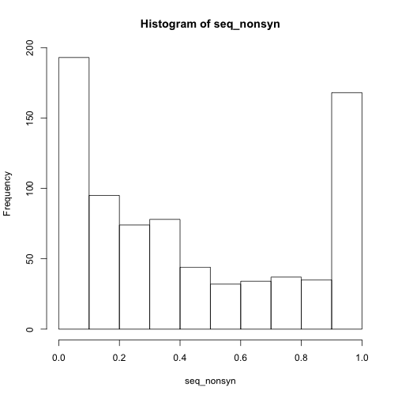
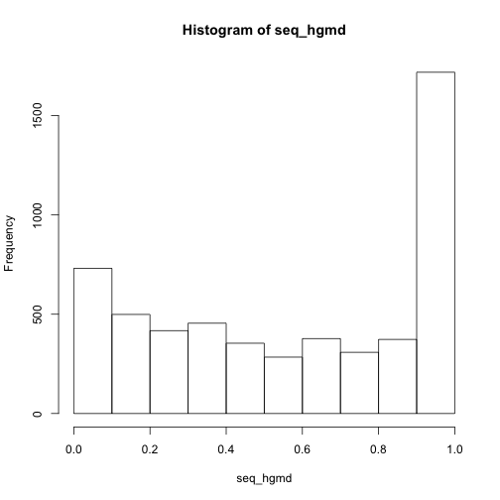
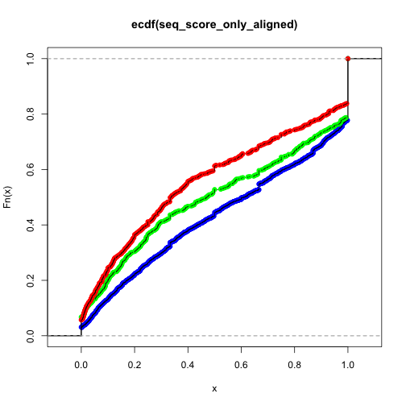
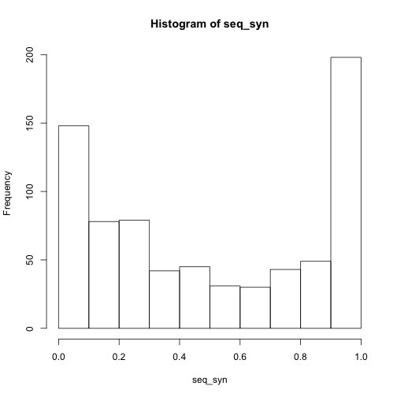
Remove residues which do not align structurally
Kstest:
Hgmd scores > syn scores > nonsyn scores significant

Slide 5
HGMD SNPs are more conserved structurally and the sequence at those sites is also more conserved
Nonsyn SNP sites are more flexible for sequence change than syn SNP sites even though structural conservation is same
Notes:
1996 Mark paper- structure and sequence conservation

Slide 6
SNPs on PPI
Do proteins with SNPs cluster together on the network ?
Compute shortest paths between all PPI nodes (Koon-Kiu)

Slide 7
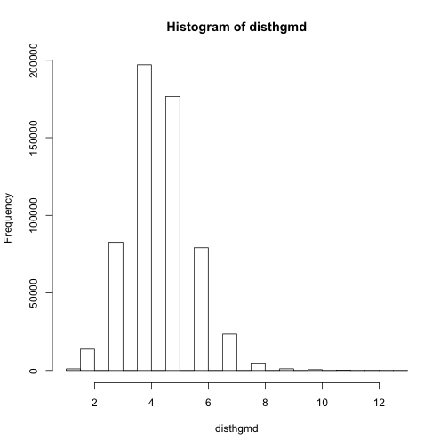
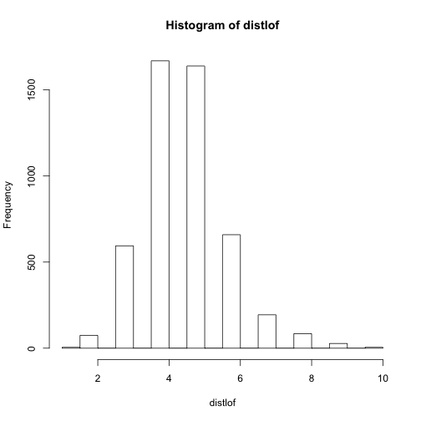
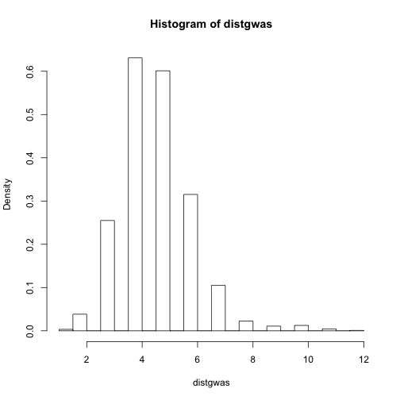
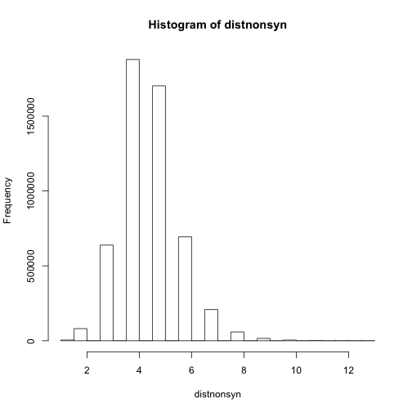

Slide 8
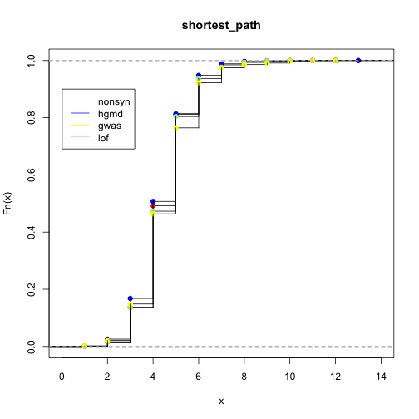
KS-test lof path lengths longer than hgmd: pvalue=9.88e-06, D= 0.0343
(consistent with t-test) gwas path lengths longer than lof: pvalue=2.68e-05, D=0.0398
(consistent with t-test)
Notes:
P-value=0.001243 and D statistics=0.0025 for nonsyn curve lies above hgmd curve
nonsyn path lengths longer than hgmd: pvalue<2.2e-16, D=0.0309 (consistent with t-test)

Slide 9
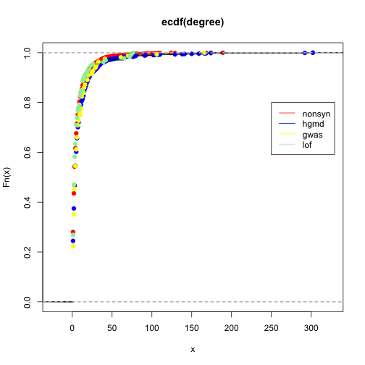
KS test: Only HGMD degrees higher than NONSYN degrees (pvalue=7.79e-06)

