Slide 1
Interpreting indel relative rate figures
Rate estimates for deletions
of length: - 15 .. - 1
Rate estimates for insertions
of length: +1 .. + 15
Enrichment
+4x
Rate estimate for all SNPs
(using same model)
+2x
-15
-3
Relative rates
0
-1
-2x
-2
+1
+3
Depletion
-4x
+2
Length multiples of 3
in black
+15
Black circle means rate
estimate extends
beyond graphing limits
Rate estimate for all indels
Red circle means rate
estimate is significant
(p < 0.05); Significant estimates
are also opague.

Slide 2
Indel rate model (Full genome logistic regression)
To calculate indel relative rates, we performed a logistic regression of CEU pilot 1 indels given GENCODE annotation, conserved elements from Phastcons 17-way alignments, tandem repeats (UCSC TRF annotation), repetitive elements, sequence uniqueness, CpG islands, recombination rates encoded as 5 states, Pilot 1 SNPs, homopolymer and microsatellite tracks each encoded as 3 states and GC in 2 windows (50bp and 250bp) encoded as 9 states for every base in the reference genome. We further independently stratified each rate estimate for indels given their length with respect to the ancestral state (-15bp to 15bp).
Response ~ SNPs + Recombination Rate + Transposon + LTR + LINE + SINE + TRF + 5’UTR + Intron + CDS + Conserved noncoding + 3’ UTR + CpG + Homopolymer + Microsatellite + Uniqueness + GC (50 bp window) + GC (250 bp window)

Slide 3
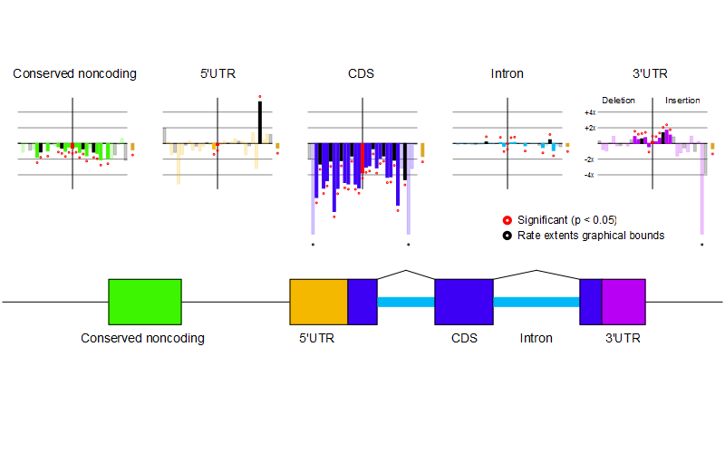
Indel rate estimates for genic annotation
(CEU Pilot 1 Indels and SNPs)

Slide 4
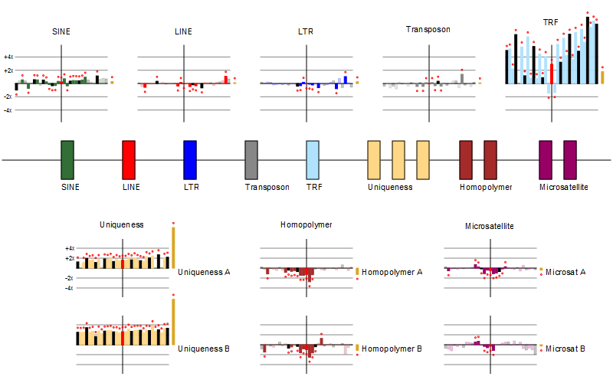
Indel rate estimates for repetitive annotation
(CEU Pilot 1 Indels and SNPs)

Slide 5
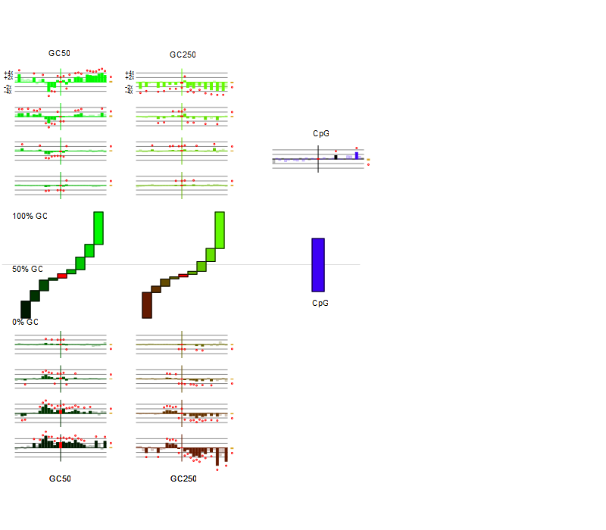
Indel rate estimates for GC
(CEU Pilot 1 Indels and SNPs)

Slide 6
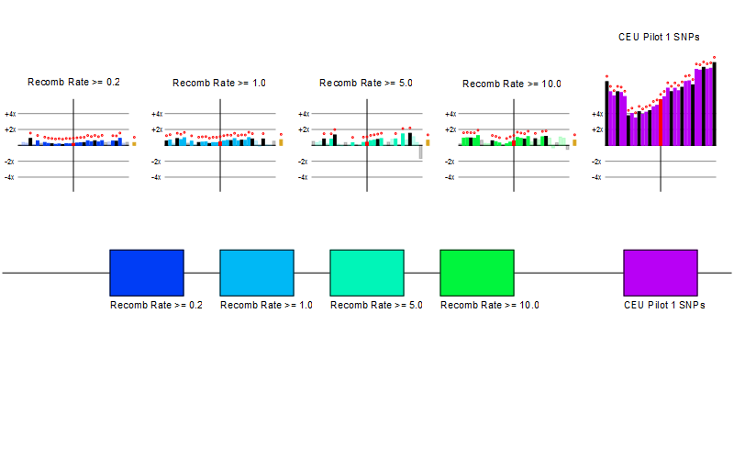
Indel rate estimates for recombination rate and SNPs
(CEU Pilot 1 Indels and SNPs)

Slide 7
Supplemental 1: Indel rate estimates for YRI

Slide 8
Indel rate estimates for genic annotation
(YRI Pilot 1 Indels and SNPs)

Slide 9
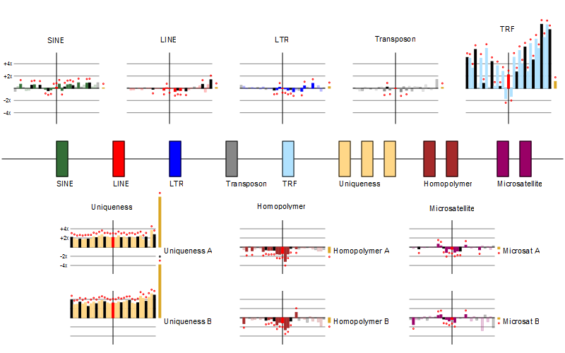
Indel rate estimates for repetitive annotation
(YRI Pilot 1 Indels and SNPs)

Slide 10
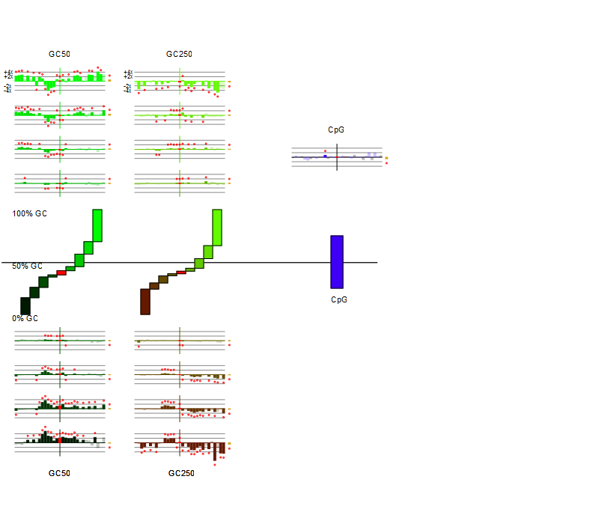
Indel rate estimates for GC
(YRI Pilot 1 Indels and SNPs)

Slide 11
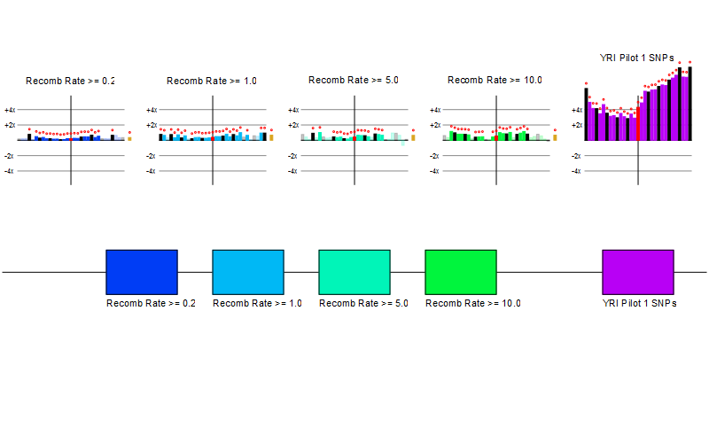
Indel rate estimates for recombination rate and SNPs
(YRI Pilot 1 Indels and SNPs)

Slide 12
Supplemental 2: Indel rate estimates for background GC model

Slide 13
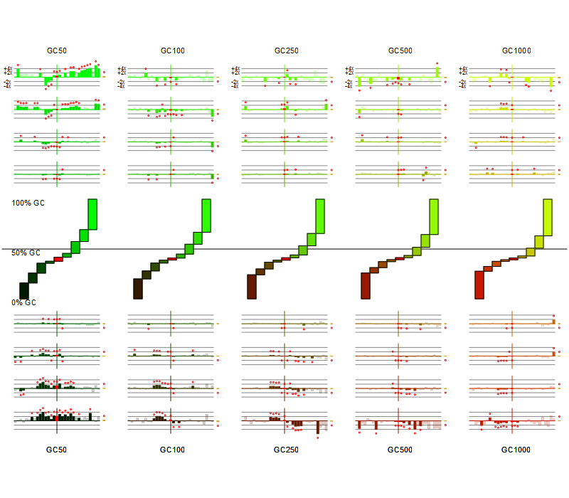
Extra GC windows tested to determine window size for full model.

Slide 14
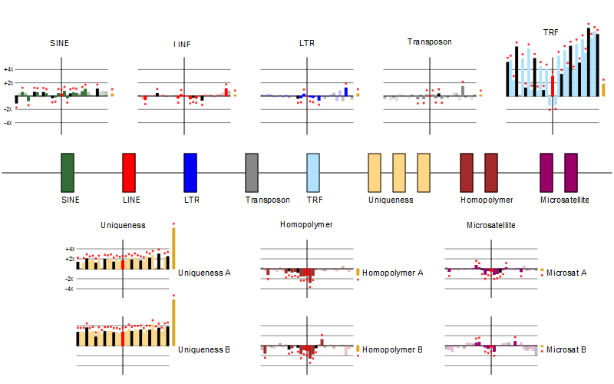
Repetitive elements added to model during GC prototyping.

Slide 15
Supplemental 3: Indel rate estimates for CEU and YRI
(using chimp-only polarization)

Slide 16
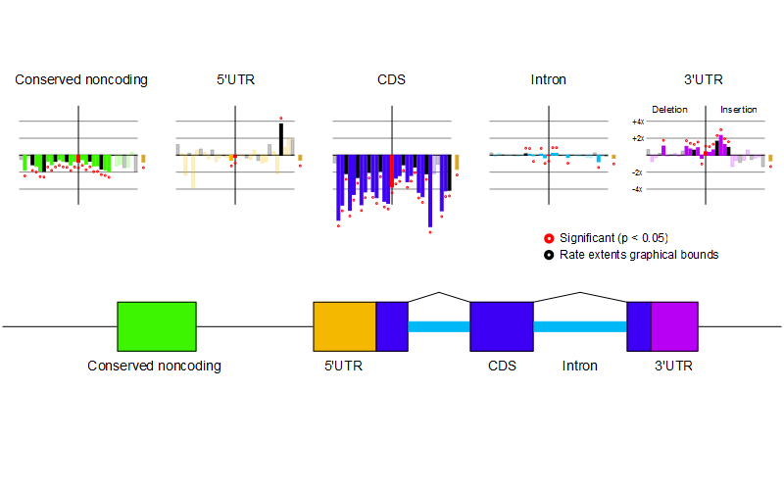
CEU and YRI genic indel rates (using polarization from P. troglodytes only).
CEU
YRI

Slide 17
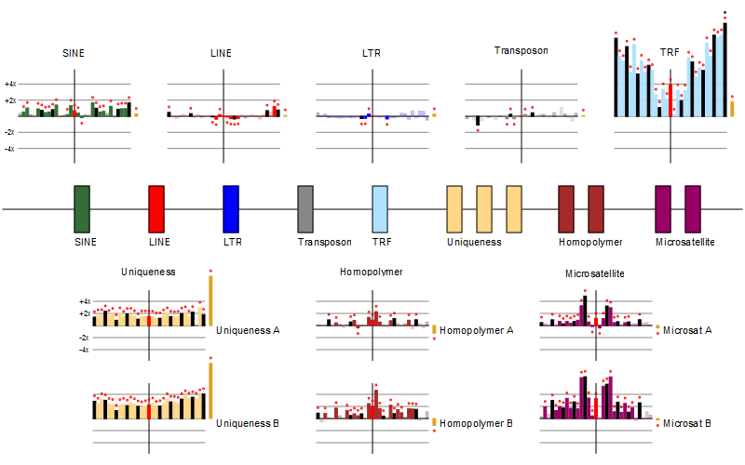
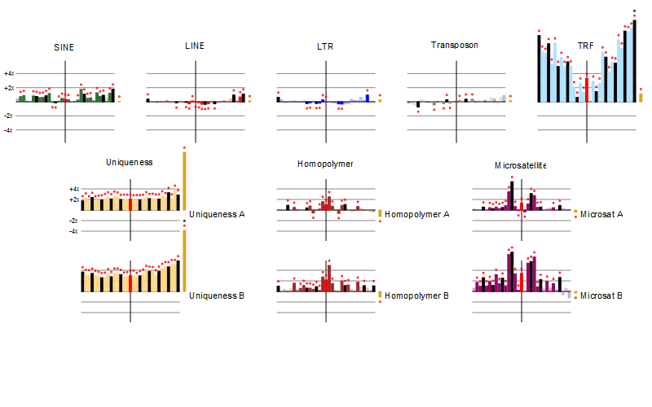
CEU and YRI repetitive
element indel rates
(using polarization from
P. troglodytes only).
CEU
YRI

Slide 18
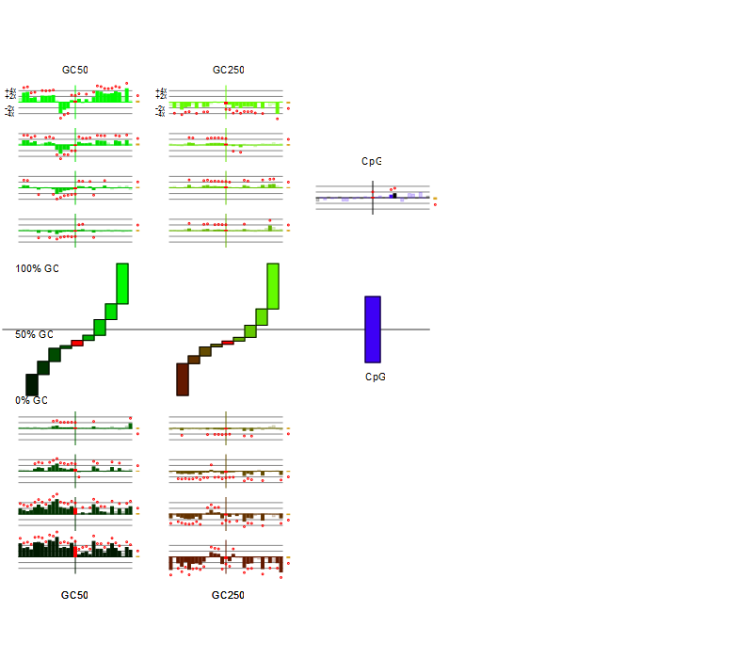
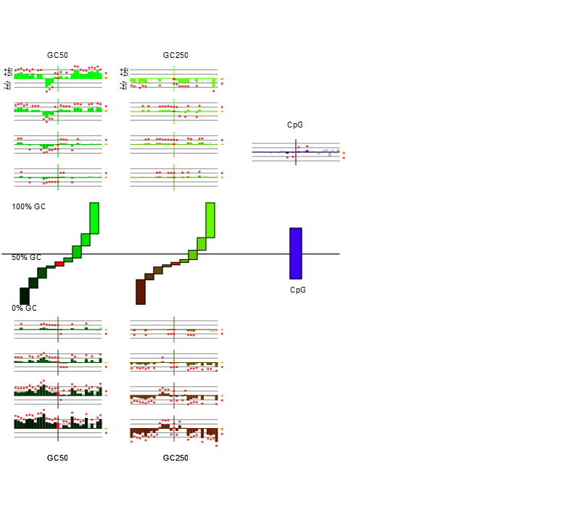
CEU and YRI GC indel rates (using polarization from P. troglodytes only).
CEU
YRI

Slide 19
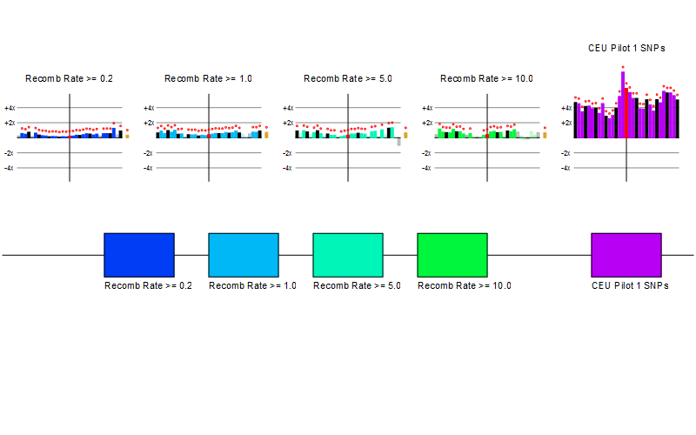
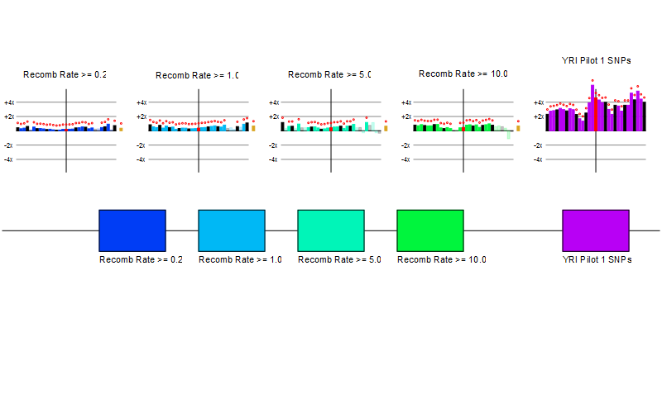
CEU and YRI recombination and SNP
indel rates (using polarization from P. troglodytes only).

Slide 20
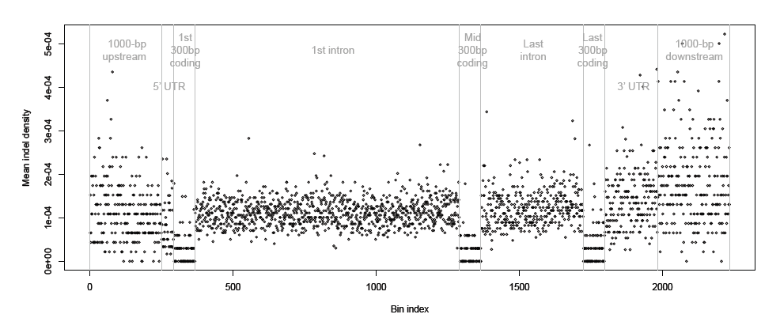
A
B

