Slide 1
Structure vs sequence conservation of SNP sites
EK, Mar 9, 2011

Slide 2
Structural conservation and sequence conservation
Structurally constrained sites
  Sequence variable (relates to convergent evolution)
  Sequence also constrained
Structurally variable
  Sequence variable

Slide 3
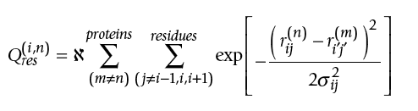

Structural alignment of proteins belonging to same SCOP family
Structural conservation scores
Sequence conservation of sites that align structurally – for pair wise alignments
  seq_score=0 if residues are different
  seq_score=1 if residues are same
Luthey-Schulten and others, 2006

Slide 4
Result of STAMP structural alignment
Colored by structure conservation scores
Colored by sequence conservation scores

Slide 5
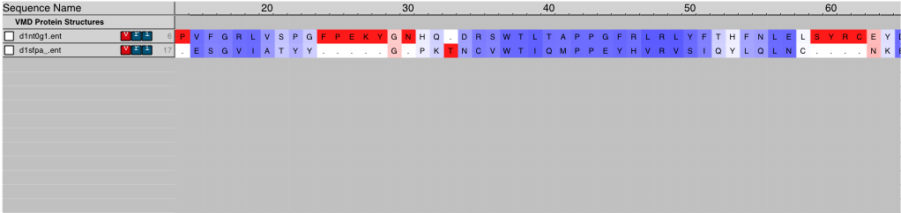
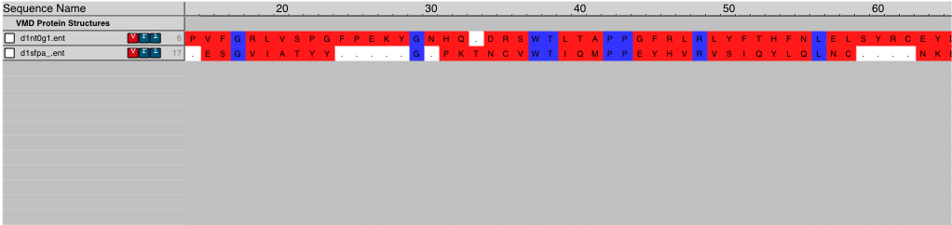
Result of STAMP structural alignment
Colored by structure conservation scores
Colored by sequence conservation scores

Slide 6
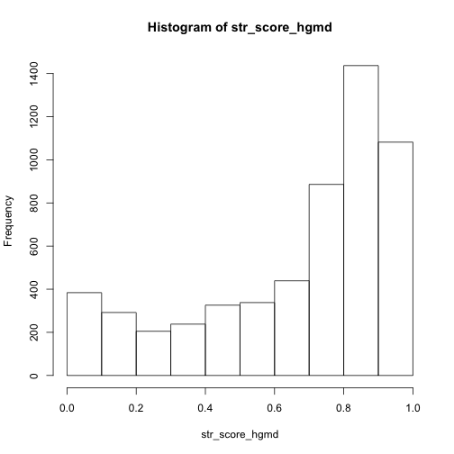
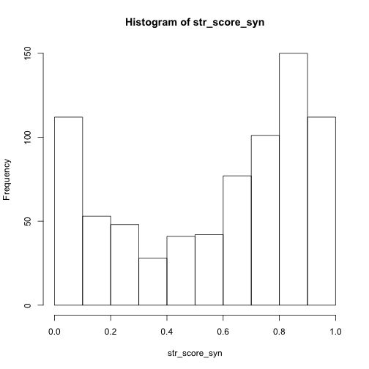
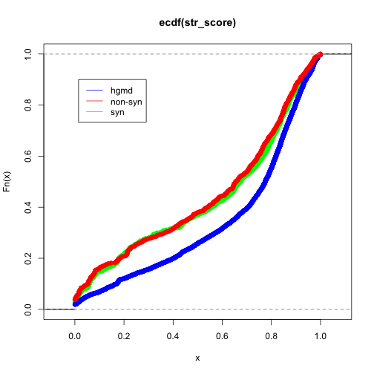
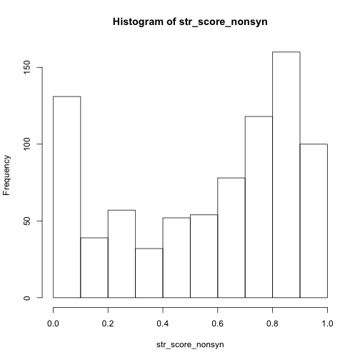
KStest: HGMD significantly lower

Slide 7
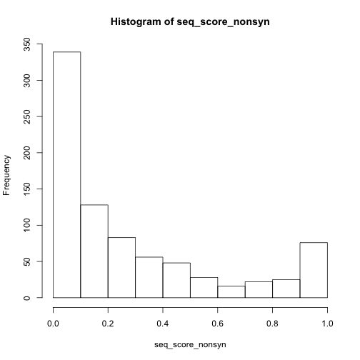
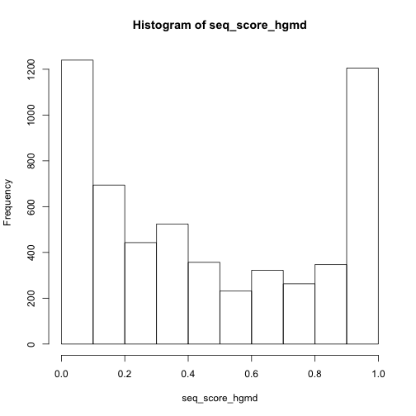
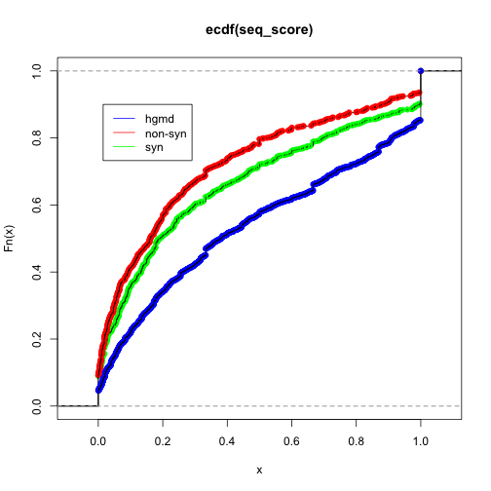
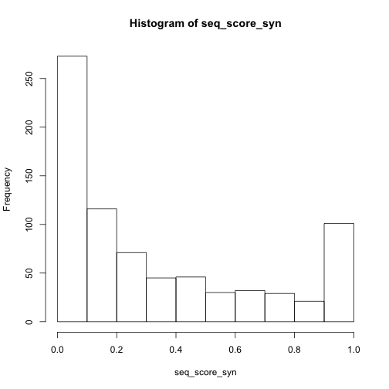
Kstest: hgmd<syn<nonsyn significant

Slide 8
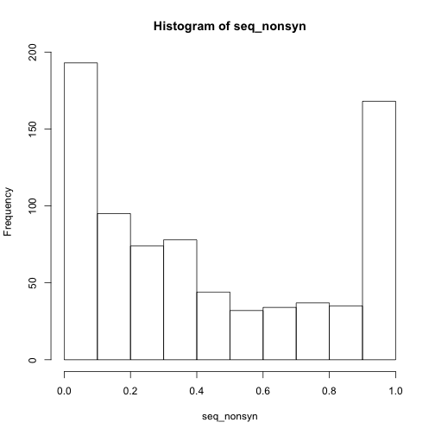
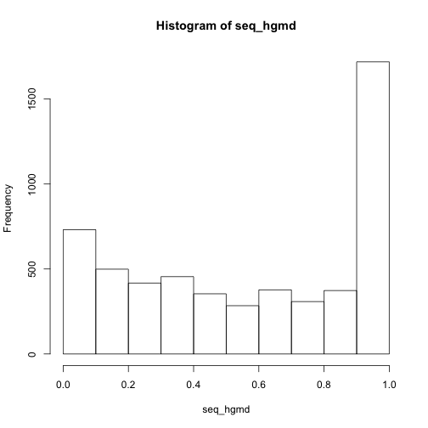
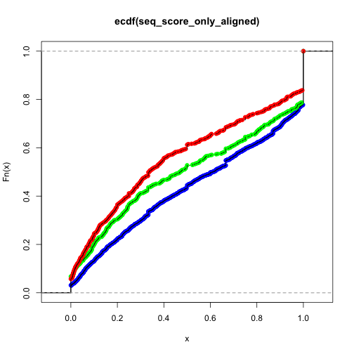
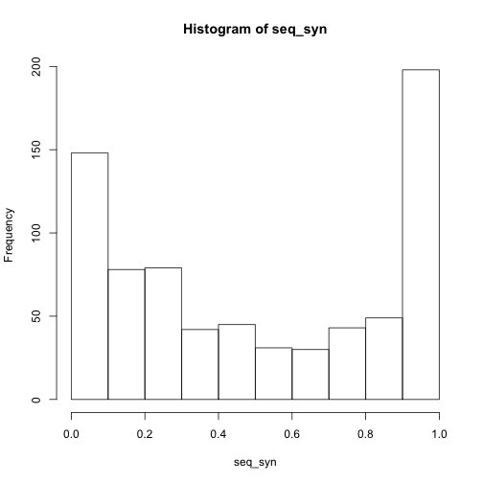
Remove residues which do not align structurally
Kstest: hgmd<syn<nonsyn significant

Slide 9
Summary
HGMD SNPs are more conserved structurally and the sequence at those sites is also more conserved
Nonsyn SNP sites are more flexible for sequence change than syn SNP sites even though structural conservation is same
To do
  variance in average scores
  another way to assess sequence conservation

