Slide 1
Initial CNV calling on phase 1 data
Alexej Abyzov, Mark Gerstein, Yale groups
March 14, 2011

Slide 2
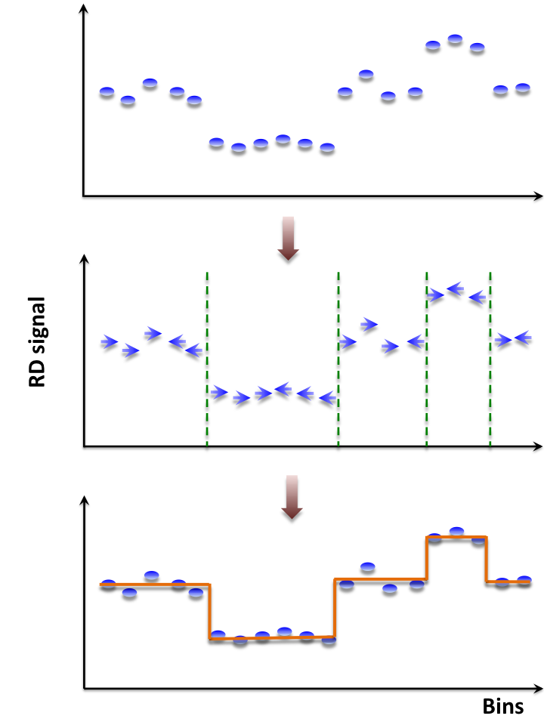
CNVnator, mean-shift approach
For each bin attraction (mean-shift) vector points in the direction of bins with most similar RD signal
No prior assumptions about number, sizes, haplotype, frequency and density of CNV regions
Not model-based (e.g. like HMM) with global optimization, distribution assumption & parameters (e.g. number of segments)
Achieves discontinuity-preserving smoothing
Derived from image-processing applications
[Abyzov et al. Gen. Res. (’11)]

Slide 3
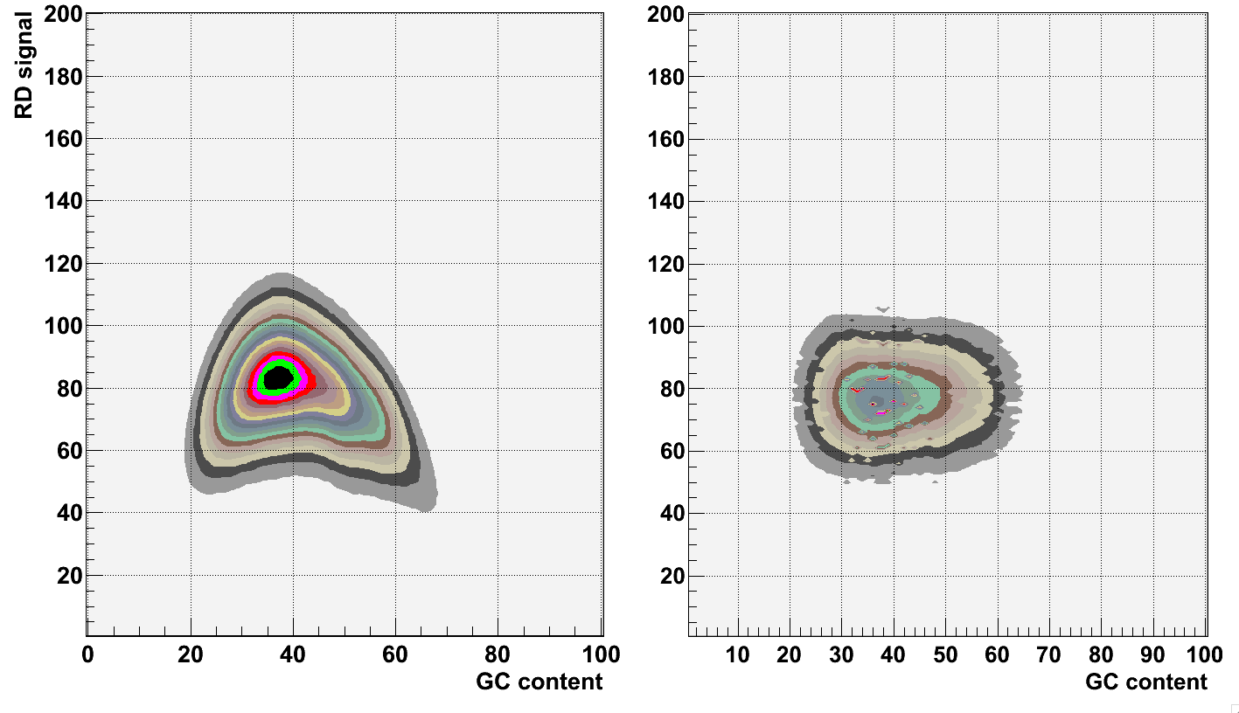
GC correction
[Abyzov et al. Gen. Res. (’11)]

Slide 4
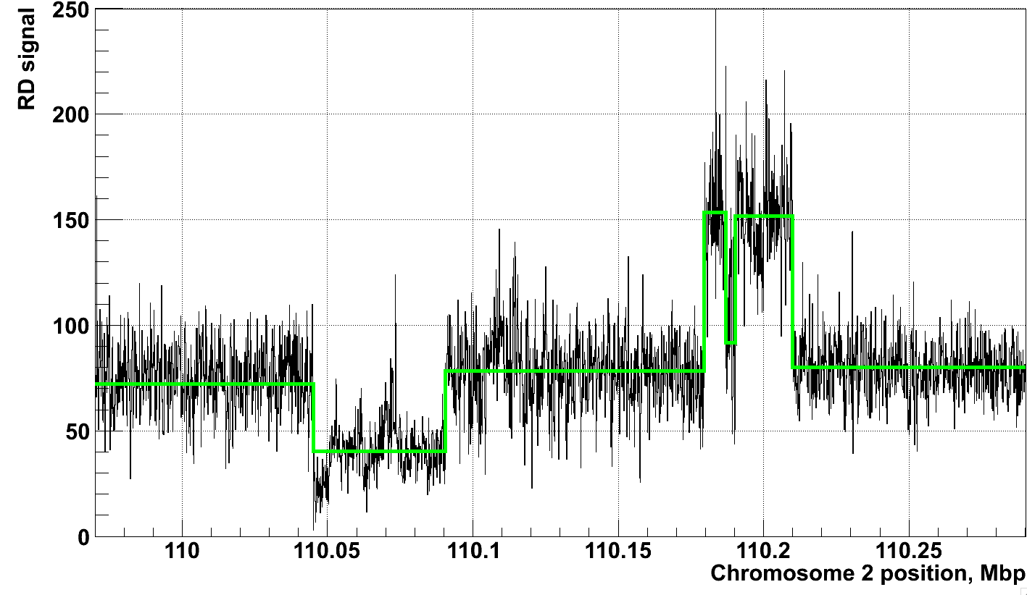
Example of application of CNVnator to RD data
[Abyzov et al. Gen. Res. (’11)]
NA12878, Solexa 36 bp paired reads, ~30x coverage

Slide 5
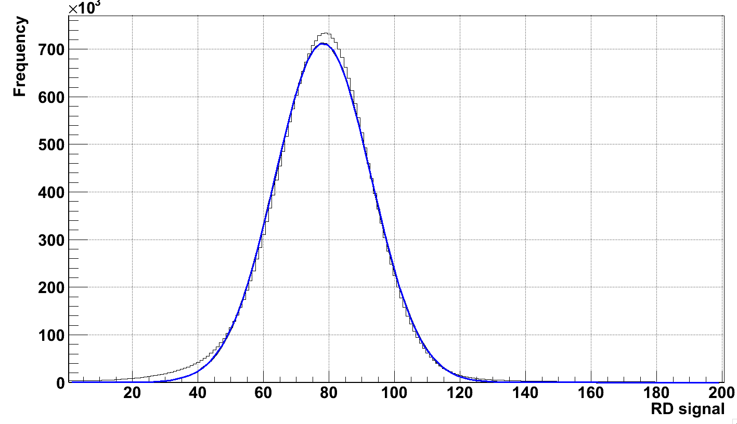
Genotyping
μ

Slide 6
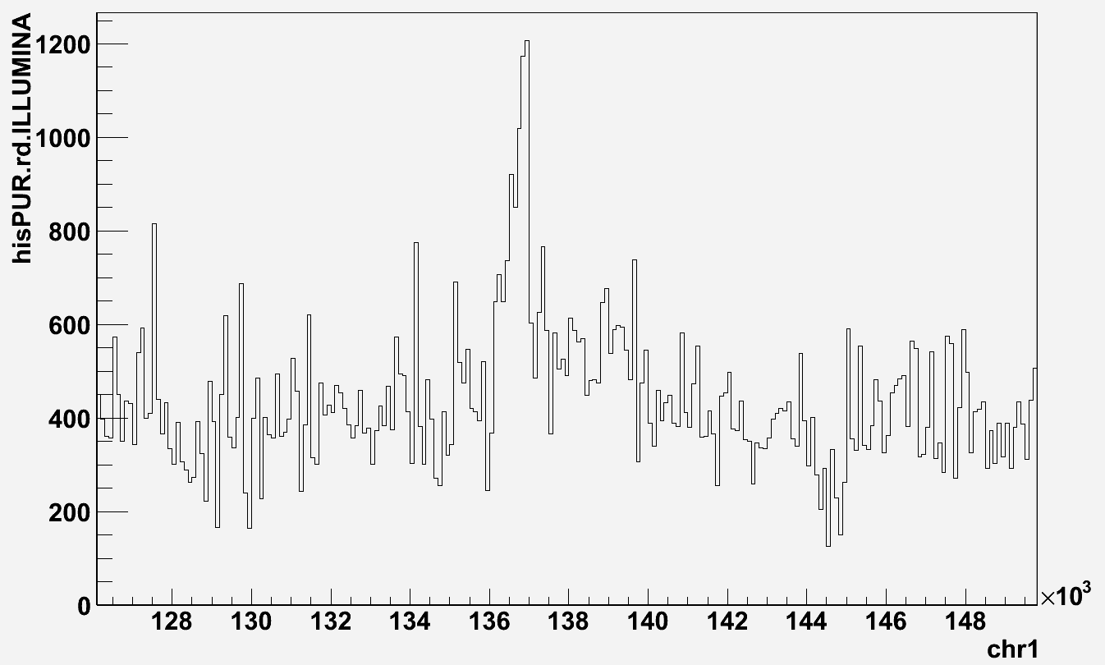
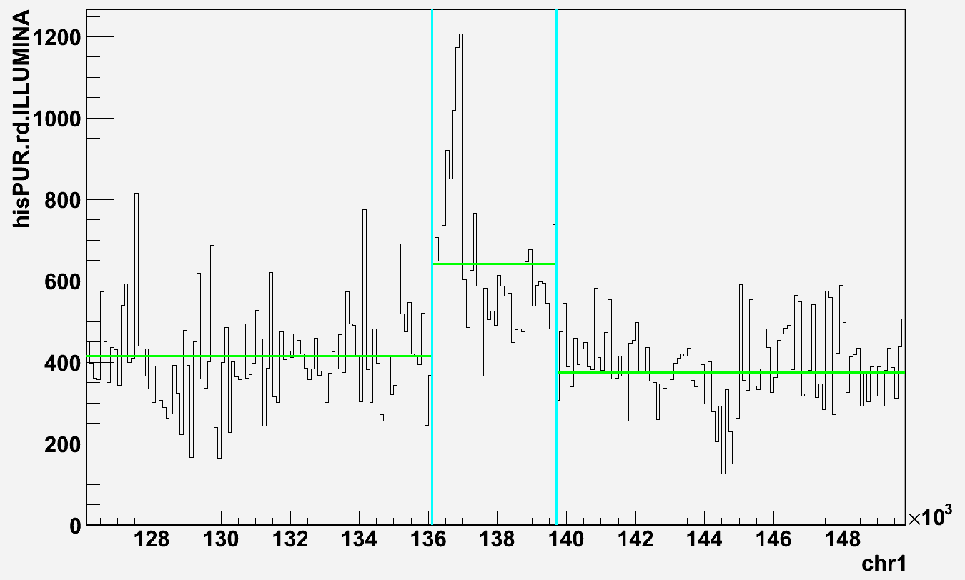
Analysis approach, phase 1 data
Data
CNVnator
Population

Slide 7
Data
Population | # | Mean read | Mean insert | Mean RD | Sigma RD | mean/sigma
ASW - Africans in Southwest | 50 | 77 | 308 | 398.2 | 62.1 | 6.4
CEU - Europeans in Utah | 88 | 53 | 223 | 871.8 | 136.0 | 6.4
CHB - Han Chinese in Beijing | 81 | 54 | 347 | 664.2 | 107.4 | 6.2
CHS - Han Chinese South | 92 | 74 | 474 | 567.9 | 83.9 | 6.8
CLM - Colombian | 52 | 91 | 377 | 356.1 | 49.9 | 7.1
FIN - Finnish | 77 | 78 | 471 | 429.0 | 69.9 | 6.1
GBR - British | 72 | 74 | 430 | 499.1 | 72.2 | 6.9
IBS - Iberian | 6 | 95 | 176 | 29.3 | 6.9 | 4.2
JPT - Japanese | 80 | 62 | 296 | 849.6 | 136.3 | 6.2
LWK - Luhya, Kenya | 83 | 90 | 350 | 516.8 | 88.4 | 5.8
MXL - Mexican | 54 | 80 | 300 | 409.0 | 45.5 | 9.0
PUR - Puerto Rican | 53 | 82 | 422 | 387.7 | 49.1 | 8.0
TSI - Toscani | 100 | 50 | 183 | 860.5 | 181.6 | 4.7
YRI - Yoruba | 80 | 49 | 203 | 810.3 | 119.3 | 6.8

Slide 8
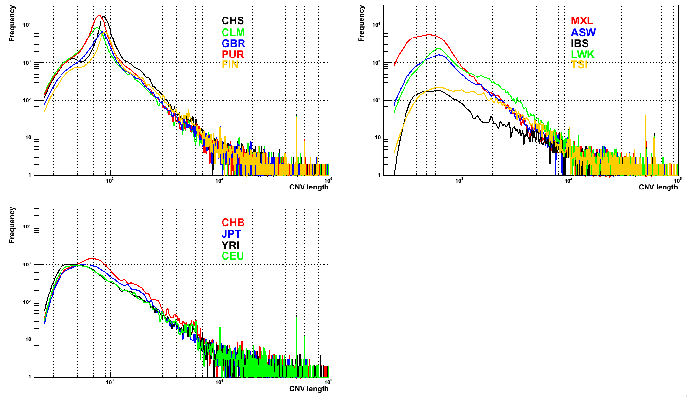
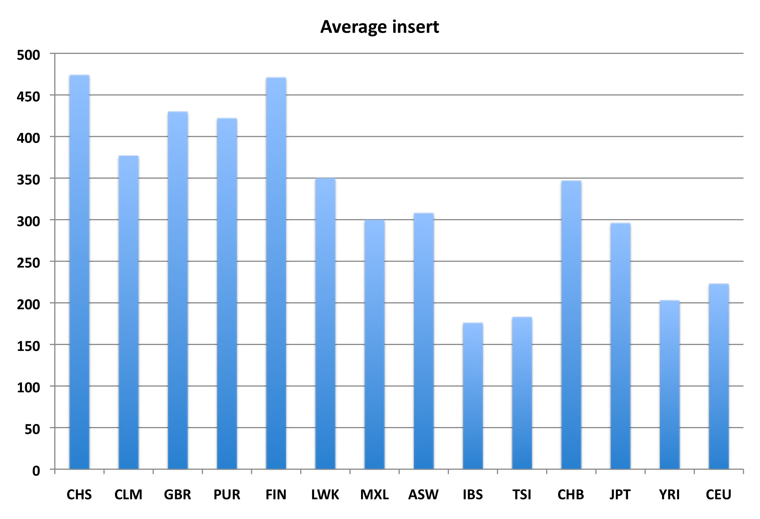
Size distribution

Slide 9
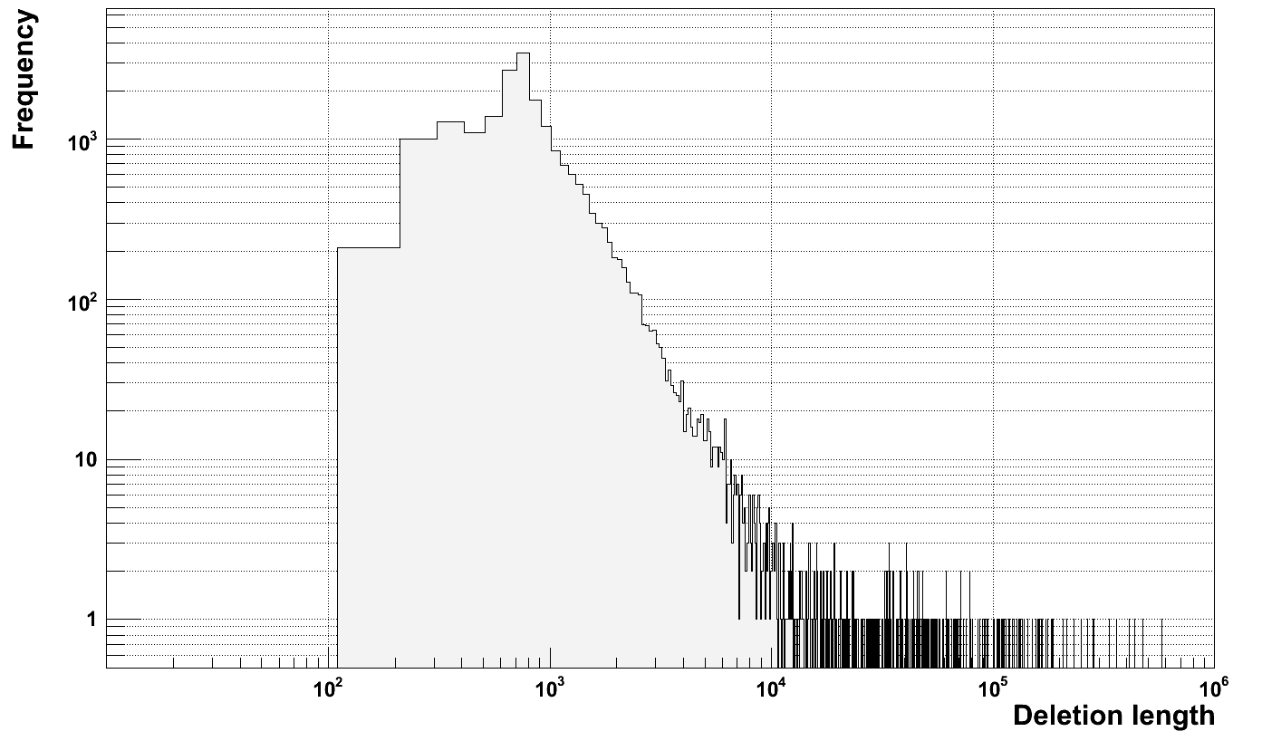
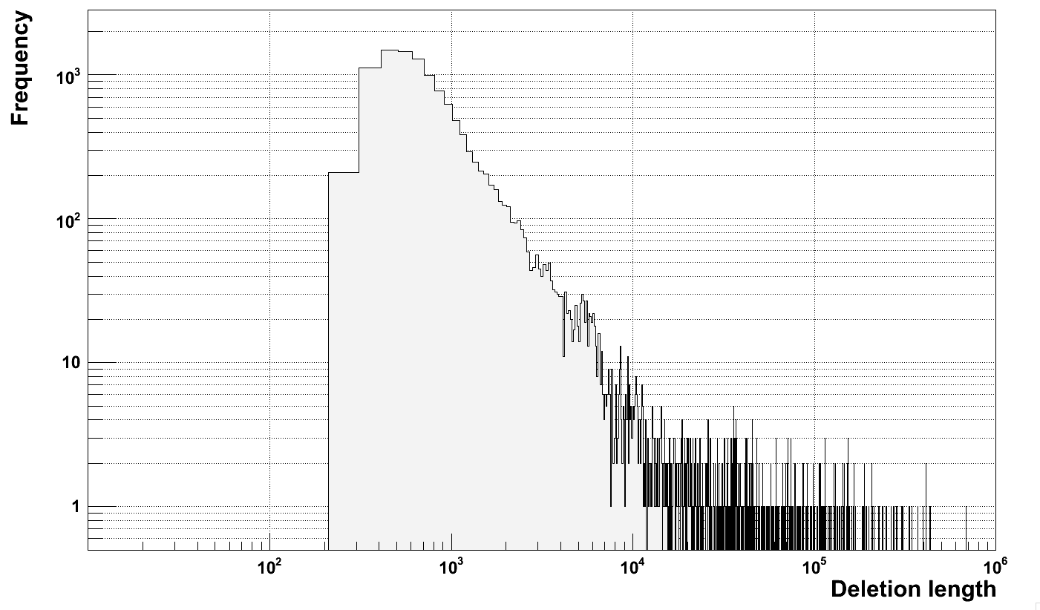
???
Deletion size
Distribution
for NA12878
on hg18
HiSeq
GAII

Slide 10
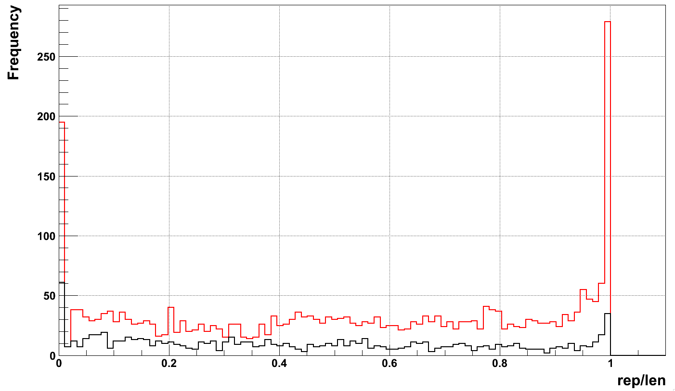
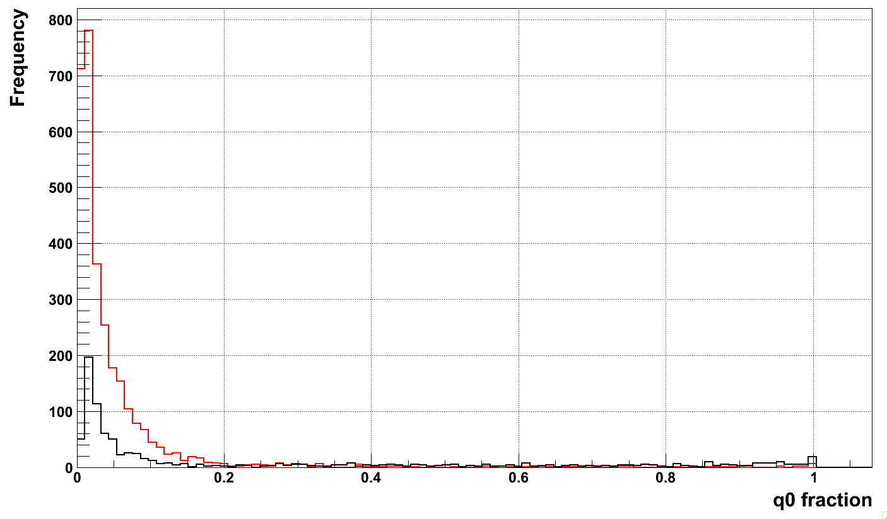
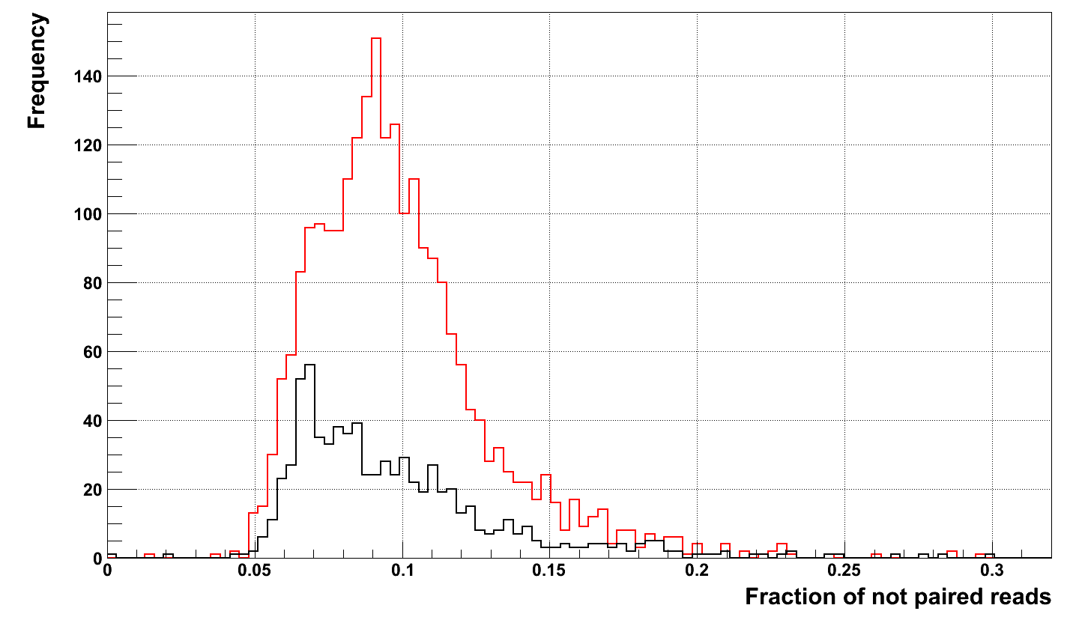
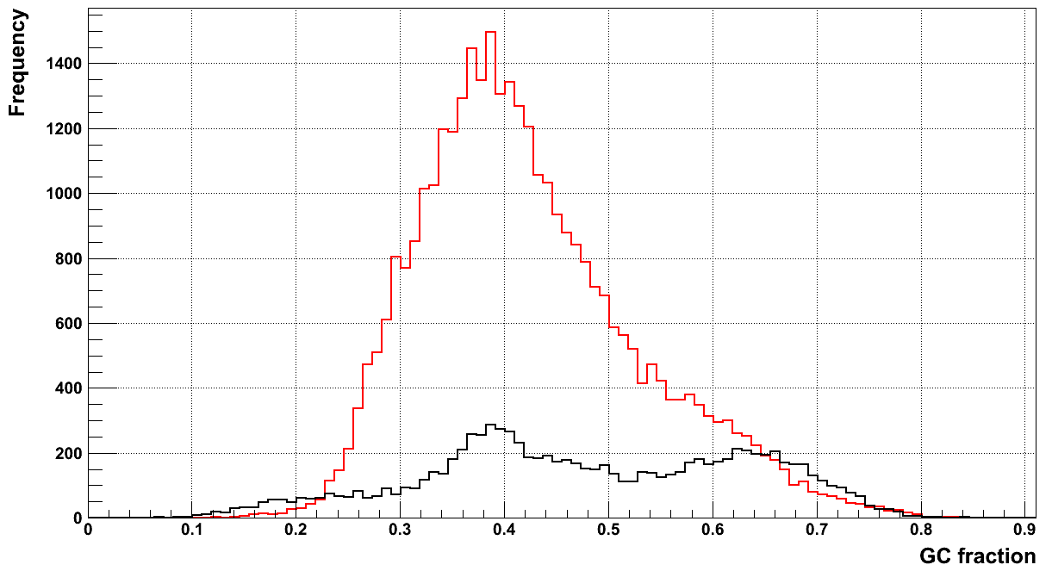
Region characterization (PUR)
700 <= len <= 900
len > 1000

Slide 11
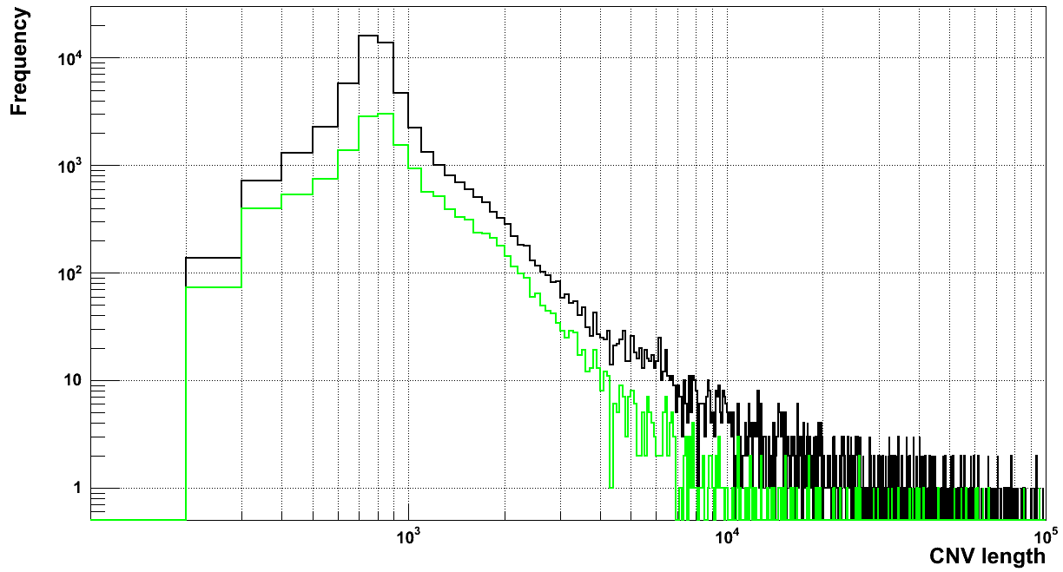
Filtering by GC is not a solution
All calls
Call with GC > 0.5

Slide 12
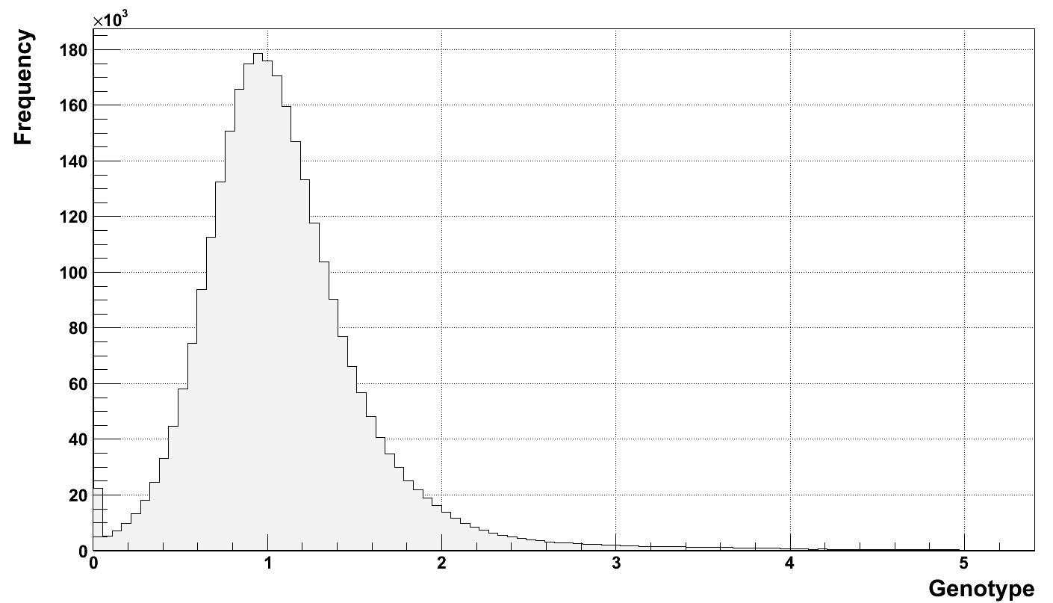
Genotyping in population

Slide 13
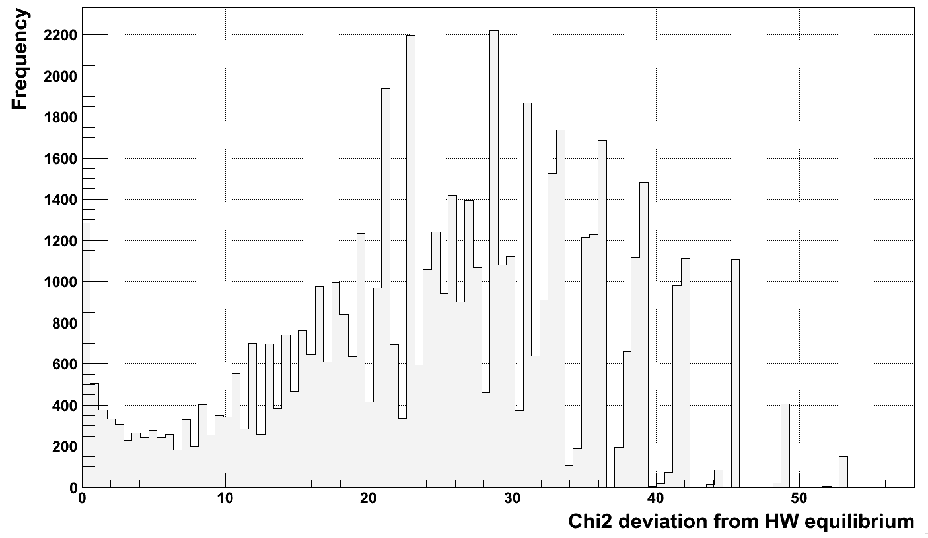
HW equilibrium

Slide 14
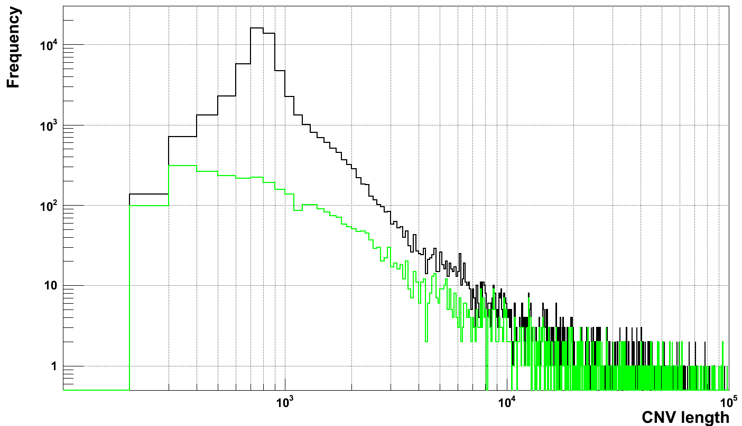
What is the difference?
All calls
Calls with Chi2 < 5

Slide 15
In DGV
Call set | # intersecting with DGV
 | 1 bp overlap | > 50% overlap | >50% reciprocal overlap
HW < 3, 2930 calls | 2058 (70%) | 2044 (70%) | 763 (26%)
HW < 5, 3773 calls | 2569 (68%) | 2550 (68%) | 863 (23%)
HW > 5, 52422 calls | 20242 (39%) | 19936 (38%) | 887 (2%)

