Slide 1
SV search update
Alexej Abyzov, Mark Gerstein
Monthly iPSC meeting
March 9, 2010

Slide 2
Outline
Results of BreakDancer
Comparison with arrays

Slide 3
Paired-ends
Read sequencing
Studied genome
Deletion
Insertion
Tandem
duplication
Inversion
MEI
Reference genome
Read mapping
Split-read
ME
sequence
library
…
Read sequencing
Studied genome
Deletion
Insertion
Tandem
duplication
Inversion
MEI
Reference genome
Read mapping
Read-depth
Genotyping
Read sequencing
Studied genome
Deletion
Duplication
Deletion
Insertion
Reference genome
Mapped read count
Breakpoint
sequence
library
…

Slide 4
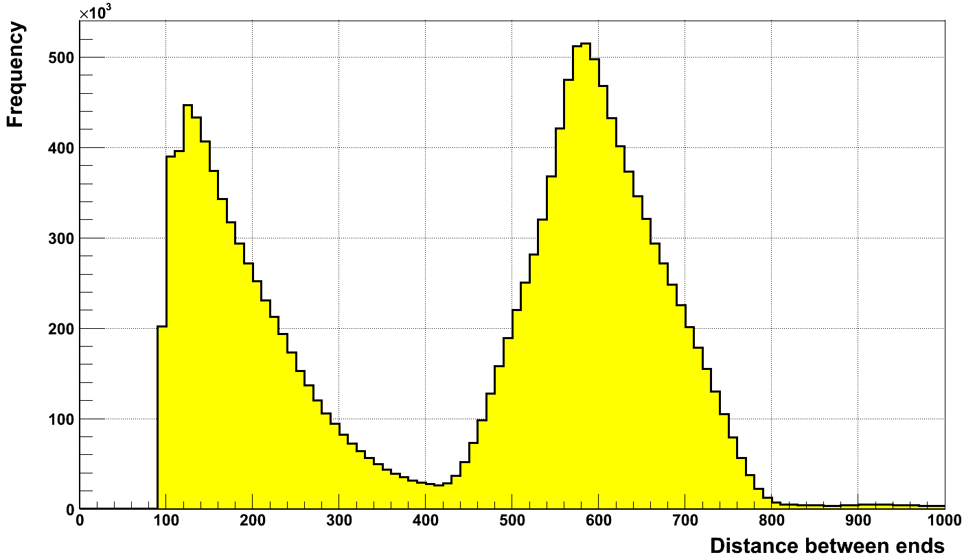
Insert length distribution
Insertions
Deletions

Slide 5
iPS cell line of PGP1
94,970 insertions
38,859 intra-chromosomal translocations?
883 deletions
641 inter-chromosomal translocations
143 inversions

Slide 6
Novelty
CNVs by CNVnator
Sample | Overlap with DGV | Concordant with DGV
iPSC (224) | 215 (96%) | 159 (70%)
Fibroblast (233) | 218 (94%) | 136 (58%)
Deletions by BreakDancer
Sample | Overlap with DGV | Concordant with DGV
iPSC (1274) | 847 (66%) | 306 (24%)
Fibroblast (1566) | 939 (60%) | 64 (4%)

Slide 7
BreakDancer
Sample | ID | Physical coverage | Mean, bp | Sigma, bp | # del. | # inv. | # tranloc. intra/inter
Fibroblast | neonatal (NHDF) |  | 328 | 45 | 1591 | 22 | 7046/41
iPSC for PGP1 | GM20431 |  | 591 596 | 72 82 | 1274 | 195 | 55681/1577
Father | S1123-01 |  | 593 | 71 | N/A | N/A | N/A
Mother | S1123-02 |  | 602 | 75 | N/A | N/A | N/A
Child (son) | S1123-03 |  | 593 | 72 | N/A | N/A | N/A

Slide 8
Array and sequencing (trio)
Person | # of CNVs calls by arrays | # of calls overlapping CNVnator calls | # of calls confirmed by genotyping | # of calls overlapping BreakDancer calls
Father | 80 | 23 | 58 | N/A
Mother | 59 | 21 | 43 | N/A
Child | 93 | 29 | 58 | N/A

