Slide 1
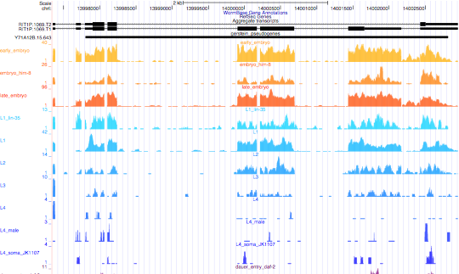
Alternative Splicing Example
Notes:
This is an example, but I might be trusting the alignment too much since there are stop codons in the first exon. Could there be an alignment problem, even though there is clearly expression?
Then I

Slide 2
*
YPREDTRKFDNQCSNLIYAKLISKFNSVELTSAMLTYGDLFNVTIVDLRSISIDIDLVKFLYTQKLETLVIGKLDGSCSDKFTSGAGEFLKIACRFCTAFVGVTL-T-WNIVGLLEHIIKNNKNTRRSLHYLDVSGCATFFQNGWIPKLR LRVLLPALRTICLESRKFAANEFPKFCKSFPNIRFLDVSSTNVRSLDGISKLRNLQVL
CLRNLNFDRYRDMMDLFGLRKLNVLDVSRDWP---------------DNYRQTIRYFLACEKVLPELKFLDCSSAYLDEDLYKELAQSHPHLRKISLLGCAQNLP
VIP---RLKVLGTQNFDSSIETLSHYLNLKREYPVQICLGEIFLQLRKLNEKNLDYDVAKCVELLVEVTVAFSP----TVPGR-MACSNAIDCLVELVI FQIF
DAFAKYIVECSTSPGFGLLETVYNDIERHRPDIW--------NDFANMLLPIL--QPF-DPVVLNGMEHLNHNVWNGIERLVHMDHEWSHEKLAKIALVCAQP--YQTAPDARAMRILEQCITEQTINFVLTGVEKWYSAKRLVNILSVAVGKQDLSLCLRILEALDKNTLITEDRKHNFNAVGWNLLTTLIQWIEIFDLEQWHIGILRVIKNLVLLSKGDWRNNWFLSNEFRAFQ QKLLNKWDSNRAYLAATILALILQS-KQKPEECDFWKPANEAIVKKLPDLLAAHITEETEVYFTNDTVPSVLRRTHG
DGIILWALLTTKIFAQQDVKNSEKIQKSNYYRRVYA-TAK-LVLSKMRRKISC
YPRENNSKFNSRCSNLIYQKLISKFNWVQLTSAMHTYGDLFNVTKVDLRSTFLDEKTARFLQTQKLKSLTIGTLRPSFRELYTTRNGSSCKIAVAPITFLFQIDLGS/WKIVKLLERLIQ--RGSGQGLRYLDLSASHTLLQEGWISKVG LRVMLPALRTLSLESHKFAEIEFPKFYKSFPNLQTLDISSTNVKDLDGISNLRNLRVL
CLRNLEFDNYTDMIDLFGLRKLRVLDISRER*VLGYCSLNKKVCFREDNYRNTIRYFLYCEKMLPELKFLDCSSLFLDADLYEKLTRSHPHLRKISVLGYTENLPQNPETARLTVLGTQGFDSCIETLTHYINVRRGYPVQVCLGEMLRILKEMHKKNQDYDVKKCANLLAEVTVALSENGVRSHPGTFLARPKAINCIVELAM SQMF
DALLIYVTGRSTFPDVERLKIHFKIIEQREPGRFFGFQRLSTEEFLHFLMQKVNPEPM/DPLIVK—ETLNPNVWIGIERLVNLHHRWCPEKLAALALKCAEPSLM
KNVIDARAMRILERCITEHTIHLVIKSVHKWRSTKRLLNILSAAVRKQDCSLCMPILEALMKST—SSYDMYSFDWLDYEELKTLIFCIEIFDSEQVHIGILQVMK
NLIMVRKLSCKNNSFTANEFRAFQ RKLLNKWDSNRAYLAVTILALLLQSCEQGPAECDFWAPANEAIVKKFPYLLAADITEDTEAYFTNGIVSRVLQRTHGDG
DIILWALLATKIFAQKDAKNAVKIKNSECFYFLHSPVSK\LAPLRMRRKISC
Notes:
PP01542
I:13997804 14002820
The stop codon is located in the intron of the genelet

Slide 3
We have discussed how there are transcribed pseudogenes
By comparing pseudogenes with the rna-seq data the same pattern keeps on showing up
I have been thinking of possible explanations for this stop codon jumping and the formation of the genelets
Originally thought h

Slide 4
Possible RNAi mechanism?
I originally thought the pseudogenes could be involved in the RNAi mechanism and bound to the parent gene to silence it, but I have not been able to come up with any good examples.

Slide 5
Next Idea!
We know they are transcribed, but we have no idea if they actually have any purpose.
By looking at the sequences by hand, the alternate splices always skip the mutation, which should cause the premature stop
Any good programs I can run to translate the RNA to see what results are giving?
Are these really pseudogenes?

