Slide 1
PubMed KeyNet

Slide 2
Number of abstract per year
Total abstract: 8,583,813

Slide 3
P8 network for each year
Cut-ff value: P<10⁻⁸

Slide 4
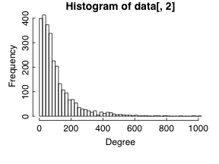
Degrees in KN2009P8

Slide 5
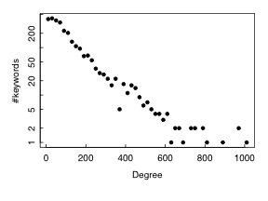
Degrees in KN2009P8

Slide 6
Co-appearance as the interaction
How many abstracts contain “P53”?
How many abstracts contain “Cancer”?
How many abstracts contain both?

Slide 7
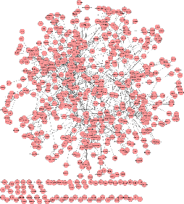
KeyNet for 1970
KN1970P8
(P8: P<10⁻⁸⁾

Slide 8
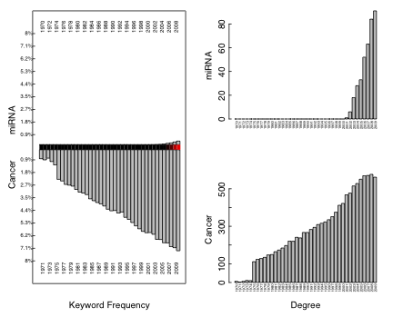
miRNA and Cancer
P-values for co-appearance

Slide 9
Knowledge propagation about “miRNA”
Year | Number of abstract
2001:miRNA | 2
2002:miRNA | 17
2003:miRNA | 45
2004:miRNA | 96
2005:miRNA | 182
2006:miRNA | 370 | Cancer
2007:miRNA | 488 | Cancer
2008:miRNA | 767 | Cancer
2009:miRNA | 1041 | Cancer | Lung cancer

Slide 10
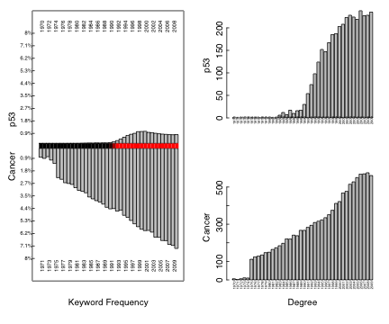
P53 and Cancer

Slide 11
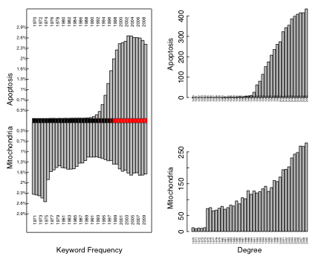
Apoptosis and Mitochondria

Slide 12
More….
Refine the keyword dictionary
Specialized KeyNets: e.g. disease-gene KeyNets
Leading Journal? (The journal where a new keyword was first used.)
Time delay of a keyword? Birthday? First interactor?
Policy effect on KeyNet: stem cell research
Evolution of the KeyNets? Is the evolution rate accelerating? (CS)
A time series of networks. How can they speak? What can they tell us?
Predictability: e.g. A-B, B-C in 1998 → A-C in 1999?

