Slide 1
CNVnator calling on 1KG phase 1 data
Alexej Abyzov
March 2, 2011

Slide 2
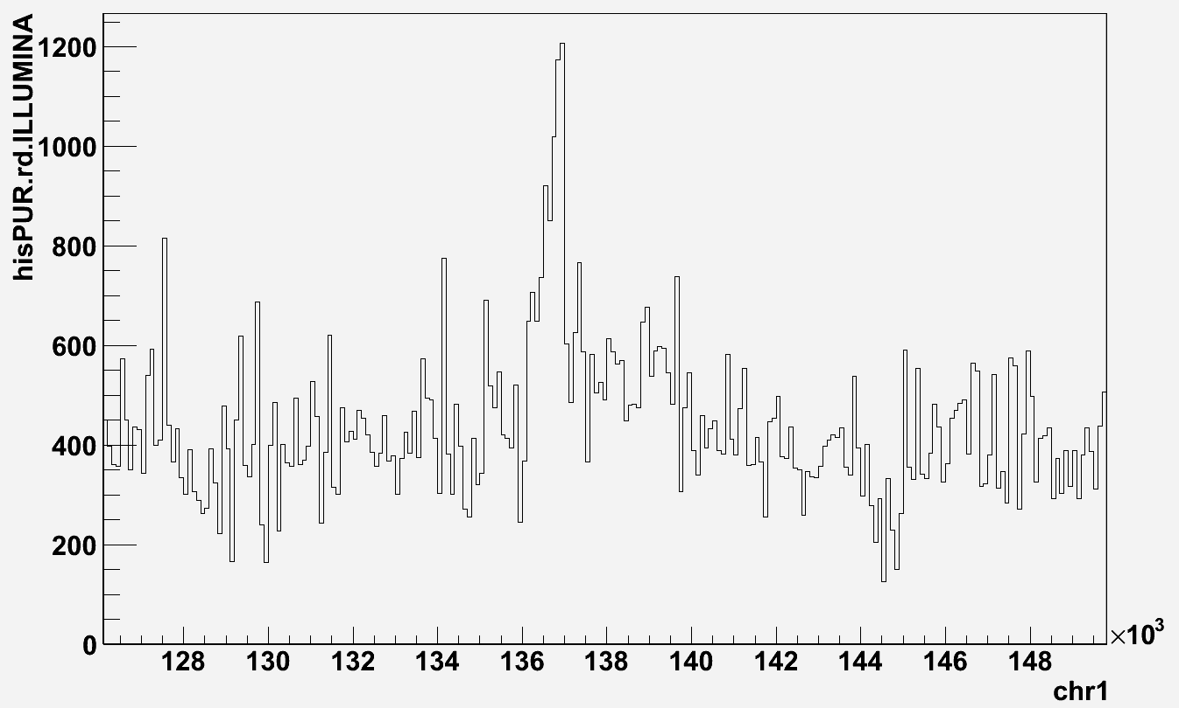
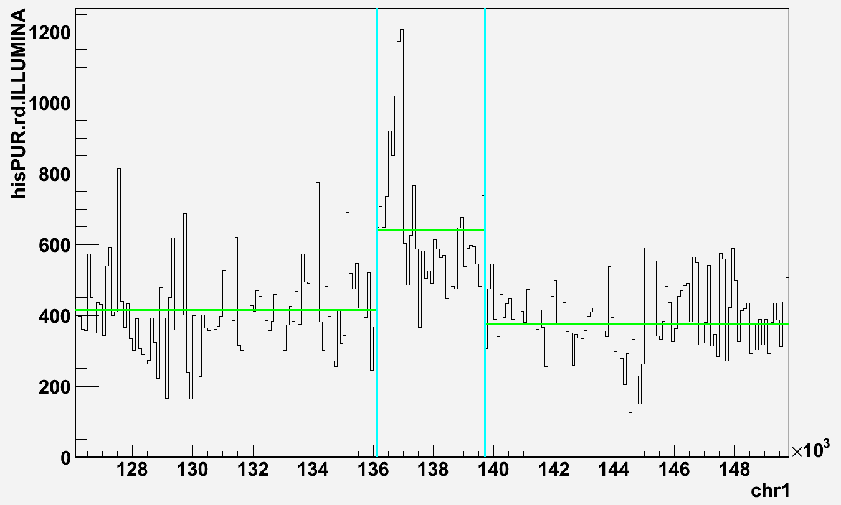
Approaches
Population
Data
CNVnator

Slide 3
Data
Population | # of individuals | Average # of reads per bin | Sigma of # of reads per bin | mean/sigma
ASW - Africans | 50 | 398.2 | 62.1 | 6.4
CEU – Europeans | 88 | 871.8 | 136.0 | 6.4
CHB - Han Chinese in Beijing | 81 | 664.2 | 107.4 | 6.2
CHS - Han Chinese South | 92 | 567.9 | 83.9 | 6.8
CLM - Colombian | 52 | 356.1 | 49.9 | 7.1
FIN - Finnish | 77 | 429.0 | 69.9 | 6.1
GBR - British | 72 | 499.1 | 72.2 | 6.9
IBS - Iberian | 6 | 29.3 | 6.9 | 4.2
JPT - Japanese | 80 | 849.6 | 136.3 | 6.2
LWK - Luhya | 83 | 516.8 | 88.4 | 5.8
MXL - Mexican | 54 | 409.0 | 45.5 | 9.0
PUR - Puerto Rican | 106 | 387.7 | 49.1 | 8.0
TSI - Toscani | 100 | 860.5 | 181.6 | 4.7
YRI - Yoruba | 80 | 810.3 | 119.3 | 6.8

Slide 4
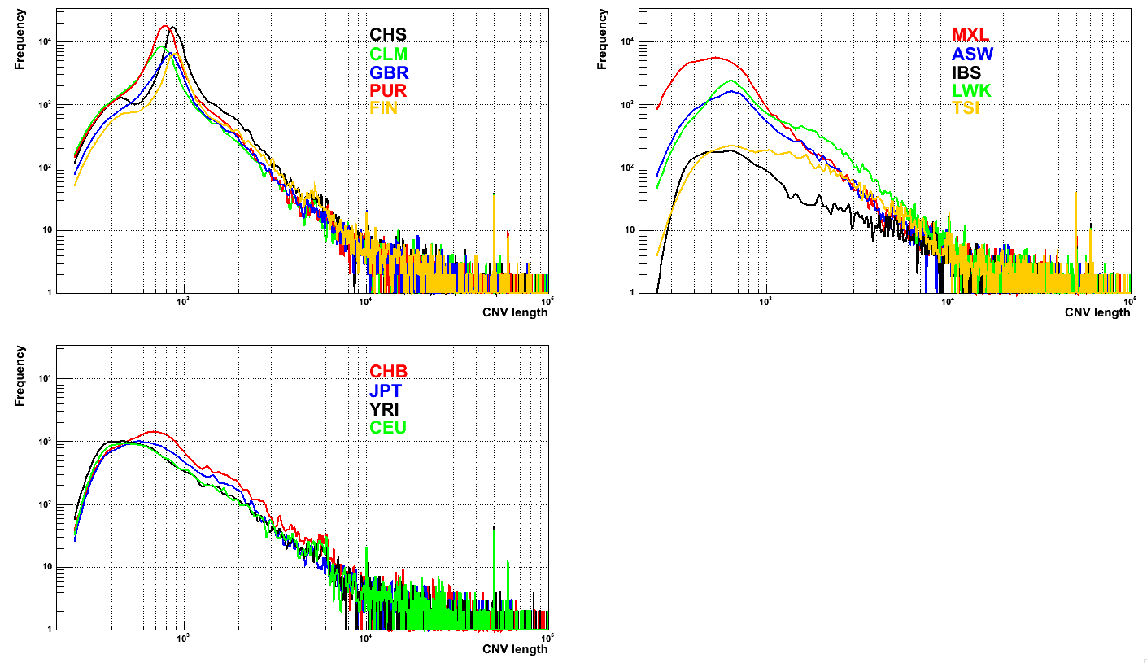
Size distribution
More detailed analysis of PUR
population

Slide 5
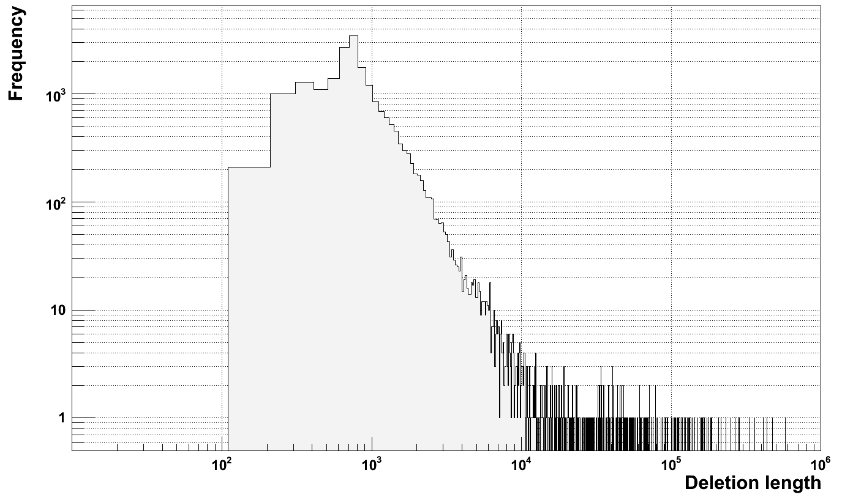
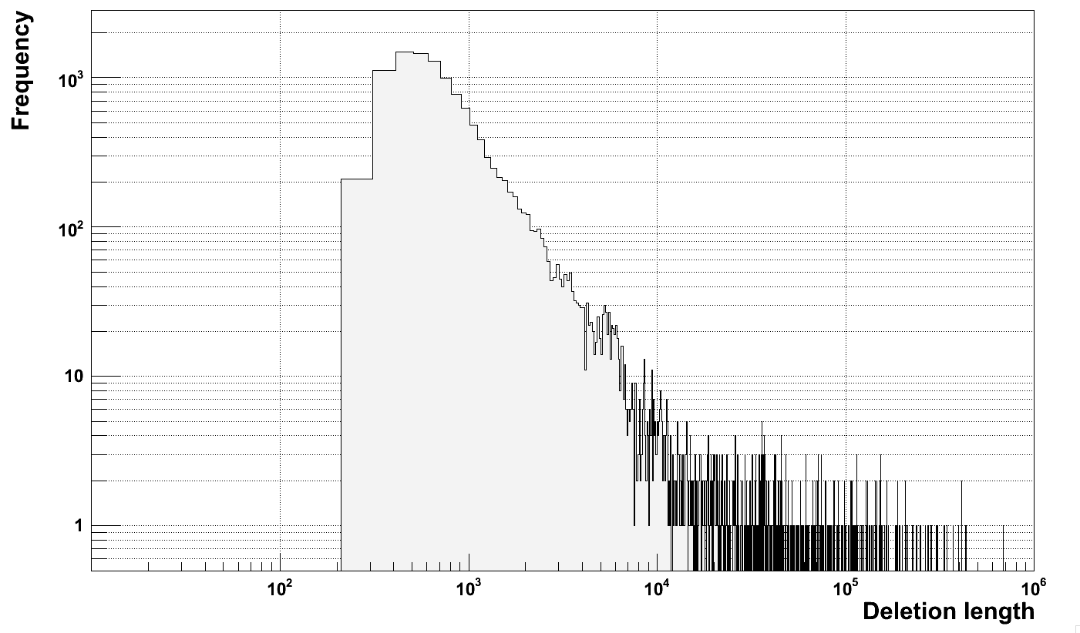
???
Deletion size
Distribution
NA12878
HiSeq
GAII

Slide 6
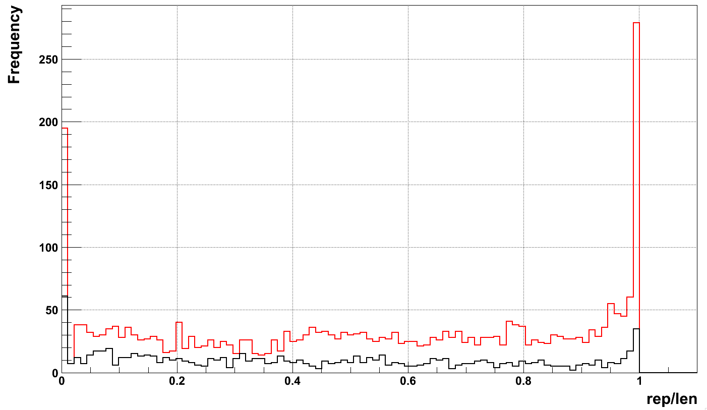
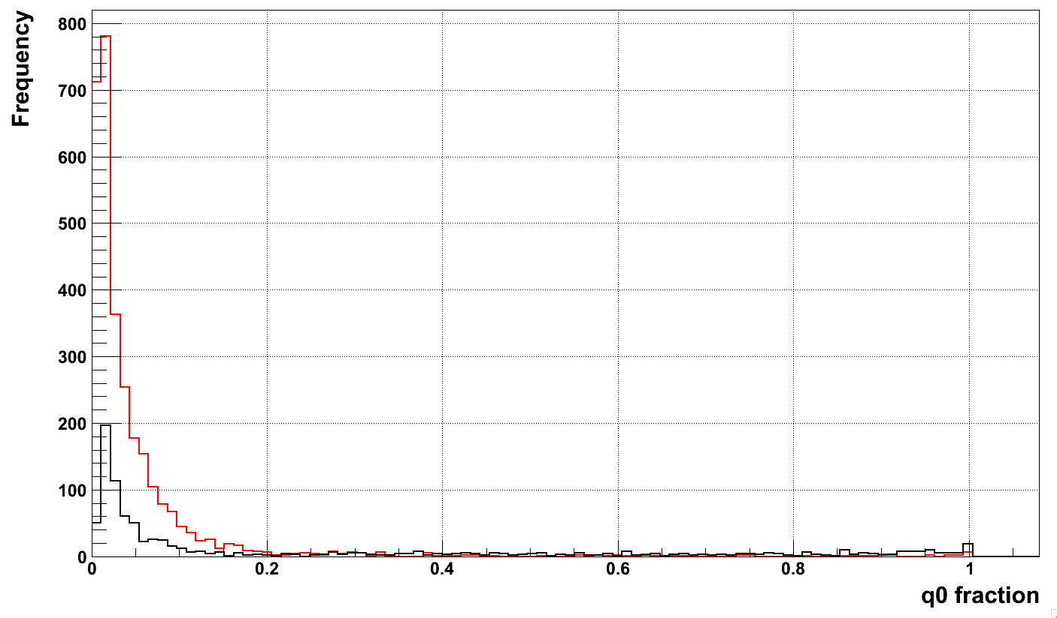
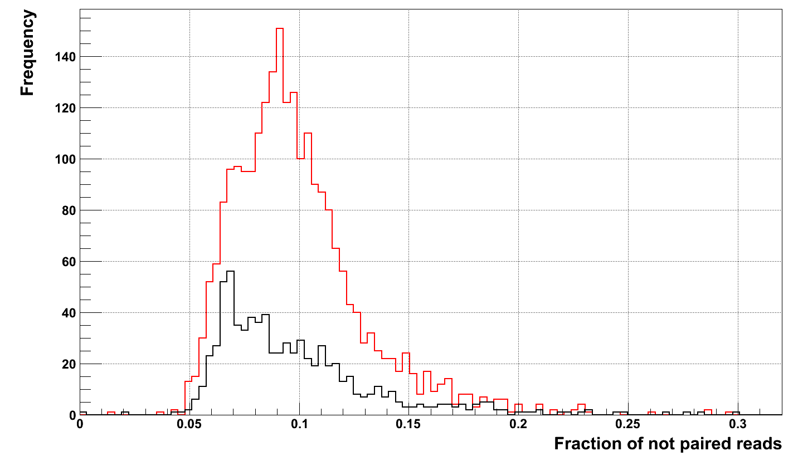
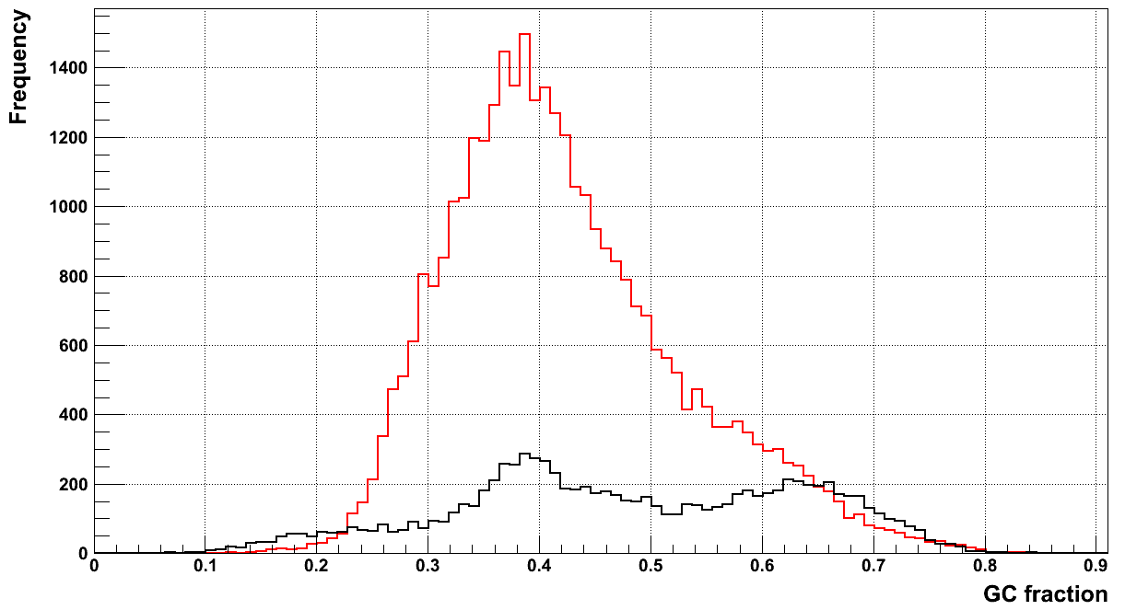
Region characterization (PUR)
700 <= len <= 900
len > 1000

Slide 7
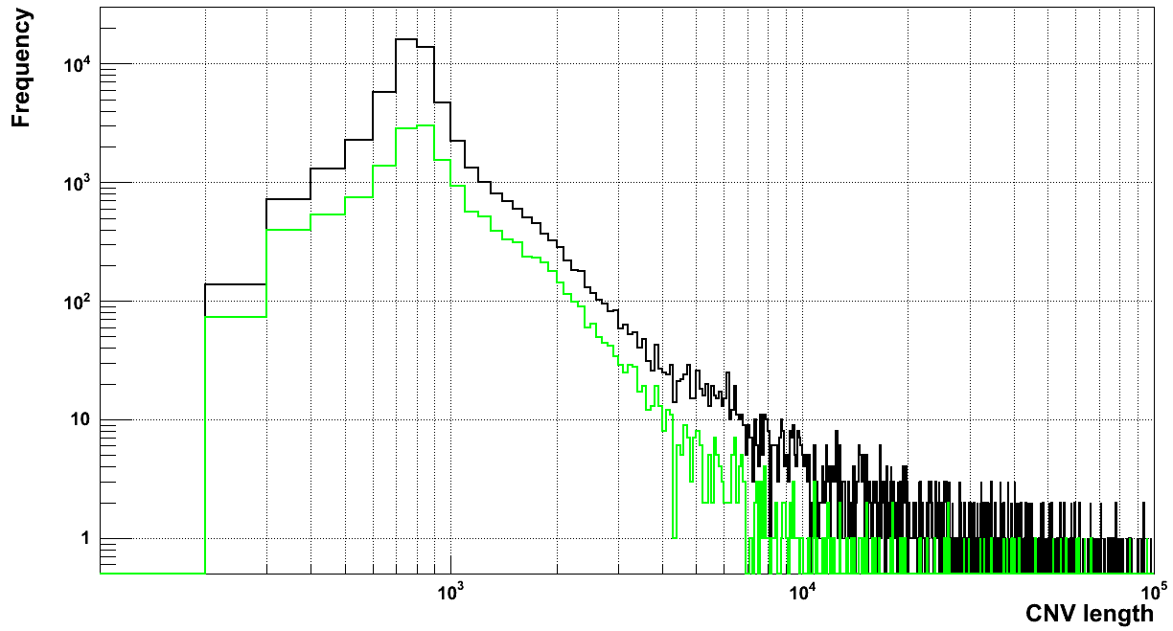
Filtering by GC is not a solution
All calls
Call with GC > 0.5

Slide 8
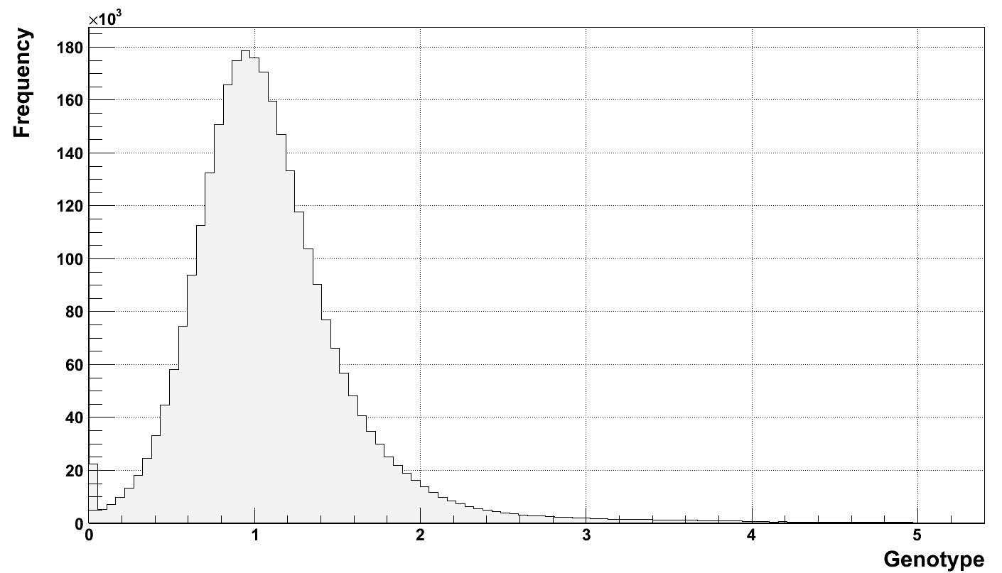
Genotyping in population

Slide 9
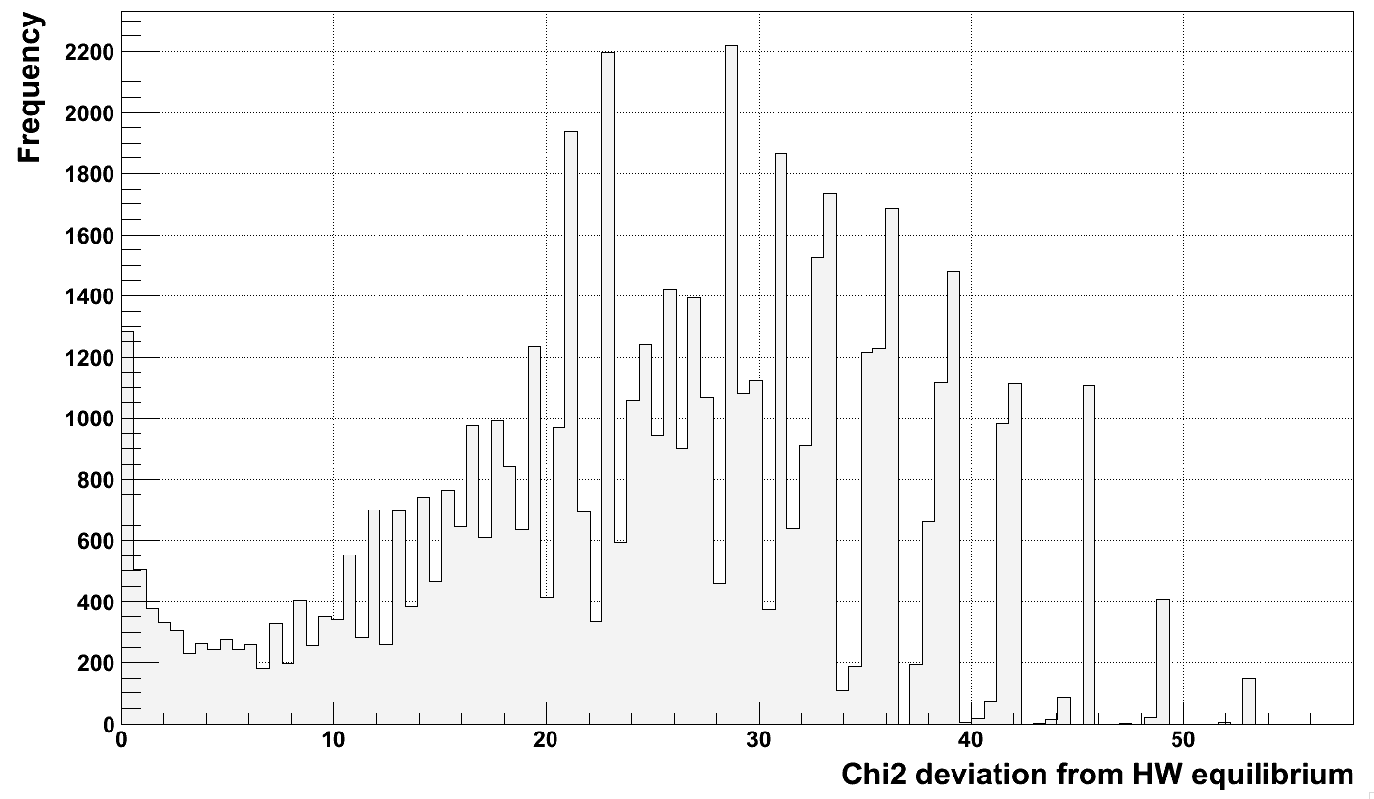
HW equilibrium

Slide 10
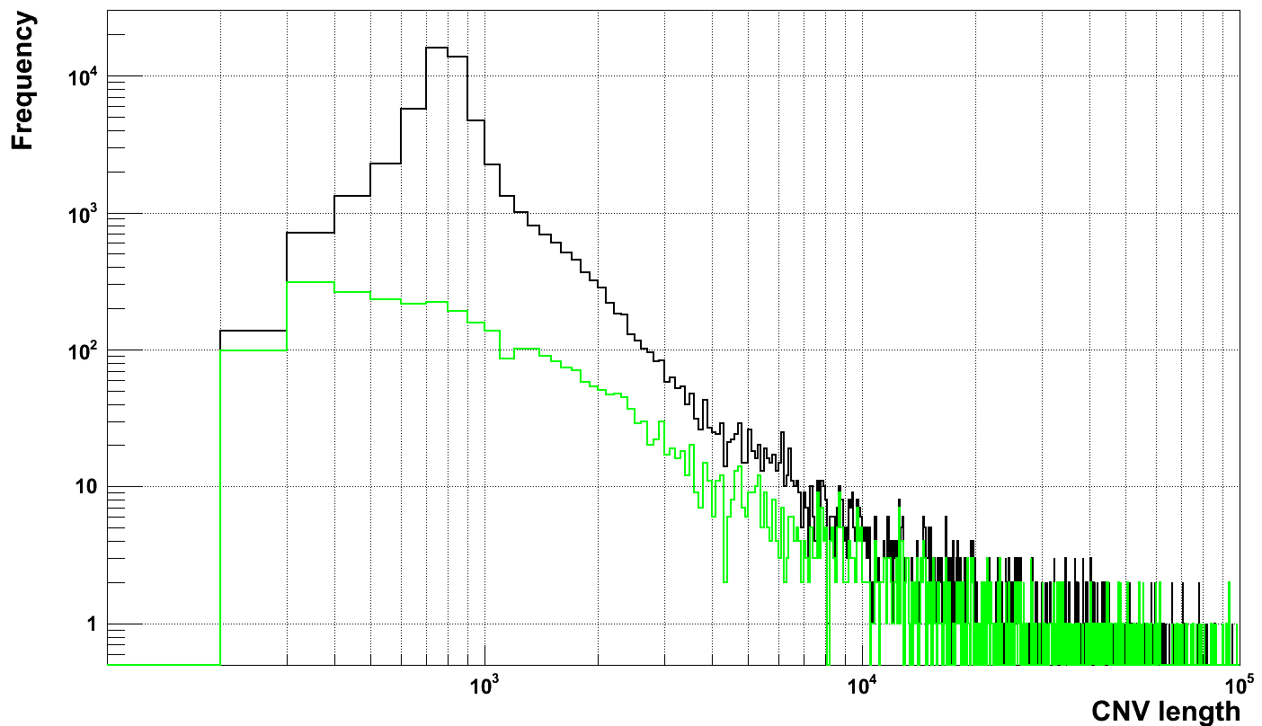
What is the difference
All calls
Calls with Chi2 < 5

Slide 11
In DGV
Call set | # intersecting with DGV
 | 1 bp overlap | > 50% overlap | >50% reciprocal overlap
HW < 3, 2930 calls | 2058 (70%) | 2044 (70%) | 763 (26%)
HW < 5, 3773 calls | 2569 (68%) | 2550 (68%) | 863 (23%)
HW > 5, 52422 calls | 20242 (39%) | 19936 (38%) | 887 (2%)
Fragmentation?

Slide 12
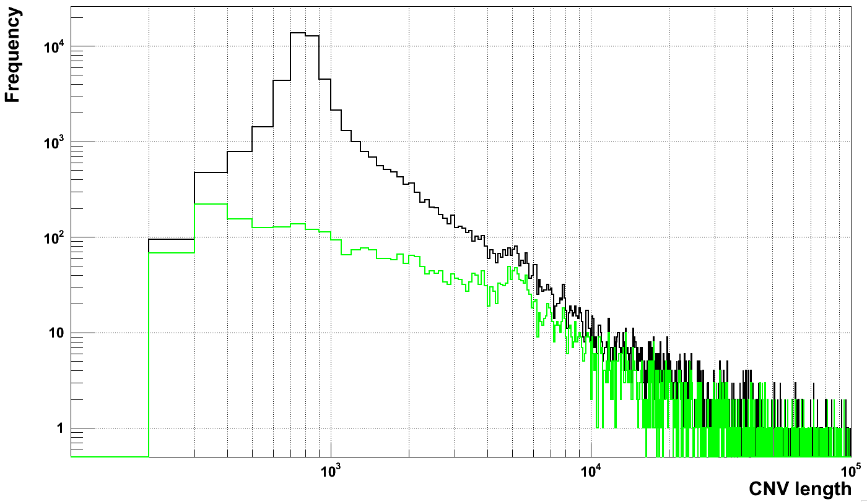
Relaxing thresholds for calling
All calls
Calls with Chi2 < 5
!!!

Slide 13
In DGV
Call set | # intersecting with DGV
 | 1 bp overlap | > 50% overlap | >50% reciprocal overlap
HW < 3, 2930 calls | 2058 (70%) | 2044 (70%) | 763 (26%)
HW < 5, 3773 calls | 2569 (68%) | 2550 (68%) | 863 (23%)
HW > 5, 52422 calls | 20242 (39%) | 19936 (38%) | 887 (2%)
Call set, relax | # intersecting with DGV
 | 1 bp overlap | > 50% overlap | >50% reciprocal overlap
HW < 3, 3516 calls | 2335 (66%) | 2275 (65%) | 947 (27%)
HW < 5, 4473 calls | 2902 (65%) | 2817 (63%) | 1085 (24%)
HW > 5, 48584 calls | 18592 (38%) | 18228 (38%) | 1060 (2%)

Slide 14
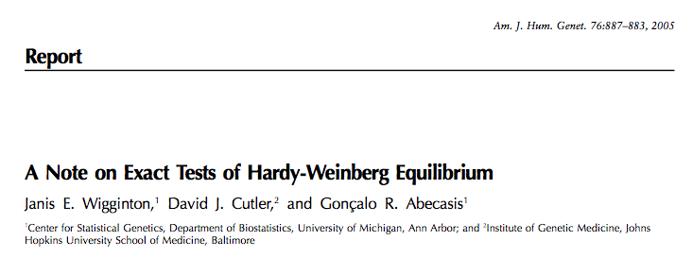
Next
Try smaller bins (e.g., 50 bp)
Precise calculations of HW equilibrium

