Slide 1
A Tale of Two Indel Callers
Want to identify differences in output between two indel calling software
  Dindel (http://sites.google.com/site/
  keesalbers/soft/dindel)
  Broad GATK (http://www.broadinstitute.org/
  gsa/wiki/index.php/The_Genome_Analysis_Toolkit)
Test on sequence data from human chromosome 22 of sample STID0000001783 (sample data courtesy of LH)
Default parameters used for both programs
Output comparison with VCF Tools

Slide 2
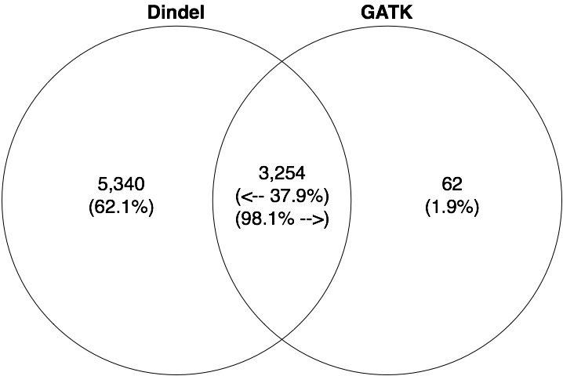
Output Comparison
Implies GATK indels are a subset of Dindel indels
Other comparisons by Hugo had an intersection percentage of ~70%

