Slide 2
HCP and LCP promoters

Slide 3
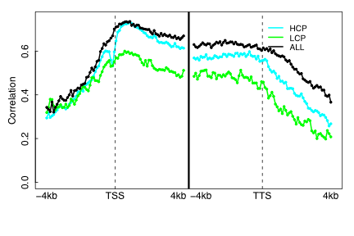
HM model

Slide 4
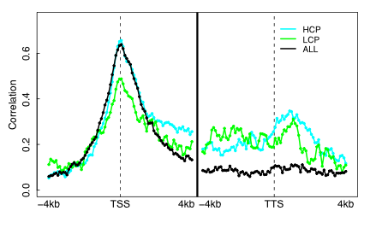
TF model

Slide 5
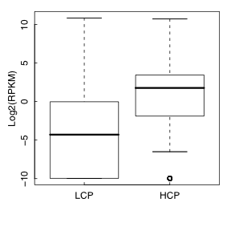
Expression levels

Slide 6
Over-normalization against Input DNA?

Slide 7
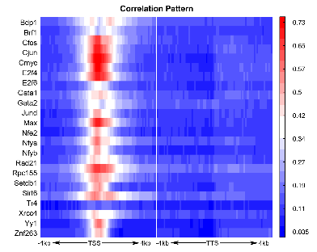
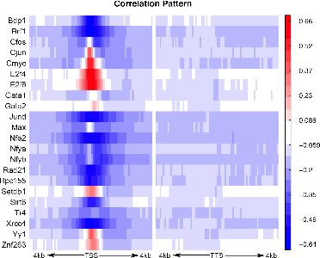
Normed vs non-normed

Slide 8
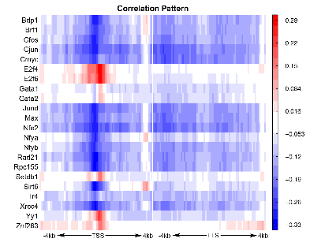
Residual plot – get rid of Input DNA

Slide 9
Using target only

Slide 10
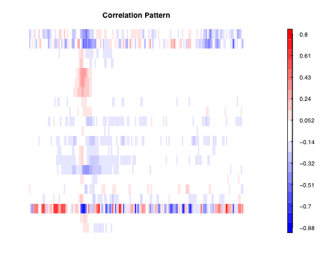
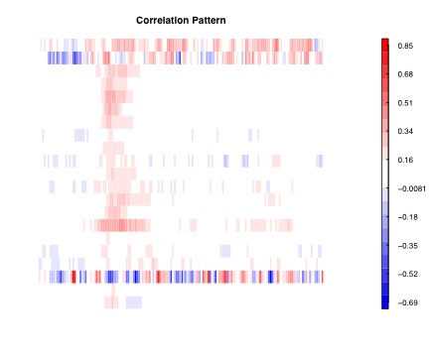
Normed vs non-normed

Slide 11
CAGE and Gencode TSS

