Slide 1
Gene Expression Prediction using Chromatin Models
ENCODE AWG
Chao Cheng (the Gerstein Lab)
Jan 20, 2011

Slide 2
Outline
Chromatin model for predicting gene expression levels based on integrative models
Support Vector Machine (SVM) – classify highly and lowly expressed gens
Support Vector Regression (SVR) – predict gene expression levels
Tissue/cell specificity of the chromatin model
Predict differentially expressed genes (K562/GM12878)
Chromatin model for predicting highly and lowly expressed miRNAs
Transcription factor (TF) model for gene expression prediction
Note: Relative importance of each chromatin feature for transcription regulation depends on its position relative to TSS: divide chromosome into small bins

Slide 3
Divide and compare strategy
TSS
TTS
Gene i
40
1
80
120
81
4 …
41 ….44
121
160
Bin 40-1
(TSS-4kb to TSS)
Bin 41-80
(TSS to TSS+4kb)
Bin 120-81
(TTS-4kb to TTS)
Bin 121-160
(TTS to TTS+4kb)
RNA-Seq data
Chromatin features:
Histone methylation
Pol II binding
Prediction target:
Gene expression level
Predictors
~10000 refseq genes
Chromatin features
Bin 1
……
Bin
160
Bin
2
Notes:
To investigate the correlation between gene expression and chromatin features, we focus on 4kb upstream and down-stream of the TSS and TTS regions. TSS is transcription start site, TTS is transcription terminal site.
We divide the 4kb DNA region upstream of TSS into 40 bins, each bin is 100 nt. From TSS, the bins are named as bin1, bin2, bin3 to bin40. Similarly, the bins downstream of the TSS are named from bin 41 to bin 80.
For each bin, we calculate the average signal of each chromatin features, for example the reads that covers the bin in a chromatin chIP-seq experiments.
Finally, for each of the 160 bins, we have a predictor matrix, containing about 10 thousands genes times about 20 chromatin features, including different chromatin modification, DNA hypersensitivity. We will build a model for each bin to predict gene expression, which is measured by RNA_seq experiments.

Slide 4
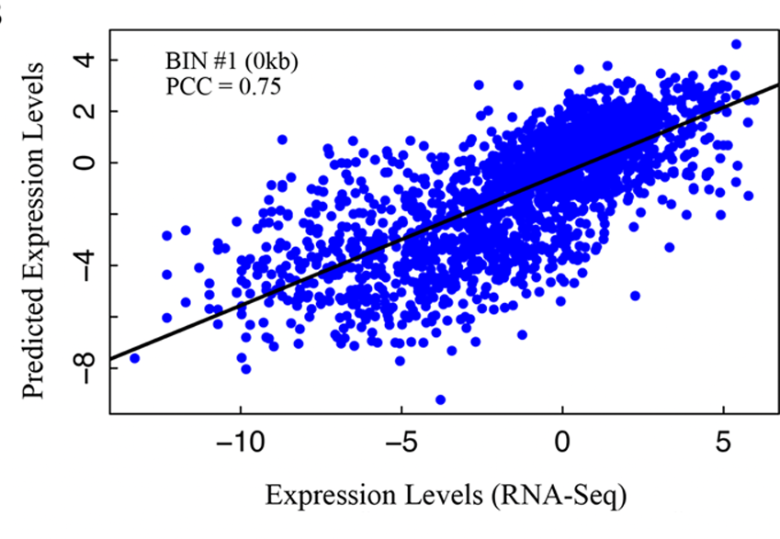
Application of our integrative model in 5 species
E
Worm (L3)

Slide 5
Correlation pattern of chromatin features with gene expression
Human: ChIP-seq, real transcription start and terminal sites
Worm: ChIP-chip, translation start and terminal sites

Slide 6
Predict gene expression class: (SVM classification)
Human K562 using 13 chromatin features
Highly expressed genes
Lowly expressed genes
AUC for BIN i model

Slide 7
Predict gene expression levels: Support Vector Regression (SVR)

Slide 8
Chromatin model is tissue/cell line specific and development stage specific
Worm
Human

Slide 9
Predicting differential expression
Yes
No

Slide 10
Predict differential expression
Human K562/GM12878

Slide 11
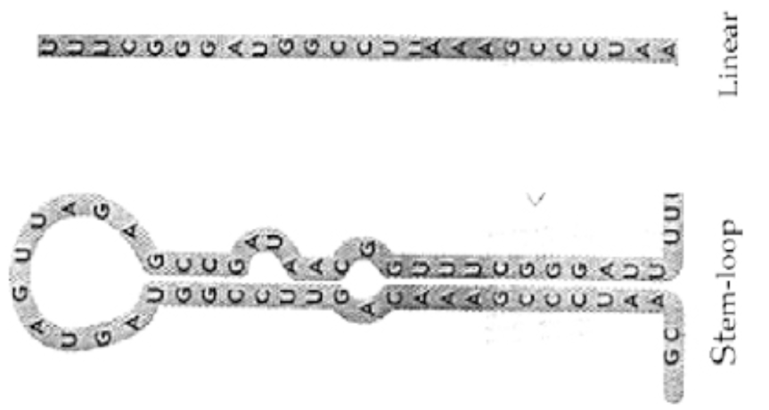
Predicting human microRNA expression
730 human microRNAs from miRBASE
- ~100 bp corresponding to the pre-microRNAs
Calculate the signal of all chromatin features in their genomic location
Apply the SVR model to predict their expression
- NOTE: the model is trained using protein-coding genes
Validate prediction results from experimental data
- microRNA expression in cellular components

Slide 12
Predict miRNA expression

Slide 13
Correlation patterns of TFs

Slide 14
TF model: prediction power

Slide 15
Histone Model: prediction power
Different with TF model

Slide 16
Conclusion
Chromatin features can accurately predict gene expression
Chromatin model is tissue/cell line/development stage specific
Chromatin feature can predict differential gene expression
ChIP-seq has higher resolution than ChIP-chip
Chromatin models are valid for protein-coding genes and microRNAs.
TF model is also predictive of gene expression
HM and TF models are different in their prediction pattern

Slide 17
Acknowledgement
Koon-Kiu
Mark Gerstein
Michael Snyder
Kevin Yip
Jason Lieb
Shirley Liu
Roderic Guigo
Tom Gingeras
ENCODE & modENCODE consortium

