Slide 1
Gene Expression Prediction using Chromatin and TF Models
ENCODE AWG
Chao Cheng (the Gerstein Lab)

Slide 2
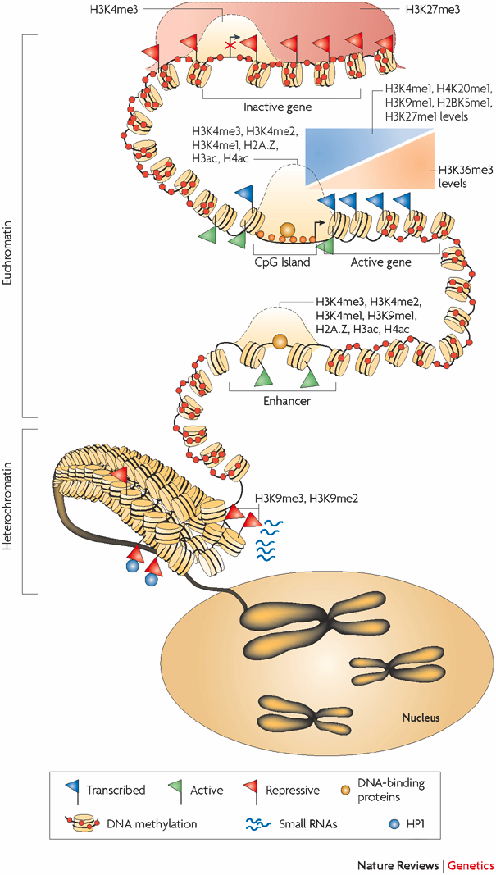
How chromatin modifications regulate gene expression?
Modulate DNA accessibility
Recruit transcription regulators
Schones et al., 2008
Notes:
Heterochromatin, Euchromatin

Slide 3
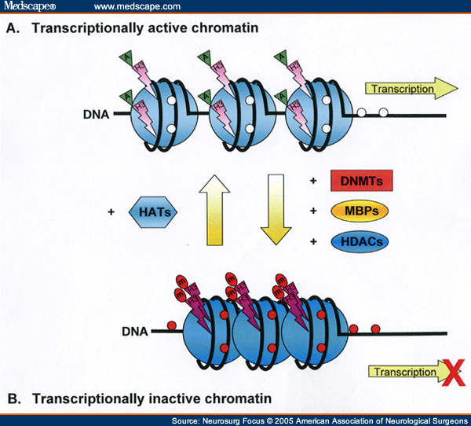
What have we done?
Part I: a chromatin model for gene expression prediction
- human K562 and GM12878 cell lines
- worm EEMB and L3
Part II: a two-step method for TFBS prediction
- yeast
- human
- worm

Slide 4
Chromatin model for gene expression prediction
Individual: correlation of each chromatin features with gene expression
Collective: hierarchical clustering of genes based on chromatin features
Integrative: supervised model for gene expression prediction
Note: Relative importance of each chromatin feature for transcription regulation depends on its position relative to TSS: divide chromosome into small bins

Slide 5
Divide and compare strategy
TSS
TTS
Gene i
40
1
80
120
81
4 …
41 ….44
121
160
Bin 40-1
(TSS-4kb to TSS)
Bin 41-80
(TSS to TSS+4kb)
Bin 120-81
(TTS-4kb to TTS)
Bin 121-160
(TTS to TTS+4kb)
RNA-Seq data
Chromatin features:
Histone methylation
Pol II binding
Prediction target:
Gene expression level
Predictors
~10000 refseq genes
Chromatin features
Bin 1
……
Bin
160
Bin
2
Notes:
To investigate the correlation between gene expression and chromatin features, we focus on 4kb upstream and down-stream of the TSS and TTS regions. TSS is transcription start site, TTS is transcription terminal site.
We divide the 4kb DNA region upstream of TSS into 40 bins, each bin is 100 nt. From TSS, the bins are named as bin1, bin2, bin3 to bin40. Similarly, the bins downstream of the TSS are named from bin 41 to bin 80.
For each bin, we calculate the average signal of each chromatin features, for example the reads that covers the bin in a chromatin chIP-seq experiments.
Finally, for each of the 160 bins, we have a predictor matrix, containing about 10 thousands genes times about 20 chromatin features, including different chromatin modification, DNA hypersensitivity. We will build a model for each bin to predict gene expression, which is measured by RNA_seq experiments.

Slide 6
Correlation pattern of chromatin features with gene expression
Human: ChIP-seq, real transcription start and terminal sites
Worm: ChIP-chip, translation start and terminal sites

Slide 7
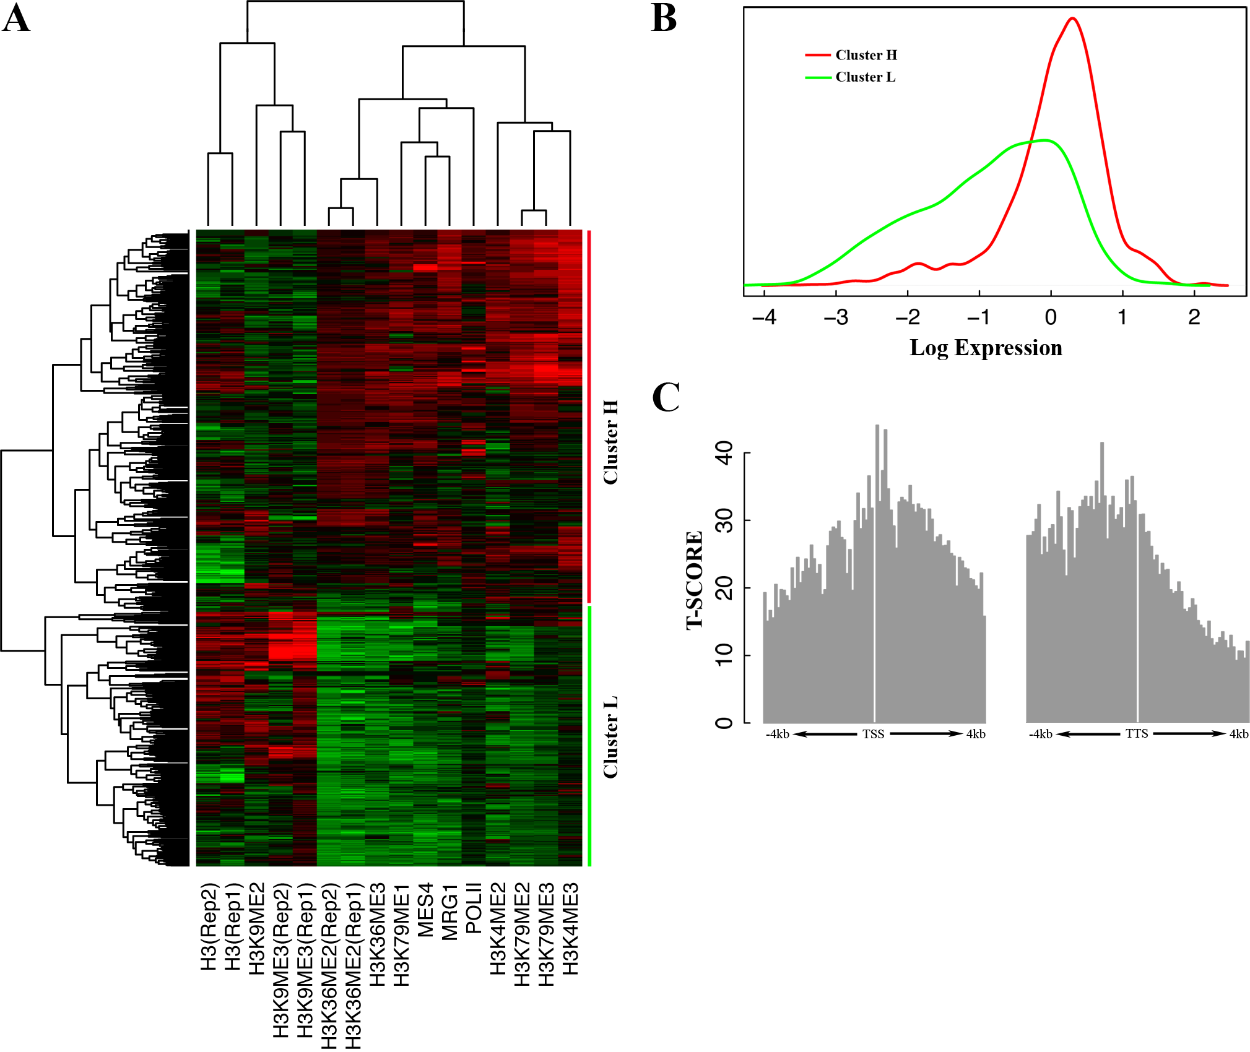
Clustering on chromatin profile
Bin #43
Worm EEMB

Slide 8
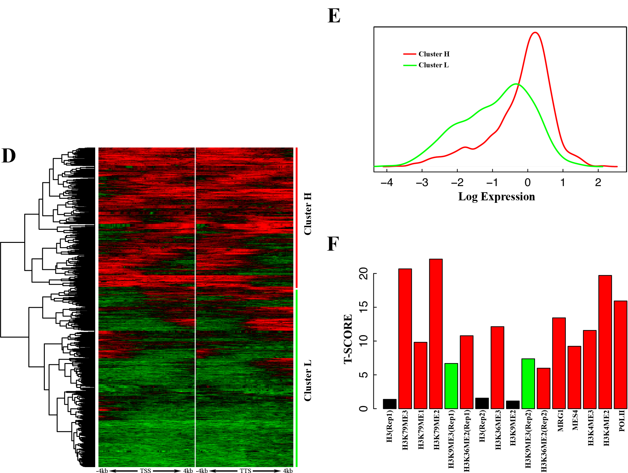
Clustering on bin profile
Worm EEMB
H3K79ME2

Slide 9
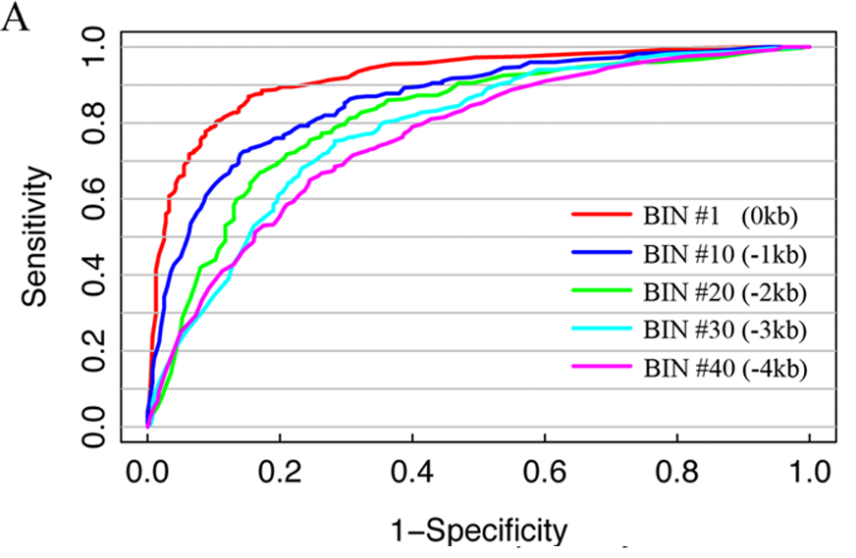
Predict gene expression: (SVM classification)
Worm EEMB

Slide 10
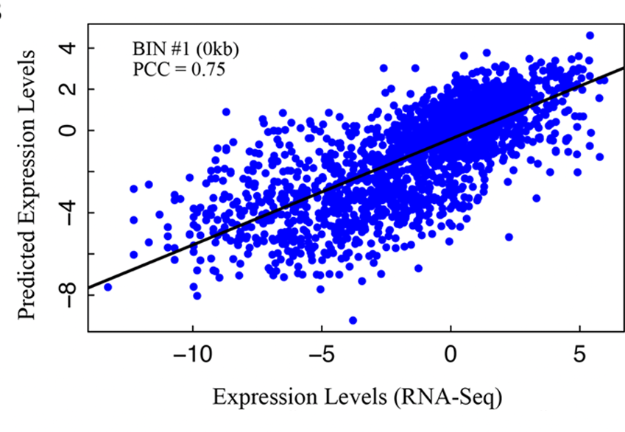
Predict gene expression: SVR regression

Slide 11
Relative contribution of each chromatin features (human)
Human K562

Slide 12
Relative importance of chromatin features (worm)

Slide 13
Chromatin model is tissue/cell line specific and development stage specific
Worm
Human

Slide 14
Development stage specificity: worm

Slide 15
Predicting differential expression
Yes
No

Slide 16
Predict differential expression
Human K562/GM12878

Slide 17
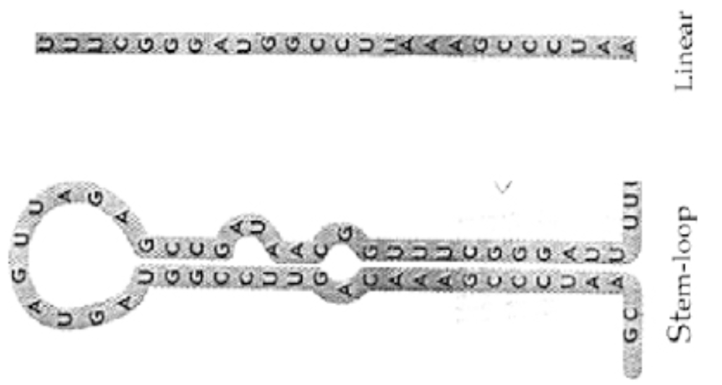
Predicting microRNA expression
162 worm microRNAs from miRBASE
- ~100 bp corresponding to the pre-microRNAs
Calculate the signal of all chromatin features in their genomic location
Apply the SVM model to predict their expression
- NOTE: the model is trainned using protein-coding genes
Validate prediction results from experimental data
- Kato et al., small RNA-seq data
Worm and human

Slide 18
Predicting worm microRNA expression

Slide 19
Conclusion
Chromatin features can accurately predict gene expression
Chromatin model is tissue/cell line/development stage specific
Chromatin feature are highly redundant in terms of expression prediction
Chromatin feature can predict differential gene expression
ChIP-seq has higher resolution than ChIP-chip
Chromatin models are valid for protein-coding genes and microRNAs.

Slide 20
Correlation patterns of TFs

Slide 21
TF model: prediction power

Slide 22
Histone Model: prediction power

Slide 23
Predict miRNA expression

Slide 24
Acknowledgement
Koon-Kiu
Mark Gerstein
Michael Snyder
Kevin Yip
Jason Lieb
Shirley Liu
Robert Waterston
ENCODE & modENCODE consortium

