Slide 1
Aligning contigs with SVs

Slide 2
Data
349 contigs (~40 kb) from Kidd’08 paper
Alignments
Blast 1 kb from each contig end against hg18
Select those with best hit on the same chromosome and strand with proper orientation
Realign contigs precisely using my algorithm to those regions

Slide 3
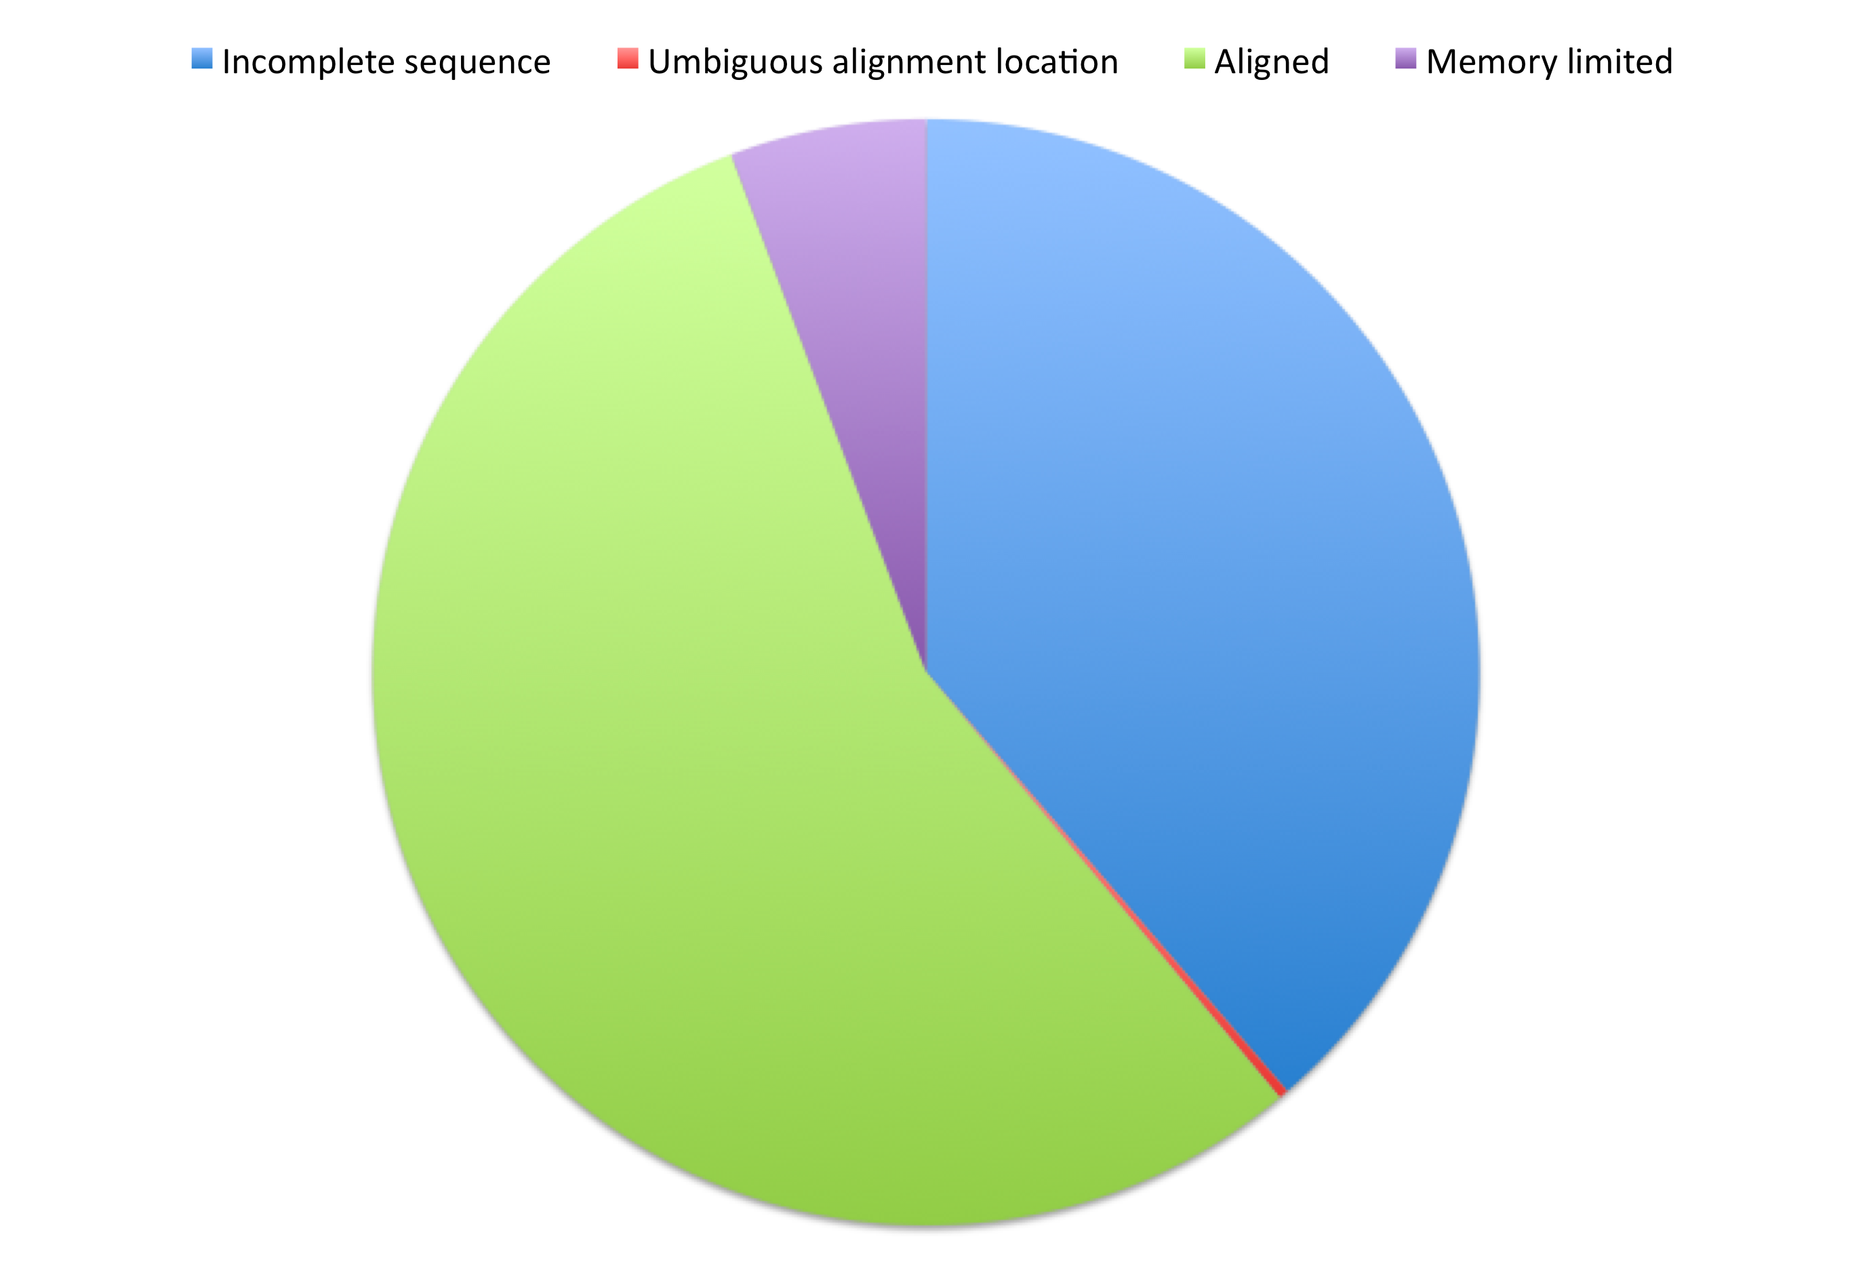
Break down

Slide 4
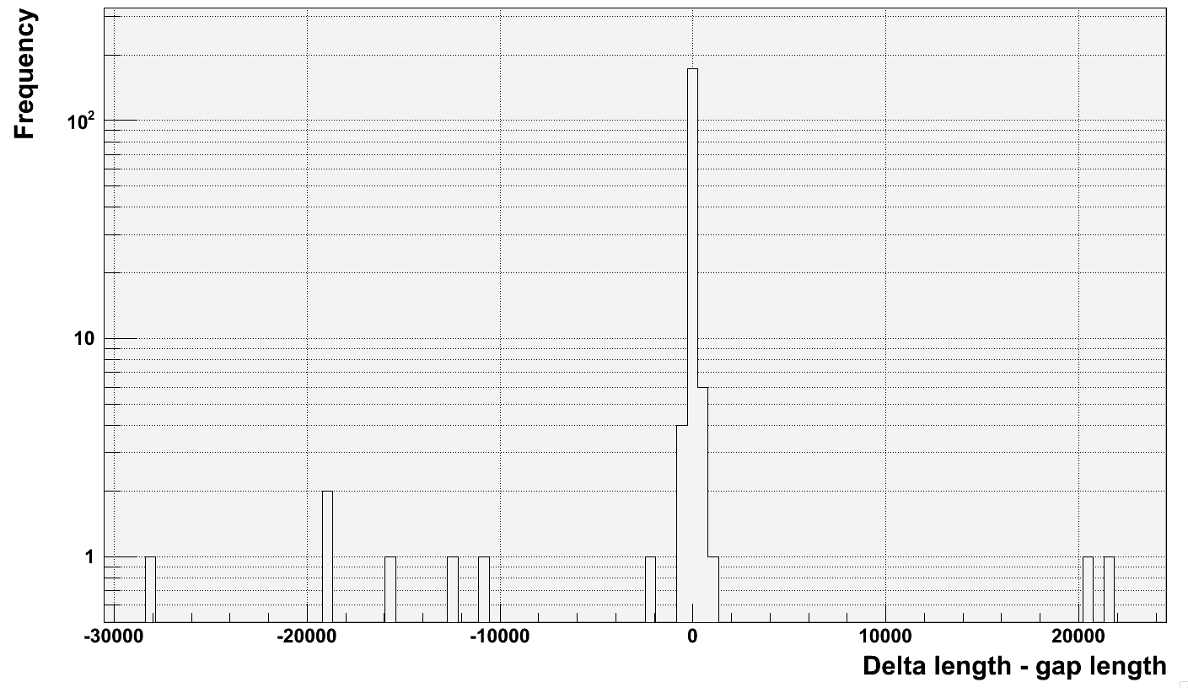
End-to-end alignment

Slide 5
VNTRs
Duplication
Reference genome, chr2
Highest score
Contig
Accession number is AC205939

Slide 6
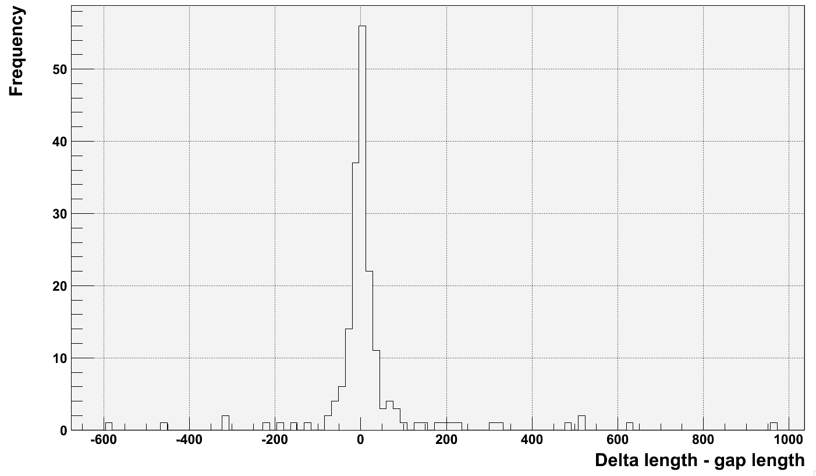
End-to-end alignment

Slide 7
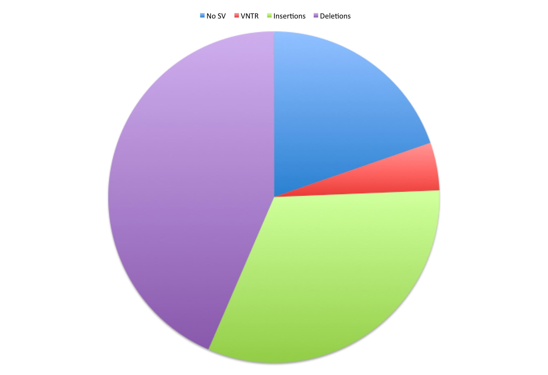
Alignment results

Slide 8
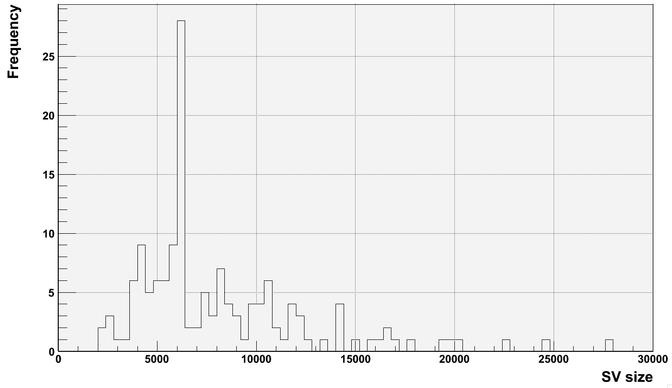
SV size distribution

Slide 9
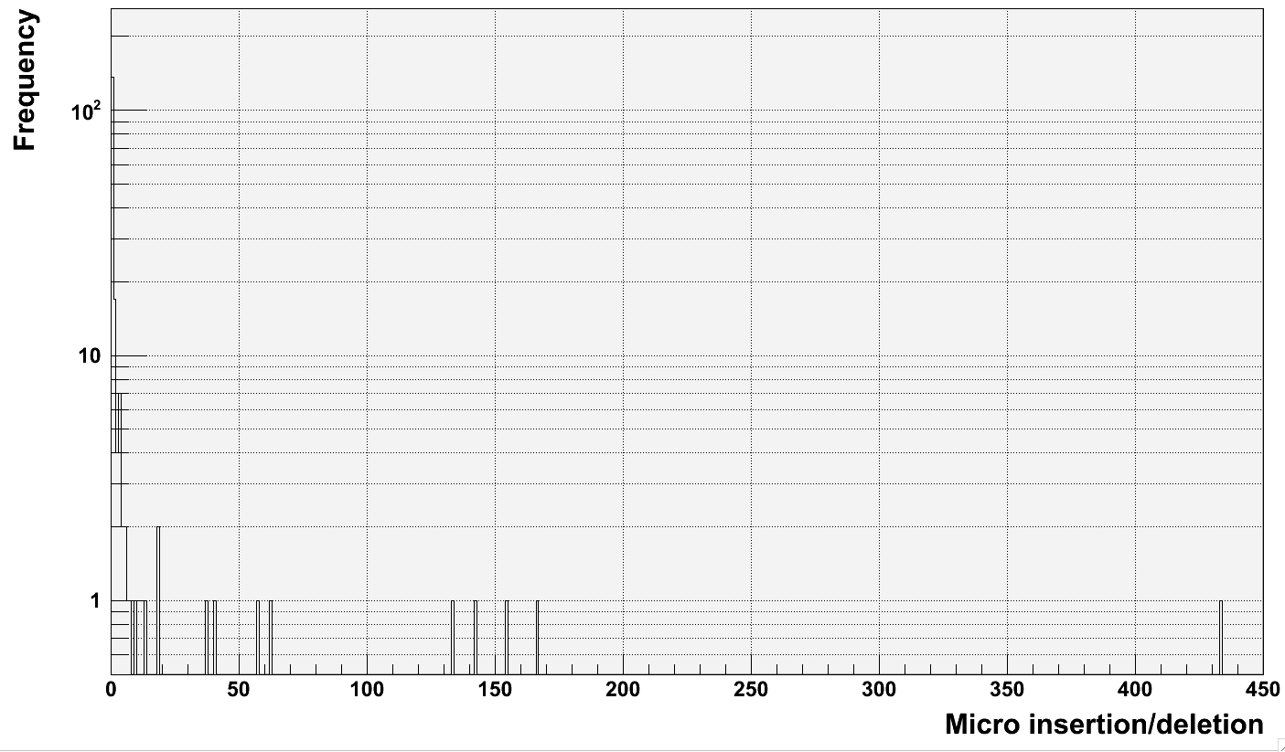
Micro insertion/deletion size distribution
brpt uncertainty
Micro insertion in 13/146 (~9%) of cases

Slide 10
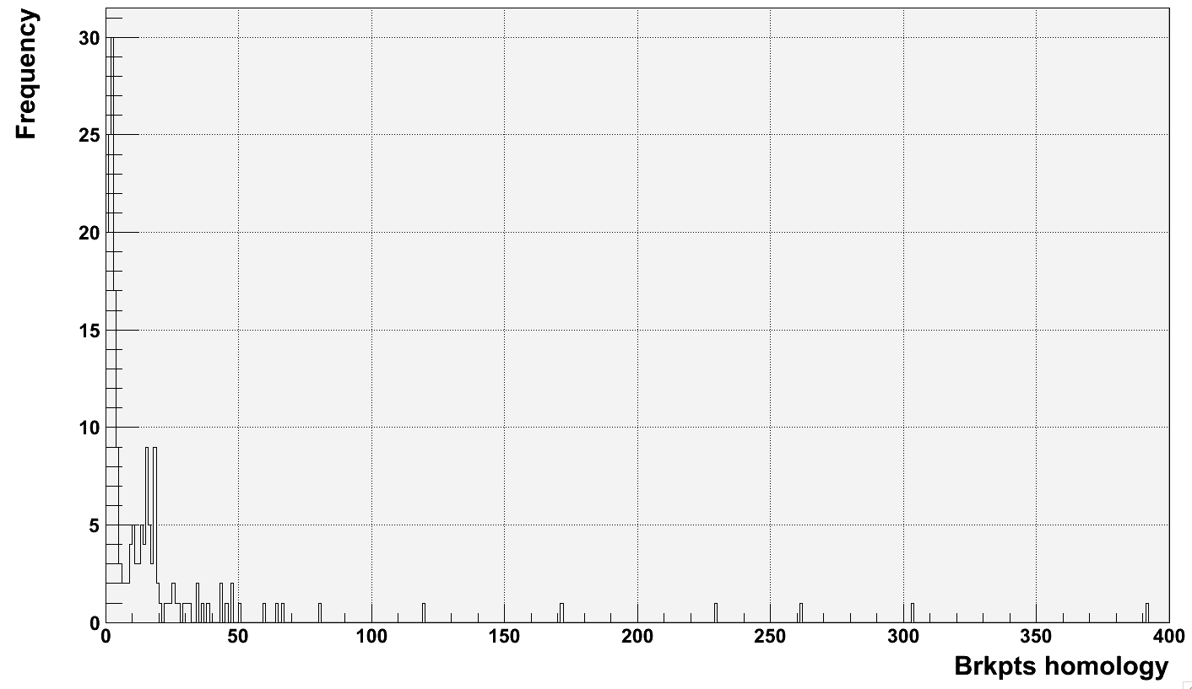
Break point homology

