Slide 1
Regulatory networks for human and C. elegans
Nets meeting 3.1
MJ

Slide 2
Human regulatory network
Algorithm for TF target identification
- 0.5kb < Distance < 2kb
Refseq gene
Transcript start sites
Chip- Seq
narrowpeak data
region start
region end

Slide 3
Algorithm for miRNA promoters identification
data
origin
miRNA
http://www.mirbase.org/
EST
UCSC Browser- human EST
Human_mouse conservation data
UCSC Browser-Comparative gene-mouse Net
H3K4me3 broad peak
ENCODE project- Bernstein/Broad lab
Cell. 2008 Aug 8;134(3):521-33.

Slide 4
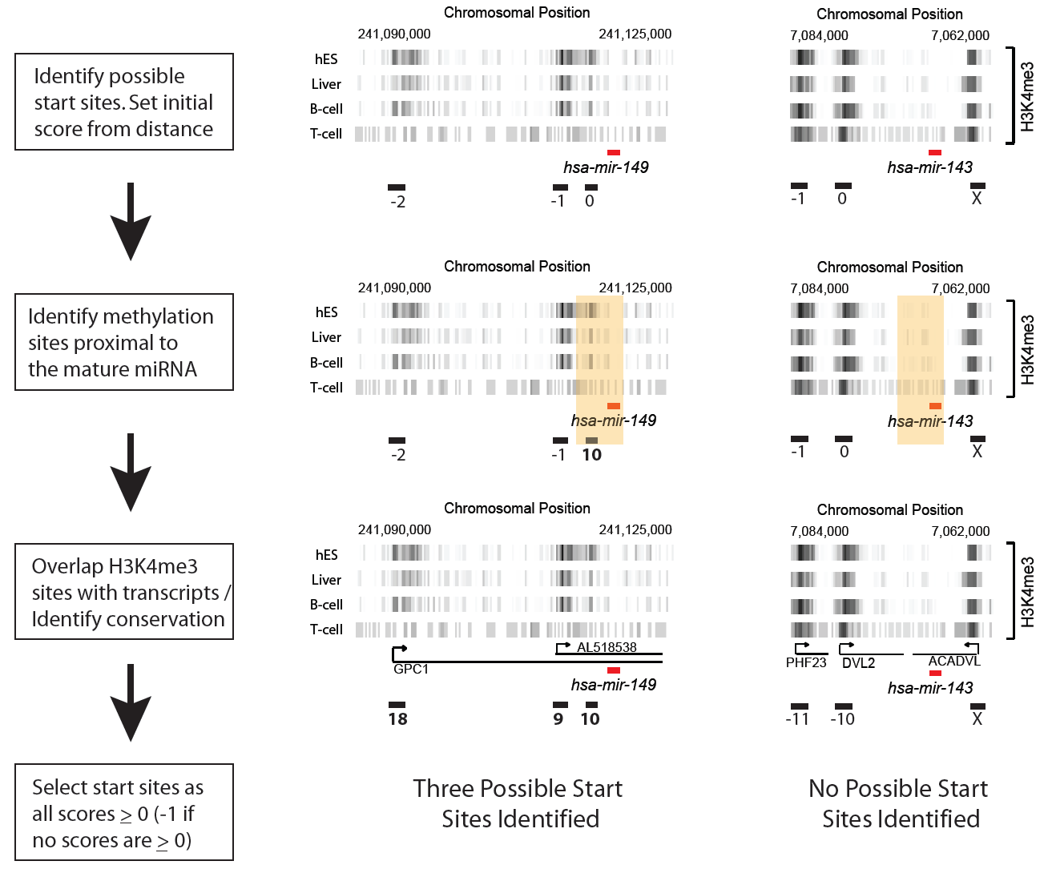

Slide 5
Results for human regulatory network
Cell line: k562 21 TFs (29 combinations of TF-treatment)
TF------XorTF network 20634 edges 6344 nodes
(chip-seq data, ref-seq gene, a list of 2000 TFs)
TF------MIR network 150 edges 97 nodes
(chip-seq data, promoters identified by previous score system)
MIR------XorTF network 118091 edges 12470 nodes
(Conserved predicted MIR targets, ref-seq gene, a list of 2000 TFs )

Slide 6
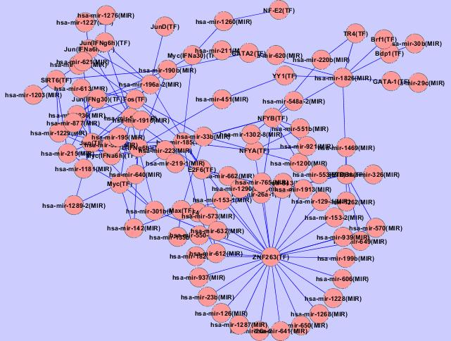
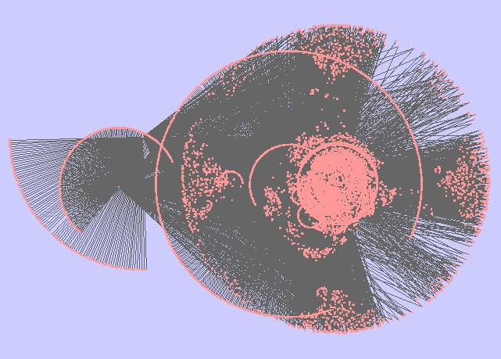
TF------MIR interation
TF------XorTF interation

Slide 7
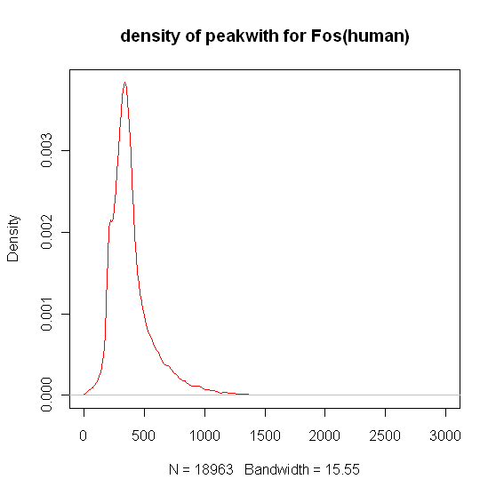
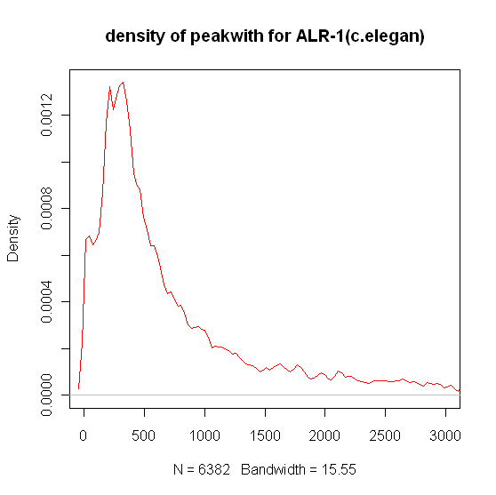
Comparison of peak widths

Slide 8
C. elegan regulatory network
Narrow down all the peaks within 500bp
40
50
30
100 bp
500 bp
Calculate the average value for each bin of 100bp from original wig file
if peak width <500 bp, keep the original enrichment start and end site
Otherwise, find the maximum 500 bp in the peak as new enrichment region.

Slide 9
C. elegan regulatory network
Algorithm for TF---XorTF identification
- 0.5kb < Distance < 1kb
Refseq gene
Transcript start sites
new peaks within 500 bp
region start
region end

Slide 10
C. elegans regulatory network
Algorithm for TF---MIR identification
- 2 kb < Distance < - 0.5kb
Mature MIR region
Assume the promoter of MIR within 1.5 kb upstream of mature MIR
new peaks within 500 bp
region start
region end

Slide 11
Results for C. elegans regulatory network
18 TFs ( different stages, 21 combinations of TF-treatment)
TF------ XorTF network 38083 edges 10575 nodes
(chip-seq data, ref-seq gene, a list of ~1000 TFs)
TF------ MIR network 268 edges 93 nodes
(chip-seq data, mature MIR information)
MIR------ XorTF network 3167 edges 5002 nodes
( Conserved predicted MIR targets, ref-seq gene, a list of ~1000 TFs )

Slide 12
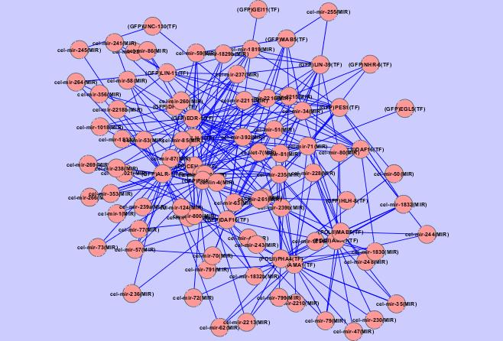
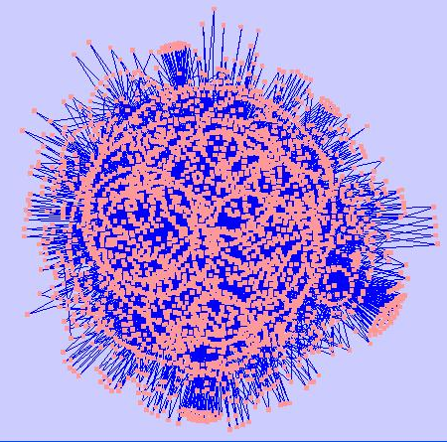
TF------MIR interation
MIR ------XorTF interation

Slide 13
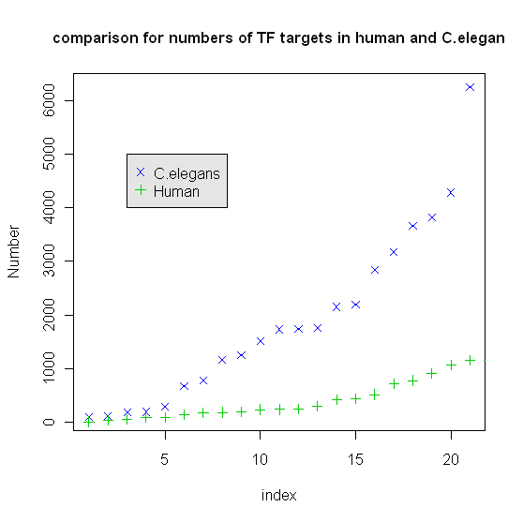

Slide 14
C. elegans Human
~20k genes ~25k genes
~1000 TFs ~ 2000 TFs
~2000 targets/ TF ~ 500 targets/TF
Think about marionette!
Probably through abandoning and switching edges to increase dimensions.
Evolution of networks much faster
than evolution of sequences

Slide 15
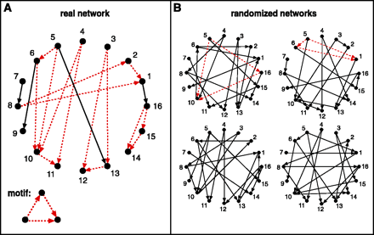
Next
Network motif: Particular subgraphs or motifs appearing significantly more or less often in a real-world network than would be expected on the basis of chance
Question: Which algorithm to generate “null” model?
Science, Vol. 298, No. 5594. (25 October 2002), pp. 824-827.

Slide 16
Switching algorithm
keeping the in- and out-degree of each node constant
first randomly selecting a pair of directed edges AB and CD
However, in case one or both of these new links already exist in the network, this step is aborted and a new pair of edges is selected.
A
C
A
C
B
D
B
D
Science, Vol. 296, No. 5569. (3 May 2002), pp. 910-913.

Slide 17
“It was the best of times, it was the worst of times, it was the age of wisdom, it was the age of foolishness, it was the epoch of belief, it was the epoch of incredulity, it was the season of Light, it was the season of Darkness, it was the spring of hope, it was the winter of despair, we had everything before us, we had nothing before us, we were all going direct to Heaven, we were all going direct the other way–in short, the period was so far like the present period, that some of its noisiest authorities insisted on its being received, for good or for evil, in the superlative degree of comparison only. ”
-----A Tale of Two Cities, Charles Dickens

