Slide 1
Allele Paper Figures/Tables

Slide 2
Fig 1 – Pipeline Schematic

Slide 3
Reads
AllSNPs
Convert
Filter
HG18 Reference
TrioSNPs
Filtered Reads
CreateRef
FatherRef
MotherRef
Bowtie
Bowtie
Father
MappedReads
Mother
MappedReads
Combine
MappedReads
TrioSNPs
GenCounts
Counts
Filter Counts
Filtered Counts
Gene Info
Filtered Gene Annotation
All Gene Annotation

Slide 4
Table 1a Summary Table

Slide 5
Summary Table# no chrX
 | RNA-Seq | ChIP-Seq
 |  | Pol II | Myc | Fos | Max | Jun
Genes with exp hets | 4,547
Genes with ASEs | 938
Novel TARs with exp hets | 14,284 (12,608)
Novel TARs with ASEs | 1401 (1193)
Binding sites with Hets |  | 4,945 | 2,935 | 1,217 | 1,310 | 359
Biding sites with ASE |  | 1,833 | 690 | 252 | 147 | 37
Notes:
258(193 consistent) for RNA-Seq
5

Slide 6
Summary Table# chrX
 | RNA-Seq | ChIP-Seq
 |  | Pol II | Myc | Fos | Max | Jun
Genes with exp hets
Genes with ASEs
Novel TARs with exp hets | 110 (97)
Novel TARs with ASEs | 88 (79)
Binding sites with Hets
Biding sites with ASE
Notes:
258(193 consistent) for RNA-Seq
6

Slide 7
Table 1b – ASE intersect ASB

Slide 8
Summary Table#updated-gns
SNP No. | RNA-Seq | ChIP-Seq
 |  | Pol II | Myc | Fos | Max | Jun
genes&BS with Hets |  | 1,273 | 895 | 246 | 217 | 8
genes&BS with ASEs |  | 111 | 52 | 11 | 5 | 2
novel TARs&BS with Hets |  | 9,115 (8,002) | 4,622 (4,003) | 814 (669) | 863 (768) | 892 (787)
novel TARs&BS with ASEs |  | 176 (160) | 50 (47) | 14 (13) | 5 (5) | 0 (0)
Notes:
Novel TARs the same
8

Slide 9
Figure 2 – examples a) gene b) novel TAR

Slide 10
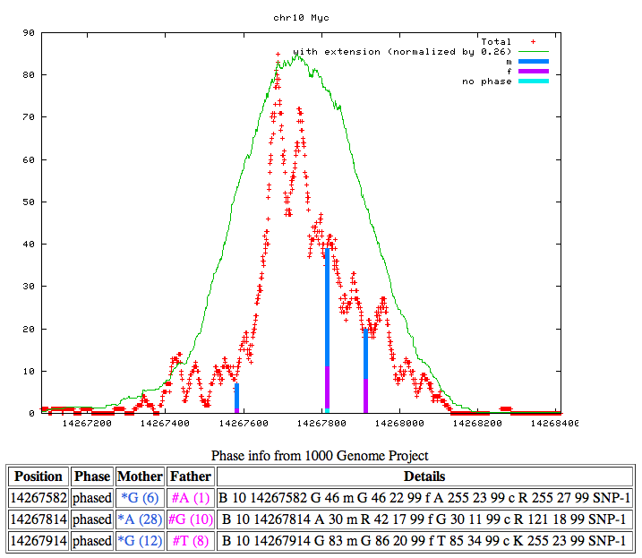
Ex: Consistent & Cooperative Binding to Maternal Allele
Pol II
Myc
Maternal
Paternal
*
*
*
*
Maternal Allele Binding (* p<0.05) for all 3 SNPs in the binding site for both Pol II and Myc
(site is in the intron of FRMD4A on chr10)

Slide 12
Figure 3a - exp vs binding

Slide 13
ASB vs. ASE(based on the best P-Value) y-axis:ratio M/P binding; x-axis: ratio of M/P expression
Pol II:
Cor: 0.3372924; P-Value: 0.0001548

Slide 14
Pol II: (sum of M/P ratio) Cor: -0.2023301; P-Value: 0.02481

Slide 15
Myc: Cor:0.4806692; P-Value: 0.0004107

Slide 16
Figure 3b – PWM

Slide 19
Figure 3b – polyphen

Slide 20
Figure 4 – technical figs

Slide 21
RNA-Seq: M/P-filtered
Notes:
After 1.5>=CNV>=0.5 filtering

Slide 22
RNA-Seq: Alt/Ref-filtered

Slide 23
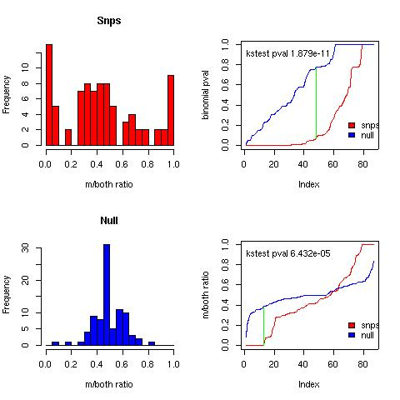

Slide 24
Figure 4– saturation – depth of sequencing

Slide 25
Figure 5 - network

Slide 26
Allele specific binging
TF’s
Paternal
Maternal
Unknown
Regulation
Genes
Allele specific expression
Paternal
Maternal
Even
Notes:
TF diff

