Slide 1
Chromatin Model for Predicting Transcription Factor Binding and Gene Expression
Chao Cheng
Group meeting
Feb 16, 2010

Slide 2
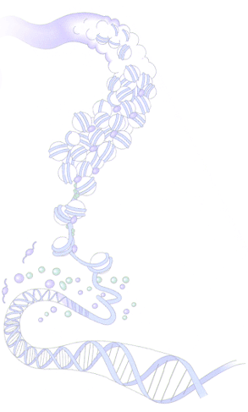
Why chromatin features?
Driven by data
- encode; modencode; published data
Important in biological research
- transcription regulation
- development
- cancer
- others

Slide 3
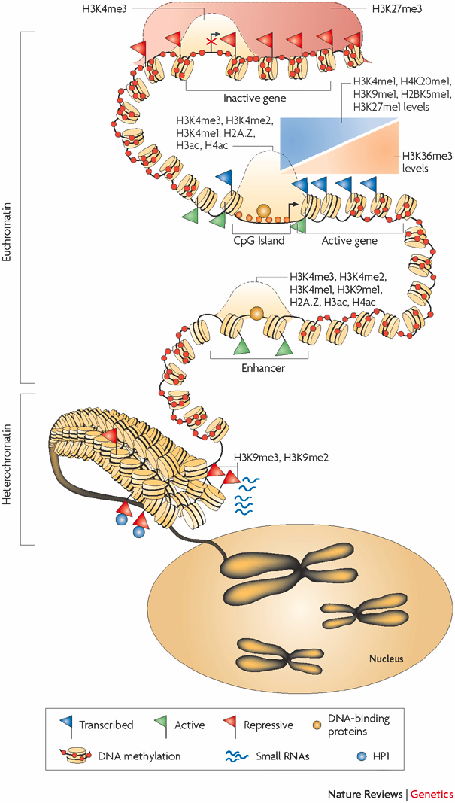
How chromatin modifications regulate gene expression?
Modulate DNA accessibility
Recruit transcription regulators
Schones et al., 2008
Notes:
Heterochromatin, Euchromatin

Slide 4
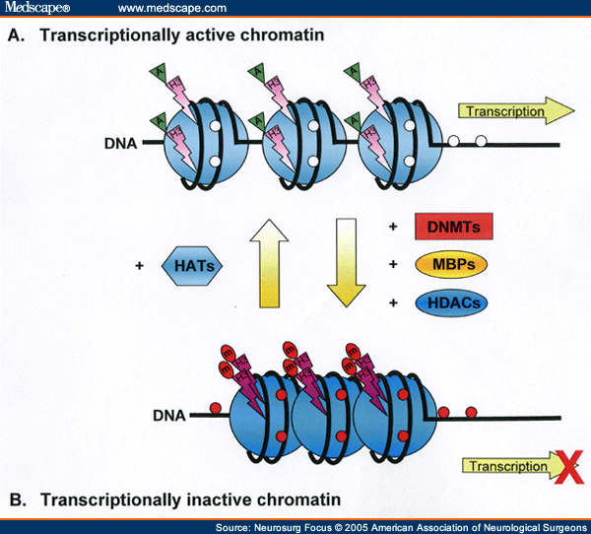
What have we done?
Part I: a chromatin model for gene expression prediction
- human K562 and GM12878 cell lines
- worm EEMB and L3
Part II: a two-step method for TFBS prediction
- yeast
- human
- worm

Slide 5
Part I: a chromatin model for gene expression prediction
Individual: correlation of each chromatin features with gene expression
Collective: hierarchical clustering of genes based on chromatin features
Integrative: supervised model for gene expression prediction
Note: Relative importance of each chromatin feature for transcription regulation depends on its position relative to TSS: divide chromosome into small bins

Slide 6
Divide and compare strategy
TSS
TTS
Gene i
40
1
80
120
81
4 …
41 ….44
121
160
Bin 40-1
(TSS-4kb to TSS)
Bin 41-80
(TSS to TSS+4kb)
Bin 120-81
(TTS-4kb to TTS)
Bin 121-160
(TTS to TTS+4kb)
RNA-Seq data
Chromatin features:
Histone methylation
Pol II binding
Prediction target:
Gene expression level
Predictors
~10000 refseq genes
Chromatin features
Bin 1
……
Bin
160
Bin
2
Notes:
To investigate the correlation between gene expression and chromatin features, we focus on 4kb upstream and down-stream of the TSS and TTS regions. TSS is transcription start site, TTS is transcription terminal site.
We divide the 4kb DNA region upstream of TSS into 40 bins, each bin is 100 nt. From TSS, the bins are named as bin1, bin2, bin3 to bin40. Similarly, the bins downstream of the TSS are named from bin 41 to bin 80.
For each bin, we calculate the average signal of each chromatin features, for example the reads that covers the bin in a chromatin chIP-seq experiments.
Finally, for each of the 160 bins, we have a predictor matrix, containing about 10 thousands genes times about 20 chromatin features, including different chromatin modification, DNA hypersensitivity. We will build a model for each bin to predict gene expression, which is measured by RNA_seq experiments.

Slide 7
Correlation pattern of chromatin features with gene expression
Human: ChIP-seq, real transcription start and terminal sites
Worm: ChIP-chip, translation start and terminal sites

Slide 8
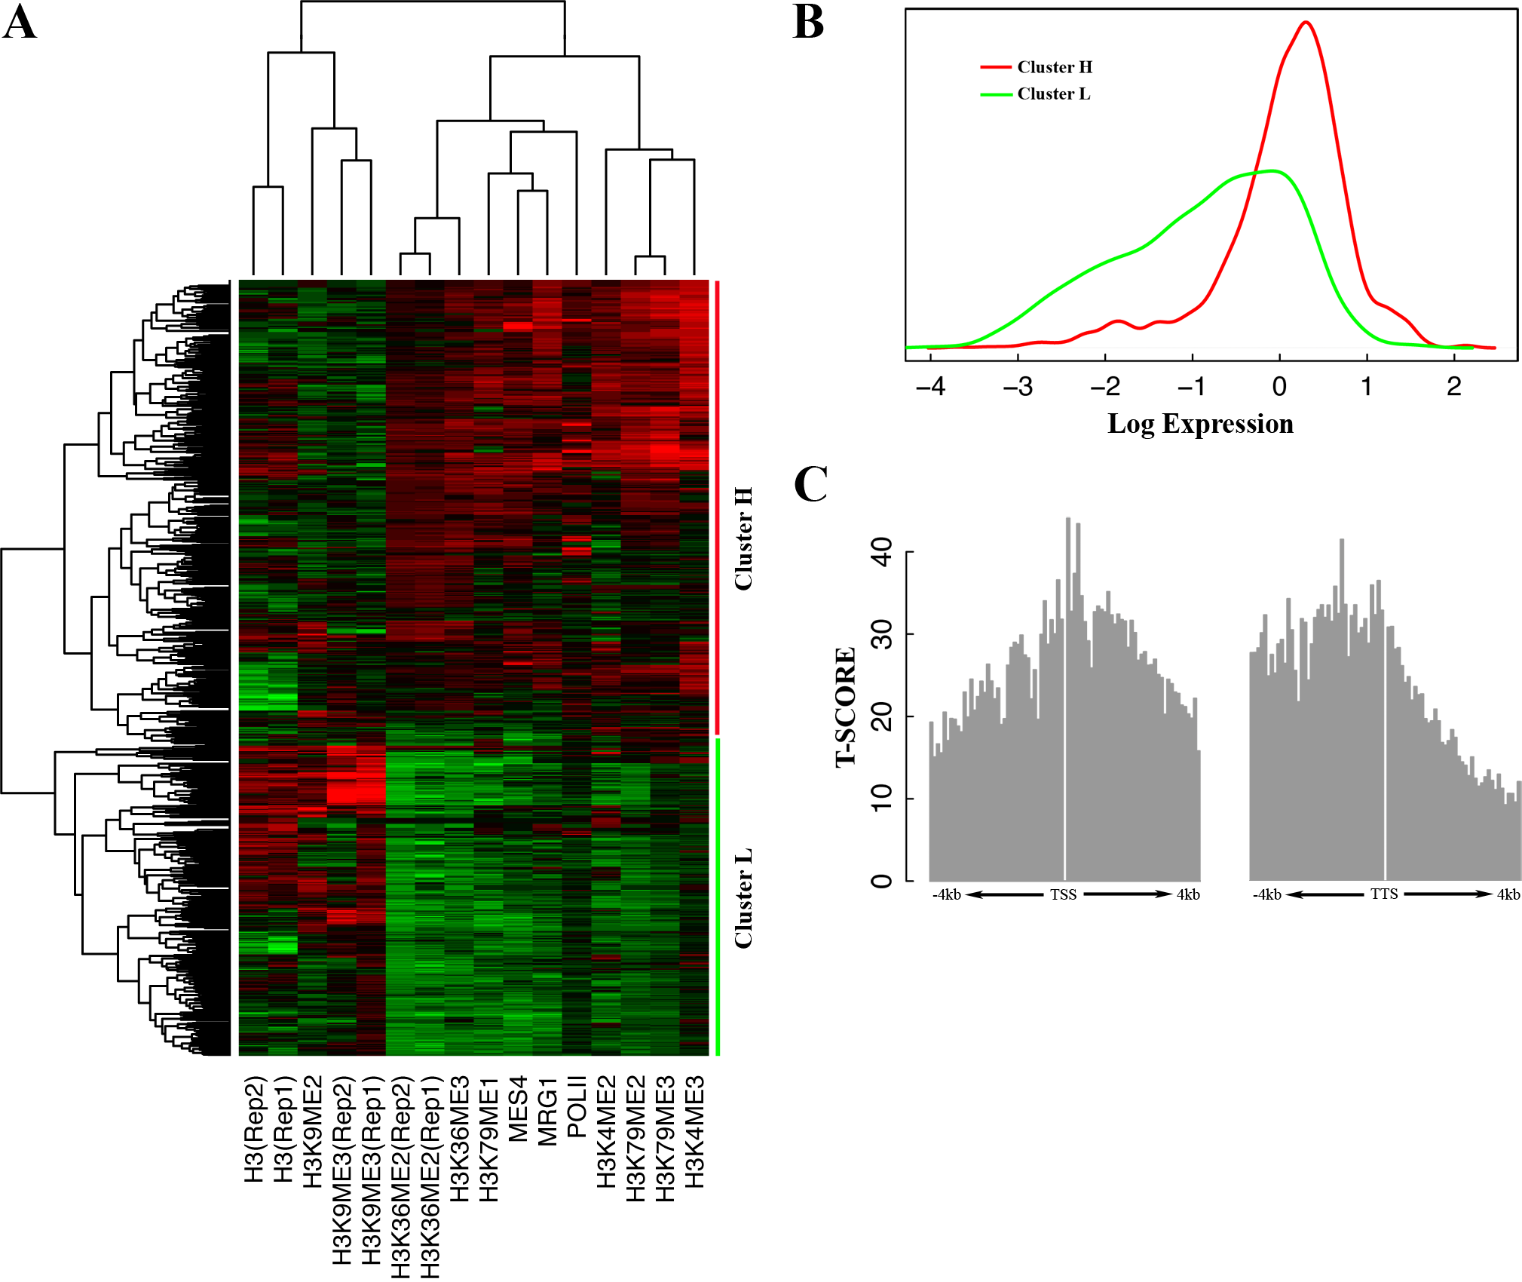
Clustering on chromatin profile
Bin #43
Worm EEMB

Slide 9
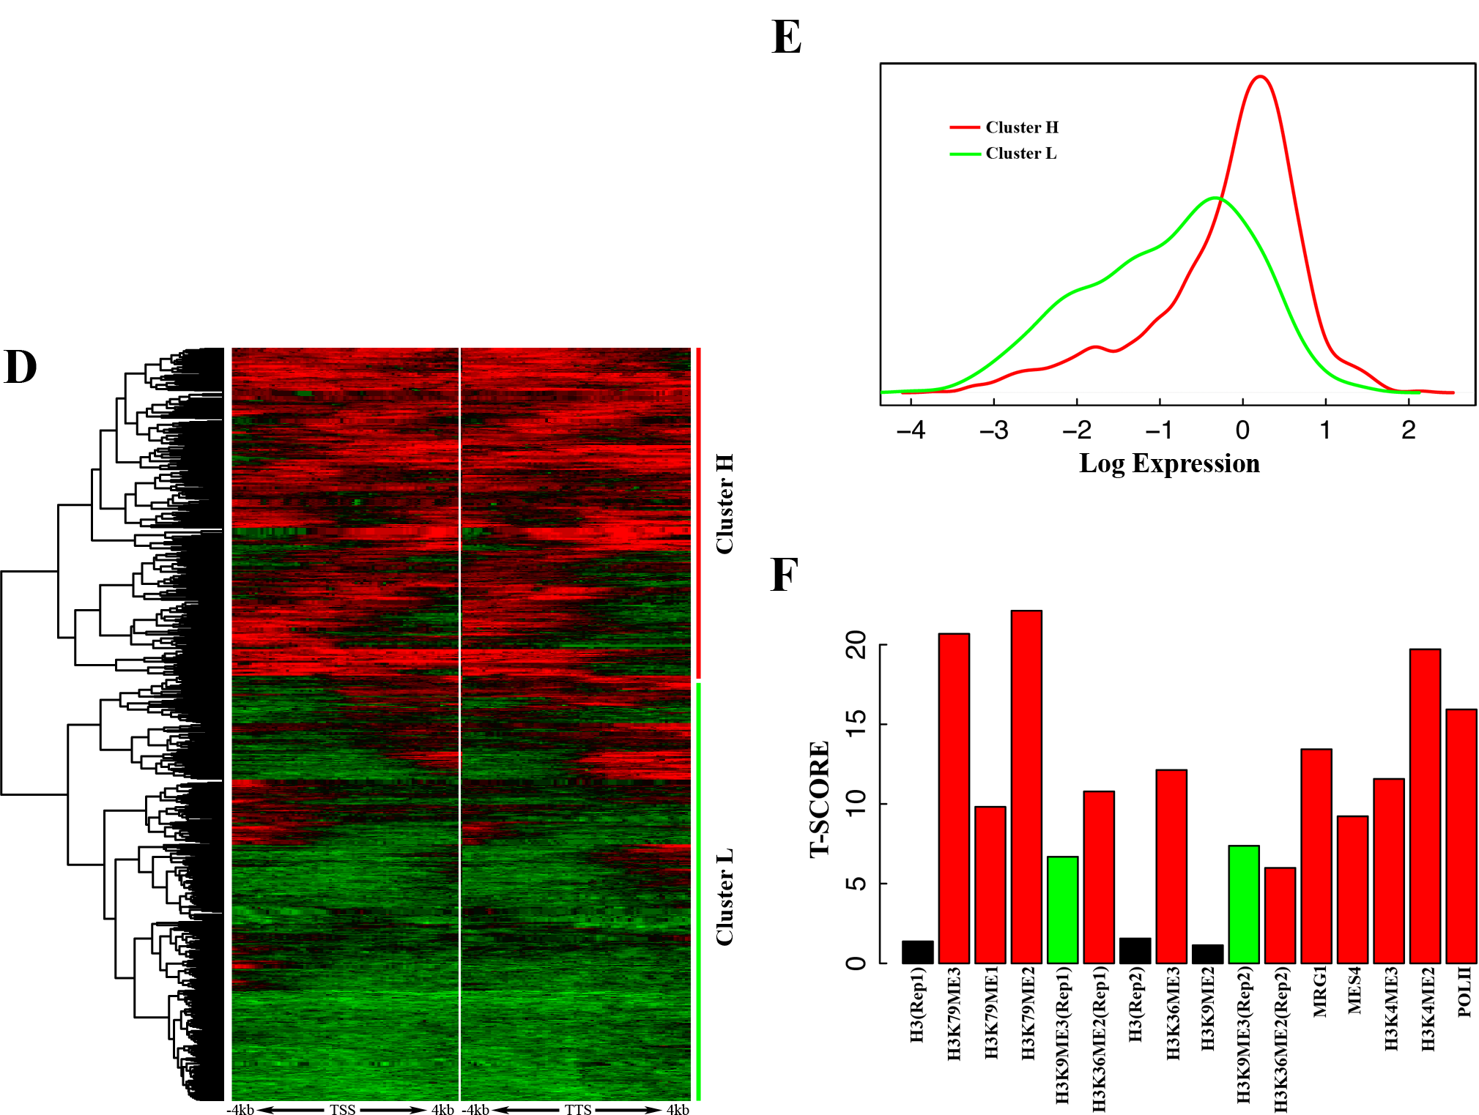
Clustering on bin profile
Worm EEMB
H3K79ME2

Slide 10
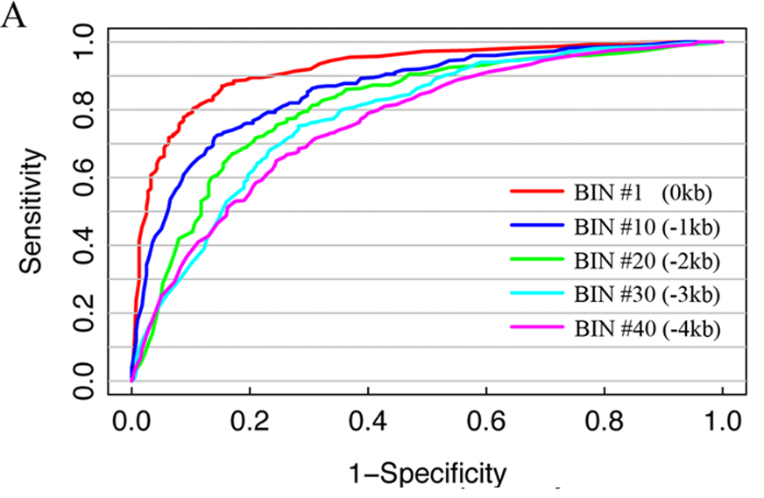
Predict gene expression: (SVM classification)
Worm EEMB

Slide 11
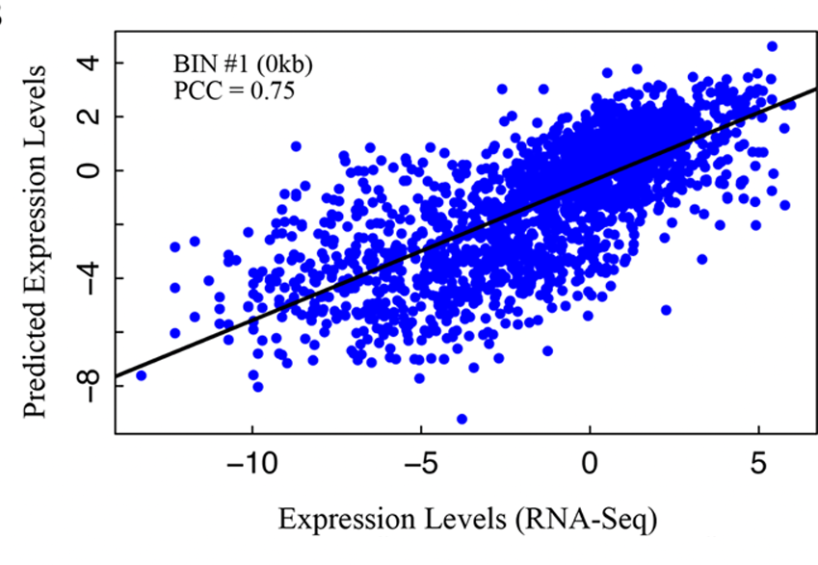
Predict gene expression: SVR regression

Slide 12
Relative contribution of each chromatin features (human)
Human K562

Slide 13
Relative importance of chromatin features (worm)

Slide 14
Chromatin model is tissue/cell line specific and development stage specific
Worm
Human

Slide 15
Development stage specificity: worm

Slide 16
Predicting differential expression
Yes
No

Slide 17
Predict differential expression
Human K562/GM12878

Slide 18
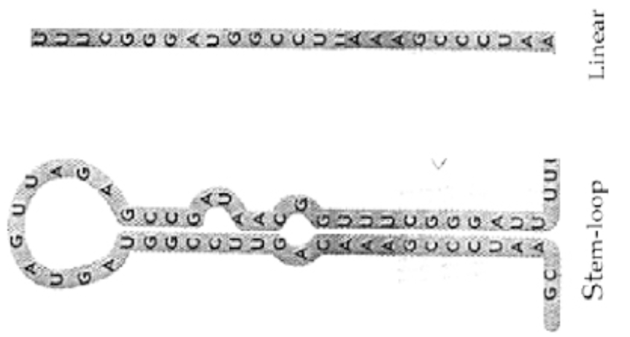
Predicting microRNA expression
162 worm microRNAs from miRBASE
- ~100 bp corresponding to the pre-microRNAs
Calculate the signal of all chromatin features in their genomic location
Apply the SVM model to predict their expression
- NOTE: the model is trainned using protein-coding genes
Validate prediction results from experimental data
- Kato et al., small RNA-seq data
Worm and human

Slide 19
Predicting worm microRNA expression

Slide 20
Conclusion
Chromatin features can accurately predict gene expression
Chromatin model is tissue/cell line/development stage specific
Chromatin feature are highly redundant in terms of expression prediction
Chromatin feature can predict differential gene expression
ChIP-seq has higher resolution than ChIP-chip
Chromatin models are valid for protein-coding genes and microRNAs.

Slide 21
Part II: A two-step approach for predicting TF binding sites
yeast: the merit of small compact genome
human: the merit of being human
worm: where to find the TF PWMs?

Slide 22
Predicting TF targets genes of yeast
TF binding data:
- ChIP-chip for 203 yeast TFs
- for each TF-gene pair, a P-value is calculated
Chromatin modification profile data
- ChIP-chip, Pokholok et al. 2005
- 14 profiles: H3(YPD), H4(YPD), H3(H2O2), H3K9AC/H3(YPD), H3K14AC/H3(YPD), H3K14AC/WCE(YPD), H3K14AC/H3(H2O2), H4AC/H3(YPD), H4AC/H3(H2O2), H3K4ME1/H3(YPD), H3K4ME2/H3(YPD), H3K4ME3/H3(YPD), H3K36ME3/H3(YPD), H3K79ME3/H3(YPD)
Positional weighted matrices for yeast TFs
- sequence analysis: motifs enriched in yeast promoters
- TF binding data:

Slide 23
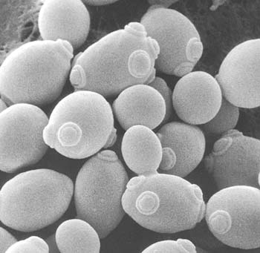
Differential chromatin features between functional TFBS and non-functional TFBS
SWI4 as example
Functional binding sites: SGD, 99
Non-functional binding sites: 485, have PWMs but not bound by SWI4
For each site, calculate the average signal over all probes within 100bp for each chromatin feature

Slide 24
Differential chromatin features between functional TFBS and non-functional TFBS

Slide 25
Final Data
Gene | TF target? | PWM Score | H3 (up stream) | …… | H3 (down-stream) | ……
YAL001C | Yes | 0.9945 | 1.555 |  | 1.222
YAL056W | No | 0 | 2.80 |  | 0.899
……
 | Yes | 0.2045 | 0.87 |  | 3.245
Up-stream signal
Down-stream signal

Slide 26
Chromatin feature improves target gene prediction
RAP1 (YPD), P<0.01

Slide 27
PWM I

Slide 28
Up vs. down-stream signal

Slide 29
Different thresholds for target gene

Slide 30
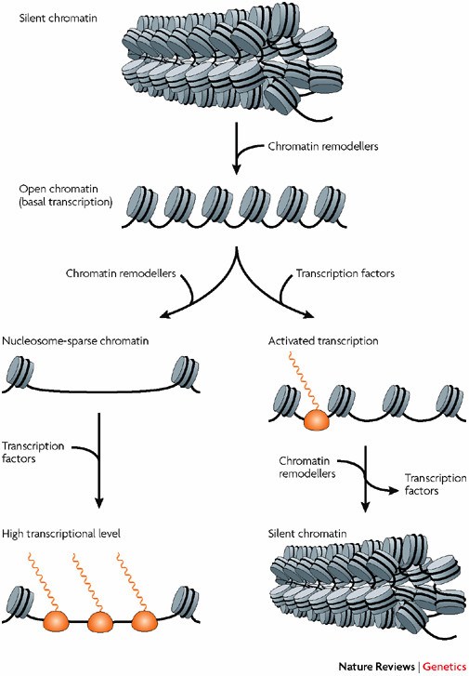
Two-step approach for TFBS prediction in human and worm
A supervised model that integrates all chromatin features to predict open chromatin regions in genome
- Binding Active Region (BAR+)
- confer tissue specificity
Search for PWM
- confer TF specificity
Report BAR+PWM+ as TFBS

Slide 31
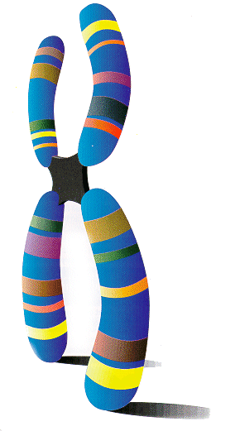
Chromatin model
Bin 1 (100bp)
Bin 2
30226454 bins
Predictor Matrix
32 experiments
Response Y
Bound by any TF
…
Encode data:
histone modification, DNA hypersensitivity,
TF binding, …
Calculate the average signal for each bin
ChIP-seq for 15 human TFs
1: Positive bins (overlap with a peak: q-value>5%)
0: negative bins

Slide 32
Chromatin features can accurately predict TF binding bins
Human

Slide 33
Prediction model is cell line specific

Slide 34
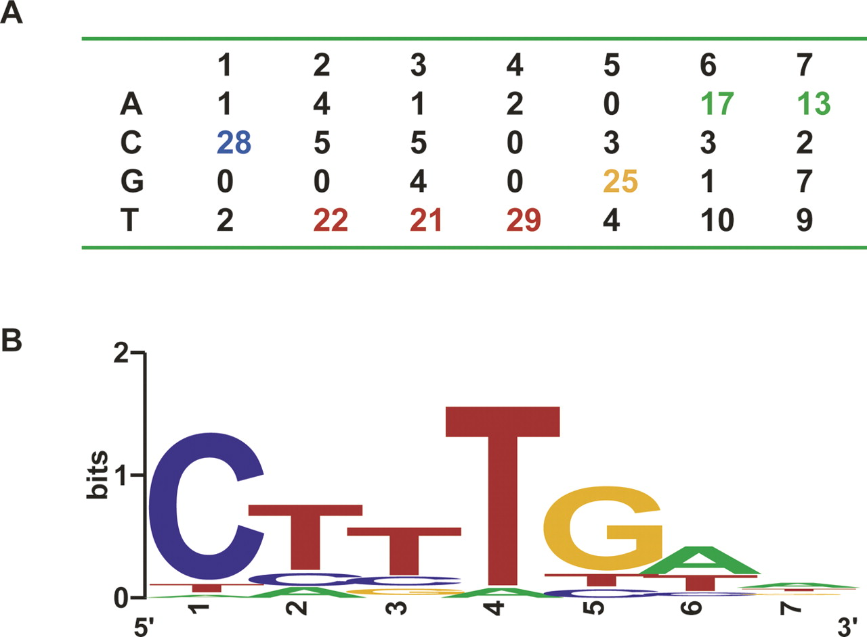
Chromatin model is not TF specific
The chromatin model largely predicts the chromatin structure, the accessibility of a DNA region and thereby not TF specific.
PWM in BAR+ regions are more likely to be functional TFBS.
Previous TFBS prediction method based on PWM only is not effective in practice due to high positive rate.
BAR+PWM+ reduce false positive rates

Slide 35
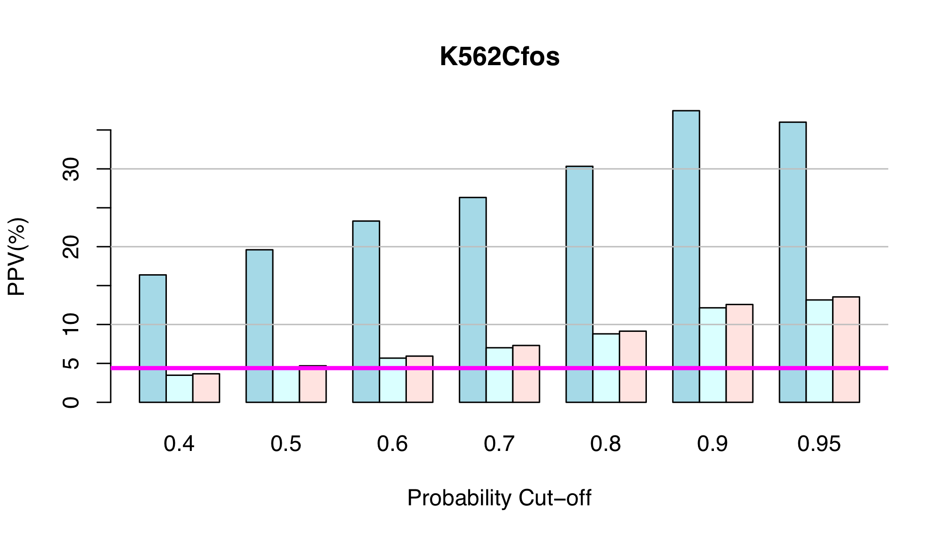
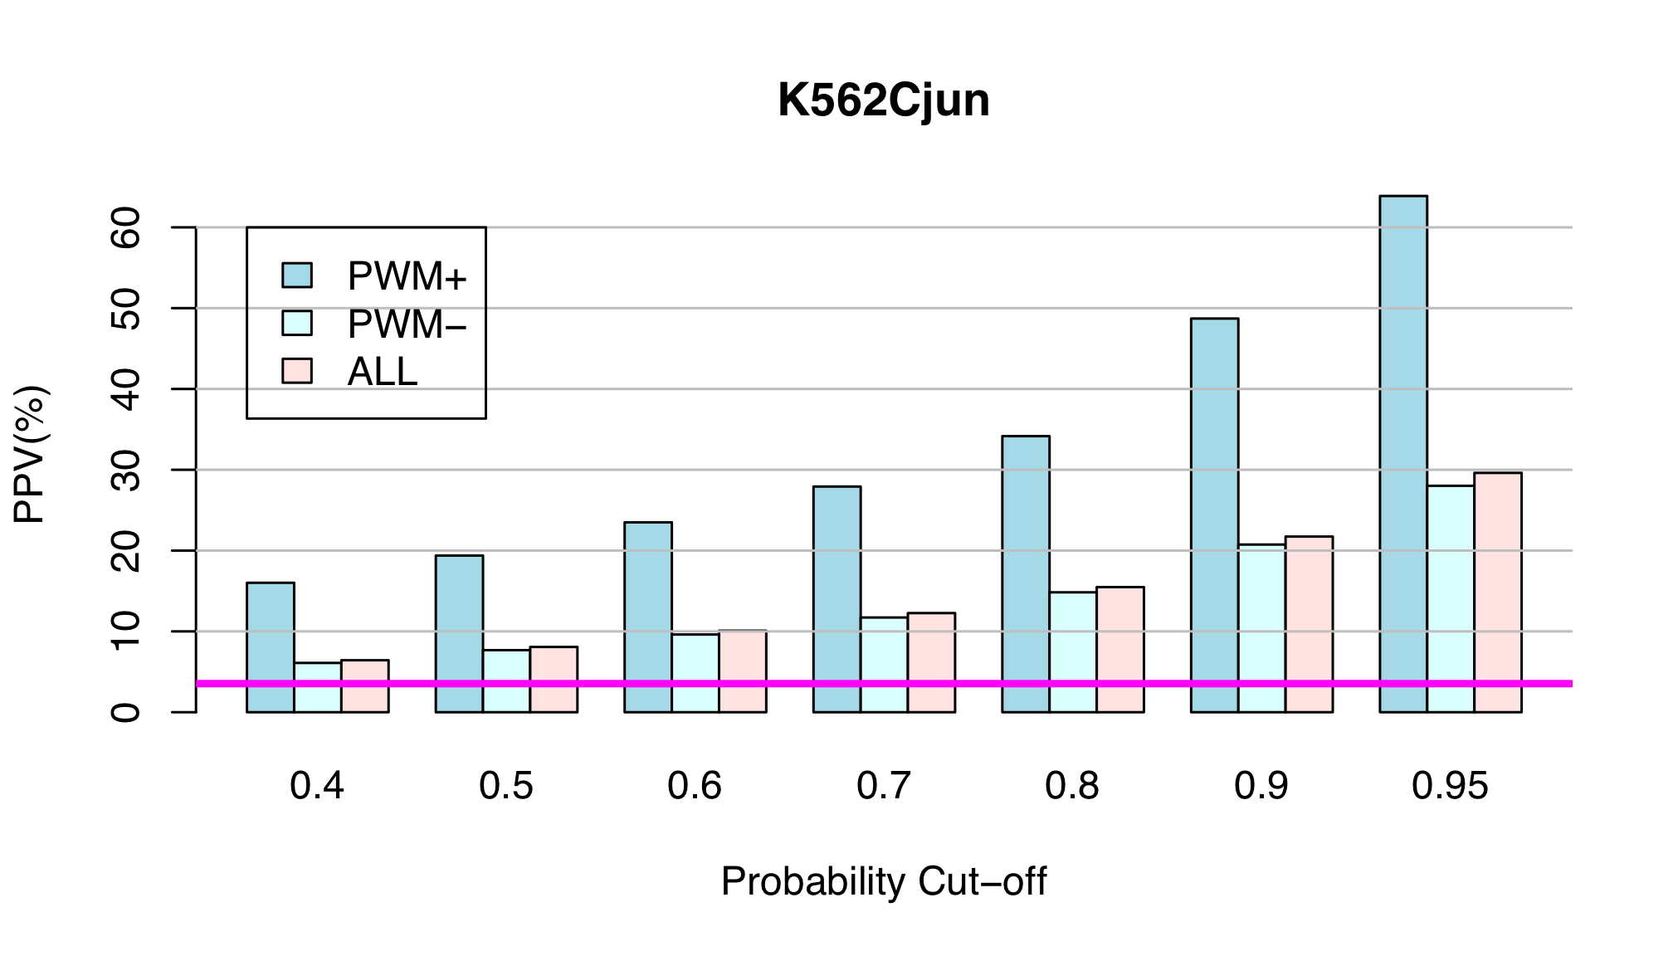
PWM enhances prediction precision
Notes:
Positive prediction value = 1-FDR

Slide 36
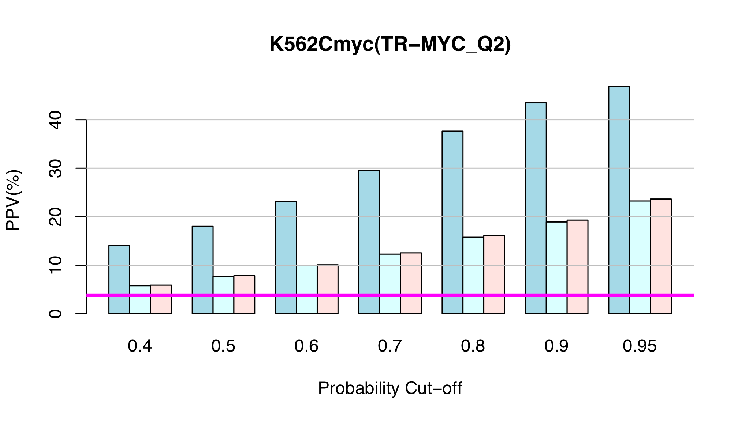
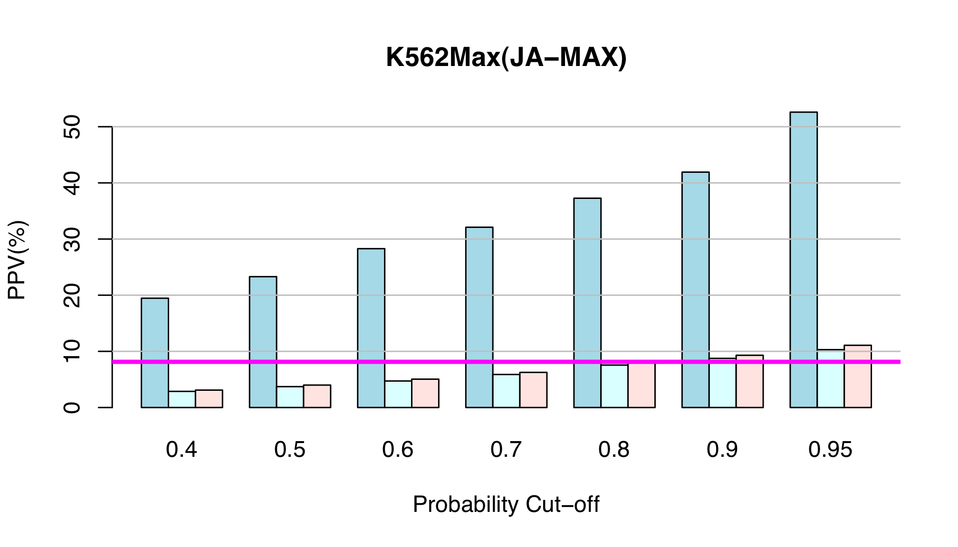
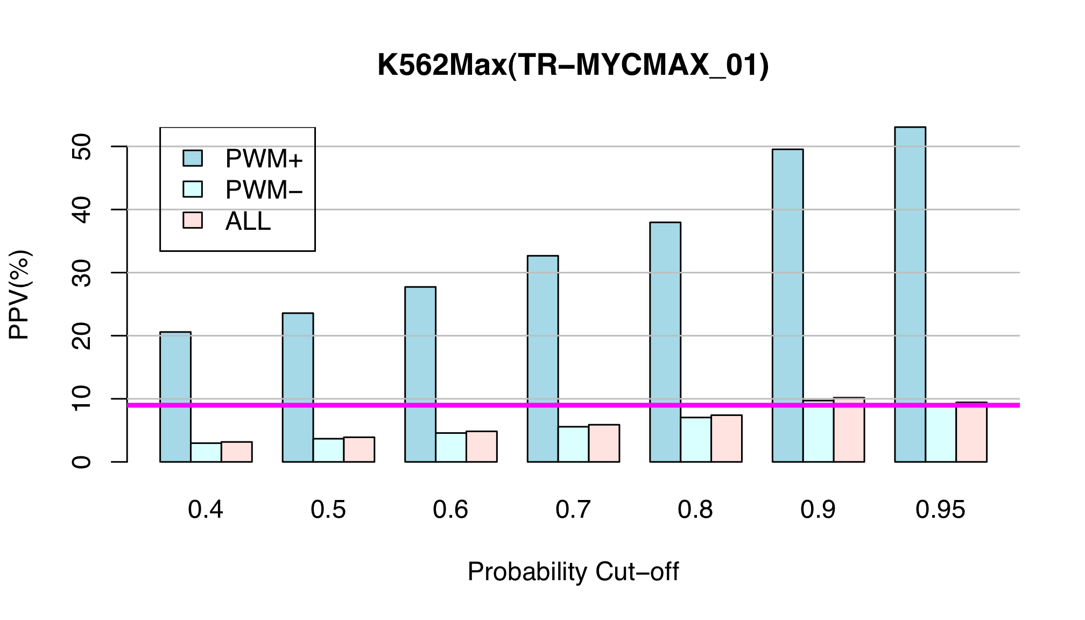
Using PWMs from database

Slide 37
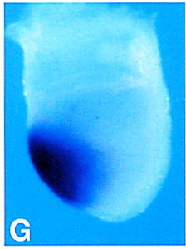
Applications of TFBS prediction method
Identify TFs that have differential activity between leukemia and normal blood cell.
- Ikaros
Predict human enhancers
- 50 enhancers, 4 have been experimentally tested in mouse embryo cells, among which 3 proved to be true positive

Slide 38
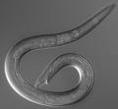
Predicting TFBS in C.elegans
worm

Slide 39
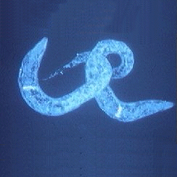
SKN-1

Slide 40
Acknowledgements
Kevin Yip
Koon-Kiu Yan
Joel Rozowsky
Chong Shou
Roger Alexander
Mengjie Chen
Genome Tech® & Nets®
Mark Gerstein

