Slide 1
Genetics and Privacy in Light of Social Media
Dov Greenbaum JD PhD
November 2012
Adjunct Assistant Professor,
Molecular Biophysics and Biochemistry
Yale University
Non-Resident Fellow,
Center for Law and the Biosciences
Stanford Law School
Attorney,
Pearl Cohen Zedek Latzer

Slide 2
A little about me
EDUCATION
PhD Genetics
    Yale University 2004
    Correlating mRNA expression values with protein levels in yeast
with Mark Gerstein
JD
  University of California, Berkeley 2007
  Focus on IP
  Wrote draft Patent Act for Jamaica as Part of Samuelson Clinic
Licensed to Practice Law
  California and
  before the United States Patent Office
PostDocs
  ETH Zurich 2005-08
  Stanford University 07-08
CURRENTLY
  Assistant (Adj) Professor, Yale
  Non Resident Fellow, Center for Law and the Biosciences
  Stanford Law School
  Practicing IP Law Pearl Cohen Zedek Latzer

Slide 3
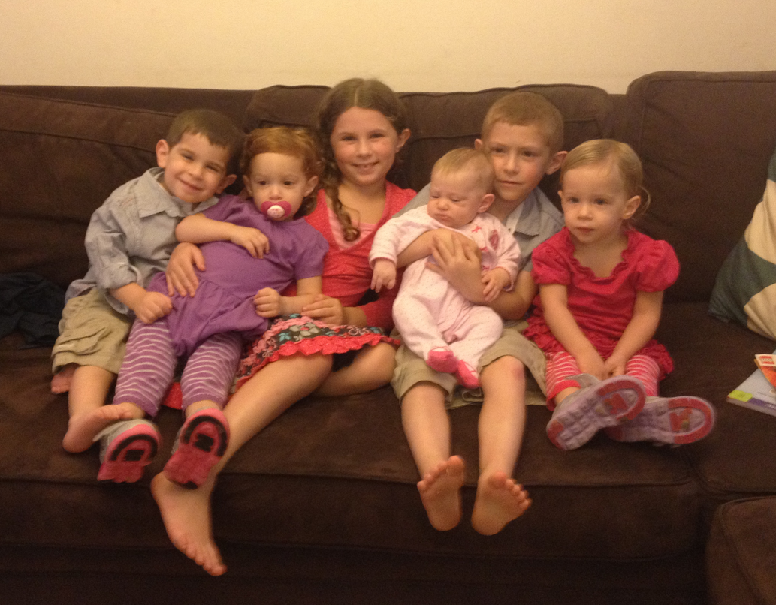
A little about me

Slide 4

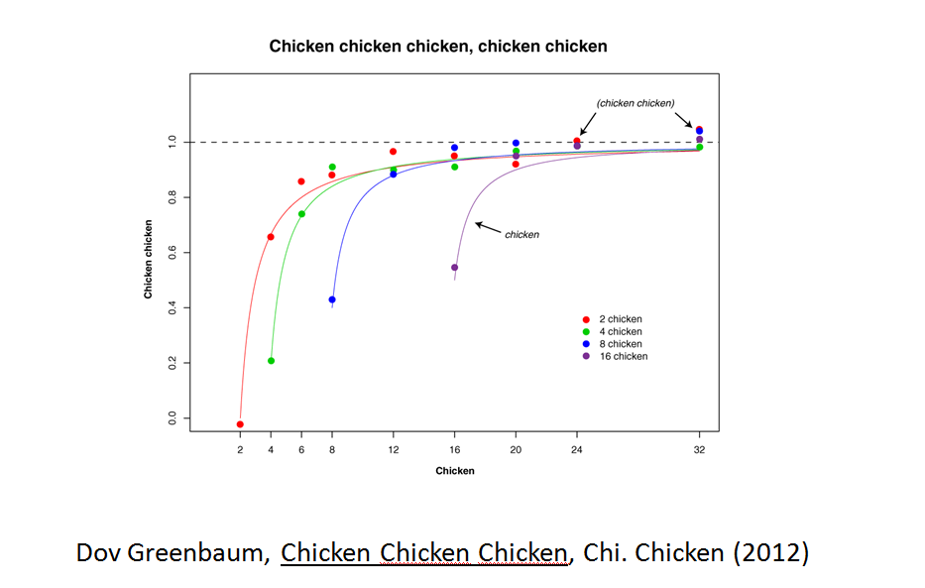
Signposting
Introduction
Chicken
Chicken
Chicken

Slide 5
Outline
Background
Threats to Genomics Privacy
Genomic Privacy in Athletics

Slide 6
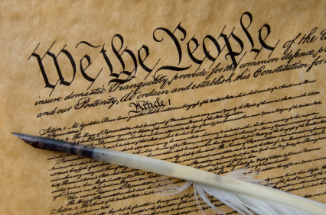
Background
Introduction
Threats to Privacy
Athletics
Genomics, Privacy, Social Media
  Privacy is a personal and fundamental right guaranteed by the US Constitution
  Privacy Act 1974
  Including:
  due process clauses of the Fifth and Fifteenth Amendments.
  Fourth Amendment against search and seizure US v Amerson 483 F. 3d 73 (2d Cir. 2007);
  Inherent in the limits on the First Amendment is a constitutional right to privacy.
Dov Greenbaum & Mark Gerstein, A Universal Legal Framework As A Prerequisite For Database Interoperability, 21 Nature Biotechnology 979 (2003).
Dov Greenbaum, The Database Debate: In Support of An Inequitable Solution, 13 Alb. L.J. Sci. & Tech. 431 (2003).
Dov Greenbaum, Are We Legislating Away Our Scientific Future? The Database Debate, 22 Duke L. & Tech. Rev. (2003).
6

Slide 7
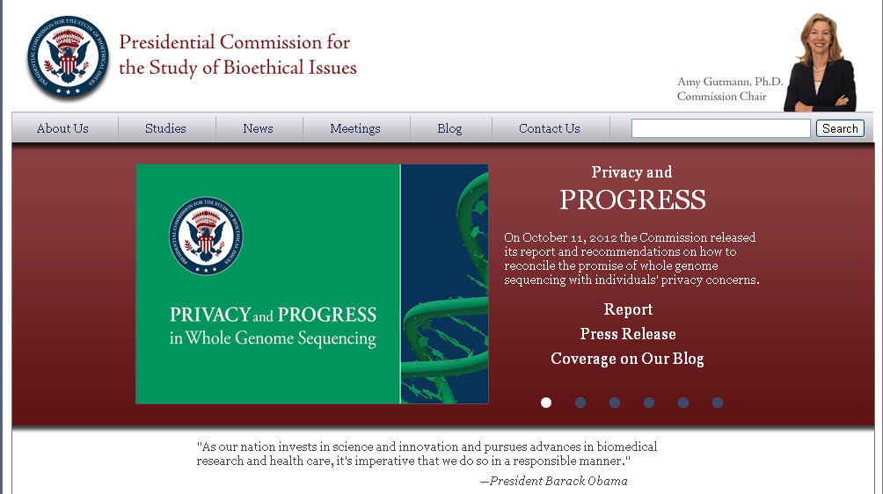
Background
Introduction
Threats to Privacy
Athletics
Genomics, Privacy, Social Media

Slide 8
Background
Introduction
Threats to Privacy
Athletics
Genomics, Privacy, Social Media
What is Genetic/Genomic Privacy
Anonymity ≠ Privacy
Working Definition:
The right to have your identifying data and/or genomic data kept undisclosed in research, in medicine and in society in general.

Slide 9

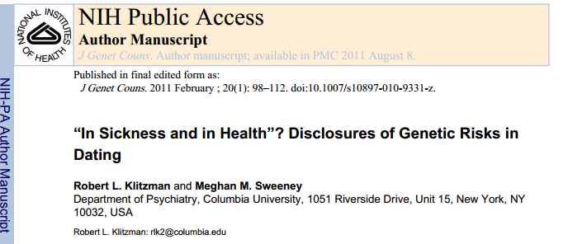
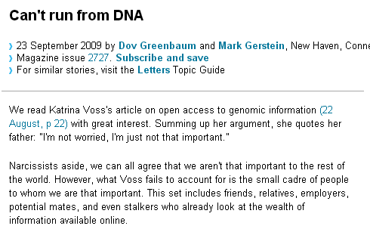
Is Genetic Privacy Important?
Background
Introduction
Threats to Privacy
Athletics
Genomics, Privacy, Social Media
Yes
Genetic Exceptionalism
Not yet sure of the relevance of the data (but the internet doesn’t forget)
Testing discloses both yours’ and your family’s data
Maybe Not
Shifting societal foci
No one really cares about your genes
You might not care
Cost Benefit Analysis: how helpful is identifiable data in genomic research?
9

Slide 10

Hollywood vs. Reality
Background
Introduction
Threats to Privacy
Athletics
Genomics, Privacy, Social Media
How much data can we really extract currently from our genome?
How predictive is the data in light of other factors? E.g., Epigenetics, Environment?
How much is media hype?
Dov Greenbaum, Is it really possible to do the Kessel Run in less than twelve parsecs and should it matter? Science in Film and its Policy Implications, 11 Vanderbilt Journal of Entertainment & Technology 249 (2009).
10

Slide 11
Its not all Hype
Background
Introduction
Threats to Privacy
Athletics
Genomics, Privacy, Social Media
Presymptomatic Genetic Testing for late onset disease is VERY informative
ApoE4
Huntington's
Alpha-1-antitrypsin deficiency
Ataxia telangiectasia
Inherited breast and ovarian cancer
Adult Polycystic Kidney Disease
Amyotrophic lateral sclerosis
11

Slide 12
What are Current Legal
Genetic Privacy Protections?
Background
Introduction
Threats to Privacy
Athletics
Genomics, Privacy, Social Media
Federal Law
  HIPAA
  GINA
  Patient Protection and Affordable Care Act
  Americans with Disabilities Act
  Executive Order 13145
State Laws
12

Slide 13

Health Insurance Portability and Accountability Act of 1996
Background
Introduction
Threats to Privacy
Athletics
Genomics, Privacy, Social Media
protects individuals from being charged higher premiums based on Genetics
does not protect groups from being charged higher premiums
Treats Genetic information like all other health information:
  to be protected it must meet the definition of protected health information (PHI):
    it must be individually identifiable
    and maintained by a covered health care provider, health plan, or health care clearinghouse.
    See 45 C.F.R 160.103 and 164.501
  a use or disclosure of genetic information in violation of the HIPAA Privacy Rule could result in a fine of $100 to $50,000 or more for each violation.
HOWEVER
the regulation does not address the type of information that is protected but, rather, who holds it
many facilities that perform direct-to-consumer genetic testing and analysis are exempt
HIPAA Doesn’t prohibit
  Requiring or requesting genetic tests
  Disclosure of genetic data without permission
  Excluding coverage for a condition
Anonymized biological material is not considered PHI
13

Slide 14

Genetic Information Nondisclosure Act of 2008
Background
Introduction
Threats to Privacy
Athletics
Genomics, Privacy, Social Media
GINA was 7+ years in the making - weakness reflects years of cumulative compromises
Title I relating to Health Insurance
Title II relating to Employment Discrimination
GINA Prohibits:
  group and individual health insurers from using genetic data for determining eligibility or premiums
  insurers from requesting that the insured undergo genetic testing
  employers from using genetic data to may employment decisions
  Employers from requesting genetic data about an employee or their family
14

Slide 15
Background
Introduction
Threats to Privacy
Athletics
Genomics, Privacy, Social Media
15
GINA Does NOT:
  Prevent health care providers from recommending genetic tests
  Mandate coverage for any particular genetic test
  Prohibit underwriting on the basis of current health information
  Include life, disability or other insurers from asking for or using genetic data
  Apply to military personal or veterans obtaining insurance through the Dept. of Veteran Affairs
  Apply to federal employers
GINA amends
  the Employee Retirement Income Security Act (ERISA),
  the Public Health Services Act (PHSA)
  HIPAA, and
  the Internal Revenue Code.
GINA also was crafted to apply to those employers covered by Title VII of the Civil Rights Act of 1964, which bans discrimination on the basis of race, color, religion, sex, or national origin. Under Title VII, employers with fewer than 15 employees are not included.

Slide 16
Background
Introduction
Threats to Privacy
Athletics
Genomics, Privacy, Social Media
Title II of GINA prohibits use of genetic information in the employment context, restricts employers and other entities covered by Title II from requesting, requiring, or purchasing genetic information, and strictly limits such entities from disclosing genetic information. The law incorporates by reference many of the familiar definitions, remedies, and procedures from Title VII of the Civil Rights Act of 1964, as amended, and other statutes protecting federal, state, and Congressional employees from discrimination.
75 Fed. Reg. 68912 (Nov. 9 2010)

Slide 17

2010 Patient Protection and Affordable Care Act (ACA)
Pub. L. No. 111-148, § 2705 (2010).
Background
Introduction
Threats to Privacy
Athletics
Genomics, Privacy, Social Media
SEC. 2705. PROHIBITING DISCRIMINATION AGAINST INDIVIDUAL PARTICIPANTS AND BENEFICIARIES BASED ON HEALTH STATUS.
‘(a) In General- A group health plan and a health insurance issuer offering group or individual health insurance coverage may not establish rules for eligibility (including continued eligibility) of any individual to enroll under the terms of the plan or coverage based on any of the following health status-related factors in relation to the individual or a dependent of the individual:
‘(1) Health status.
‘(2) Medical condition (including both physical and mental illnesses).
‘(3) Claims experience.
‘(4) Receipt of health care.
‘(5) Medical history.
‘(6) Genetic information.
‘(7) Evidence of insurability (including conditions arising out of acts of domestic violence).
‘(8) Disability.
‘(9) Any other health status-related factor determined appropriate by the Secretary.
17

Slide 18

Americans with Disabilities Act
42 USC §12101 et seq.
Background
Introduction
Threats to Privacy
Athletics
Molecular Biology and the Law
ADA was interpreted by the Equal Employment Opportunity Commission (EEOC) as including genetic information, but its protections in this area are “limited and uncertain” (EEOC Commissioner Paul Miller 2000)
No Supreme Court cases in this area however, the Court may likely find that genetic defects may not be covered.
18

Slide 19
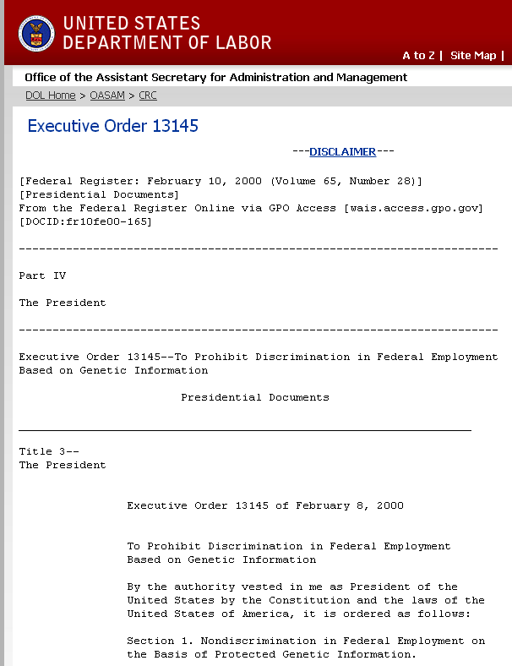
Executive Order 13145 (Clinton Feb. 9, 2000)
Background
Introduction
Threats to Privacy
Athletics
Genomics, Privacy, Social Media
The Executive Order directs departments and agencies to implement several nondiscrimination requirements. Under the Executive Order, departments and agencies must not:
engage in adverse employment actions on the basis of protected genetic information or information about a request for, or the receipt of, genetic services;
request, require, collect, or purchase protected genetic information about employees, with limited exceptions;
maintain protected genetic information in general personnel files, rather than in confidential medical files; or
disclose protected genetic information about employees, except in limited circumstances.
Under the Executive Order, departments and agencies must assure the confidentiality of any protected genetic information that they collect. This information must be treated with the same care as other confidential medical information and must be kept in files that are maintained separately from official personnel files
19

Slide 20
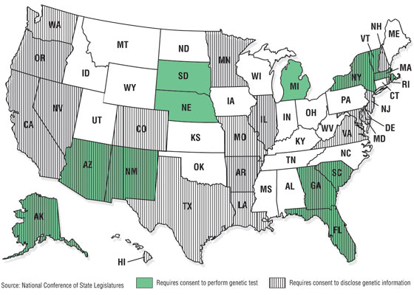
Background
Introduction
Threats to Privacy
Athletics
Genomics, Privacy, Social Media
20

Slide 21
Background
Introduction
Threats to Privacy
Athletics
Genomics, Privacy, Social Media
Legal protections notwithstanding…
We can’t stop people from sharing their own data
Data is difficult to anonymize
  Protection of Data is administratively costly
  Protection of Data is monetarily costly
Usefulness of protected data is limited
Data is held in insecure locations
Data is passed around among researchers/medical professionals through insecure channels
Tradeoff: Accessibility vs. Protection
21

Slide 22
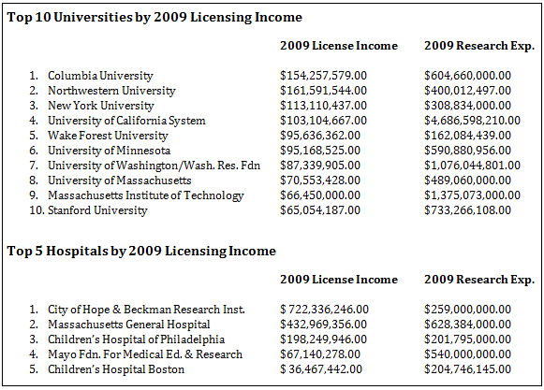
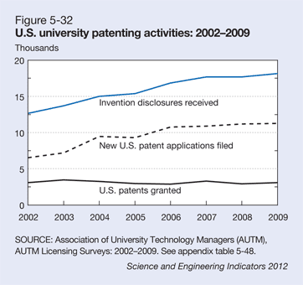
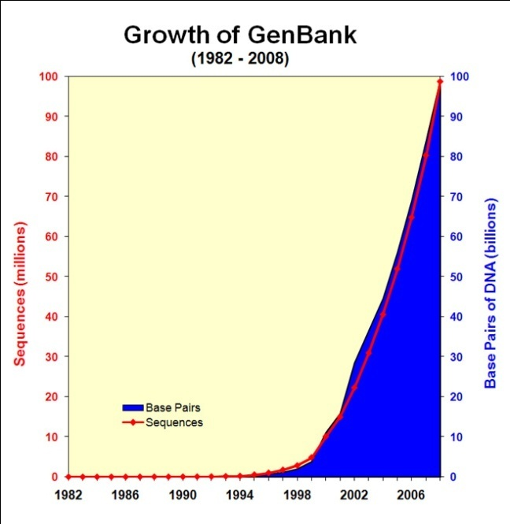
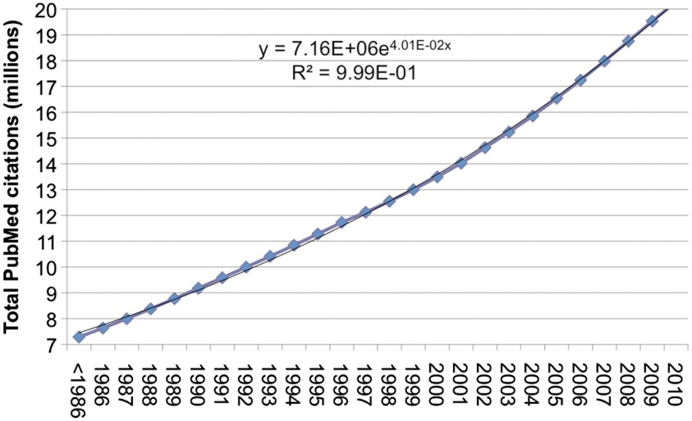
Trend is toward closed data even in science
Background
Introduction
Threats to Privacy
Athletics
Genomics, Privacy, Social Media
IP
Licensing
Size of data
Privacy Concerns

Slide 23
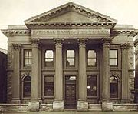

Want to promote SAFE Access
Background
Introduction
Threats to Privacy
Athletics
Genomics, Privacy, Social Media
High Level Data formats that are informative but without too much disclosure
  Mapped Read Format (MRF)
  CRAM
Centralized and Monitored Cloud Computing Resources
Look to other models (e.g., Financial Services)
Informed Consent
Education
Dov Greenbaum, Mark Gerstein, The Role of Cloud Computing in Managing the Deluge of Potentially Private Genetic Data, 11 American Journal of Bioethics 39 (2011).
8. Dov Greenbaum, Andrea Sboner, Xinmeng Jasmine Mu, Mark Gerstein, Genomics & Privacy: Implications of the New Reality of Closed Data for the Field, 7 PLOS COMPUTATIONAL BIOLOGY, e1002278. Epub 2011 Dec 1.

Slide 24
Outline
Background
Introduction
Threats to Privacy
Athletics
Genomics, Privacy, Social Media
Background
  Working Definition
  Pros and Cons
  Current Protections
  Stumbling blocks
  Potential components of a solution
Threats to Genomic Privacy
Genomic Privacy in Athletics

Slide 25
Outline
Background
Introduction
Threats to Privacy
Athletics
Genomics, Privacy, Social Media
Background
Threats to Genomic Privacy
  You
  Someone Else
  Government
Genomic Privacy in Athletics

Slide 26
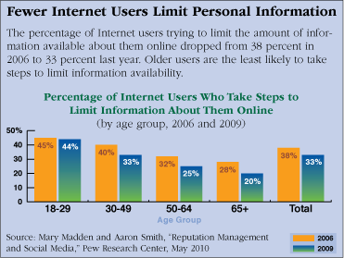
Threats to Privacy
Introduction
Background
Athletics
Genomics, Privacy, Social Media
26

Slide 27
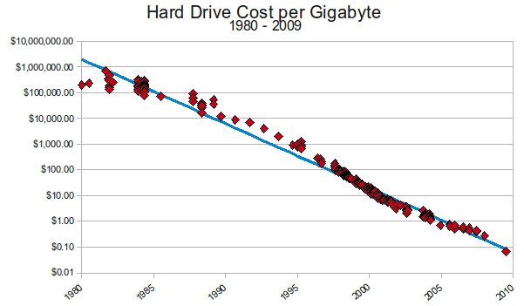
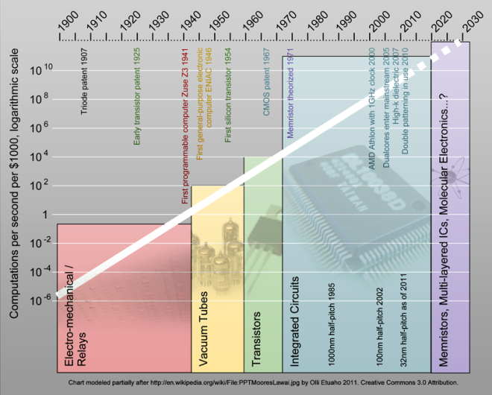
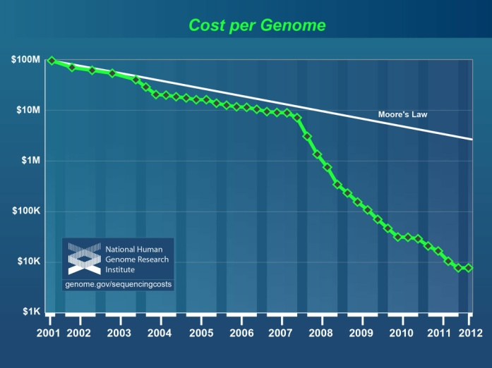
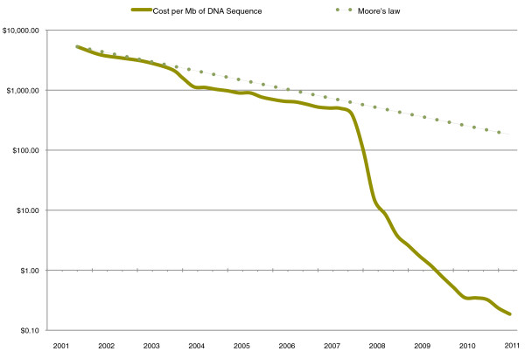
Threats to Privacy
Threats to Privacy
Introduction
Introduction
Background
Background
Athletics
Athletics
Genomics, Privacy, Social Media
Dov Greenbaum, Privacy Concerns in Personal Genomics STEP White Paper Series (University of California at Berkeley)
27

Slide 28
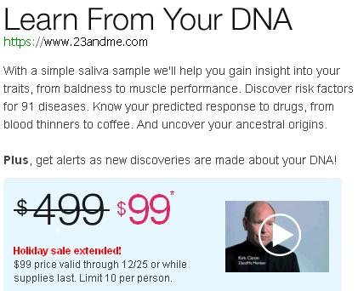
Threats to Privacy
Threats to Privacy
Introduction
Introduction
Background
Background
Athletics
Athletics
Genomics, Privacy, Social Media
Dov Greenbaum, Privacy Concerns in Personal Genomics STEP White Paper Series (University of California at Berkeley)
28

Slide 29
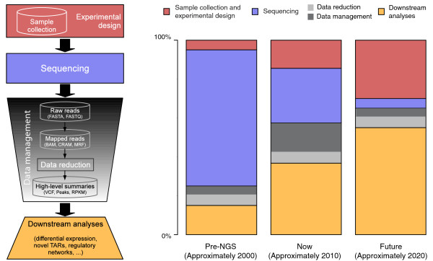
Threats to Privacy
Introduction
Background
Athletics
Genomics, Privacy, Social Media
Andrea Sboner, Xinmeng Mu, Dov Greenbaum, Mark Gerstein, The Real Cost of Sequencing, 12 Genome Biology 125 (2011

Slide 30
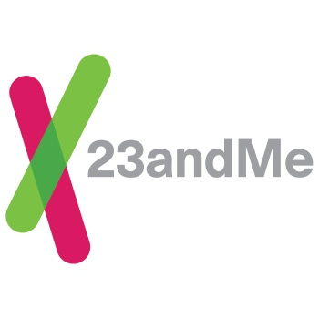


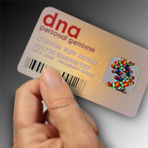
Rise of the Personal Genomics Industry
Threats to Privacy
Introduction
Background
Athletics
Genomics, Privacy, Social Media
30

Slide 31

Generation S
Threats to Privacy
Introduction
Background
Athletics
Genomics, Privacy, Social Media
31
Dov Greenbaum & Mark Gerstein, Sharing Too Much Online, New York Times, October 6, 2011.

Slide 32












32

Slide 33
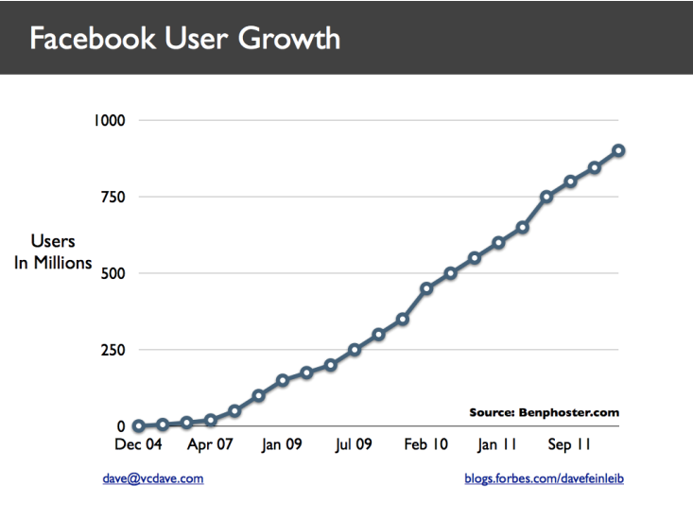
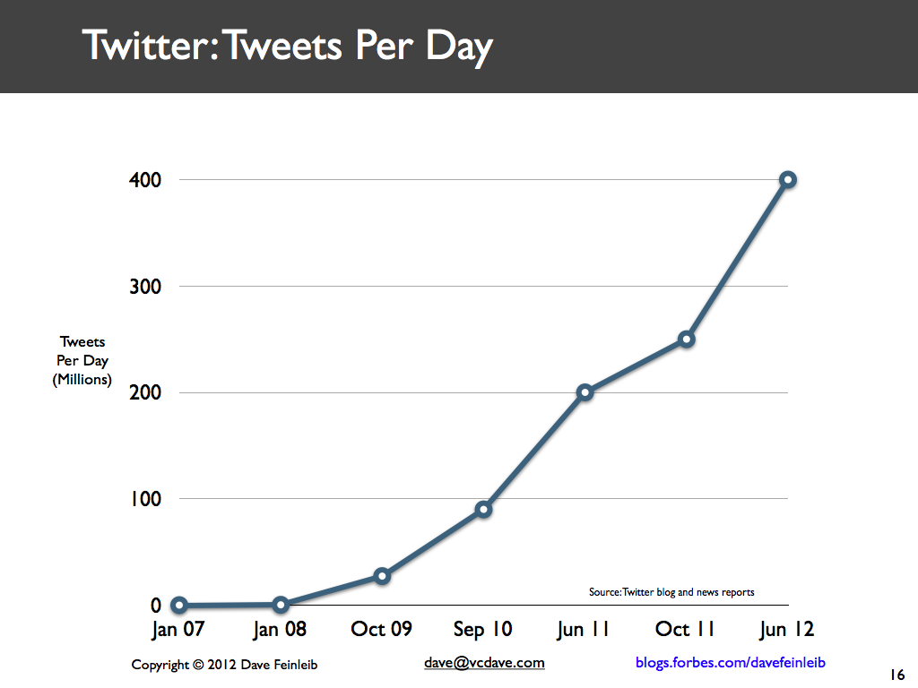
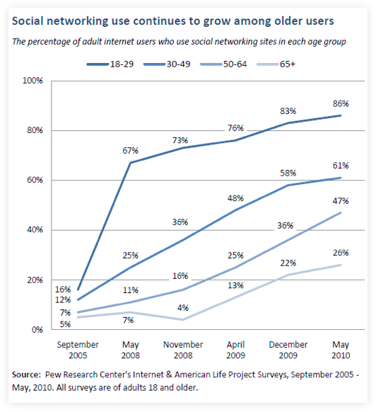
Threats to Privacy
Introduction
Background
Athletics
Genomics, Privacy, Social Media
33

Slide 34
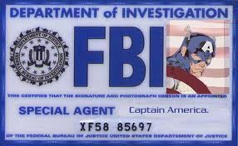





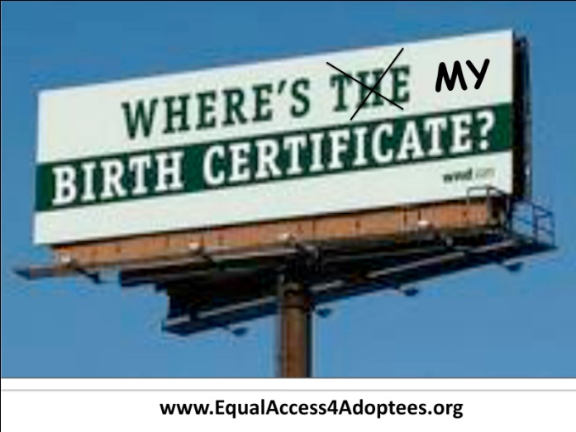
Who wants to crack your data
Threats to Privacy
Introduction
Background
Athletics
Genomics, Privacy, Social Media
34

Slide 35

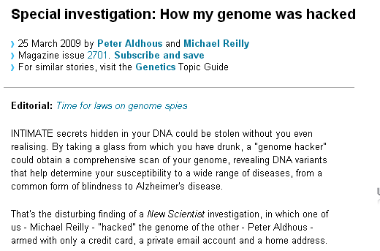
Threats to Privacy
Introduction
Background
Athletics
Genomics, Privacy, Social Media

Slide 36


Threats to Privacy
Introduction
Background
Athletics
Genomics, Privacy, Social Media
Cross correlated small set of identifiable IMDB movie database rating
records with large set of “anonymized” Netflix customer ratings
36

Slide 37
Profiling Method
Threats to Privacy
Introduction
Background
Athletics
Genomics, Privacy, Social Media
Profiling from genomic data. A number of physical attributes can now be inferred from DNA analysis, such as gender, blood type, approximate skin pigmentation, and manifestations of Mendelian disorders. Reliability of predictions will likely increase regarding height or other aspects of skeletal build, hair color and texture, eye color, and even some craniofacial features. Soon many chronic disease susceptibilities will be predictable and, before long, some behavioral tendencies will be. In 5 to 10 years, many attributes will be profilable
Alternative method requires substantial mulit-level datasets
37

Slide 38
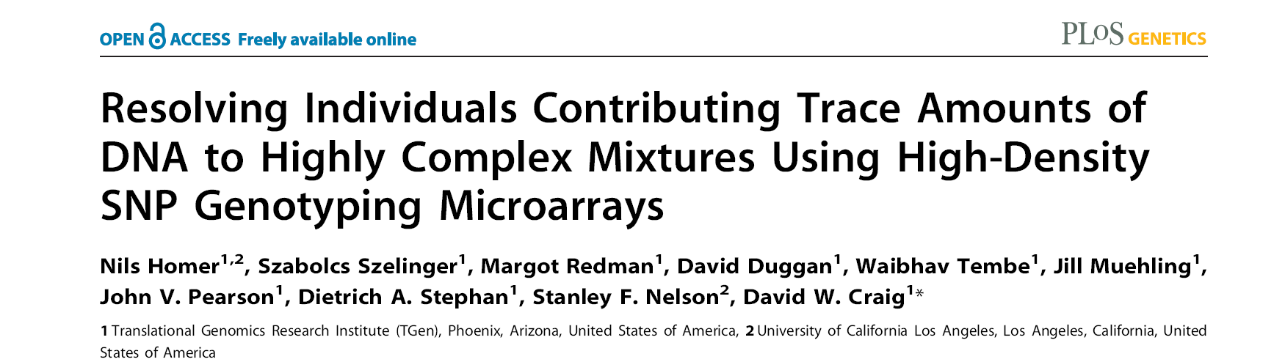
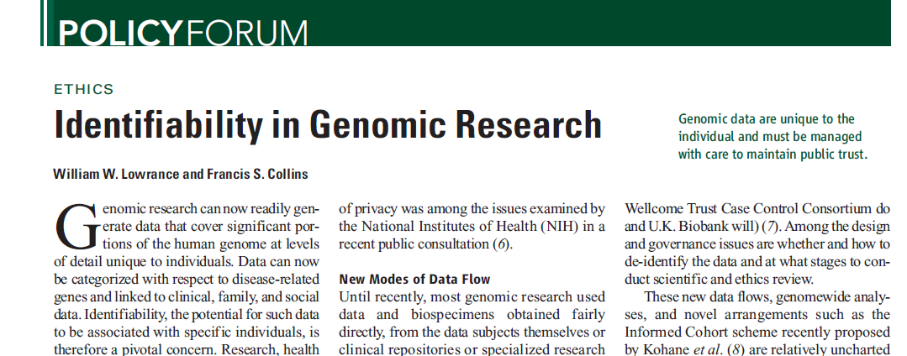
Threats to Privacy
Introduction
Background
Athletics
Genomics, Privacy, Social Media
Matching against reference genotype. The number of DNA markers such as single-nucleotide polymorphisms (SNPs) that are needed to uniquely identify a single person is small; Lin et al. estimate that only 30 to 80 SNPs could be sufficient
Linking to nongenetic databases. A second route to identifying genotyped subjects is deduction by linking and then matching geno-type- plus-associated data (such as gender, age, or disease being studied) with data in health-care, administrative, criminal, disaster response, or other databases … If the nongenetic data are overtly identified, the task is straightforward
a framework for accurately and robustly resolving whether individuals are in a complex genomic DNA mixture using high-density single nucleotide polymorphism (SNP) genotyping microarrays.
We demonstrate an approach for rapidly and sensitively determining whether a trace amount (<1%) of genomic DNA from an individual is present within a complex DNA mixture.
38

Slide 39
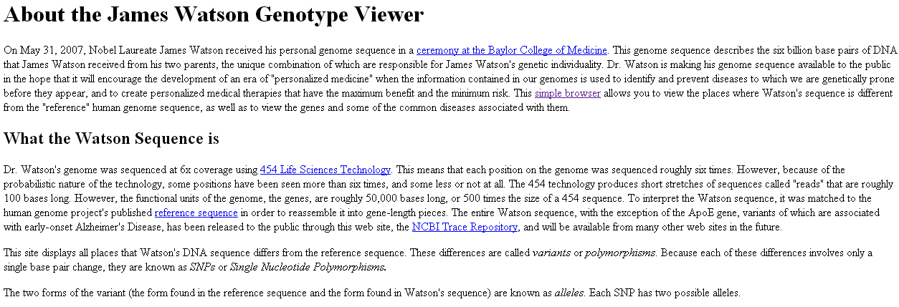
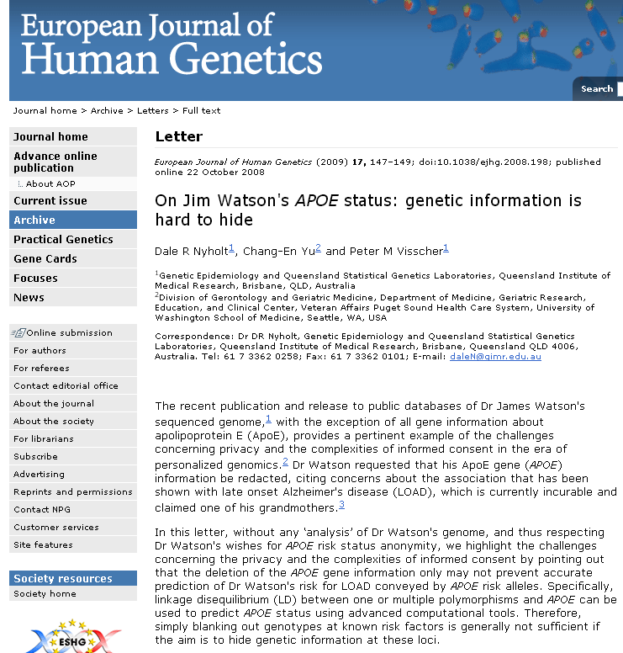
Threats to Privacy
Introduction
Background
Athletics
Genomics, Privacy, Social Media

Slide 40

No One
40

Slide 41
Reiterating…
Potential Solutions
Threats to Privacy
Introduction
Background
Athletics
Genomics, Privacy, Social Media
Informed Consent
Education
Best Practice
Data Formats
Cloud Computing
Dov Greenbaum, Mark Gerstein, The Role of Cloud Computing in Managing the Deluge of Potentially Private Genetic Data,
11 American Journal of Bioethics 39 (2011).
Dov Greenbaum, Jiang Du, Mark Gerstein, Genomic Anonymity: Have We Already Lost It? 8 American Journal of Bioethics 71-4 (2008).
Dov Greenbaum, Andrea Sboner, Xinmeng Jasmine Mu, Mark Gerstein, Genomics & Privacy: Implications of the New Reality of Closed Data for the Field, 7 PLOS Computational Biology, e1002278. Epub 2011 Dec 1.
41

Slide 42
Threats to Privacy
Introduction
Background
Athletics
Genomics, Privacy, Social Media

Slide 43
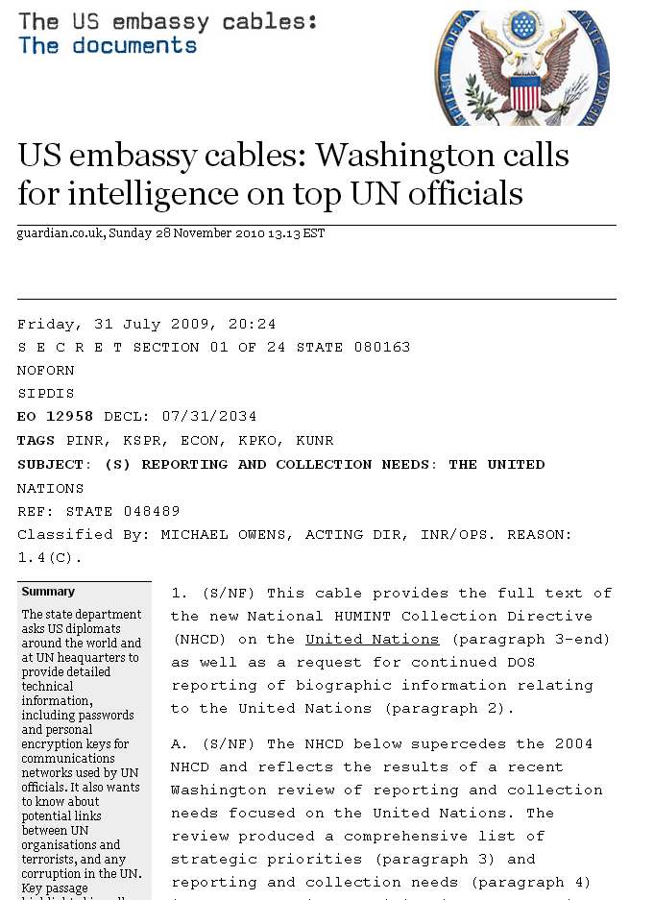
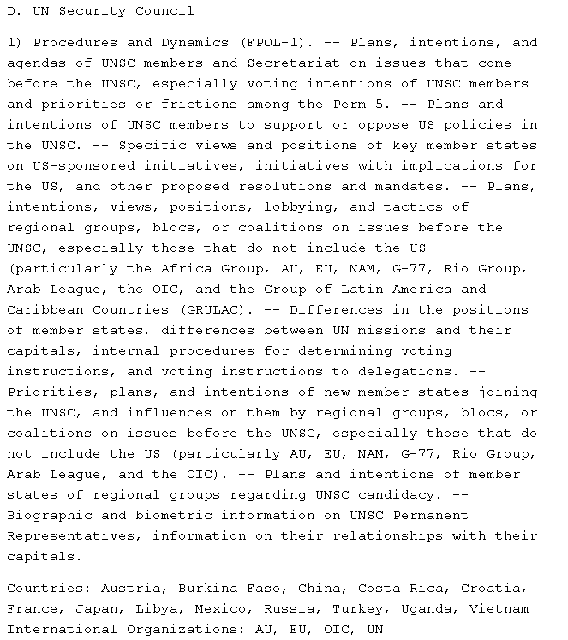
Threats to Privacy
Introduction
Background
Athletics
Genomics, Privacy, Social Media

Slide 44
US Armed Forces
Threats to Privacy
Introduction
Background
Athletics
Genomics, Privacy, Social Media
All individuals entering the military also receive genetic tests for sickle cell anemia and G6PD (Glucose 6-phosphate dehydrogenase) deficiency
As of 2002, the United States military's DNA repository contained 3.2 million samples.
44

Slide 45
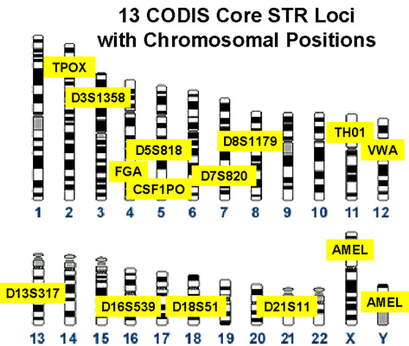

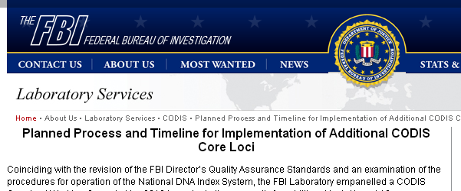
Threats to Privacy
Introduction
Background
Athletics
Genomics, Privacy, Social Media
Statutory Authority
DNA Identification Act of 1994
Antiterrorism and Effective Death Penalty Act 1996
Crime Identification Technology Act 1998
DNA Analysis Backlog Elimination Act 2000
(compulsory collection from those in Federal custody)
US PATRIOT Act 2001
(All terrorism related crimes)
Justice for All Act 2004
(all violent and sexual crimes; all felonies)
DNA Fingerprinting Act 2005
(Arrested or non-US detainees)
Adam Walsh Child Protection and Safety Act 2005
(arrested)
Combined DNA Index System
~10 Million Offender Profiles
~150,000 Investigations
45

Slide 46
Threats to Privacy
Introduction
Background
Athletics
Genomics, Privacy, Social Media
Gov’t can hold DNA indefinitely but use of this data may violate the offender’s privacy rights.
Boroian v Mueller 616 F.3d 60 (1st Cir. 2010)
Other Federal and State courts disagree
  E.g., Green v. Berge 354 F.3d 675 (7th Cir, 2004)(Easterbrook J. concurring)
CODIS has been used for familial searches. I.e., for potential relatives of a subject. Raises concerns about privacy violations vis-à-vis the family member and the suspect
  The Constitutionality of this has yet to be reviewed.
Some courts have indicated that may re-evaluate
the use of these loci in light of new data re junk DNA.
  US v. Stewart, 532 F.3d 323 (1st Cir. 2008)
Multiple lawsuits question the constitutionality of CODIS
  Haskell v. Harris, — F.3d — (9th Cir. (Cal) 2012) (finding DNA Fingerprinting of arrestees pursuant to California’s Prop 69 to be constitutionally sound)
  United States v. Fricosu, — F.Supp.2d – (2012), 2012 WL 592322 (denying challenge of the constitutionality of the practice on Fourth Amendment grounds)
  United States v. Pool, 2009 WL 2152029 (E.D. Cal, 2009), affirmed by 621 F.3d 1213 (9th Cir. (Cal.) 2010), rehearing en banc granted by 646 F.3d 659 (9th Cir. 2011), opinion vacated as moot by 659 F.3d 761 (9th Cir. 2011)
  United States v. Mitchell, 652 F.3d 387 (3rd Cir. 2011) (en banc), pet. for cert. filed (Nov. 22, 2011)(No. 11-7603, 11A384), cert. denied – S.Ct. – (Mar. 19, 2012).
46

Slide 47
Threats to Privacy
Introduction
Background
Athletics
Genomics, Privacy, Social Media

Slide 48
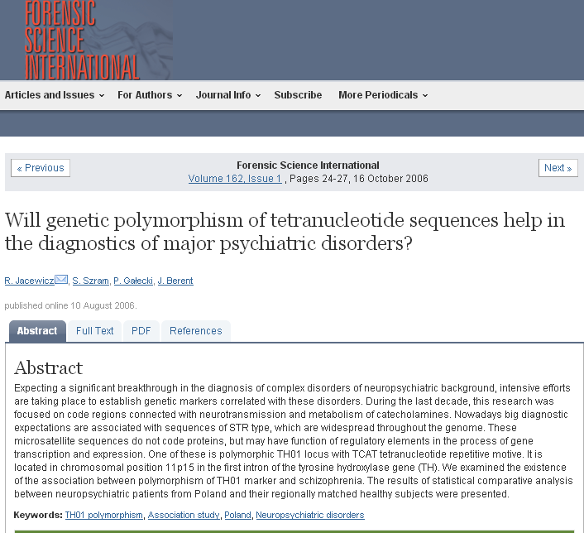
Threats to Privacy
Introduction
Background
Athletics
Genomics, Privacy, Social Media

Slide 49

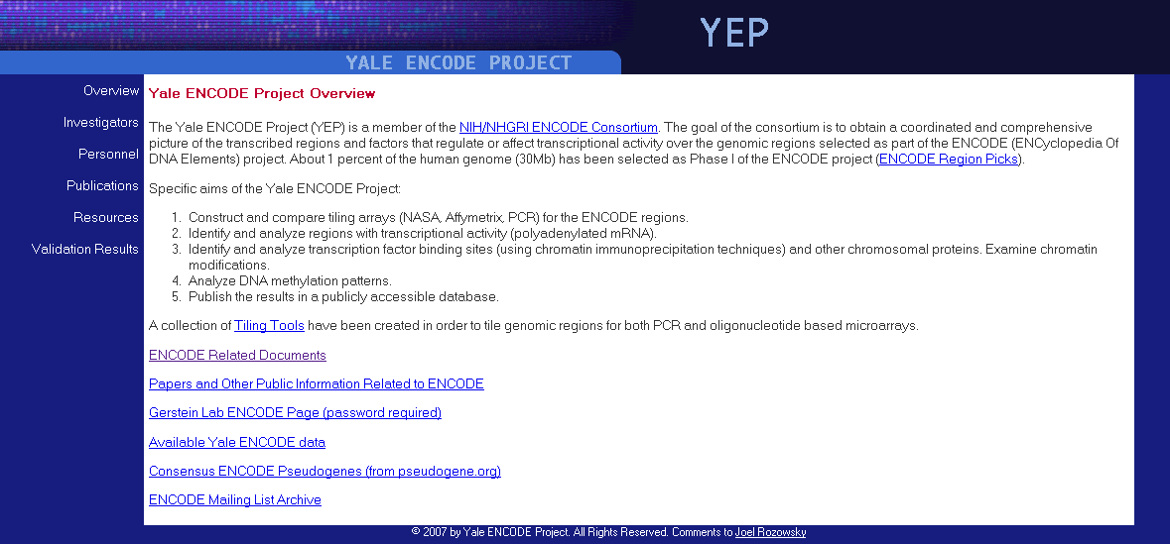
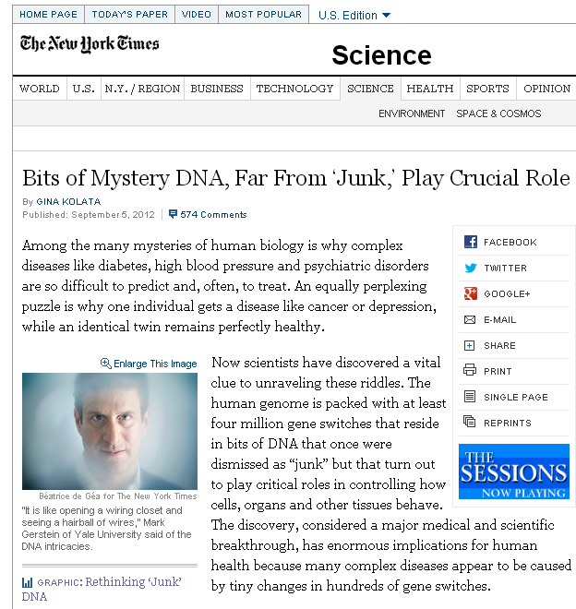
Threats to Privacy
Introduction
Background
Athletics
Genomics, Privacy, Social Media

Slide 50

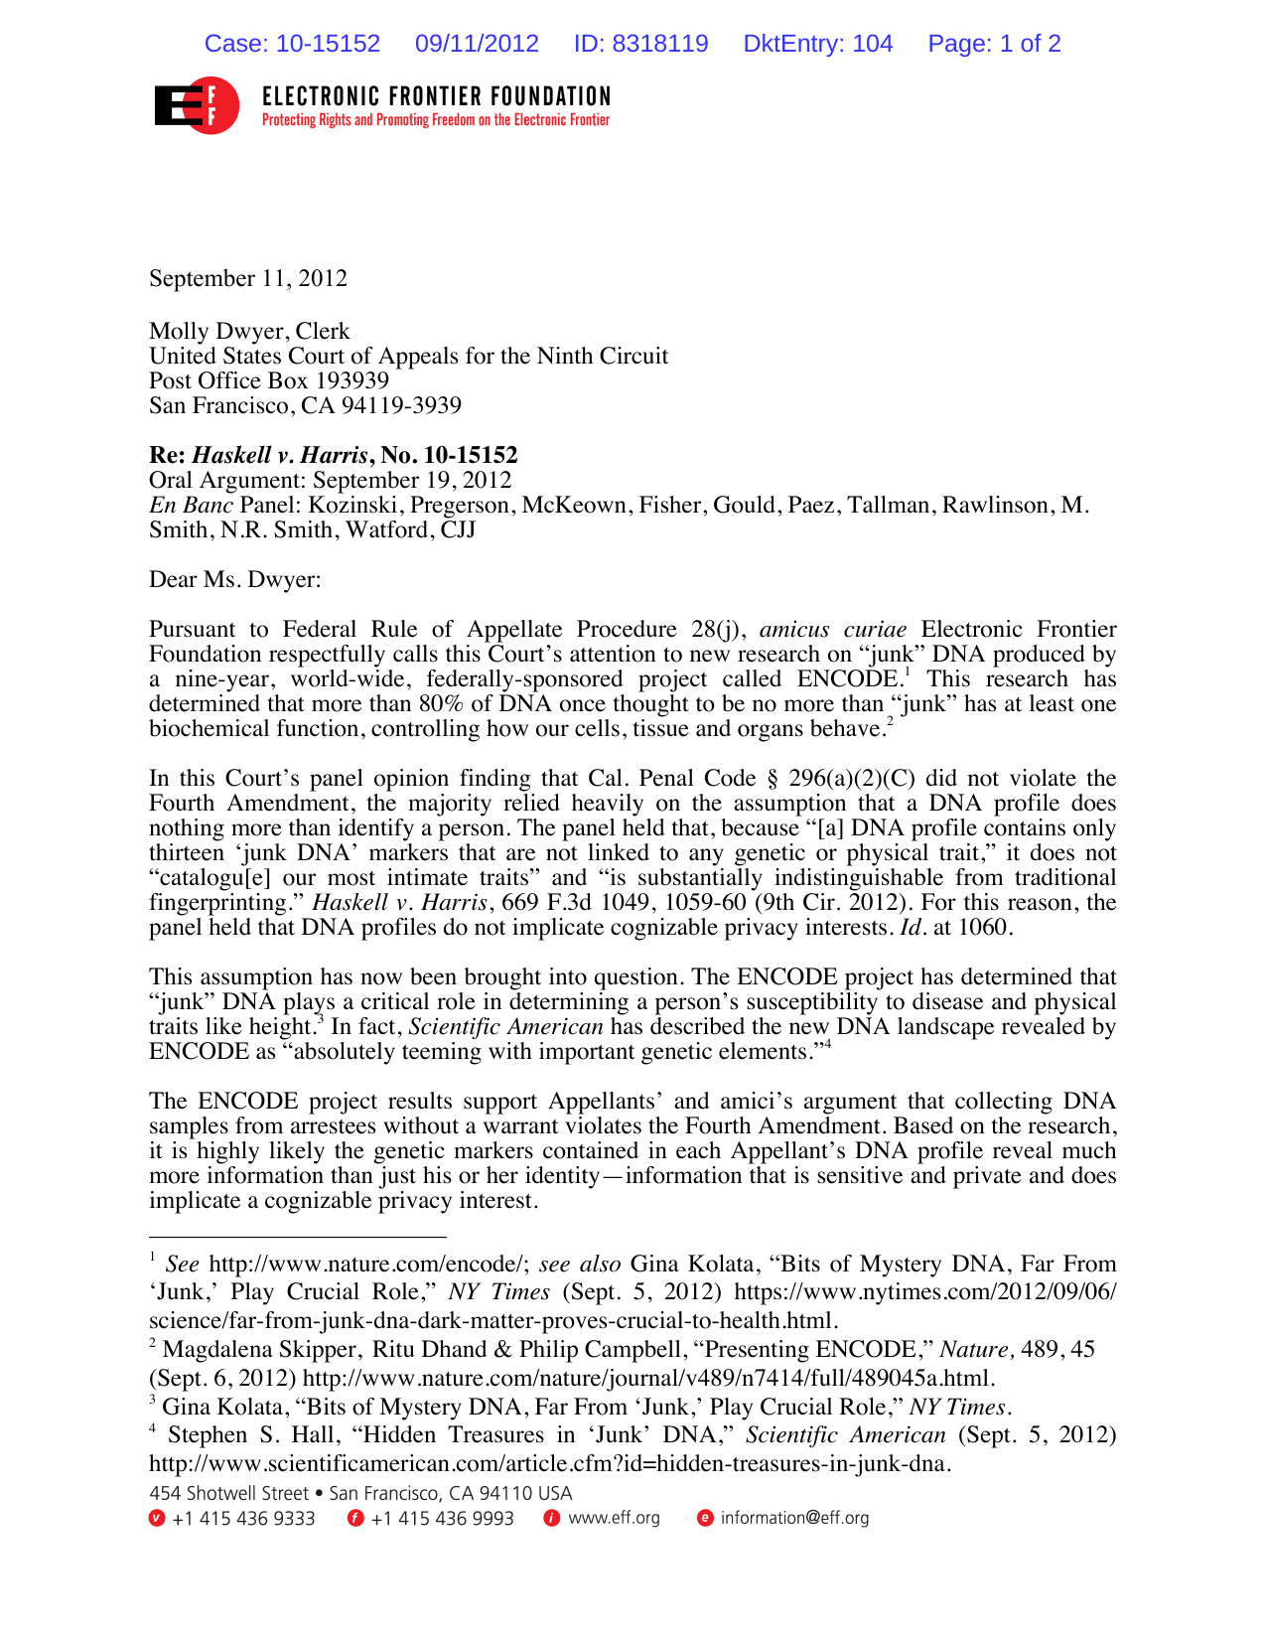
Threats to Privacy
Introduction
Background
Athletics
Genomics, Privacy, Social Media
The ENCODE project results reinforce the point that DNA contains important information about who we are, who we will be and our relationships with other people. That data should not be in the hands of the government without probable cause to believe it is linked to a crime.

Slide 51

Threats to Privacy
Introduction
Background
Athletics
Genomics, Privacy, Social Media
Characterization of the Standard and Recommended CODIS Markers†
Sara H. Katsanis M.S.1,*,
Jennifer K. Wagner J.D., Ph.D.2
Article first published online: 24 AUG 2012
The bottom line is that knowing a person’s unique 13- or 24-marker profile at the genomic sites used by CODIS does not, to the best of our current knowledge, allow reliable, valid inference of anything more than identity (aside from sex) without performing additional analyses and drawing additional inferences from those analyses (e.g. estimating ancestry from the CODIS genotypes and subsequently performing analyses to infer phenotypes from those ancestry estimates). Importantly, the statutes establishing CODIS expressly prohibit the use of CODIS profiles for analysis other than identity.

Slide 52
Outline
Background
Introduction
Threats to Privacy
Athletics
Genomics, Privacy, Social Media
Background
Threats to Genomic Privacy
  You – Social Media
  Someone Else Biohackers, your nephew who signed up for 23 and me
  Government
  Wikileaks
  The Armed Forces
  The FBI and Codis
Genomic Privacy in Athletics

Slide 53
Outline
Background
Introduction
Threats to Privacy
Athletics
Genomics, Privacy, Social Media
Background
Threats to Genomic Privacy
Genomic Privacy in Athletics
Basketball
Baseball being Baseball
Use in predicting Athleticism
Use in Invading your Idol’s privacy
New Project at looking at College Varsity Athletes

Slide 54
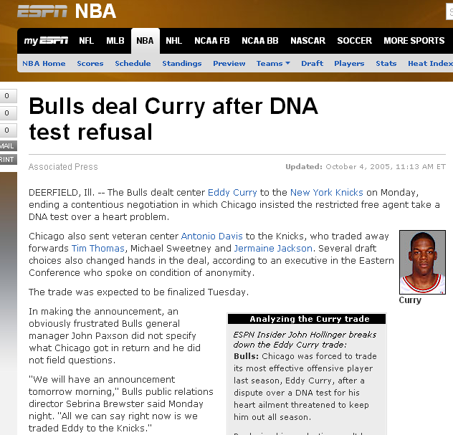
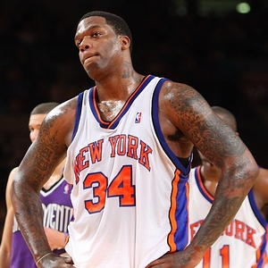
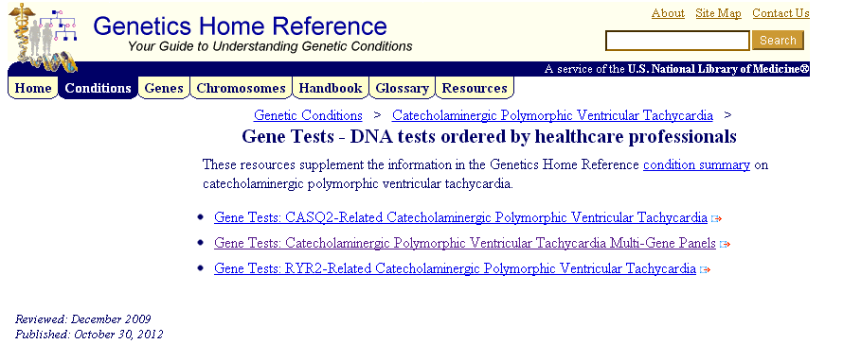
Athletics
Introduction
Background
Threats to Privacy
Genomics, Privacy, Social Media

Slide 55
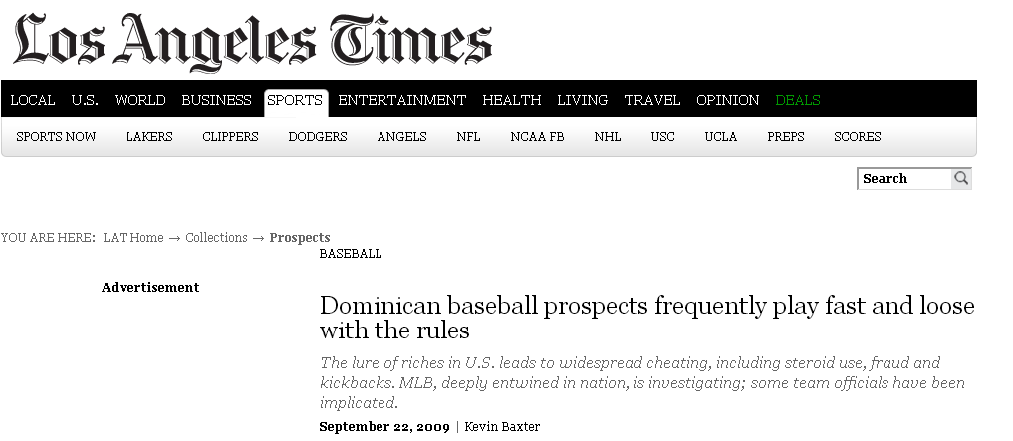
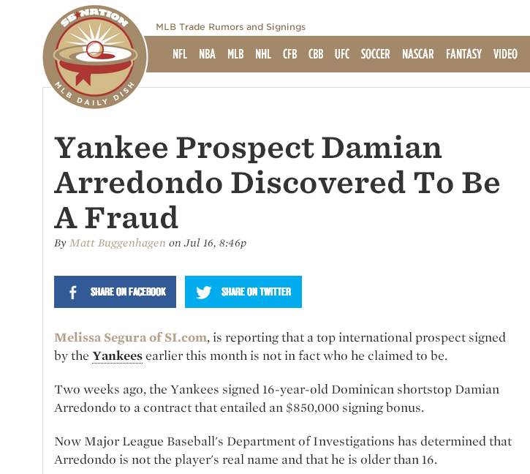
Athletics
Introduction
Background
Threats to Privacy
Genomics, Privacy, Social Media
The situation has led MLB investigators and many teams to ask players to undergo DNA and bone-marrow testing to prove their age and identity. Private investigators are also routinely hired to look into a player's age.
Document fraud is hardly new, though. When the U.S. sought stricter document verification after the Sept. 11, 2001, terrorist attacks, it was revealed that 540 Dominican major league and minor league players had a different identity or were a different age, including Santana, who lowered his age by a year, and Furcal, who said he was 19 when he was really 21.

Slide 56
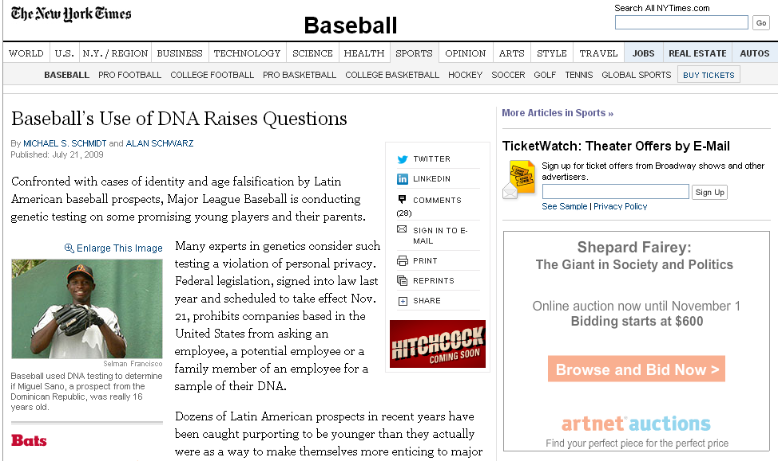
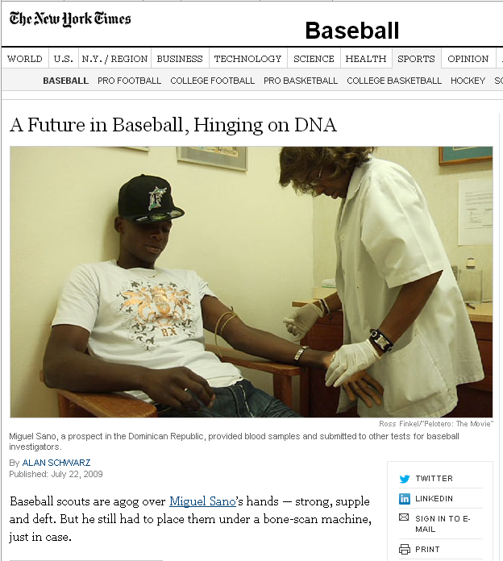
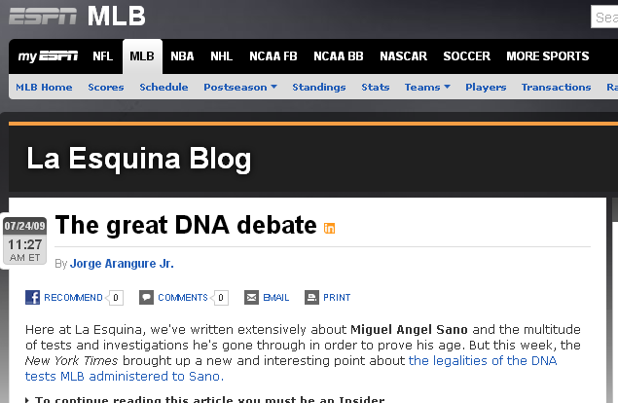
Athletics
Introduction
Background
Threats to Privacy
Genomics, Privacy, Social Media
Title VII does not apply extra territorially to non-US citizens employed by US companies overseas.
EEOC v. Arabian American Oil Co. 499 U.S. 244 (1991)
Even if an alien is hired in the US, as long as the “place of employment” is extra territorial, Title VII does not apply.
Shekoyan v. Sibley Intl 409 F3d (D.C. Cir 2005)
56

Slide 57
Athletics
Introduction
Background
Threats to Privacy
Genomics, Privacy, Social Media
Title II of GINA prohibits use of genetic information in the employment context, restricts employers and other entities covered by Title II from requesting, requiring, or purchasing genetic information, and strictly limits such entities from disclosing genetic information. The law incorporates by reference many of the familiar definitions, remedies, and procedures from Title VII of the Civil Rights Act of 1964, as amended, and other statutes protecting federal, state, and Congressional employees from discrimination.
Fed. Reg. 68912 (Nov. 9 2010)
29 CFR 1635.3 - Definitions specific to GINA.
(f) Genetic test— (1) In general. “Genetic test” means an analysis of human DNA, RNA, chromosomes, proteins, or metabolites that detects genotypes, mutations, or chromosomal changes.
(2) Genetic tests include, but are not limited to:
(viii) DNA testing that reveals family relationships, such as paternity

Slide 58
29 CFR 1635.3 - Definitions specific to GINA.
Athletics
Introduction
Background
Threats to Privacy
Genomics, Privacy, Social Media
(c) Genetic information.
  (1) Genetic information means information about:
  (2) Genetic information does not include information about the sex or age of the individual, the sex or age of family members, or information about the race or ethnicity of the individual or family members that is not derived from a genetic test.
  Its unclear if information regarding age is not considered genetic information and is allowed but requesting genetic information to determine age would not be allowed.
  Its unclear if MLB requesting of DNA to verify age to discriminate based on age fraud is different from requesting DNA information regarding susceptibility to injury and then discriminate based on that susceptibility.

Slide 59

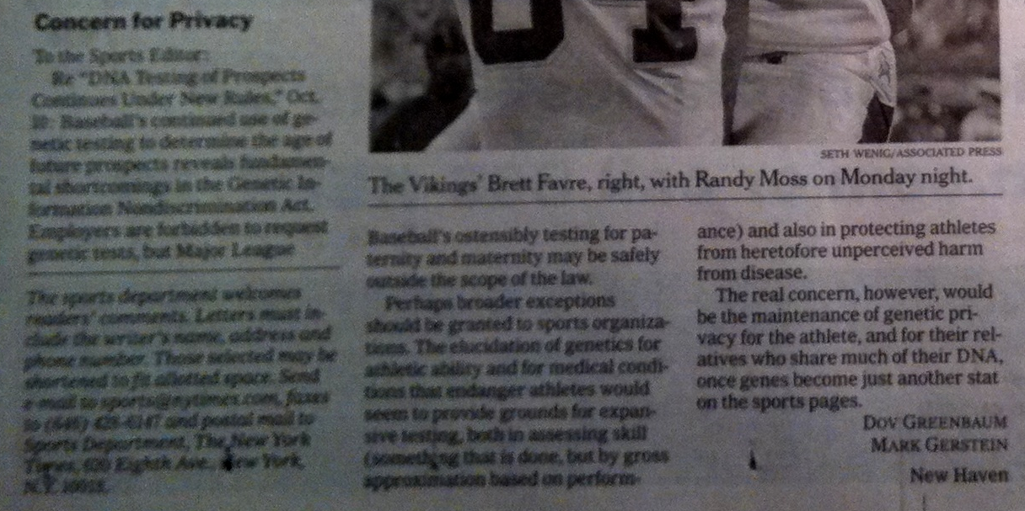
Athletics
Introduction
Background
Threats to Privacy
Molecular Biology and the Law

Slide 60

Athletics
Introduction
Background
Threats to Privacy
Molecular Biology and the Law
Testing Isn’t Everything
To the Sports Editor:
Re “In N.C.A.A., Question of Bias Over a Test for a Genetic Trait,” April 12: The article on testing for the sickle-cell trait in athletes raises many of the same issues often found in direct-to-consumer genetic testing services: too much information, not enough knowledge.
As a population, those with sickle-cell trait have life expectancies similar to those of noncarriers. Although there are definitive associations with increased morbidity and mortality, carriers of the genes may irrationally curtail otherwise normal activity.
Alternatively, given the real and perceived discrimination against carriers, many may choose not to be tested and will not have the requisite knowledge to avoid activities that could cause real harm.
In direct-to-consumer genetic testing or the testing of athletes, education and greater public awareness are the keys to preventing disaster.
Dov Greenbaum
Mark Gerstein
New Haven

Slide 61
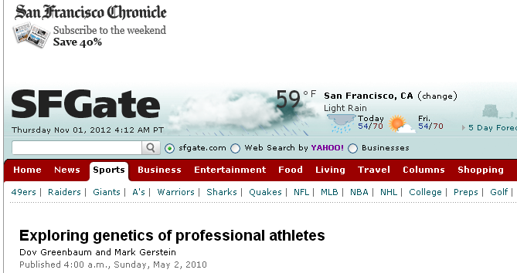


Athletics
Introduction
Background
Threats to Privacy
Genomics, Privacy, Social Media
Dov Greenbaum & Mark Gerstein, Personal Genomics Requires Redefining Privacy -- The Human Blueprint: Dangerous Secrets,
SF CHRONICLE, Insight Section, Page 2, Nov. 2, 2008
61

Slide 62


Athletics
Introduction
Background
Threats to Privacy
Genomics, Privacy, Social Media

Slide 63
CRS March 2008
63

Slide 64

What do Athletes Really Want?
Athletics
Introduction
Background
Threats to Privacy
Genomics, Privacy, Social Media
64

Slide 65

Varsity Athlete Project
Athletics
Introduction
Background
Threats to Privacy
Genomics, Privacy, Social Media
Actionable markers present in the current literature (186 SNPs total)?
  Sickle Cell Trait (1 SNP, deterministic)
  ACL rupture (4 SNPs, moderate effect)
  Achilles tendinopathy/rupture (5 SNPs, moderate effect)
  BMD/Stress Fracture (>95 SNPs, small effect each)
  Osteoarthritis (19 SNPs, moderate effect)
  Nutrients and vitamins: iron, vitamin D, Ca²⁺, Mg²⁺, vitamin E, vitamin B₁₂, homocysteine and phytosterol levels (51 SNPs, each with small to moderate effect)
  Hypertrophic Cardiomyopathy* (11 SNPs, deterministic)
65

Slide 66
ELSI Concerns
Athletics
Introduction
Background
Threats to Privacy
Genomics, Privacy, Social Media
Privacy :
Relevant parties
  Athletes
  Parents
  Families
  Coaches
  Trainers
  Doctors
  Team
  School/Owner
  League
  Fans
  World
Issues of Informed consent
Can you opt out of all responsibilities?
  Incidental findings
  Underage freshman
  Requirements to report to the school, to future teams, to teammates, to coaches
  Requirements to follow up
  Standard of care- currently undefined
  Liabilities
Risk Benefits to Athletes
  Risk Benefit to team
  Requirements to disclose if drafted
  Requirements to be tested if drafted
  Requirement to disclose to scholarship providing schools
Dov Greenbaum & Mark Gerstein, Exploring Genetics of Professional Athletes, San Francisco Chronicle, Insight Section, May 2. 2010.
Dov Greenbaum, Introducing Personal Genomics to College Athletes: Potentials and Pitfalls, 12 American Journal of Bioethics 45 (2012).
Dov Greenbaum, Editorial, Special Issue on Genetics and Athletics. 6 Recent Patents on DNA and Gene Sequences (2012).
Dov Greenbaum & Mark Gerstein , The Age of Genetically Optimized Sports, Wall Street Journal, July 23 2012.
66

Slide 67
Outline
Background
Threats to Genomics Privacy
Genomic Privacy in Athletics

Slide 68
Outline
Background
Introduction
Threats to Privacy
Athletics
Genomics, Privacy, Social Media
Background
  Working Definition
  Pros and Cons
  Current Protections
  Stumbling blocks
  Potential components of a solution
Threats to Genomic Privacy
Genomic Privacy in Athletics

Slide 69
Outline
Background
Introduction
Threats to Privacy
Athletics
Genomics, Privacy, Social Media
Background
Threats to Genomic Privacy
  You – Social Media
  Someone Else Biohackers, your nephew who signed up for 23 and me
  Government
  Wikileaks
  The Armed Forces
  The FBI and Codis
Genomic Privacy in Athletics

Slide 70
Outline
Background
Introduction
Threats to Privacy
Athletics
Genomics, Privacy, Social Media
Background
Threats to Genomic Privacy
Genomic Privacy in Athletics
Basketball
Baseball being Baseball
Use in predicting Athleticism
Use in Invading your Idol’s privacy
New Project at looking at College Varsity Athletes

Slide 71
Thank You
71

